Slide 1
Media Mentorship in the Age of COvID
Mary Kuehner
Early Literacy Librarian

Slide 2
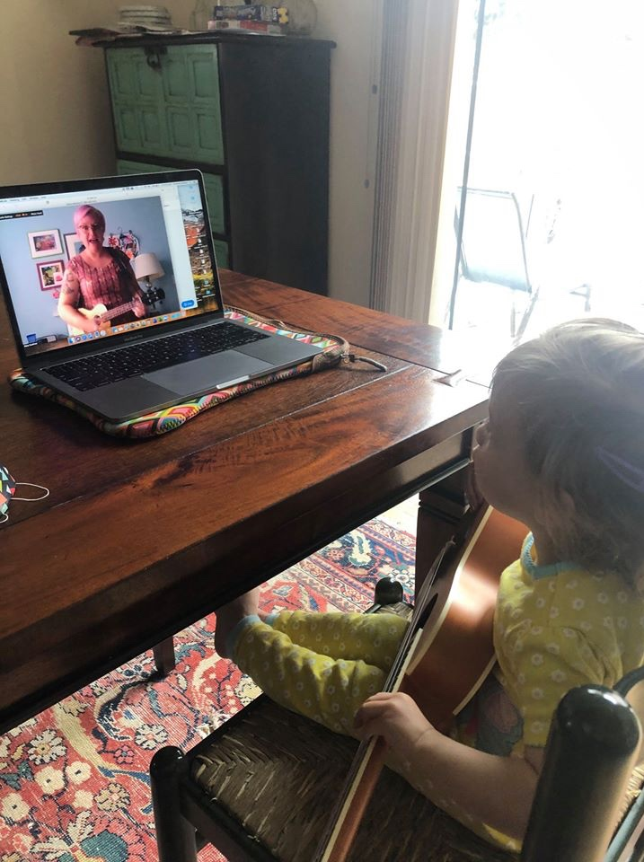
About me:
Librarian in children's services for 23 years
Founding member of CLEL
Currently Early Literacy Librarian at Arapahoe Libraries in charge of the Learning on the Go program
Chair of the Excellence in Early Literacy Digital Media Award 2018-2019
Helped create EELDM Award criteria

Slide 3
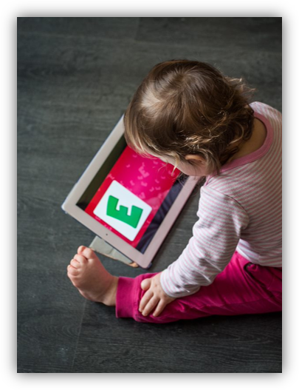
Agenda:
What is media mentorship?
Why should librarians be media mentors? CAN I be a media mentor?
What do the experts say about screen time?
Best practices vs. Reality
Evaluating early learning media: things to remember & resources
What else can we do?
Questions/sharing
"Children using computers." by San José Public Library is licensed under CC BY-SA 2.0

Slide 4
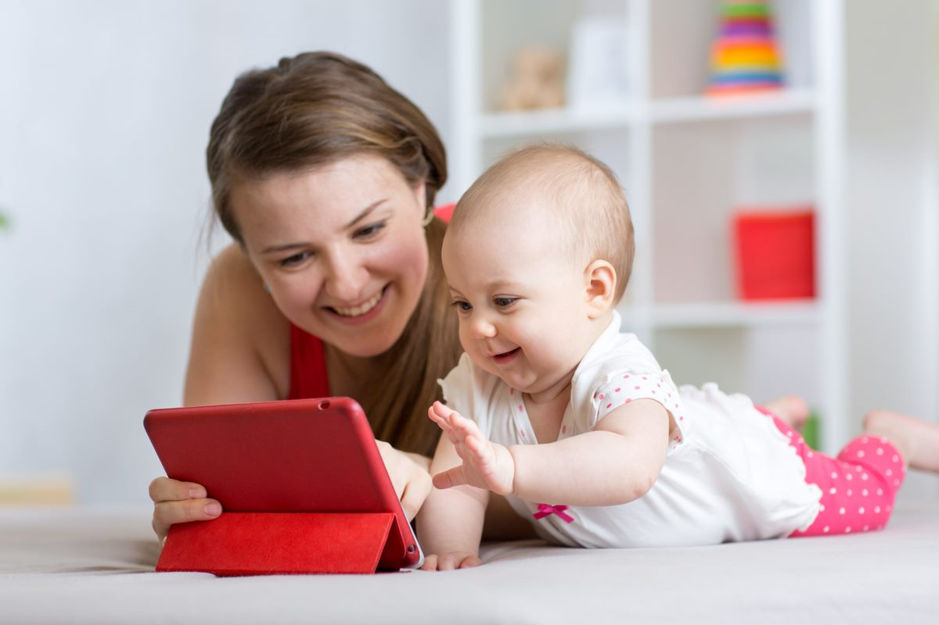
What are your parents saying about screentime? What do you already know?
Please share in the chat what you've heard from parents or what you have heard.

Slide 5

What is media mentorship?
"As the materials and services required by the families we serve change and expand, our core functions as practitioners serving youth change and expand as well.”
"A media mentor provides recommendations to meet a family’s stated or implied needs based on authoritative recommendations. A family looking for recommendations will be given these resources with objective interpretation by the media mentor, and it is up to the family to use the recommendations to make their own decisions regarding media use."

Slide 6
Why should librarians be media mentors?
One of ALSC's core competencies
Another form of advisory which IS our job.
NOT our job to impose our values.
"Media mentors support children and families in their media use and decisions."
Real talk: screens are not going anywhere.
It's another form of literacy

Slide 7
WAIT! I can't be a media mentor! I can't tell a what's app from a fortnite.
First of all, YES you can
You ARE a trusted resource to your patrons.
You don't have to know everything. You are a library professional: know where to LOOK.
"Let's Find Out"

Slide 8
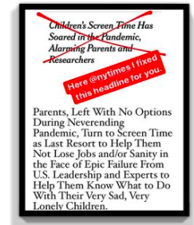
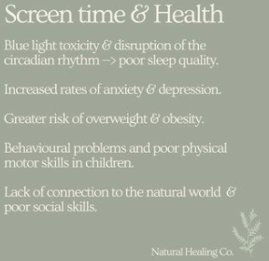
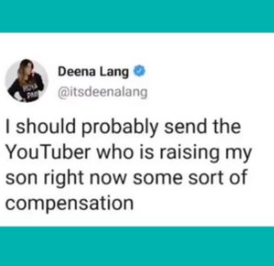
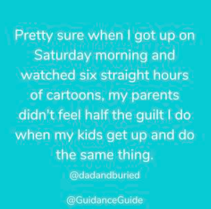
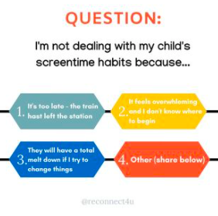
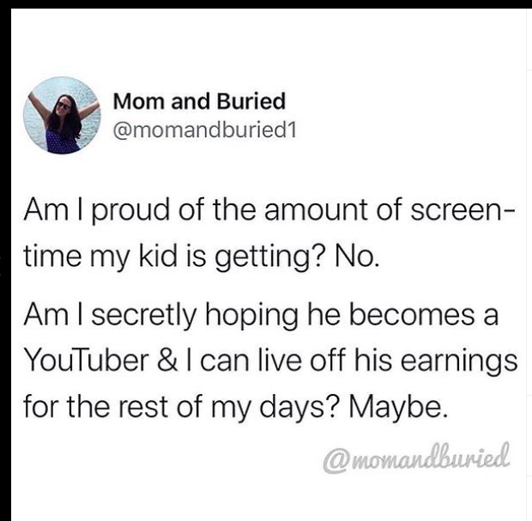
THESE ARE THE MESSAGES CAREGIVERS ARE GETTING (ALL FROM INSTAGRAM #SCREENTIME):
*looking for original source

Slide 9

LET'S TALK SCREEN TIME: WHAT DO THE EXPERTS SAY?
Let's talk screen time: What do the experts say?
Younger than 18 – 24 months: "Avoid digital media use (except video-chatting)”​
18 - 24 months: “if you want to introduce digital media, choose high-quality programming and use media together with your child. Avoid solo media use in this age group."
2 - 5 years:" limit screen use to 1 hour per day of high-quality programming, co-view with your children, help children understand what they are seeing, and help them apply what they learn to the world around them."

Slide 10

Let's talk screen time: What do the experts say?
Children and Screens: Institute of Digital Media and Child Development
Exposure to screens by infants is distracting and disrupts sustained play. Screens distract parents, too, and reduces the quality of their interactions with the infant.
"Once children can comprehend screen media content (by about 2 ½ years) television and interactive screen media can influence their knowledge. Educational media have been shown to be effective in enhancing educational knowledge and skills, but what remains unclear are the best methods of using screens to teach very young children, while at the same time ensuring socio-emotional, sensory, and physical (motor skills) development."

Slide 11


Let’s talk screen time: What do the experts say?
Fred Rogers Center + NAEYC Joint Statement:
Technology can be useful
Limits are important
Equitable access
Research needed

Slide 12
“There is no science behind this right now. If you are looking for specific time limits, then I would say: Don’t be on it all day.”
DR. JENNY RADETSKY, PEDIATRICIAN & EXPERT ON CHILDREN AND MEDIA, UNIVERSITY OF MICHIGAN'S C.S. MOTT CHILDREN'S HOSPITAL
https://www.nytimes.com/2020/04/13/parenting/manage-screen-time-coronavirus.html

Slide 13
“Screens are not inherently toxic. They’re neutral. It’s what we do with them that matters.” Rich bristles at comparisons between screen addiction and drug dependency. “The word ‘addiction’ is inaccurate,” he says, because technology “is not something that changes you biologically.”
DR. MICHAEL RICH, DIRECTOR OF THE DIGITAL WELLNESS LAB AT BOSTON CHILDREN'S HOSPITAL
https://www.motherjones.com/media/2021/06/kids-screen-time-science-panic/

Slide 14
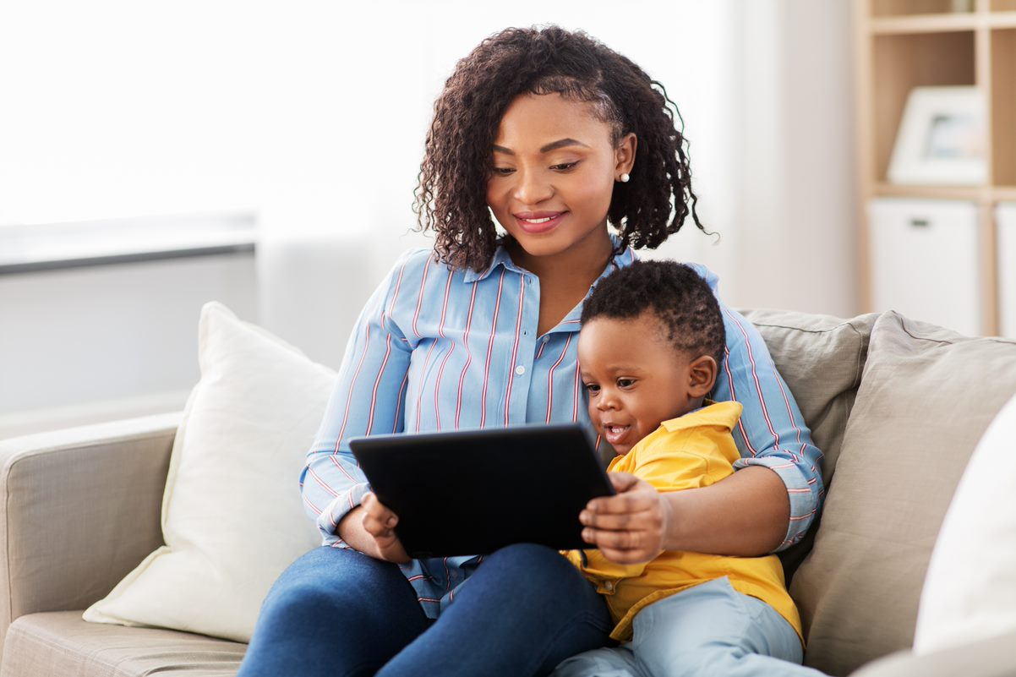
Let's talk media mentorship + covid: best practices vs. reality
New AAP Guidelines (2020) – NO screen time limits mentioned
It's all about balance/moderation
Suggest ways to be thoughtful about media use
Family Media Plan
Help caregivers evaluate media

Slide 15
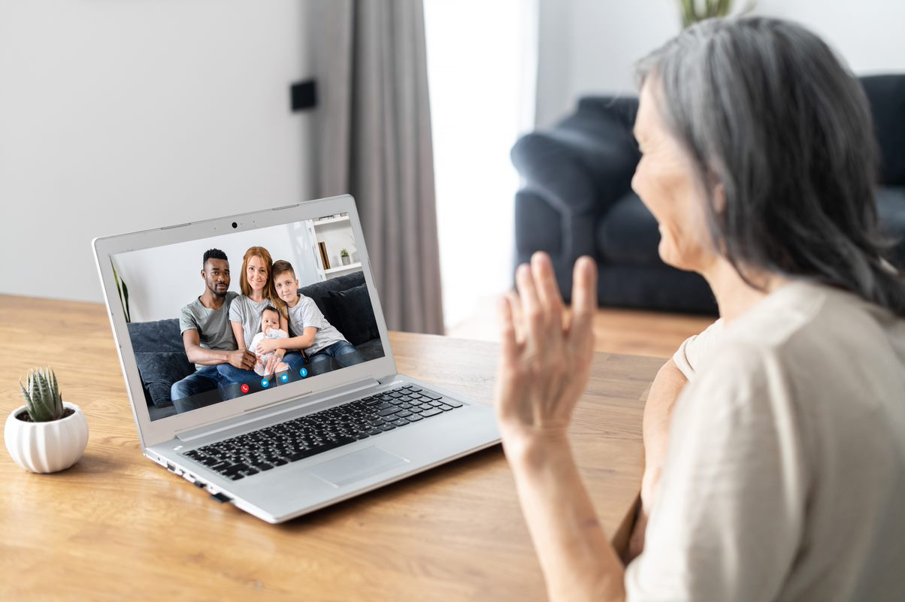
LET'S TALK MEDIA MENTORSHIP + COVID: BEST PRACTICES VS. REALITY
Encourage co-viewing
Suggest multiple forms of media
Try using media in new ways
Encourage being mindful of own media use
At the end of the day, caregivers must BE KIND to themselves. We're all new to this!

Slide 16

Media evaluation: The three C's
Content
Context
Child
From Tap, Click, Read by Lisa Guernsey

Slide 17
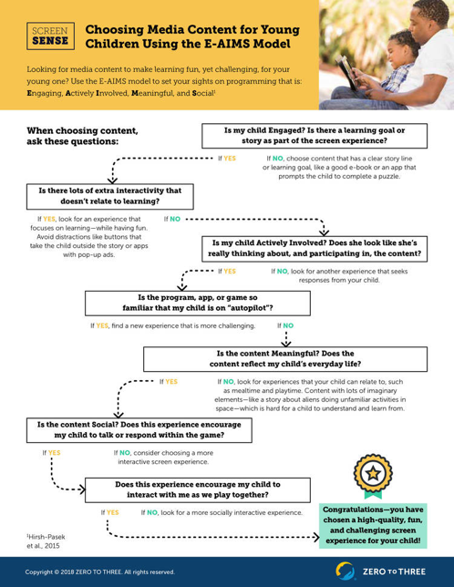
Evaluating media using the e-aims model
Engaging
Actively Involved
Meaningful
Social
https://www.zerotothree.org/resources/2533-choosing-media-content-for-young-children-using-the-e-aims-model

Slide 18

Excellence in Early Learning Digital Media Award
First awarded in 2019​
"The purpose of this award shall be to recognize the most distinguished digital media created for an early learning audience by a producer based in the United States."​
Can be apps, websites, dvds, shows, software, enhanced ebooks, etc...​
Media for children aged 2 – 8​
"Allows for meaningful joint media engagement, co-viewing, shared play experiences and/or guided play"

Slide 19
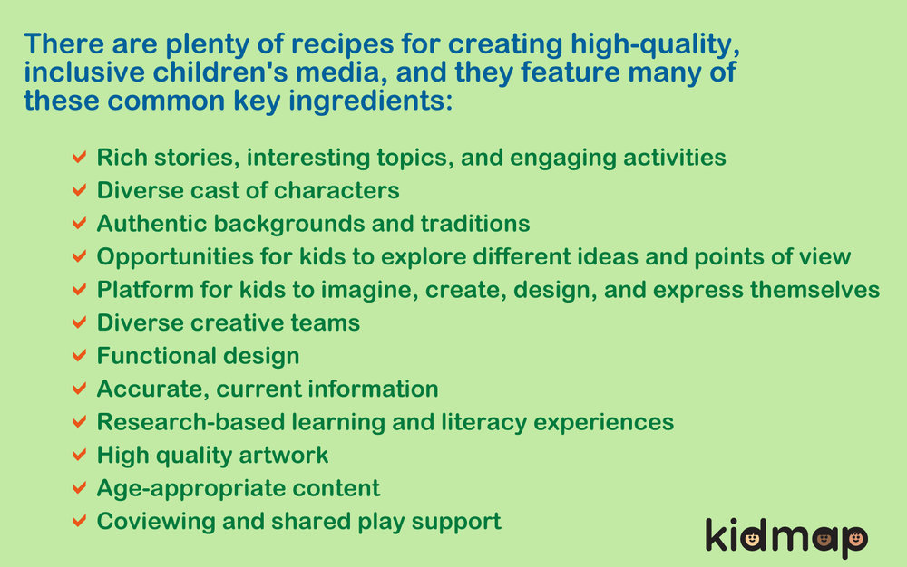
KIDMAP: Kids inclusive and diverse media action project
Geared to content creators
DIG (Diverse, Inclusive, Growth) checklist for inclusive, high-quality inclusive media:

Slide 20
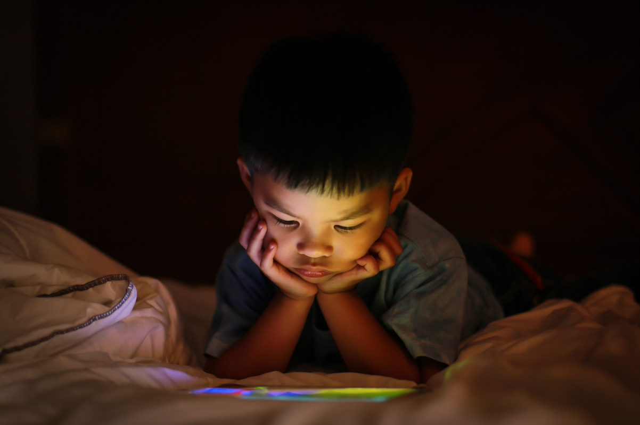
Media review resources
Carissa's List
Children's Technology Review
Common Sense Media
School Library Journal
Arapahoe Library's Blog

Slide 21







Companies creating consistently high-quality apps
Toca Boca
PBS Kids
Sago Mini
Harvard Graduate School of Education
Tiny Bop!
Fox and Sheep
Nosy Crow
Cowly Owl
Originator
Avokiddo

Slide 22
Question: what else can libraries do to support caregivers with online learning?
Offer "bite-size" tips when you have the opportunity.
Curated apps/websites
Invite experts to do virtual programs
Blog posts
Social media
Provide training for caregivers on the software their kids are using
Share ideas for offline experiences/Make and Takes

Slide 23
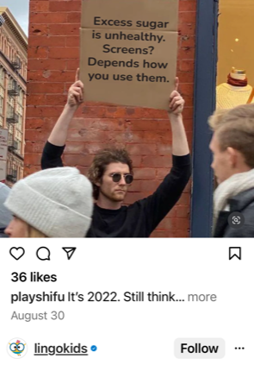
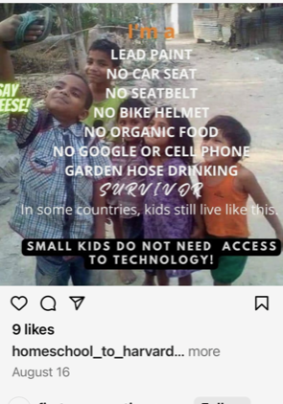
#Screentime
What do you think about these images?

Slide 24
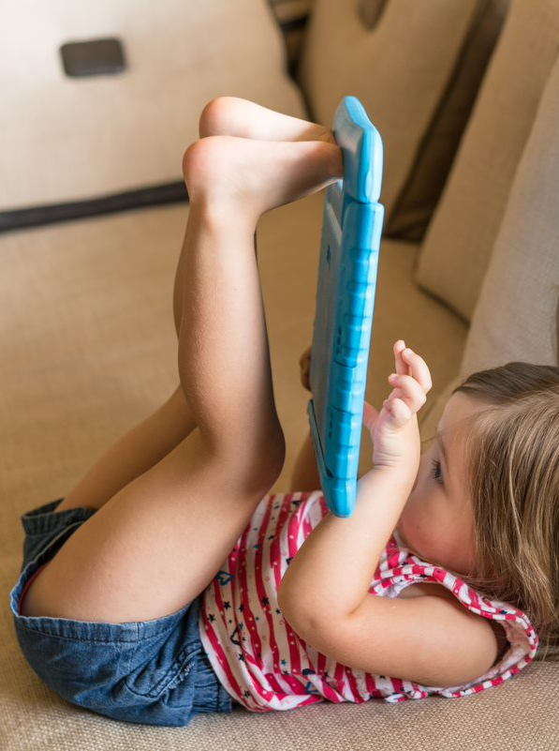
Questions/comments?
Mary Kuehner
Arapahoe Library District
mkuehner@ald.lib.co.us

