Slide 1
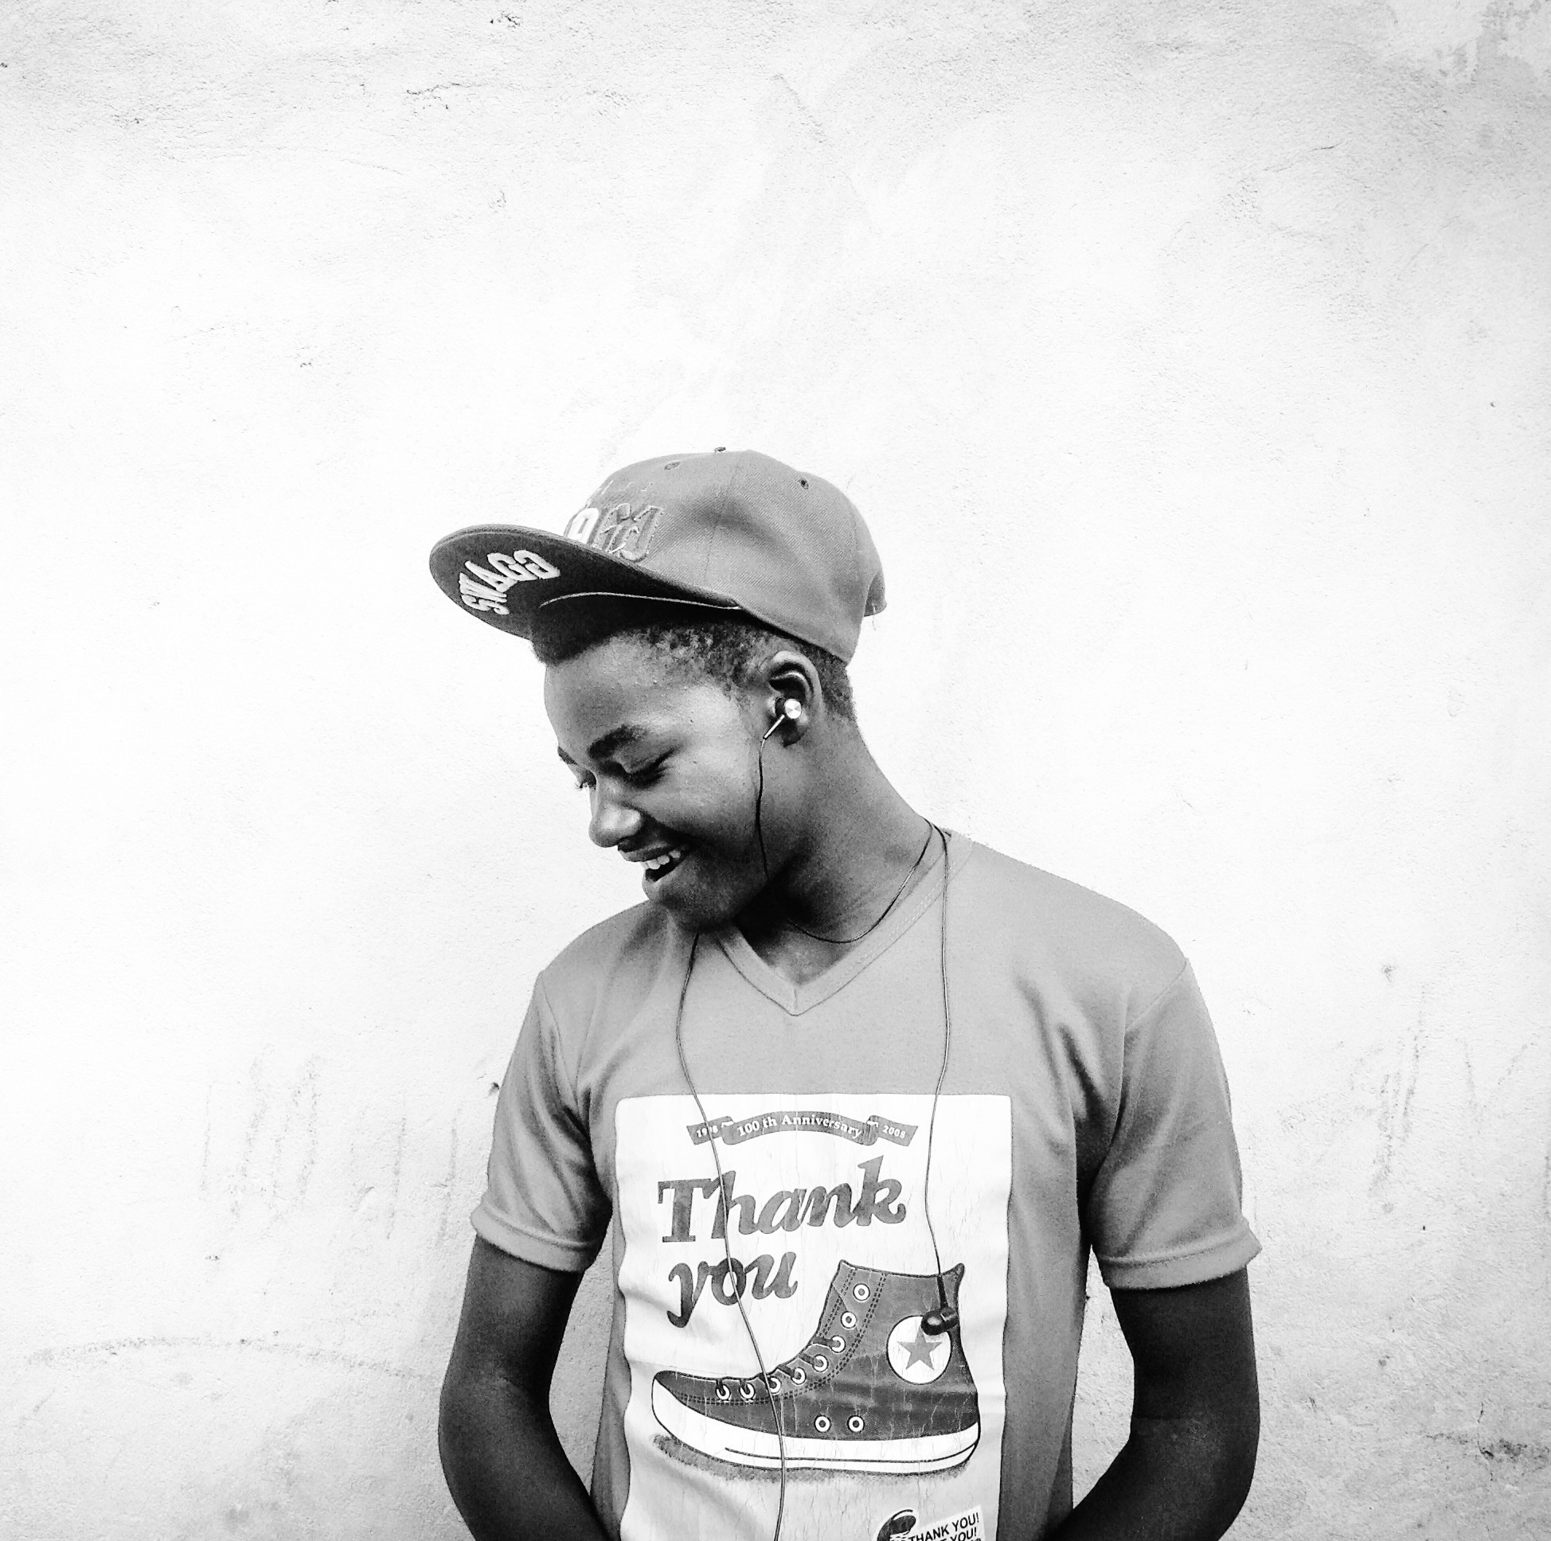
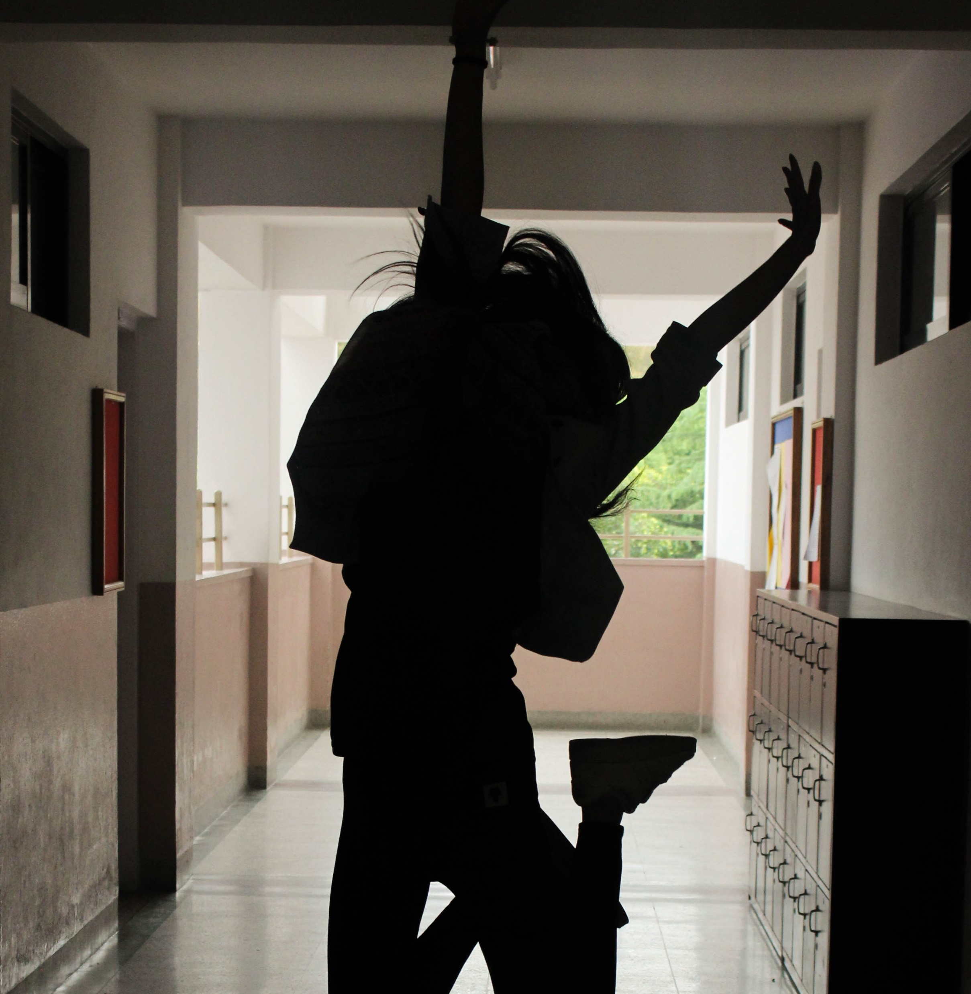
Understanding Teens: Intersectional Factors affecting teens

Slide 2
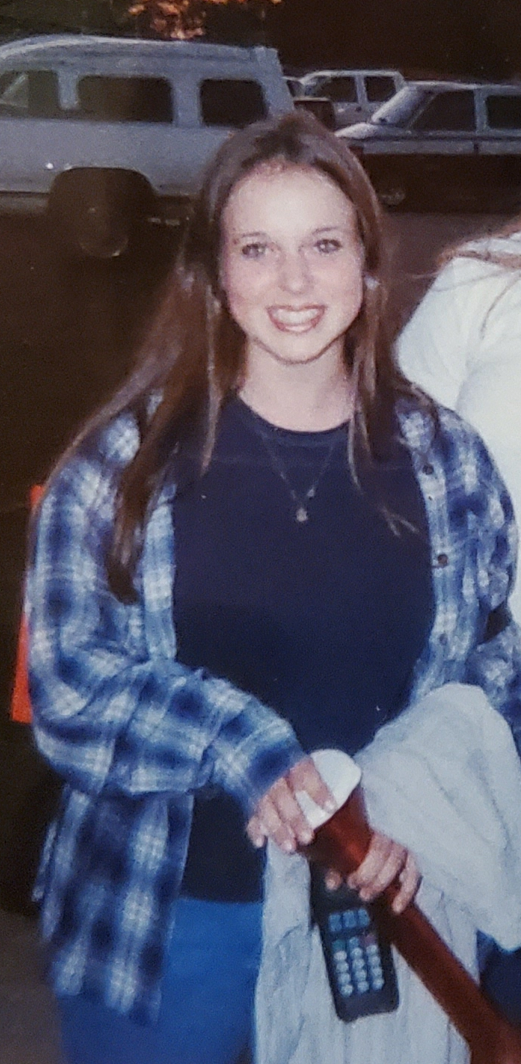
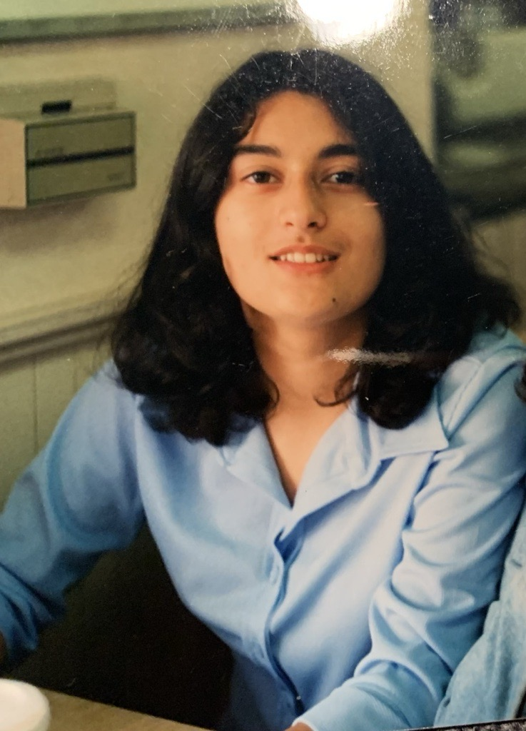
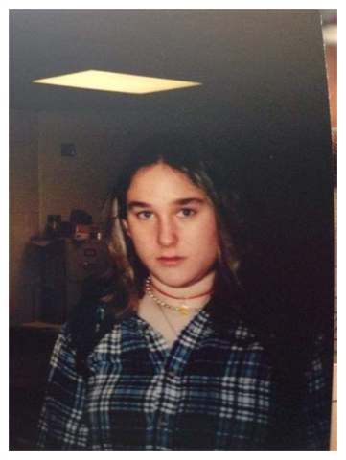
Introductions – please share in chat

Slide 3
we invite you to…
Stay curious
Be open
Consider intent and impact

Slide 4
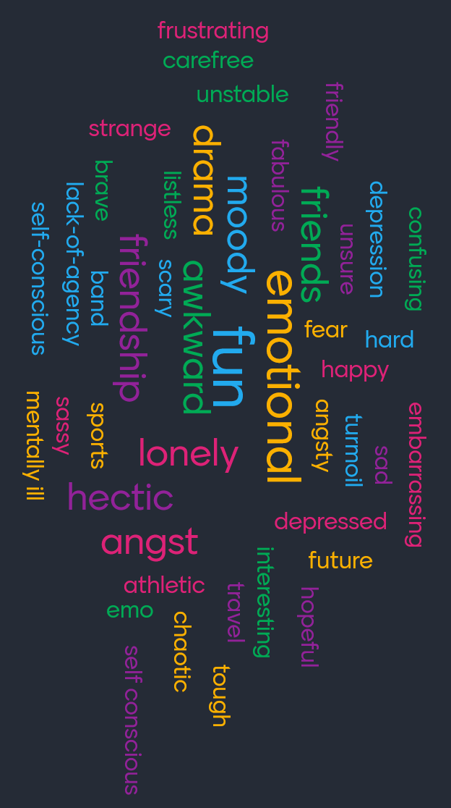
Please share in chat:
What do you like most about working with youth or teens?
What do you find most challenging?

Slide 5
Intersectional Factors affecting teens

Slide 6
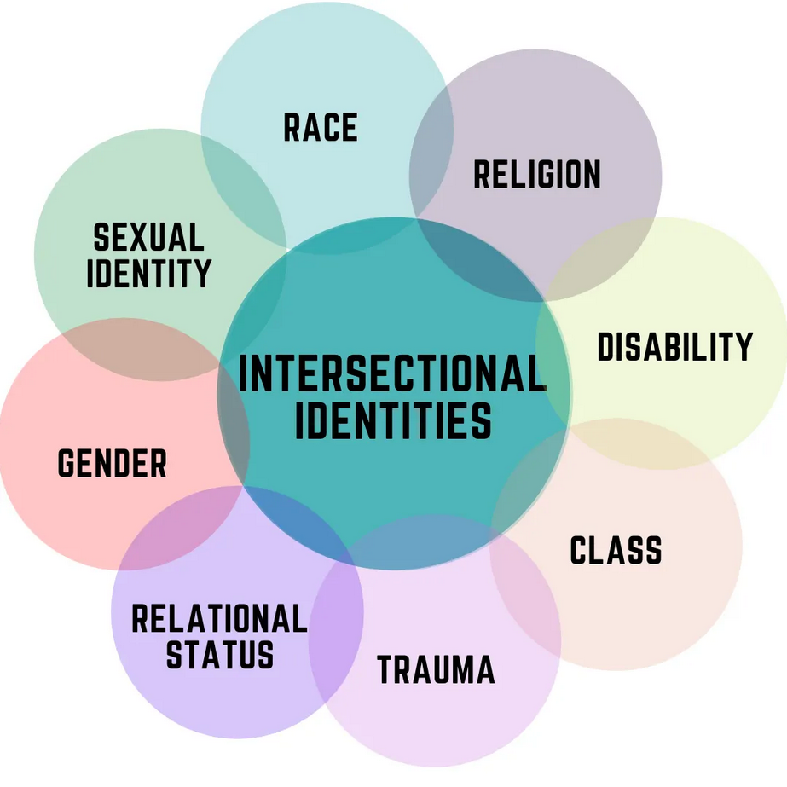
Please share in chat:
What are some factors, both internal and external, that might affect how teens show up in our libraries?

Slide 7
Biological Factors
Sleep
Brain Development
Puberty
Notes:
The Brain Science!
Mention Jill Bolte Taylor Neuroanatomical Transformation of the Teenage Brain TEDx Youth video in handout
Scientists have gotten very interested in researching what’s going on, neurologically, with teen brains. In terms of sheer intellectual power, the brain of an adolescent is a match for an adult’s. The capacity of a person to learn will never be greater than during adolescence
Teens, as a group, engage in high-risk behaviors more often than other age groups – why? Mortality rates jump between early & late adolescence: death by injury rates between ages 15-19 are 6 times that of the rate between ages 10-14
So there have been a number of studies in the past several years to look at differences between the ways adults and teens process information and make judgments.
Prefrontal cortex not fully developed and most decisions are made in amygdala
That there are differences: teens’ brains are still developing
Think of it like a toddler at baby storytime who has a meltdown – actions not always a deliberate choice
Jill Bolte Taylor talks about the body’s giant pruning of the synapses in the brain during the teen years, meaning that they literally lose half their minds

Slide 8
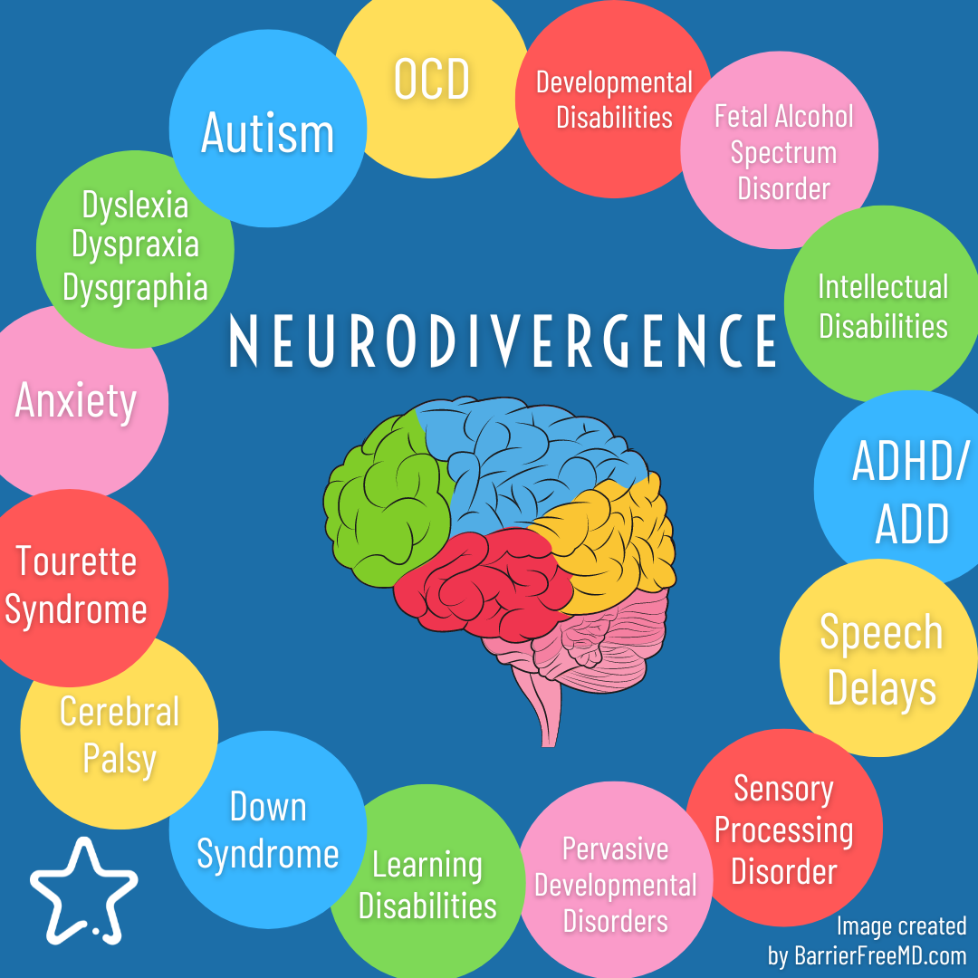
Neurodiversity

Slide 9
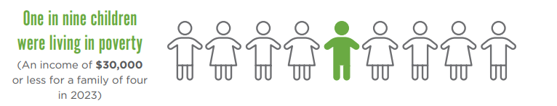
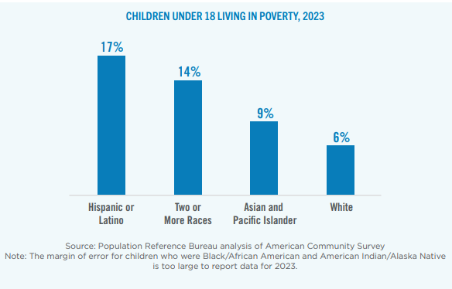
poverty

Slide 10
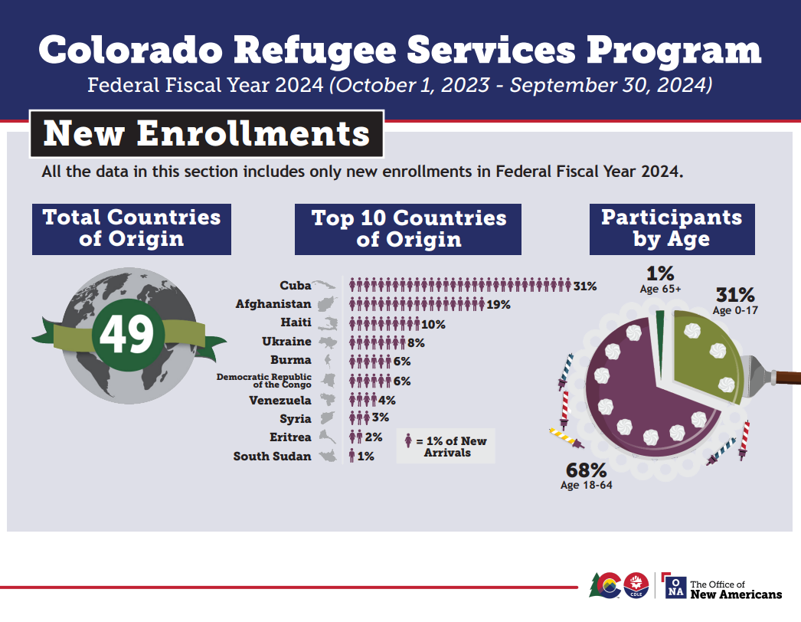
Immigrant and Refugee Status
Refugee Core Stressors
Traumatic stress
Resettlement stress
Acculturation stress
Isolation stress
The National Child Traumatic Stress Network
https://www.nctsn.org/what-is-child-trauma/trauma-types/refugee-trauma/about-refugees

Slide 11
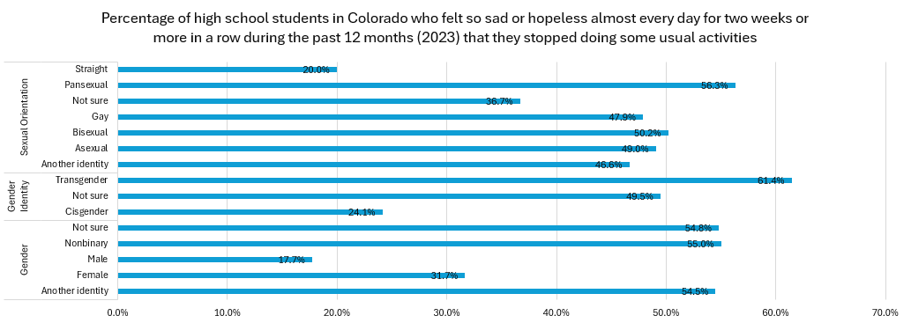
Mental health
Source: 2023 Healthy Kids CO report - https://cdphe.colorado.gov/hkcs

Slide 12
Some Contributors to Poor Mental Health
Safety
Worry about the future
Body image
Relationship pressures

Slide 13
Mental health – resources
iMatter (https://www.imattercolorado.org)
Safe2Tell
Colorado Crisis Services (https://coloradocrisisservices.org)
Text 988 (Suicide and Crisis Lifeline)
LGBTQ+ Youth Crisis Support from The Trevor Project: Call – 1-866-488-7386, Text "Start" to 678-678 or chat online at thetrevorproject.org/get-help

Slide 14
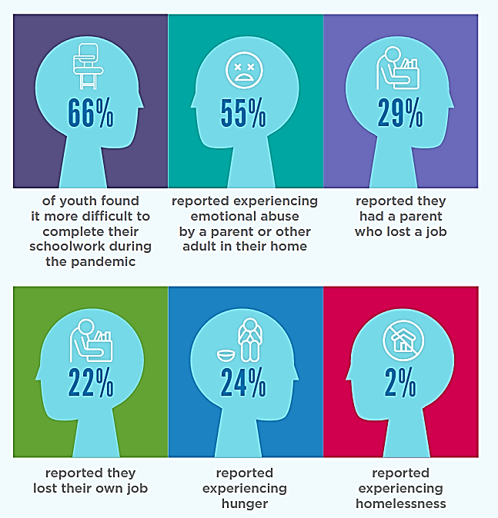
Effects of covid
Mental health
Social-emotional learning and self regulation
Fine motor skills
Source: Kids Count in Colorado Building Understanding Report

Slide 15
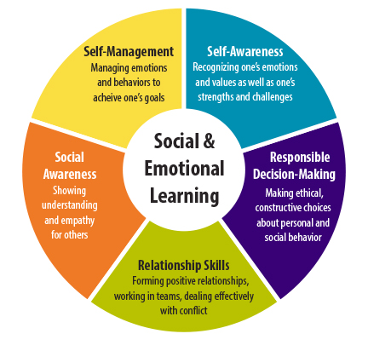
Social & Emotional Learning

Slide 16
Group discussion about intersectional factors
Please share in chat
What have you seen in your community related to these or other intersectional factors? What are some ways the library can offer support?

Slide 17
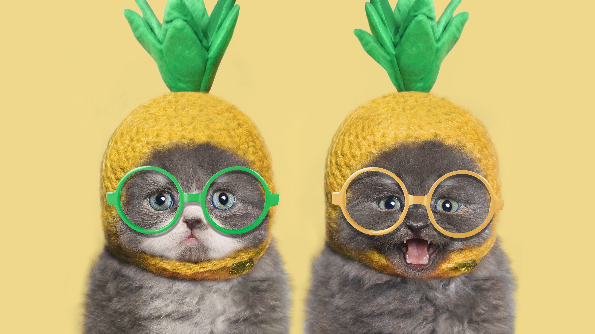
Questions?

Slide 18
Thank you!
Anush – abalayan@ald.lib.co.us
Catherine – cboddie@ald.lib.co.us
Erica – eschimmel@ald.lib.co.us

