Slide 1


TEEN MENTAL HEALTH:
In their own words
CSL in Session, February 2020
Cameron Riesenberger, Pikes Peak Library District
Christine Kreger, Colorado State Library
Beth Crist, Colorado State Library
Notes:
CK will transition to this slide after CSL in Session intro

Slide 2
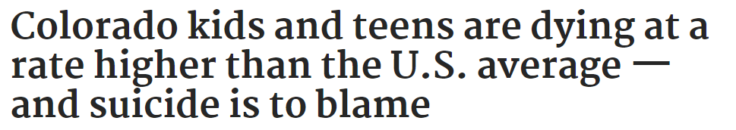
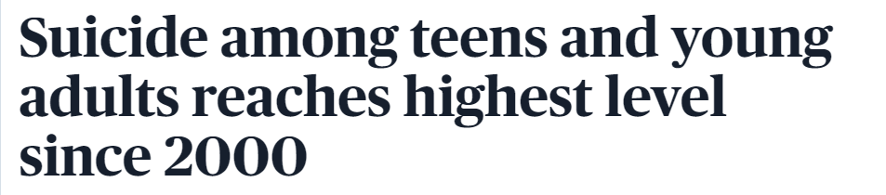
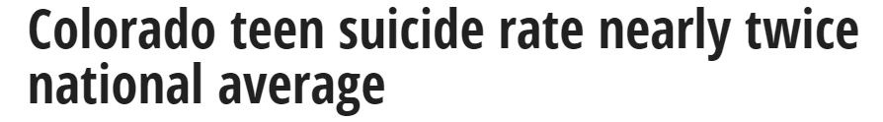
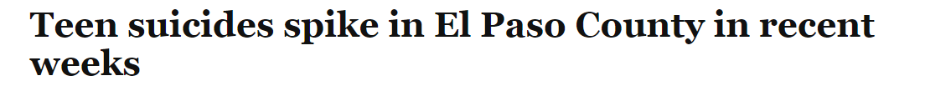
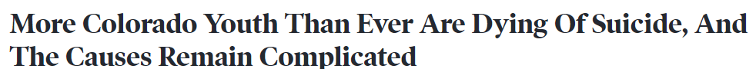
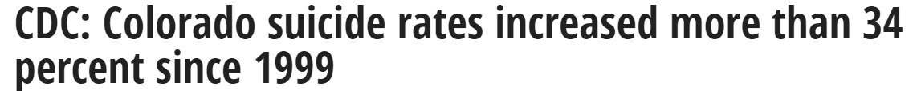
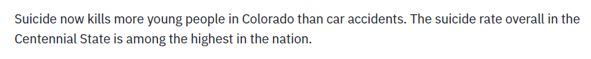
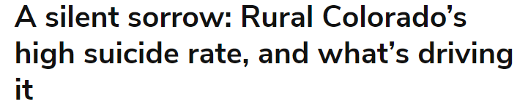
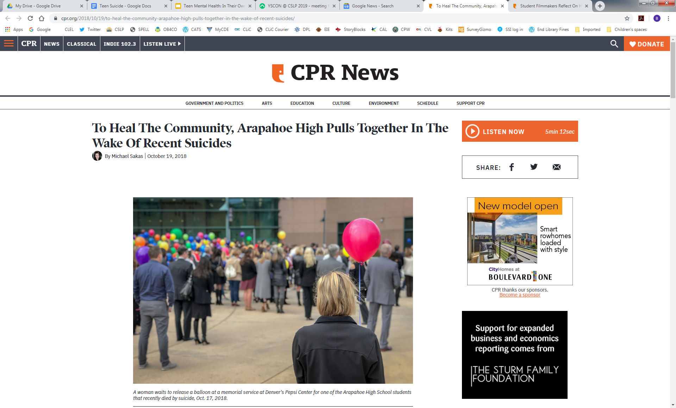
Headlines about Colorado suicide rates
Notes:
3 minutes
Each of us read a stat:
CK - Colorado is among the wealthiest, healthiest states in the nation but has a higher teen and child death rate than the national average, a rate that has grown worse over the past two decades.
Cameron - Suicide is the leading cause of death for coloradans ages 10-24. 21 deaths per 100,000 teens in 2017
Beth - Colorado ranked fifth in the nation in terms of suicide death rates and has consistently been in the top 10 since 2009
CK - Welcome to Teen Mental Health: In their own words
We each introduce ourselves
CK - As you can see from the headlines and the stats we just gave, teen suicide is a growing problem in Colorado and nationwide. The community impact of youth suicides is profound, with far-reaching social and emotional effects, and the libraries in which we work are a critical part of the communities this is affecting.
Our goal today is to bring more awareness to teen mental health and teen suicide, to share some research from Colorado communities, and to brainstorm ways that libraries can help affect change. We do want to state at the outset, that we by no means feel that libraries and library staff will or should solve the problem of teen suicide. Rather, we hope to be a part of larger community conversations. That said, we will be spending time today reflecting, sharing, and brainstorming. You should each have a copy of the workbook for this session, as well as a legal size handout. We will use this as we move through the session for notes and reflections.
There may be some things that we see, hear, or talk about today that you may find triggering. We will not be offended if at any time you need to step out for a few minutes or find it necessary to find another session.

Slide 3
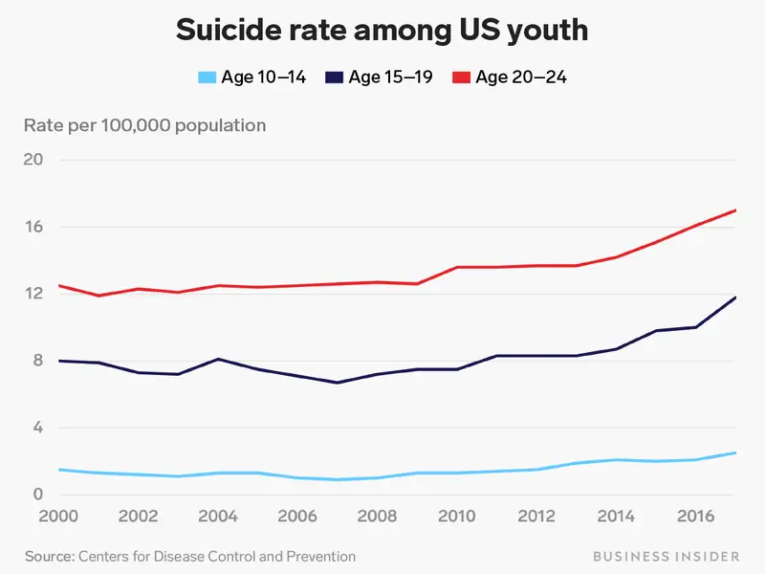
Suicide Rate Among US Youth

Slide 4
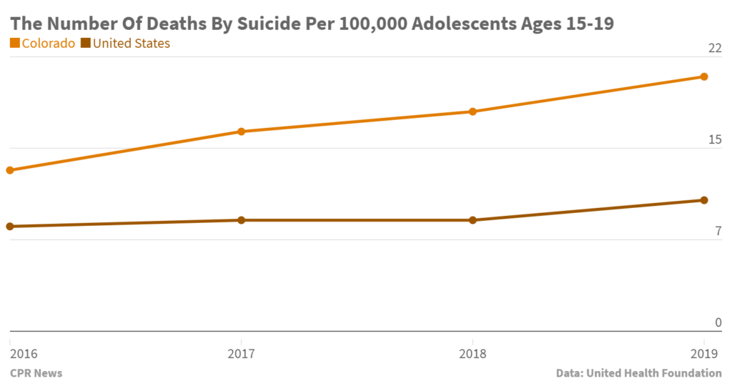
The Number of Deaths by Suicide per 100,000

Slide 5
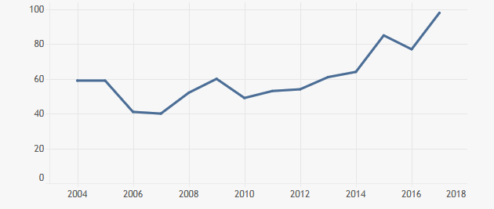
Number of suicides per year in Colorado, 2004-2018
Age: 10-19 years
From the Colorado Department of Public Health & Environment
Notes:
1 minute
Beth digs a bit deeper into stats?
High of 75 suicides in 2017 (69 in 2018)
74% boys, 26% girls
68% white non-hispanic, 23% hispanic, 6% african american, 2% asian/pacific islander, 1% american indian

Slide 6
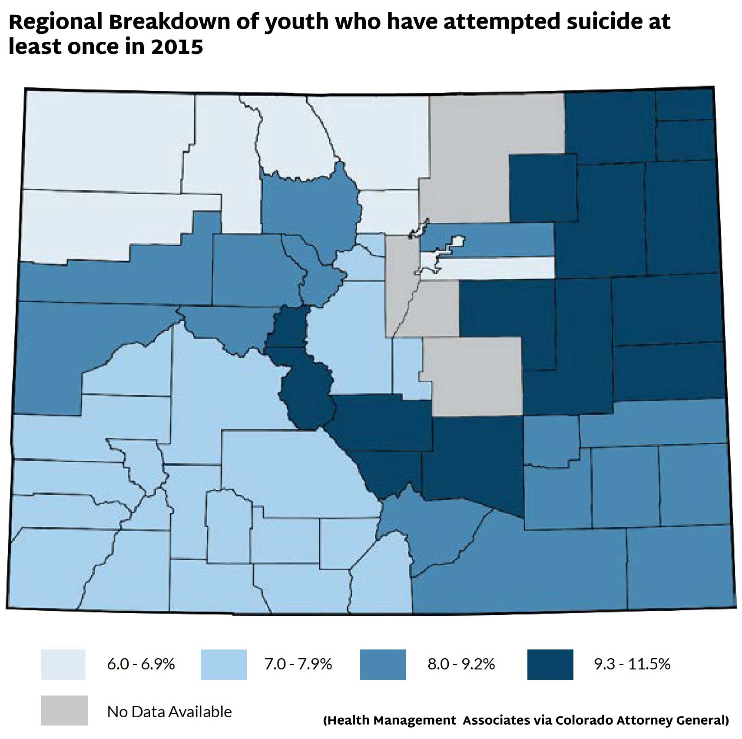
Regional breakdown of youth who have attempted suicide at least once in 2015
Notes:
1 minute
Beth?

Slide 7

Video: Kids in Crisis
https://www.youtube.com/embed/zaAej0yw4gI?start=23&end=120
Notes:
4 minutes for videos
https://www.youtube.com/watch?v=zaAej0yw4gI
Beth -
Trigger warning?
Play:
Kids in Crisis: :23-2:00 -
Not Alone: 8:06-11:04

Slide 8
Community Conversations to Inform Youth Suicide Prevention: A study in youth suicide in four Colorado Counties
*Risk Factors/Barriers
*Protective Factors
*Recommendations
https://coag.gov/app/uploads/2019/05/community-conversations-to-inform-youth-suicide-prevention.pdf
Notes:
5 minutes
CK -
Thank you all for sharing your thoughts about these videos and for participating in conversations about this difficult subject. Now we are going to switch gears a bit and share some Colorado specific research.
In December 2017, the Colorado Office of the Attorney General’s Office of Community Engagement, hired Health Management Associates (HMA) to study four counties in the state which had experienced recent suicide clusters among middle and high school-aged youth and which had historically high rates of suicide across every age group. - (El Paso, Pueblo, Mesa, La Plata)
Data collected via:
Interviews
Focus groups - including teen focus groups
reviewed information on current suicide prevention activities and resources in the four counties and across Colorado
reviewed traditional and social media coverage related to suicide in the four counties and the state
reviewed publicly available information on school policies and procedures related to suicide intervention, prevention and postvention
This research led to the publication of the Community Conversations to Inform Youth Suicide Prevention: A study in youth suicide in four Colorado Counties. We don't have time to delve into every aspect of this report, but it listed in the resources at the back of your packet. Over 80 pages, but worth a read
According to the report, since 2009, colorado has seen an almost yearly increase in suicides. Other notable facts:
more females are attempting suicide, but more males are dying by suicide.
In the 2017 Healthy Kids Colorado Survey (HKCS), 17 percent of all participating middle and high school students reported considering suicide and 7 percent reported making one or more suicide attempts in the previous 12 months
When it comes to LGBTQ+ Youth, the numbers rise to 44.8 percent reported considering suicide and 19.9 percent attempted suicide in the previous 12 months,
In addition to describing how the data was gathered, key findings covered:
Risk factors and barriers
Facilitators and Protective factors
Recommendations
These categories may have differed slightly from community to community or based upon how the data was gathered, but we pulled the top level items for each category and included them on your legal sized handout.

Slide 9
Risk Factors and Barriers
Pressure/anxiety about failing Lack of prosocial activities (Sports, band, afterschool activities) Lack of acceptance or tolerance for people’s differences Lack of coping skills/resilience in the face of challenges Substance abuse Adult and teen suicide is becoming normalized Access to lethal means Lack of resources/funding for public health and social services programs Lack of mental health providers trained to work with youth Stigma associated with help-seeking Fear Lack of health insurance | Social media/cyberbullying Lack of connection to a caring adult Poor employment/lack of economic opportunities in community Generational poverty “Western Mentality” of solving your own problems rather than seeking help. Mental health issues (depression, anxiety, etc.) No time for teens to decompress/self-care Lack of mental health providers who accept Medicaid Lack of coordination/collaboration between health/service organizations Compassion fatigue Need for trained gatekeepers – parents/family members/school personnel/youth peers
“We are putting band aids on huge tears.” – School Staff
Notes:
4 minutes - Give a minute to review Risk factors.
Realize quite a bit of text on the screen, but these are the risk/factors and barriers mentioned in the report, in no particular order. Take a minute or so to scan, and post initial thoughts/impressions in the chat area

Slide 10
Protective Factors
Community resources/youth suicide prevention efforts
Increased collaborative efforts of the public health departments
Access to extracurricular activities
Access to faith-based organizations/activities
Access to nature/outdoor activities/resources
“You are someone’s favorite person, so build relationships and connect with kids.” – School Staff
Notes:
2 minutes Give a minute to review Protective Factors
What are your first impressions after reviewing the data?

Slide 11
Recommendations
Prioritize relationship building between adults and youth. Create a culture of support for youth in crisis/post crisis. Implement programs or strategies that build resilience and coping skills. Increase access to prosocial activities and supportive environments. Leverage current public awareness campaigns to destigmatize getting help for mental health needs, including suicidal ideation. Create coalitions of providers and foster relationships between providers and youth serving organizations.
Notes:
4 minutes
Here are 6 of the original 8 recommendations from the report. We thought that these might resonate with libraries and library staff. Take a look and feel free to share thoughts and inpressions in chat.
Possibly turn on whiteboard and have them place a checkmark next to one that aligns with library mission/goal.
Keep these recommedations in mind as move into our next section. Cameron will share some of the things that the Pikes Peak LIbrary District as been doing...
Pick one to brainstorm?

Slide 12
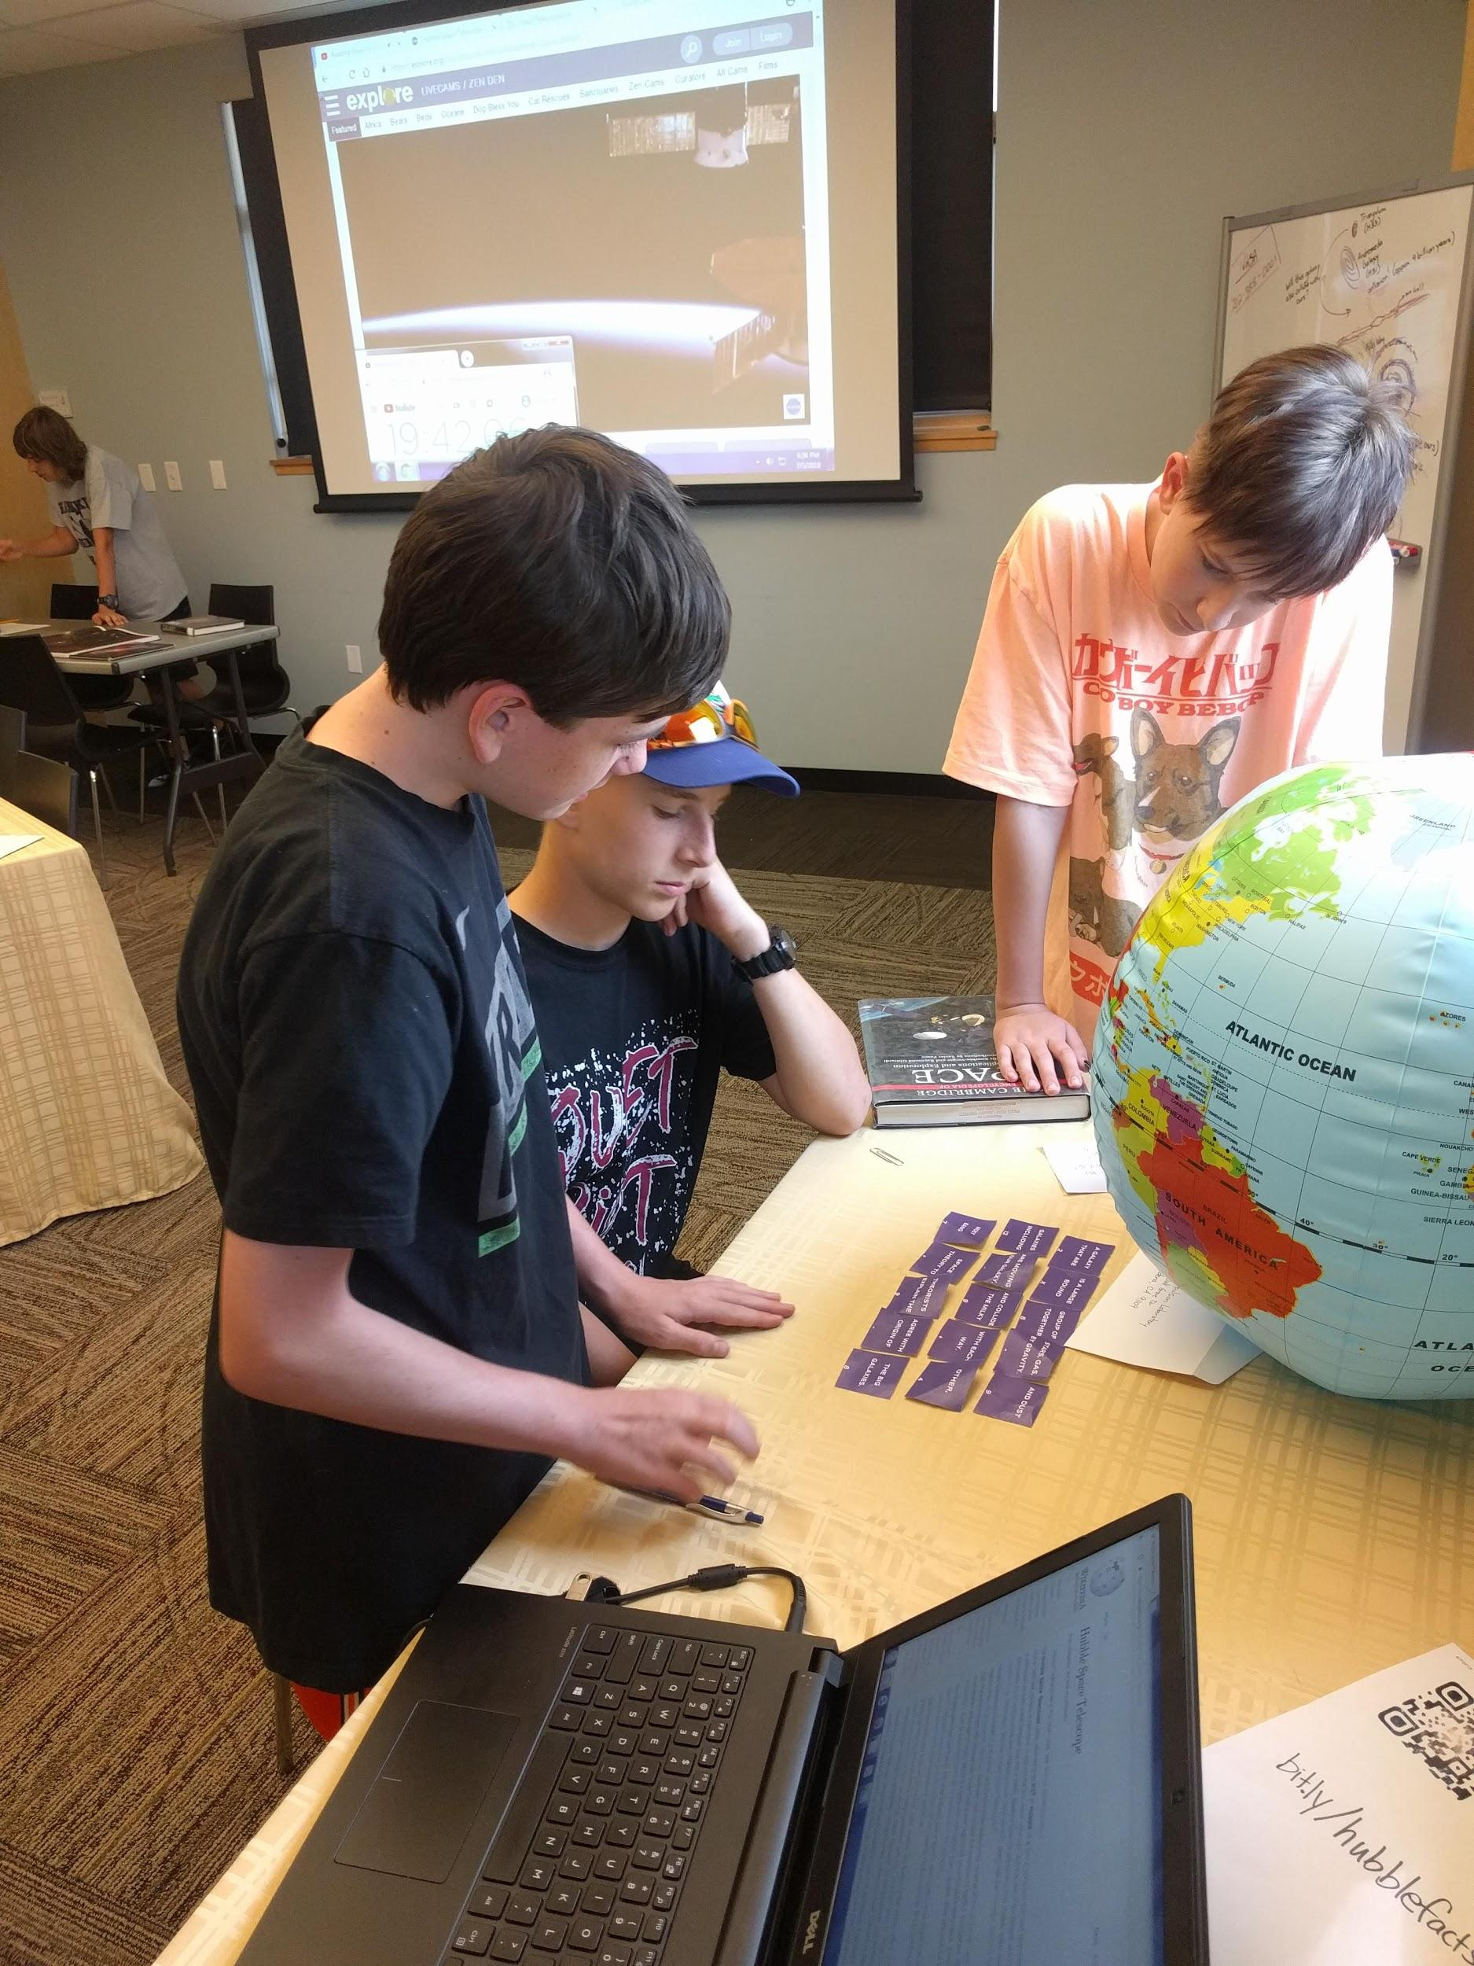
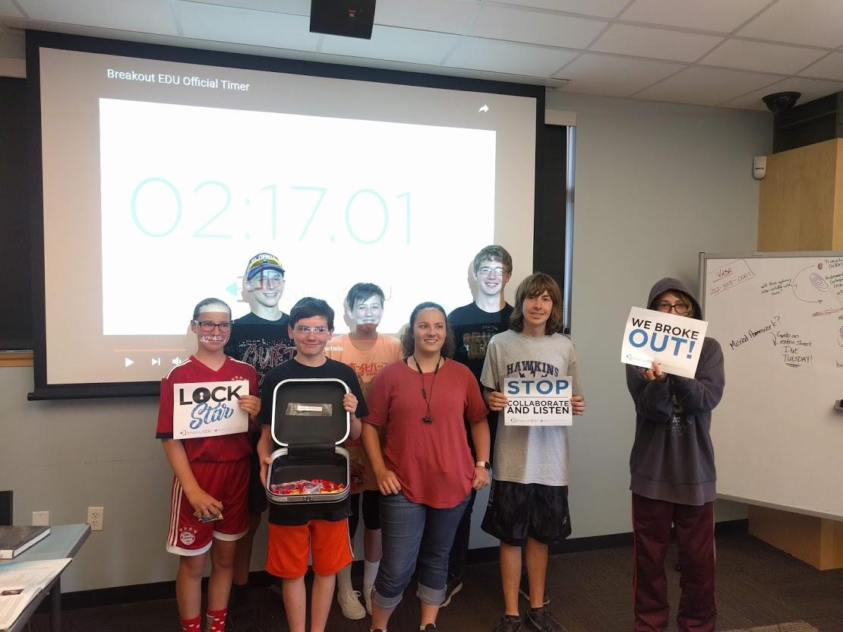
WHAT IS THE LIBRARY’S ROLE?
Notes:
5-8 minutes
Cameron
[Story about why this work is important to me]
We don't expect libraries to solve the problem, and we don't expect staff to become counselors...so what can we do?
This is a lot to take in, you don't have to read all of the research etc.
Cameron share what PPLD does
Levels from easy to more involved
Information Resources - Tough Topics Bookmark and Resource Guide
Easiest way to get involved, and everyone should be providing informational resources on teen mental health and difficult issues
Tough Topics bookmark led to Tough Topics Research Guide (research.ppld.org/toughtopics)
Include local information for youth serving organizations and teen support networks.
Guide averages 200 vists per month.
Booklists for fiction/non-fiction featuring characters living with mental illness
Partnerships
El Paso County Youth Suicide Prevention Working Group
Even if your area doesn’t have a group like this, reach out to your public health department (can offer resources and statistics for your area)
Interdisplinary (School districts, public health, data scientists, behavioral health, etc).
66 partner agencies and around 24 unaffiliated parents/community members.
Trained over 160 youth pastors in Youth Mental Health First Aid
Established school based resource network of all schools in El Paso County for information sharing and support
Picked up the tough topics guide as a main community resource.
NAMI - Below the Surface
Advertising campaign for the CO Crisis Service textline developed using teen focus groups.
Succintly addresses many of the pressures teens face
Through the Work Group, connected with NAMI to bring Below the Surface to PPLD. First non-school in the county.
Campaign was picked up by the State. I invited the state program coordinator to present at CATS WW, if you would like more information on the campaign, I can provide you with her contact information.
National Safe Place
National program, long process

Slide 13
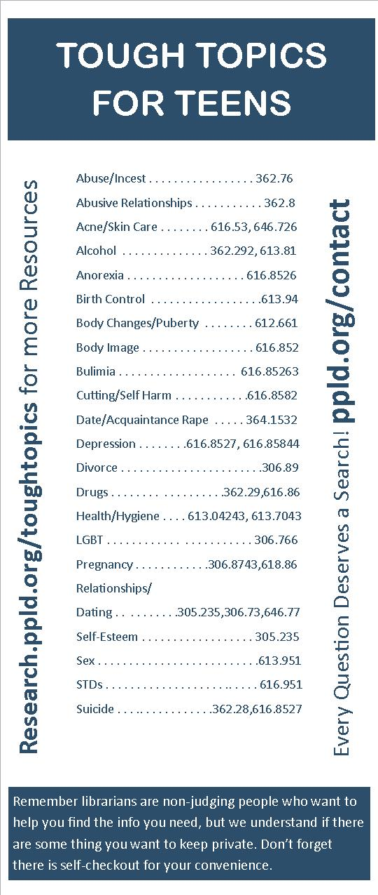
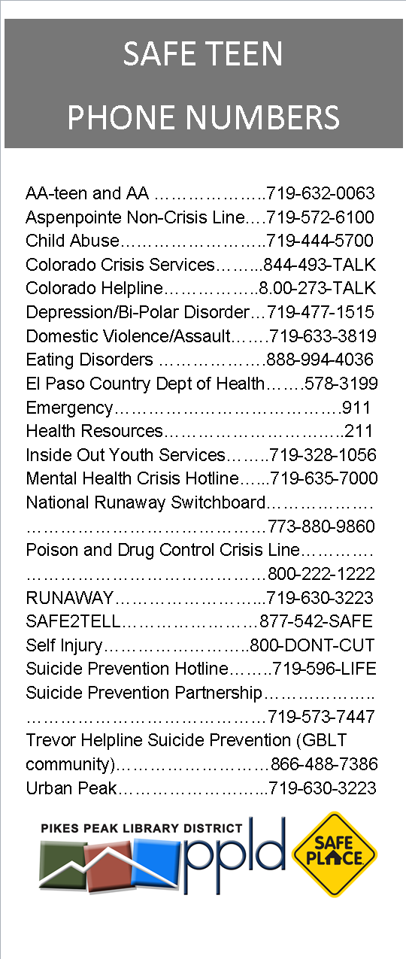
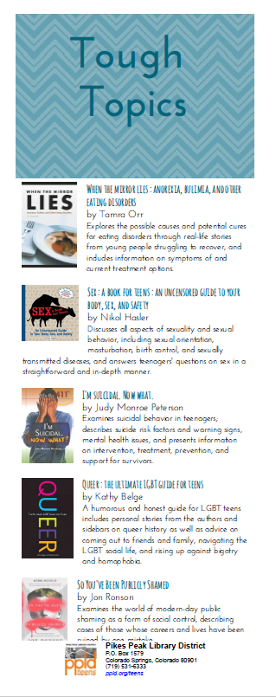

Example Bookmarks
Notes:
5-8 minutes
Cameron
[Story about why this work is important to me]
We don't expect libraries to solve the problem, and we don't expect staff to become counselors...so what can we do?
This is a lot to take in, you don't have to read all of the research etc.
Cameron share what PPLD does
Levels from easy to more involved
Information Resources - Tough Topics Bookmark and Resource Guide
Easiest way to get involved, and everyone should be providing informational resources on teen mental health and difficult issues
Tough Topics bookmark led to Tough Topics Research Guide (research.ppld.org/toughtopics)
Include local information for youth serving organizations and teen support networks.
Guide averages 200 vists per month.
Booklists for fiction/non-fiction featuring characters living with mental illness
Partnerships
El Paso County Youth Suicide Prevention Working Group
Even if your area doesn’t have a group like this, reach out to your public health department (can offer resources and statistics for your area)
Interdisplinary (School districts, public health, data scientists, behavioral health, etc).
66 partner agencies and around 24 unaffiliated parents/community members.
Trained over 160 youth pastors in Youth Mental Health First Aid
Established school based resource network of all schools in El Paso County for information sharing and support
Picked up the tough topics guide as a main community resource.
NAMI - Below the Surface
Advertising campaign for the CO Crisis Service textline developed using teen focus groups.
Succintly addresses many of the pressures teens face
Through the Work Group, connected with NAMI to bring Below the Surface to PPLD. First non-school in the county.
Campaign was picked up by the State. I invited the state program coordinator to present at CATS WW, if you would like more information on the campaign, I can provide you with her contact information.
National Safe Place
National program, long process

Slide 14
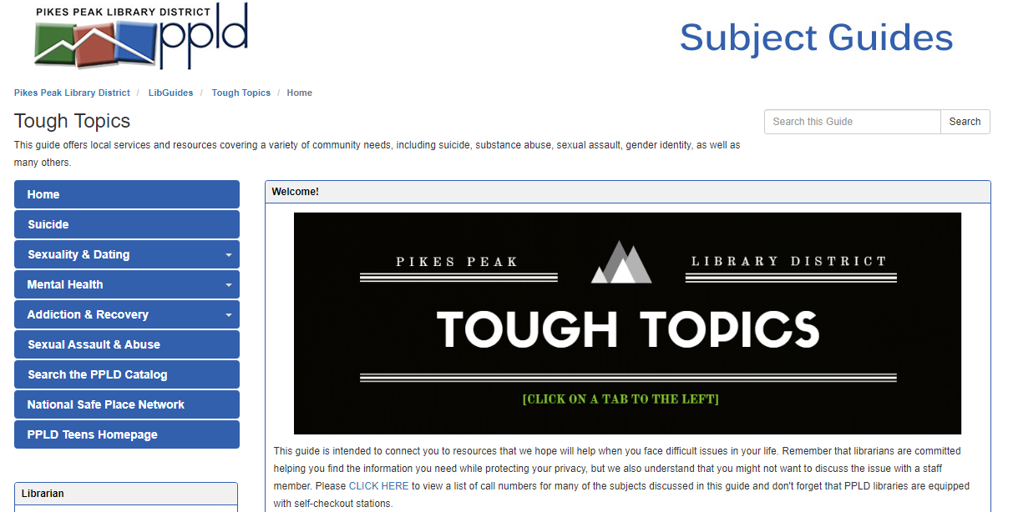
Pikes Peak Library Tough Topics Online Guide
https://research.ppld.org/toughtopics
Notes:
5-8 minutes
Cameron
[Story about why this work is important to me]
We don't expect libraries to solve the problem, and we don't expect staff to become counselors...so what can we do?
This is a lot to take in, you don't have to read all of the research etc.
Cameron share what PPLD does
Levels from easy to more involved
Information Resources - Tough Topics Bookmark and Resource Guide
Easiest way to get involved, and everyone should be providing informational resources on teen mental health and difficult issues
Tough Topics bookmark led to Tough Topics Research Guide (research.ppld.org/toughtopics)
Include local information for youth serving organizations and teen support networks.
Guide averages 200 vists per month.
Booklists for fiction/non-fiction featuring characters living with mental illness
Partnerships
El Paso County Youth Suicide Prevention Working Group
Even if your area doesn’t have a group like this, reach out to your public health department (can offer resources and statistics for your area)
Interdisplinary (School districts, public health, data scientists, behavioral health, etc).
66 partner agencies and around 24 unaffiliated parents/community members.
Trained over 160 youth pastors in Youth Mental Health First Aid
Established school based resource network of all schools in El Paso County for information sharing and support
Picked up the tough topics guide as a main community resource.
NAMI - Below the Surface
Advertising campaign for the CO Crisis Service textline developed using teen focus groups.
Succintly addresses many of the pressures teens face
Through the Work Group, connected with NAMI to bring Below the Surface to PPLD. First non-school in the county.
Campaign was picked up by the State. I invited the state program coordinator to present at CATS WW, if you would like more information on the campaign, I can provide you with her contact information.
National Safe Place
National program, long process

Slide 15

Below the Surface Marketing
https://www.namicoloradosprings.org/below-the-surface---colorado-crisis-text-line.html
Notes:
5-8 minutes
https://www.namicoloradosprings.org/below-the-surface---colorado-crisis-text-line.html
Cameron
[Story about why this work is important to me]
We don't expect libraries to solve the problem, and we don't expect staff to become counselors...so what can we do?
This is a lot to take in, you don't have to read all of the research etc.
Cameron share what PPLD does
Levels from easy to more involved
Information Resources - Tough Topics Bookmark and Resource Guide
Easiest way to get involved, and everyone should be providing informational resources on teen mental health and difficult issues
Tough Topics bookmark led to Tough Topics Research Guide (research.ppld.org/toughtopics)
Include local information for youth serving organizations and teen support networks.
Guide averages 200 vists per month.
Booklists for fiction/non-fiction featuring characters living with mental illness
Partnerships
El Paso County Youth Suicide Prevention Working Group
Even if your area doesn’t have a group like this, reach out to your public health department (can offer resources and statistics for your area)
Interdisplinary (School districts, public health, data scientists, behavioral health, etc).
66 partner agencies and around 24 unaffiliated parents/community members.
Trained over 160 youth pastors in Youth Mental Health First Aid
Established school based resource network of all schools in El Paso County for information sharing and support
Picked up the tough topics guide as a main community resource.
NAMI - Below the Surface
Advertising campaign for the CO Crisis Service textline developed using teen focus groups.
Succintly addresses many of the pressures teens face
Through the Work Group, connected with NAMI to bring Below the Surface to PPLD. First non-school in the county.
Campaign was picked up by the State. I invited the state program coordinator to present at CATS WW, if you would like more information on the campaign, I can provide you with her contact information.
National Safe Place
National program, long process

Slide 16
Action Planning
What is one thing you will share with your organization?
What is one thing you will do in next month?
Notes:
5 minutes
CK -
As we wrap up today's session, we want to thank you all again for your participation and sharing of thoughts and ideas. This is a very tough topic, and our hope is that we can keep the conversation going beyond this session. We are also hoping to do some more webinars on this topic this winter/spring in conjunction with the Colorado Department of Education and other interested organizations.
For now, we want you all to take a few minutes and answer these questions in your workbook.
If you finish early, we also have an evaluation for you to fill out. This is a separate eval from the one in sched - the state library needs its own data.

Slide 17
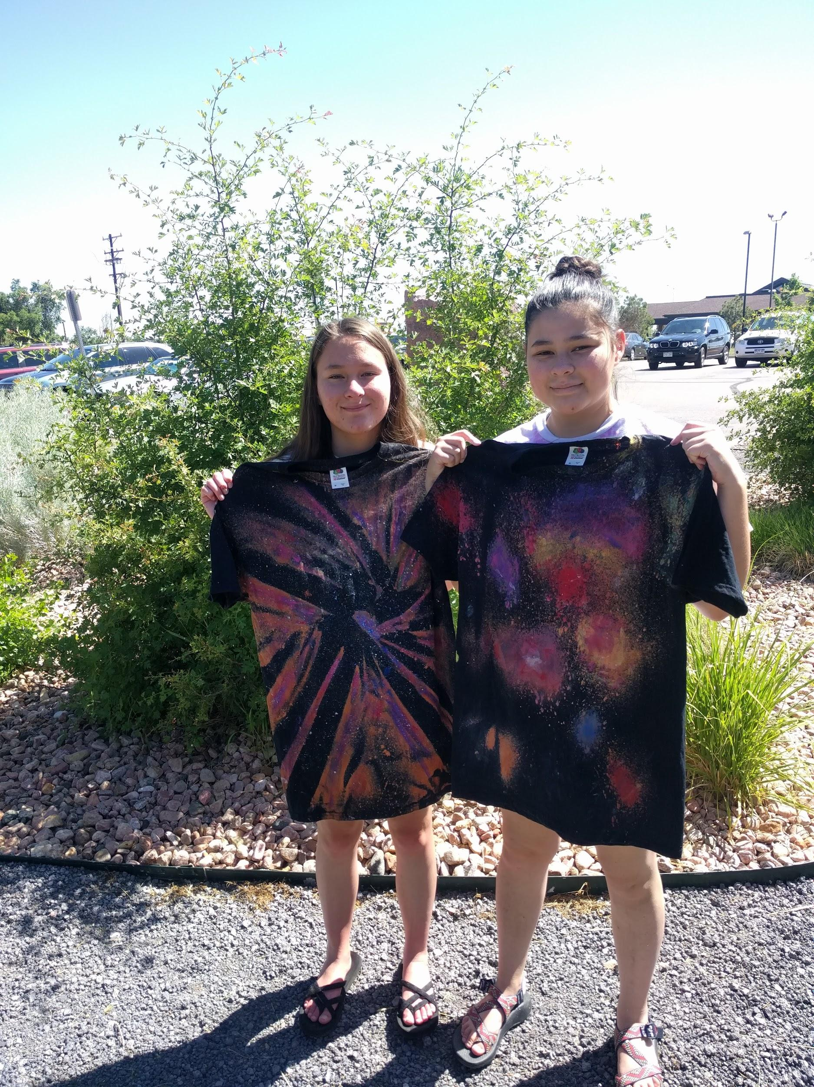
Thank You!
Notes:
5 Minutes
We can try and address any additional questions you have.
Have a great rest of your conference!

