Slide 1
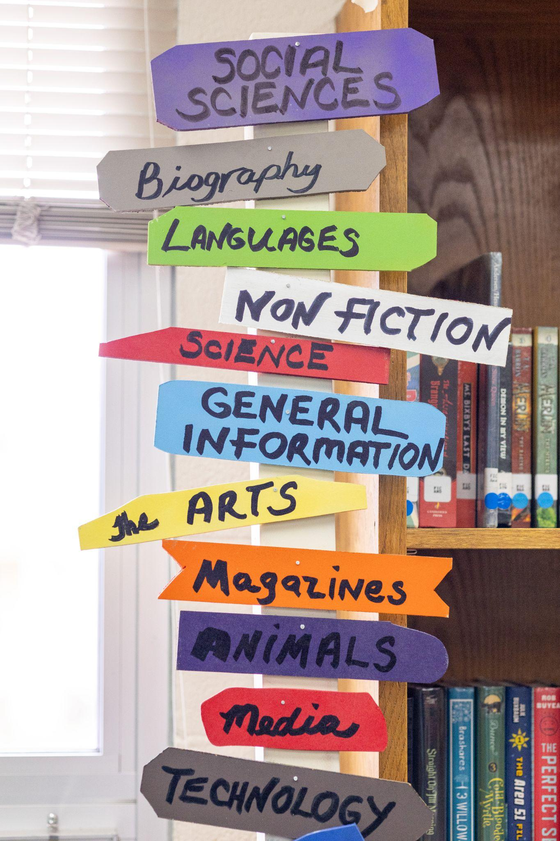
Everyday Library Evaluation
Part 3: Data Analysis and Visualization

Slide 2
Today’s Session
Evaluation/Data lifecycle
LRS Tableau Dashboards Demo
Misleading visualizations
Visualizing Data: a misleading y-axis
Choosing What to Visualize
Cleaning Data
Accessibility and Visualizations
Format: print or online?
Audience: Board, Public, Grantors?
Keep it simple!
Careful Color Combos for All
Real world examples/workshop!
MS Excel, Google Sheets, Google Docs, Canva

Slide 3
Data/Evaluation Lifecycle
Step 5
Tell people, repeat and destroy!
Step 1
Defining question/problem/outcome
Library Evaluation Lifecycle
Step 4
Analysis/Synthesis/Data use/ Visualizations
Step 2
Collection tool creation
Step 3
Collection & Storage

Slide 4
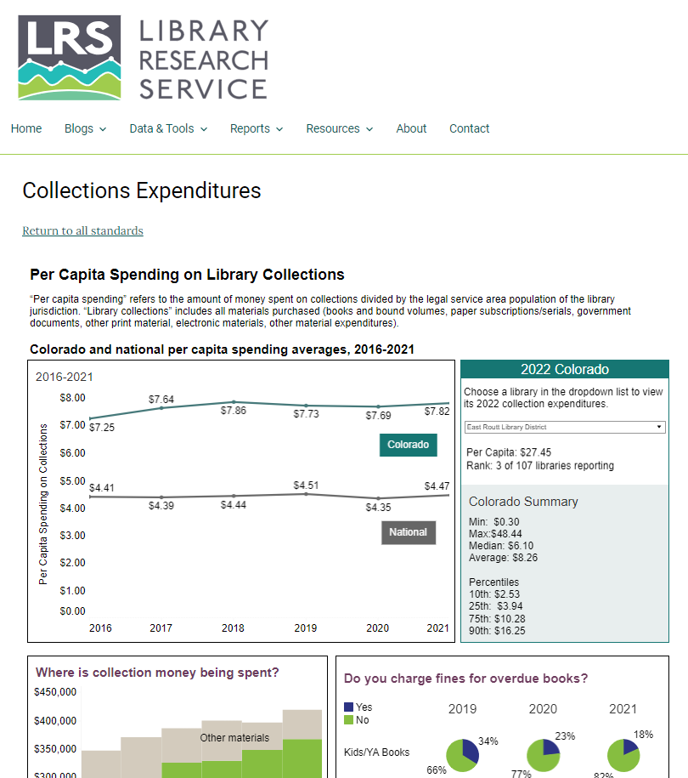
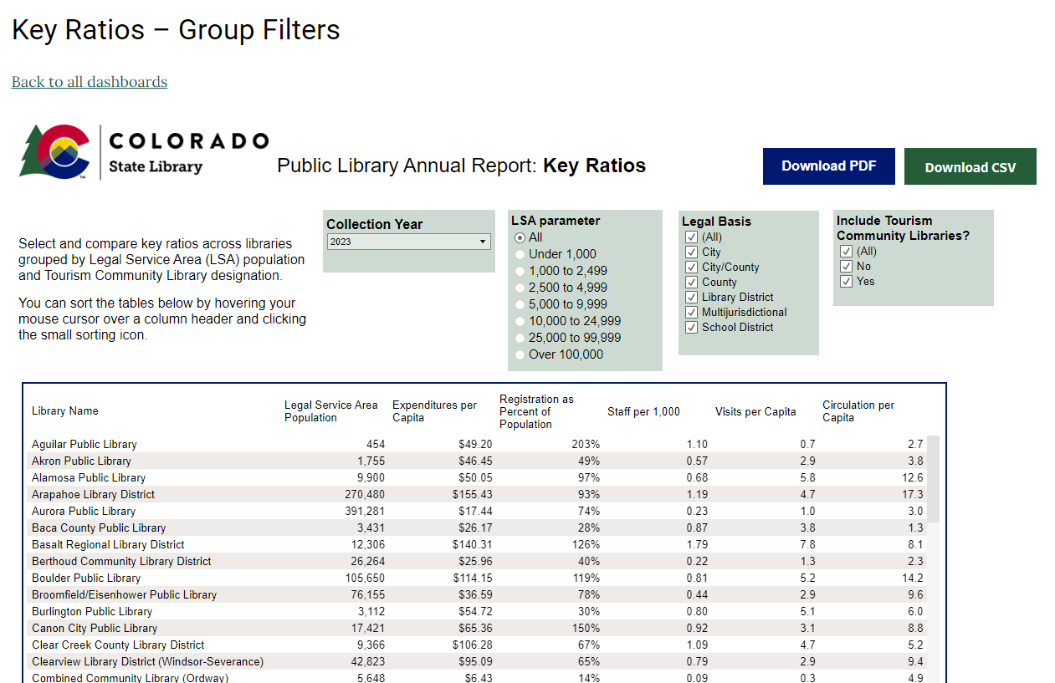
Public Library Annual Report Visualizations
General PLAR data
Visualizations with a Library Standards focus
https://lrs.org

Slide 5
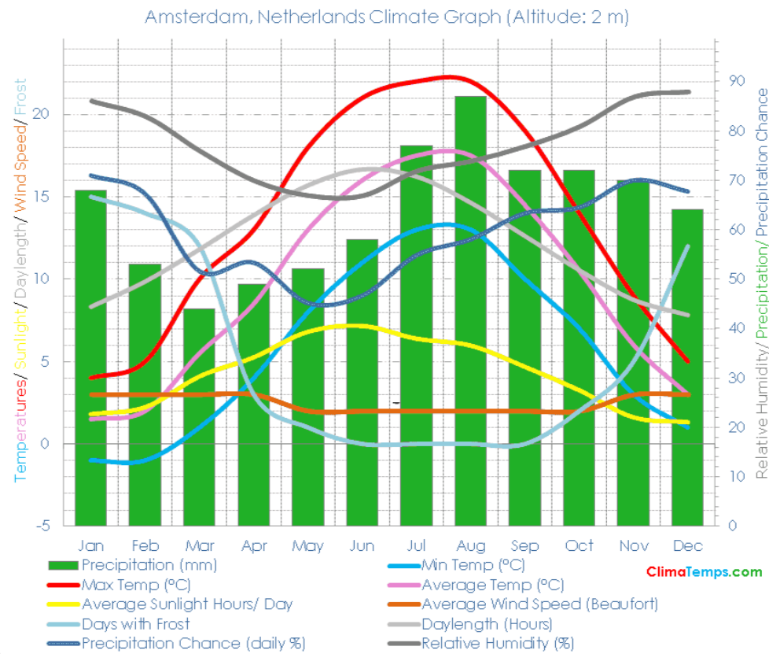
This Seems Fine?
https://www.reddit.com/r/dataisugly/

Slide 6
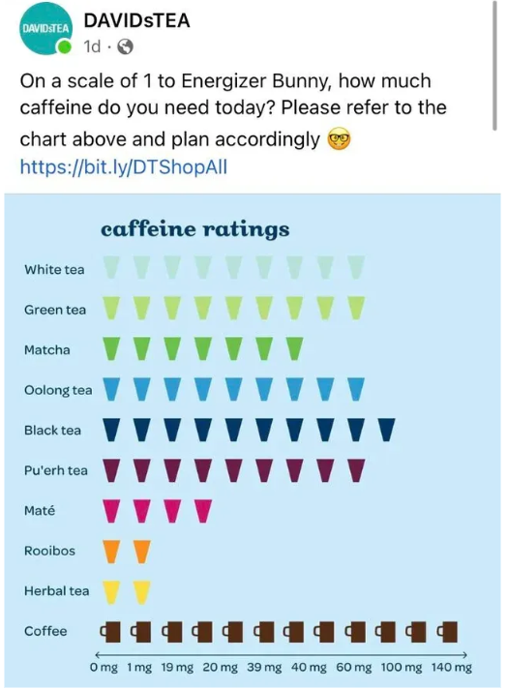
What’s happening here?
https://medium.com/@thomas.ellyatt/bad-data-visualisation-real-life-examples-out-there-in-the-wild-eb5032329aeb

Slide 7
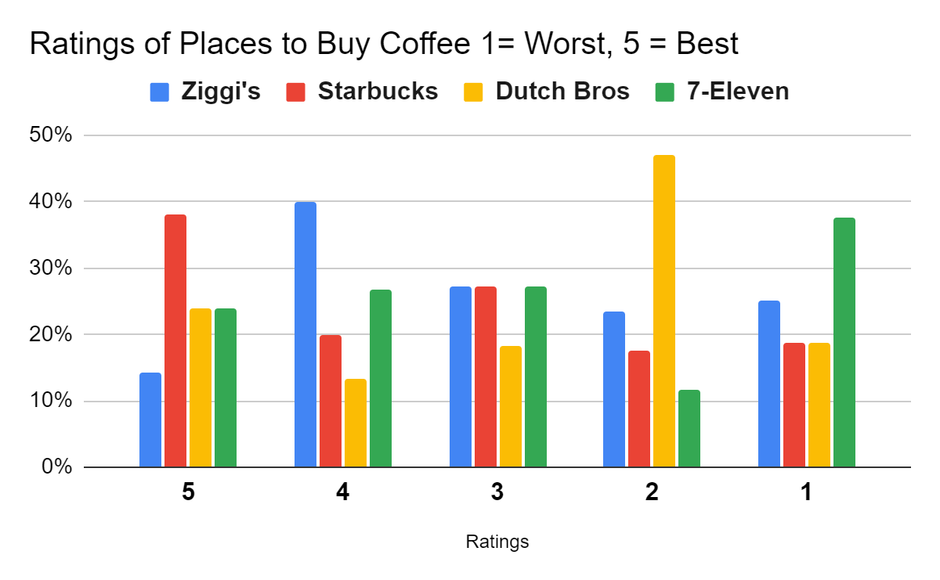
What Are Ways to Improve this Chart?

Slide 8
Why Visualize Data?
A good visualization makes data easier to understand
Can assist communications with board members/trustees
Can help draw comparisons with peer libraries
Draws people into the conversation
Quickly conveys trends or patterns
Makes it memorable

Slide 9
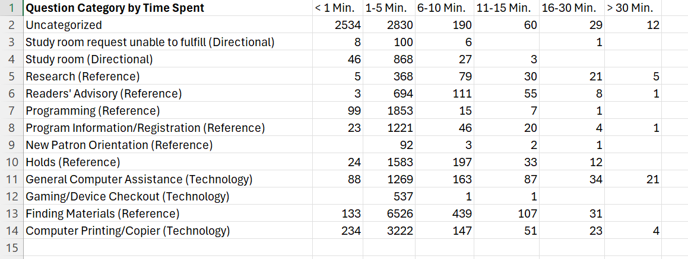
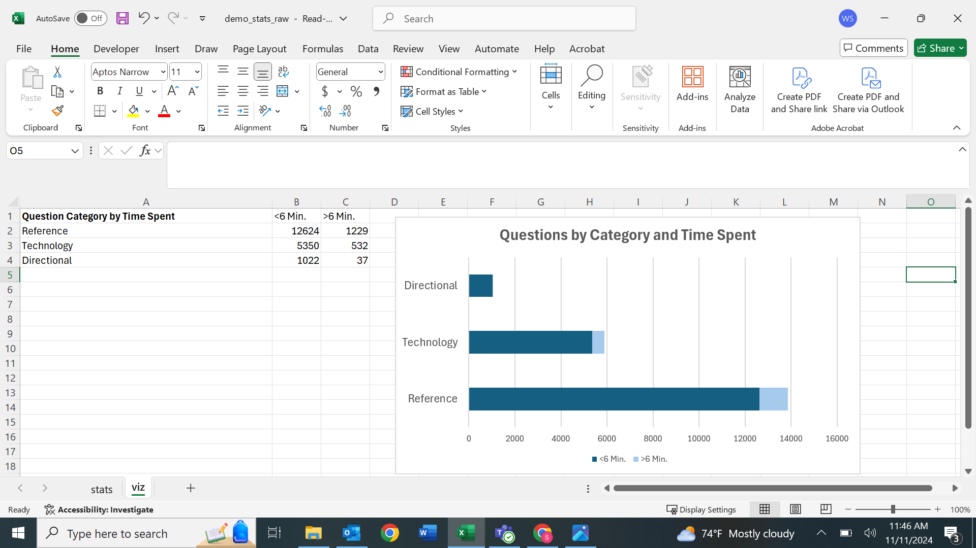
Why Visualize Data? Example

Slide 10
Cleaning Data
Removing irrelevant data
Calculating comparable units of measure (if needed)
Removing duplicates
Improving formatting

Slide 11
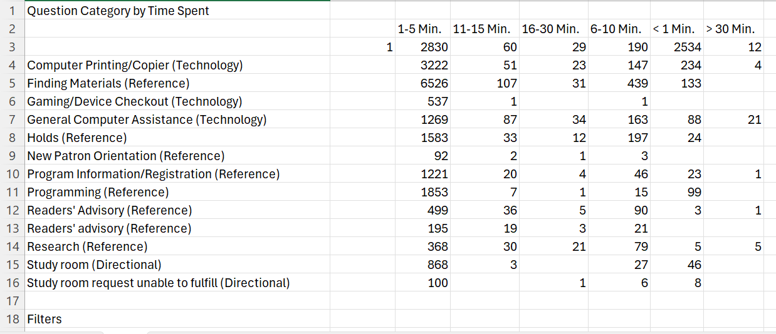
Cleaning Data – Example 1

Slide 12
Cleaning Data – Example 2

Slide 13
Accessibility Tips
Keep it simple
Choosing the right chart type
Print vs digital accessibility
Static vs interactive
Choose colors carefully
Write it out:
This horizontal stacked bar chart shows that more questions categorized as Reference were asked than questions categorized as Directional or Technology. Most questions asked in each category required less than six minutes to answer.

Slide 14
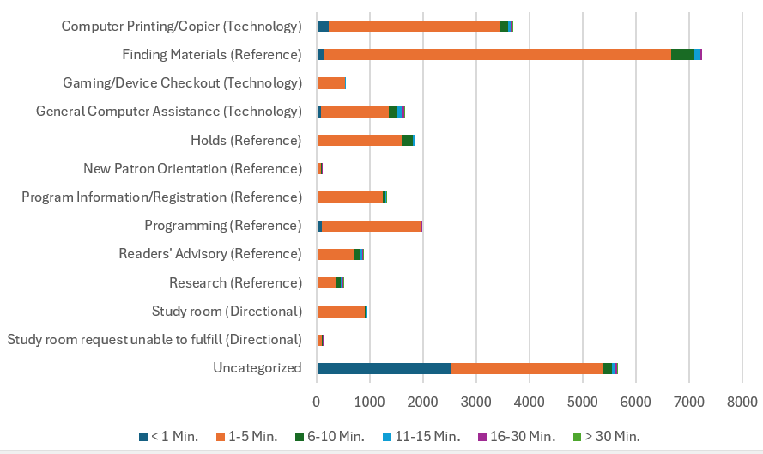
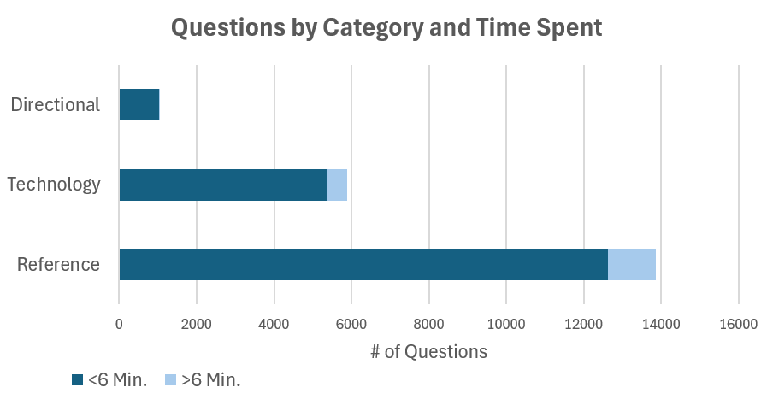
Accessibility - Example

Slide 15


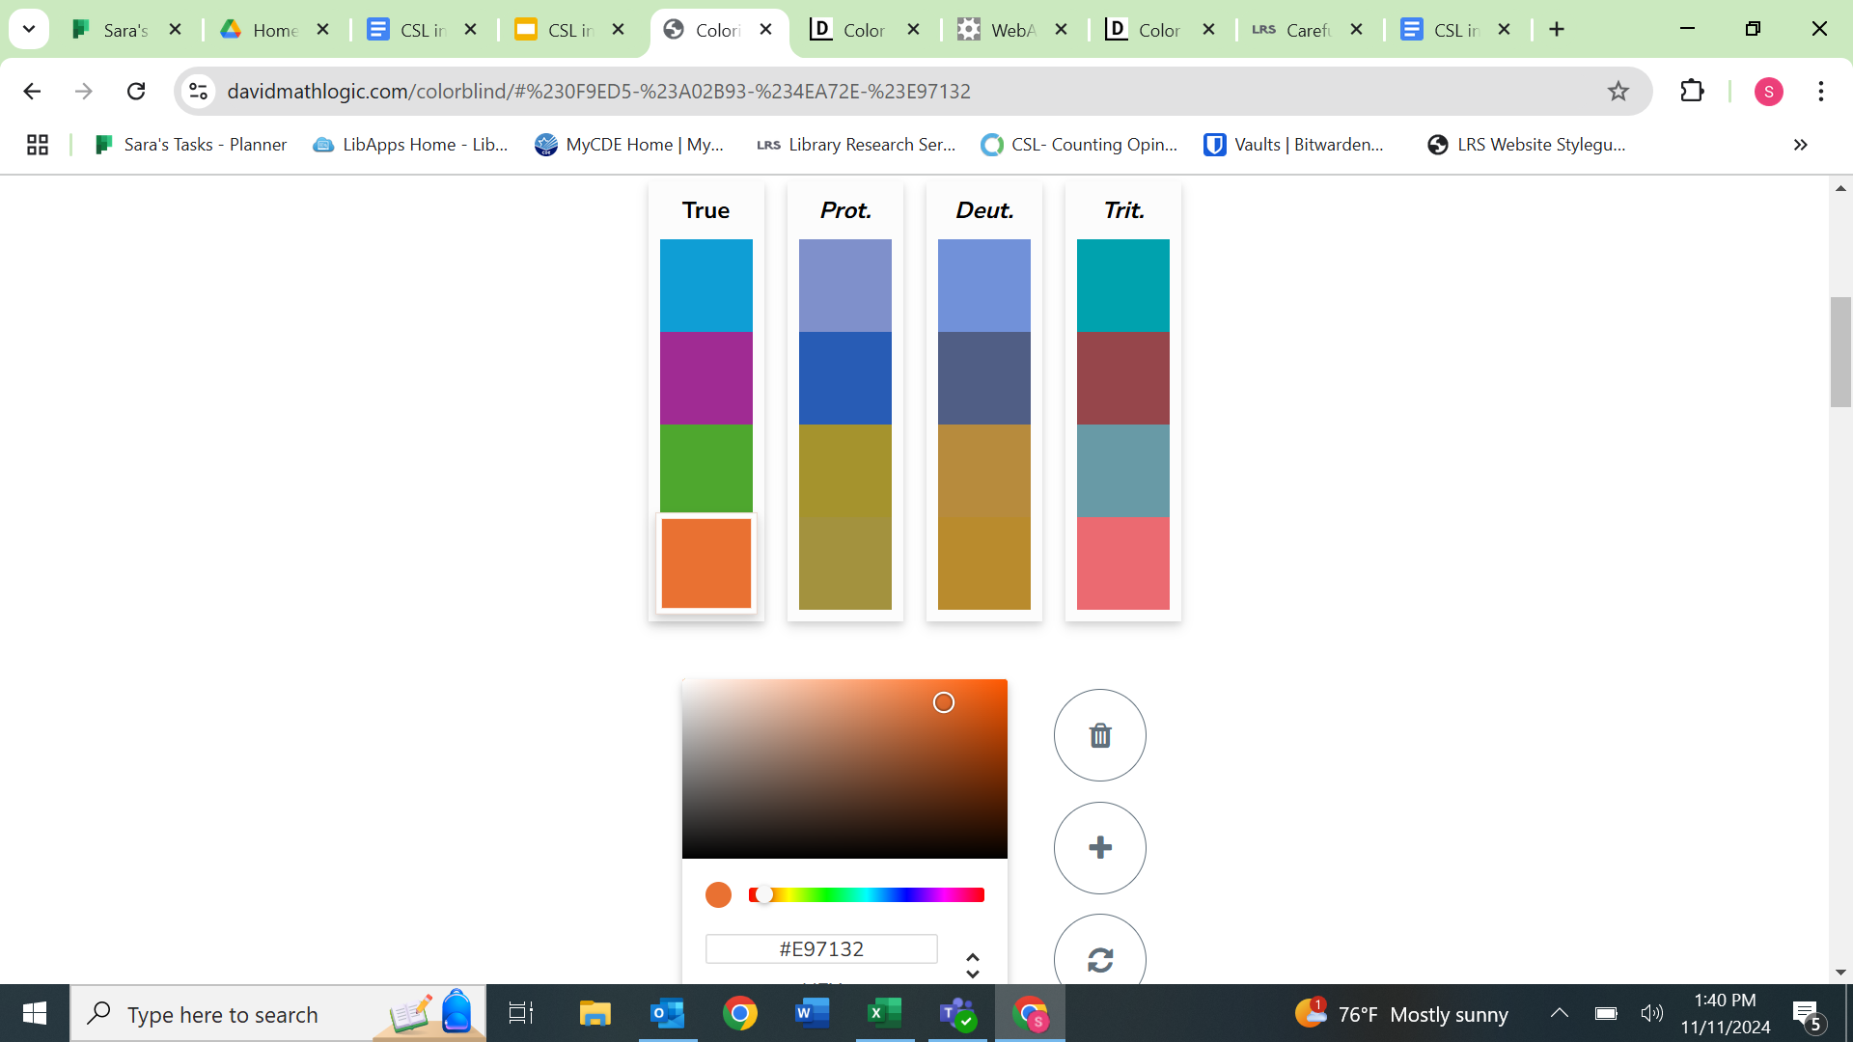
Accessibility and Color
Color contrast is your friend!
WebAIM Contrast Checker
Datawrapper Blog
Different values of the same color can be more effective than similar shades of different colors.
Deuteranomaly: The most common type of color vision deficiency that causes green to look redder
Made with Coloring for Color Blindness by David Nichols

Slide 16


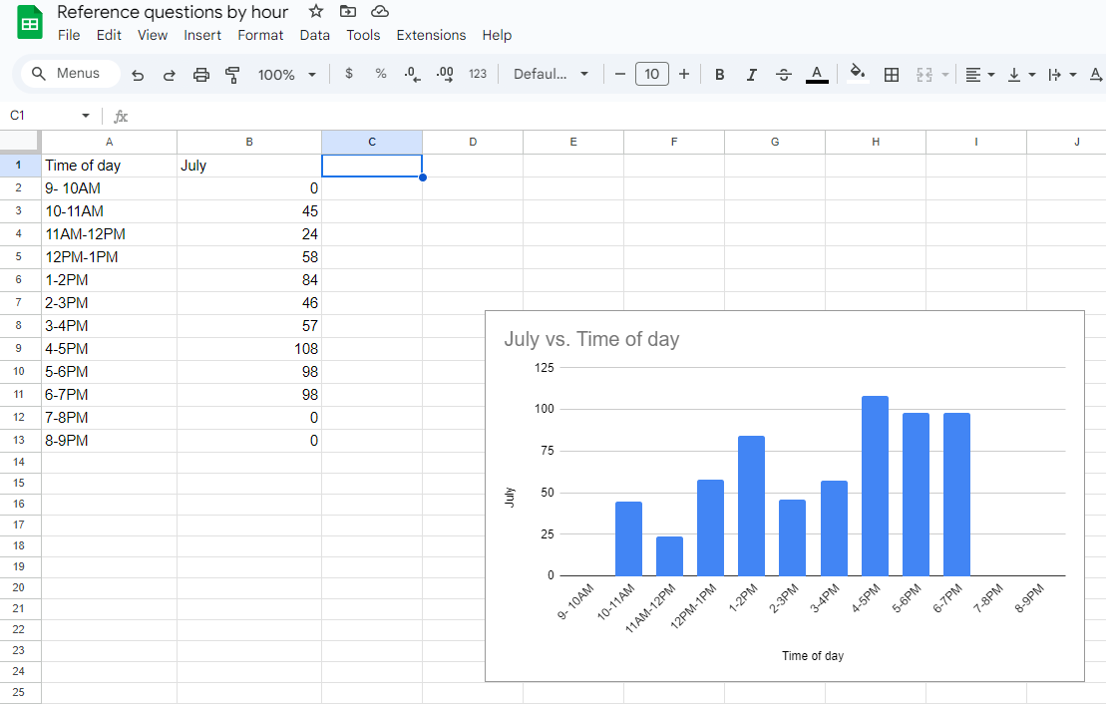
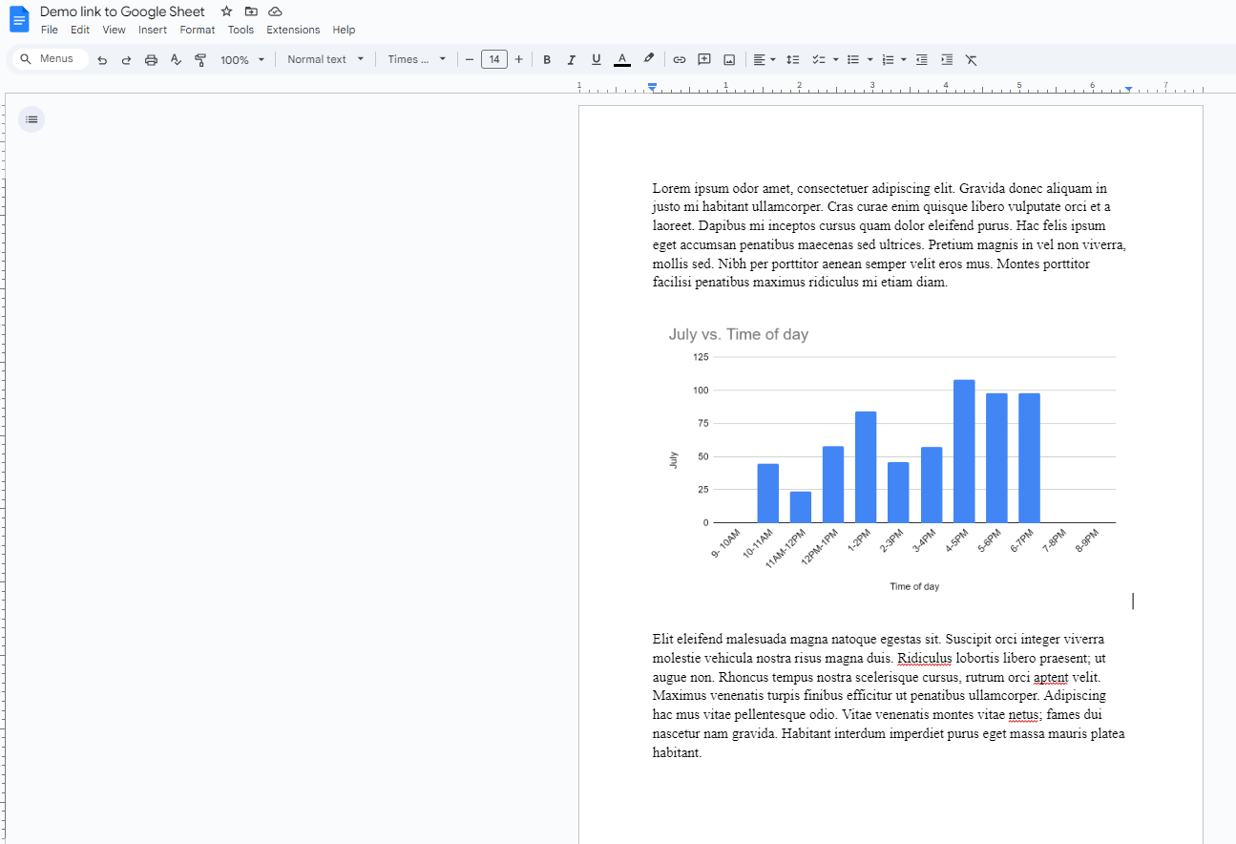
Connecting Google Sheets and Google Docs
Connect Google Sheets and Docs with automatically updating visualizations for routine reporting.
The same can be done using Microsoft Excel and Word.

Slide 17

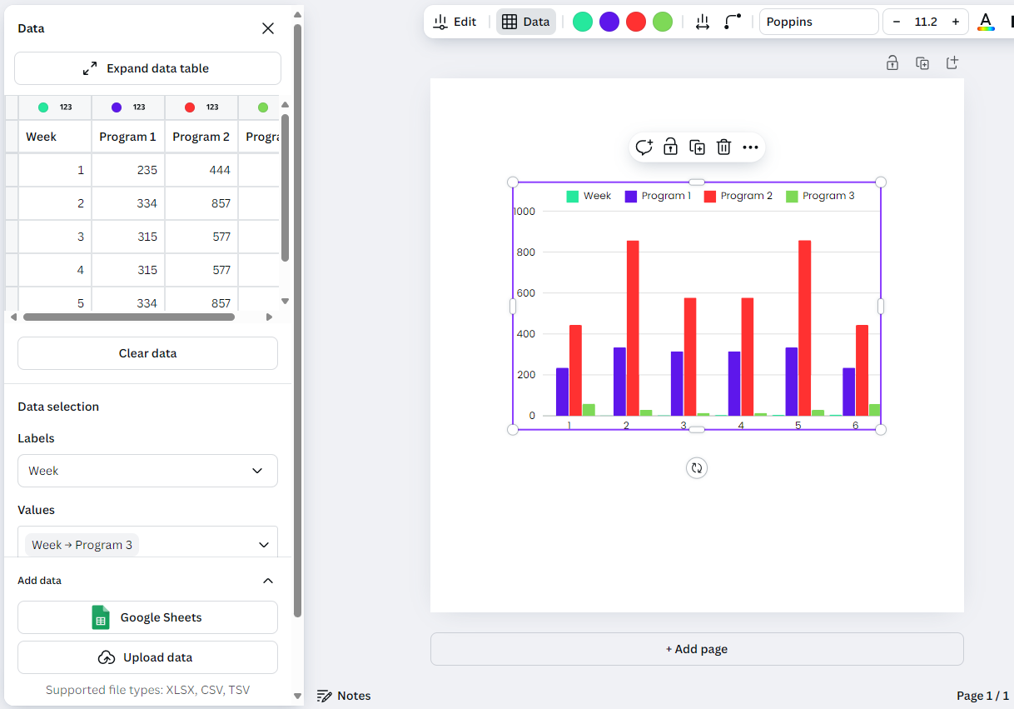
Bringing the Data Fun to Canva
Import CSV, Excel, and others
Data updates with Google Sheet changes
Graphics can be exported for use in Google Docs, MS Word, or websites
Canva how-to: https://www.canva.com/help/charts/
Rule of thumb for print projects: 300 pixels is roughly 1” in print. Example: 1200x900 pixels would print well at 4”x3”.

Slide 18
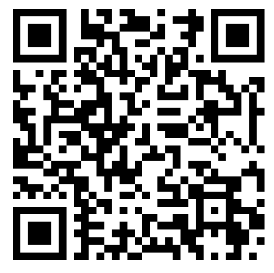

Thank you!
Please take our survey!
Presenters: Sara Wicen & Dana Petersen
Presentation Name:
Everyday Library Evaluation: Data Analysis and Visualization
https://costatelibrary.libwizard.com/f/program_evaluation
Contact us: LRS@lrs.org | Sara: wicen_s@cde.state.co.us | Dana: petersen_d@cde.state.co.us

