Slide 1

Bienvenidos:
Creating welcome for Hispanohablantes and Latines at Your library
Cristy Moran (she/ella)
Adult Library Services Senior Consultant
Colorado State Library
Coloradostatelibrary.org/spanishforlibraries

Slide 2
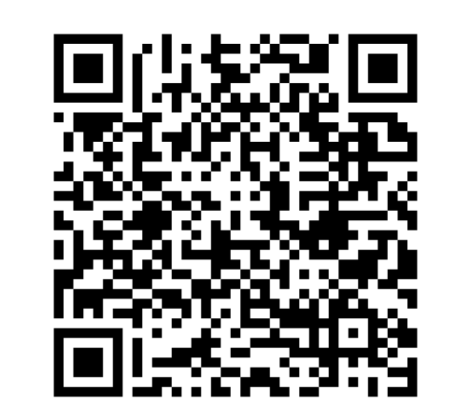
Outcomes
Gain insight to the hispanohablante and Latine population you serve
Discover barriers to feeling welcome at libraries from the perspective of [some] hispanohablantes
Establish best practices for welcoming visitors (regardless of linguistic barriers)

Slide 3
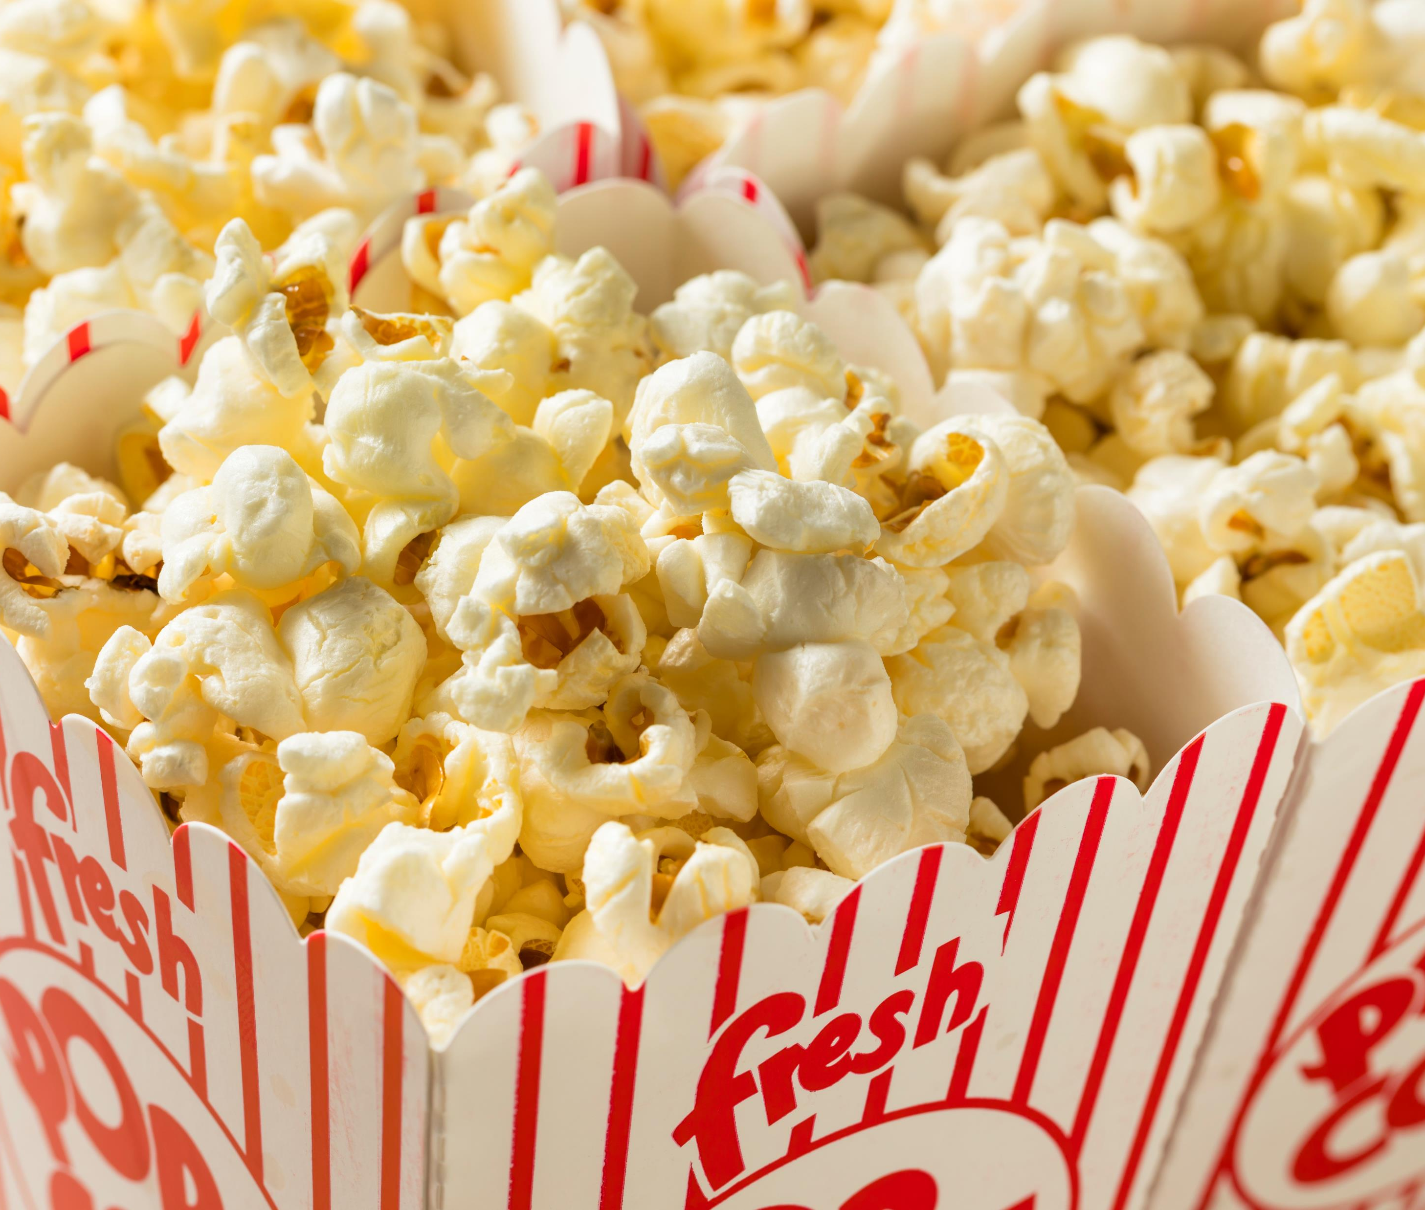
¿Cómo se dice?
Notes:
I shared this question and a link to a Radio Ambulante Instagram post about this on my LinkedIn and from the comments on my post alone – far fewer and far less global than the original post – I got:
Rositas de maíz – that’s Cuban
Palomitas – Costa Rica
Maíz pira – Colombia – and another from Colombia is crispetas
Mexico had palomitas *and* (qualified as “more recently”) po corrrrn
Pocholo – Argentina
Canchita – Perú

Slide 4
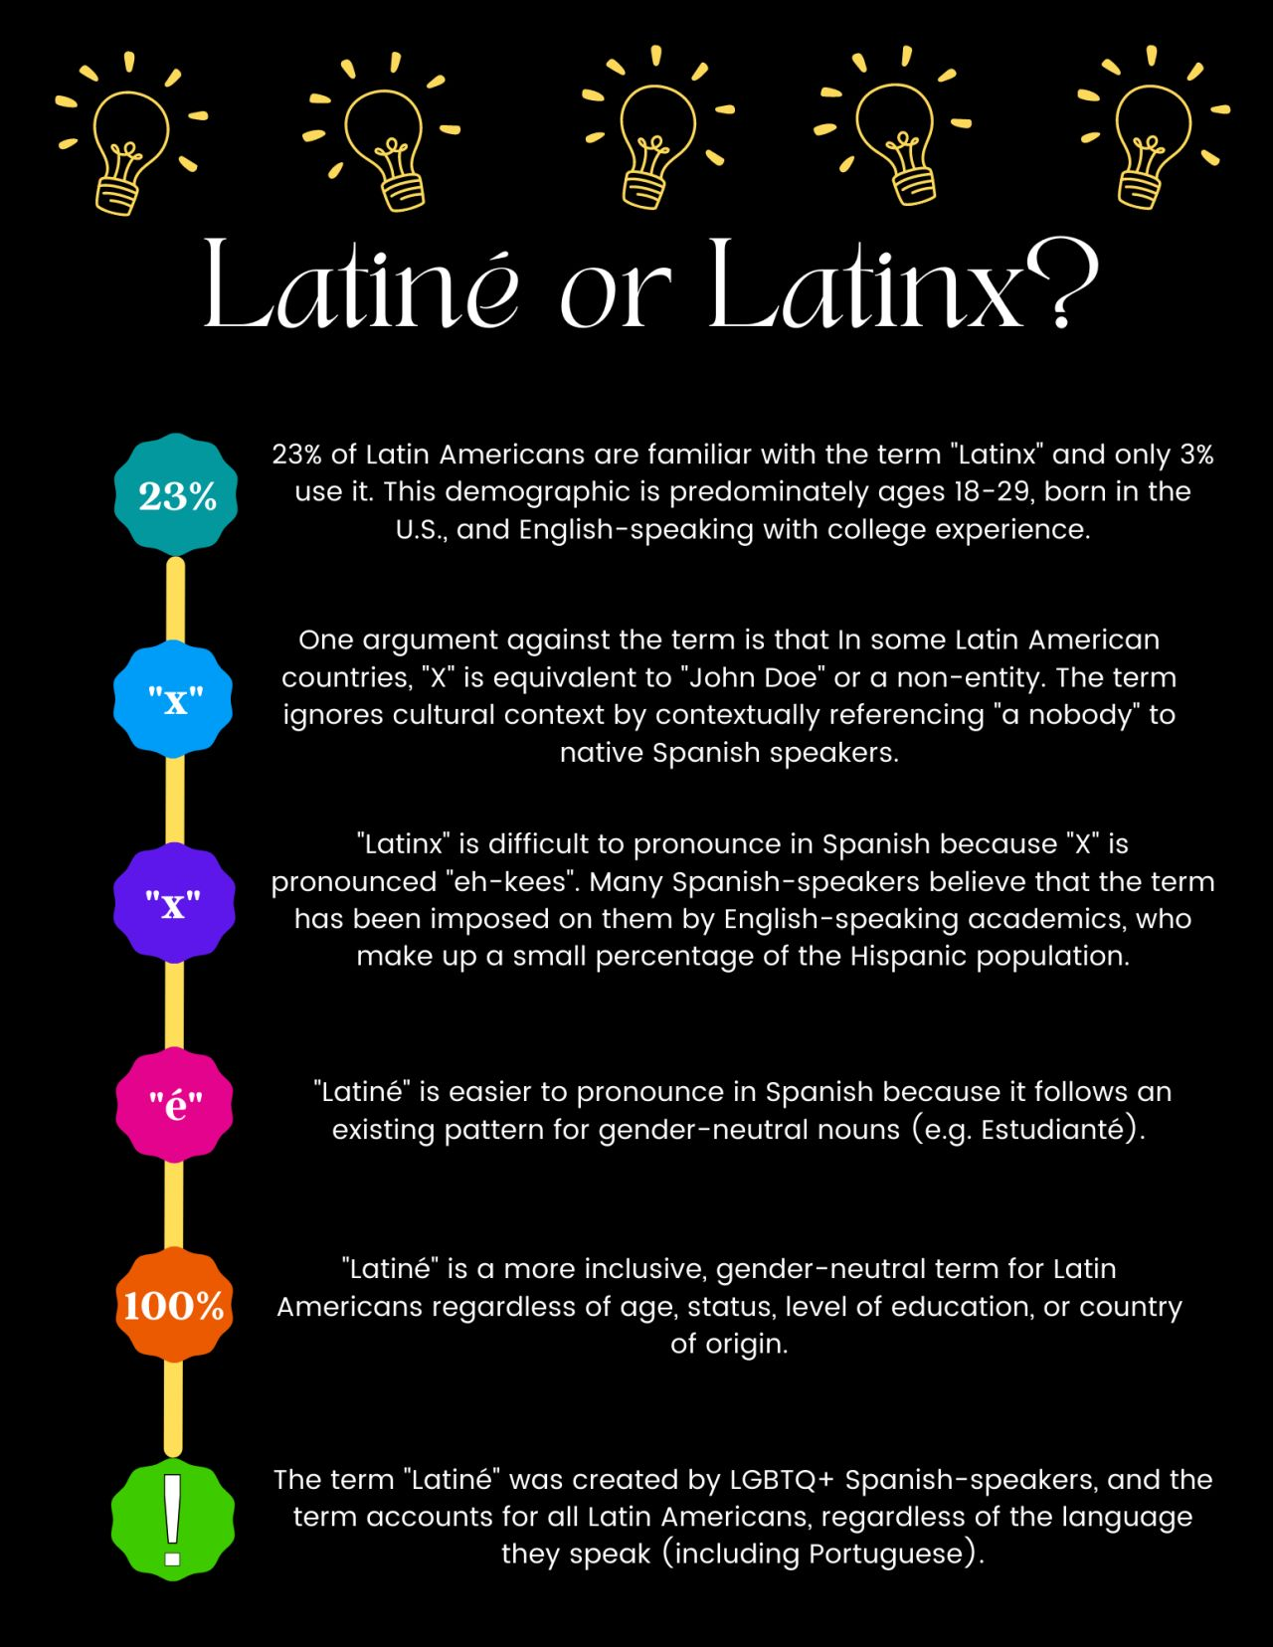
First: Terminology
Hispanic
Latino/a
Latinx / Latine / Latin@
Spanish
Spanish-Speaking
Hispanohablantes
Notes:
Spanish is a language, Latin America refers to a huge swath of land that extends beyond continents, not every person who lives in Latin American countries speaks Spanish nor do all Spanish speakers come from or live in Latin America.
The terms we use to declare ourselves some version of what you see on this slide varies immensely person to person and even context to context.
Let’s review what the terms you’ll usually hear associated with Spanish-speakers as cultural or ethnic identity markers.
[Read through slide]
Latinidad is inclusive of various races, religions, traditions, languages, geographical or national origin, political systems, ideologies, histories, types of music, cuisines… and borders, while fixed on maps, are not fixed in our experiences.
A best practice, then, is to be respectful regardless of what term you use. I bolded my preferred term – but that wasn’t always my own preferred term, nor will it likely always be my preferred term. But you will have your own and you may change your mind along the way.

Slide 5


Next:
Five Important Ideas
Capture important words or ideas (think of them as “tags”) as they come up in the presentation
*1 word or idea per 1 sticky note

Slide 6
Quick Facts

Slide 7
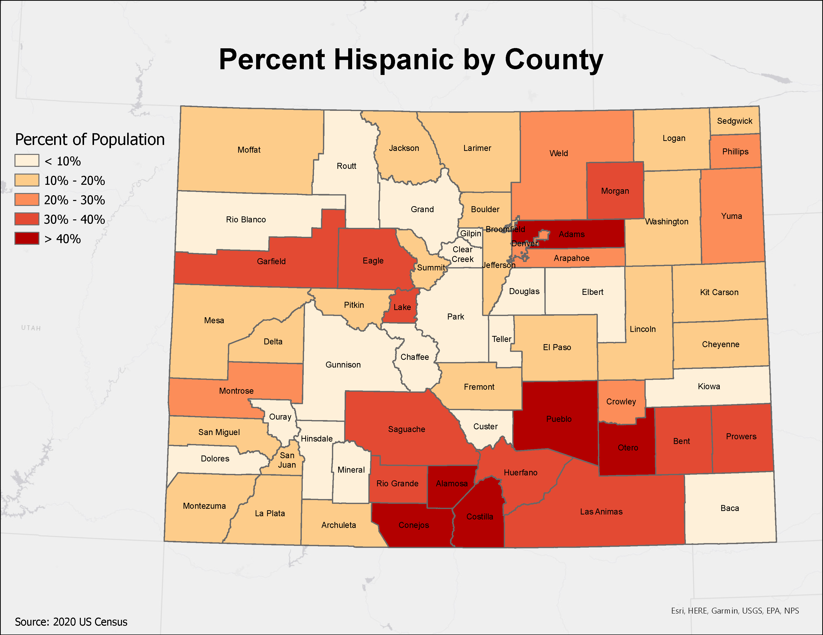
Colorado By the Numbers
22.5% Hispanic self-identified population (Census Quick Facts, 2022)
Languages Spoken at Home (American Community Survey 2022 5-year)
  11% Coloradans speak Spanish at home
  35% of Spanish at-home speakers self-assess English speaking “less than very well”
Top cultures/ ethnicities/ countries of origin (American Community Survey 2022 5-year):
  Mexico (912K)
  Spain (121K)
  Puerto Rico (41K)
  El Salvador (20K)
  Cuba (13K)

Slide 8
Pro-tips from your colegas y socios

Slide 9
DO: Start with a smile, end with a smile, laugh along the way
“Smile and acknowledge the customer.”
“Provide a bilingual welcome that extends beyond cursory acknowledgment, as not all institutions are welcoming to Spanish-speakers and immigrants.”
“Many immigrants have a lot of distrust for people in the United States because they have been treated unfairly in the past or simply because they don't speak English. So a smile goes a LONG way and word-of-mouth spreads quickly.”
“Never feel pressured to say or do something to greet someone in Spanish... Do not freak out or run for help—just smile, wave your hand, and leave it there.”

Slide 10
DO: Try English first, Speak simply (not loudly)
“Don't freak out! Don't go running looking for a Spanish speaker in the building, it is not a medical emergency. Do your best effort to communicate, use Google translate, use your hands, use your face, speak slowly, point at things. We appreciate so much when people try.”
“Try to be mindful of when they might need help from someone who is fully bilingual (if they are available), and when they might not.”
“Non-English speakers are not a problem to be solved. They're active users of the library who deserve to be addressed as a human being and not just glossed over and ignored until you find someone that speaks the language they prefer to communicate in.”

Slide 11
DO: Have [appropriate] multilingual signage
“I wish we had more bilingual signage. Our Spanish-speaking population is 20% and it would be really helpful for folks to be able to navigate the library when it's friendly to their language.”
“… if possible, make your building signs bilingual.”
“Google translate is an alternative, but it is never correct so it's understandable if when you try it people won't know sometimes what you are meaning. There's always a cultural aspect to translation and you have to think about inclusion in more ways than just putting Spanish and English on the signs or flyers.”

Slide 12
DON’T: Run to your bilingual colleagues first. “It’s not an emergency.”
“I wish they knew how challenging it is to be interrupted in a moment’s notice and what that can do to your productivity on a daily basis.”
“…the extra burden they place on those who are able to speak Spanish.”
“…How mentally taxing switching between two languages... “
“Please try everything you can before you call on your bilingual colleague…huge weight on my shoulders when I get called over and over again to interpret--I wonder how would these folks be served if I wasn't there.”
“It can feel very isolating to be the only person who can provide this service.”

Slide 13
DON’T: Correlate English language fluency with anything other than English language fluency
“Support non-English-speakers wherever they are linguistically and give them the freedom to be wherever they are in their language journey.”
“I would like them to know how intimidating it can be to try to communicate in another language. Having patience during these interactions can make the patrons feel that this is a space for them.”
“English language isn’t easy to learn, and that many people work long hours for little pay so sometimes it’s the last thing on their minds.”

Slide 14
DON’T: Use library jargon (ever, btw)
“In Latin America, libraries have a role closer to Academic libraries in the United States. So, most of the time, when we go to the library, it is related to studying rather than to programs. The efforts should be focused to let them know what kind of services/programs/events they can find in a library in the United States because we have a lot!!!”
“Promotion and outreach into any marginalized community isn't about just a few events, but of creating relationships within that community and that takes a lot of time and effort and one might not see returns until about after two years.”

Slide 15

Signs of Welcome
Add Spanish language to each desktop and laptop keyboard – toggle instructions on a sticker, table tent, postcard, etc.
Posters (and all directional or essential signage) in English and Spanish
Got jigsaw puzzles? Why not dominoes?
Not just coffee, but café
Don’t DIY – Find a partner: Promotores, immigration services, Spanish language radio station (hyperlocal, high yield)

Slide 16
Five Important Ideas

Slide 17
Your Five Important Ideas
Five Important Ideas
Start typing your five important ideas onto this slide.
Doesn’t matter where. We’ll move them!

Slide 18
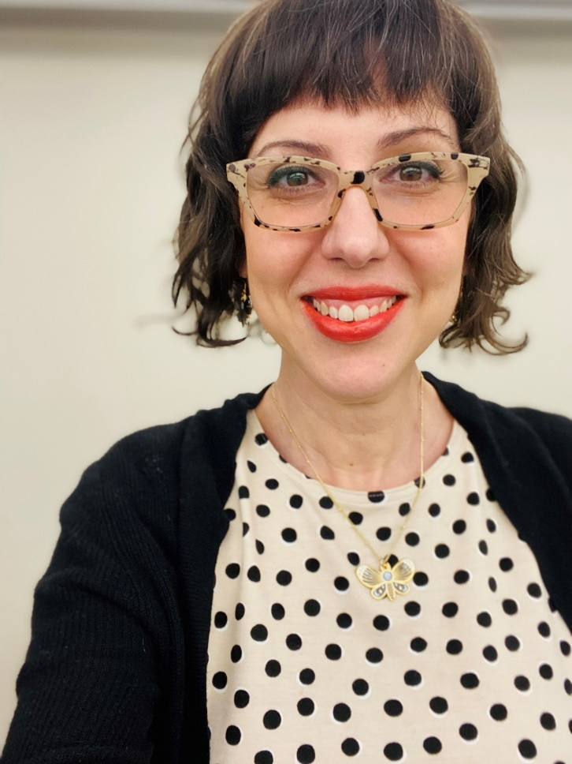
Contact
Coloradostatelibrary.org/spanishforlibraries
Cristy Moran (she/ella)
Adult Library Services Senior Consultant
Colorado State Library
Moran_c@cde.state.co.us
https://calendly.com/cristymoran/
Subscribe to Colorado State Library’s blog, Colorado Virtual Library, at coloradovirtuallibrary.org/email
Notes:
My name is Cristy Moran (she/ella) and I am the Adult Library Services Senior Consultant at the Colorado State Library. To reach me about language access, how your library can better serve hispanohablante communities, or just because YOU need a librarian, send me an email or set up an appointment with me. This slide lists my contact information. Find me at the Colorado State Library online or in person.
There are many more resources, references, and ideas that didn’t make it in here. Follow the posts on Colorado Virtual Library blog to get news as well as ideas from other Colorado libraries and short articles about this topic. And find Colorado State Library on LinkedIn or subscribe to the libnet listerv to keep the conversation going.

