Slide 1
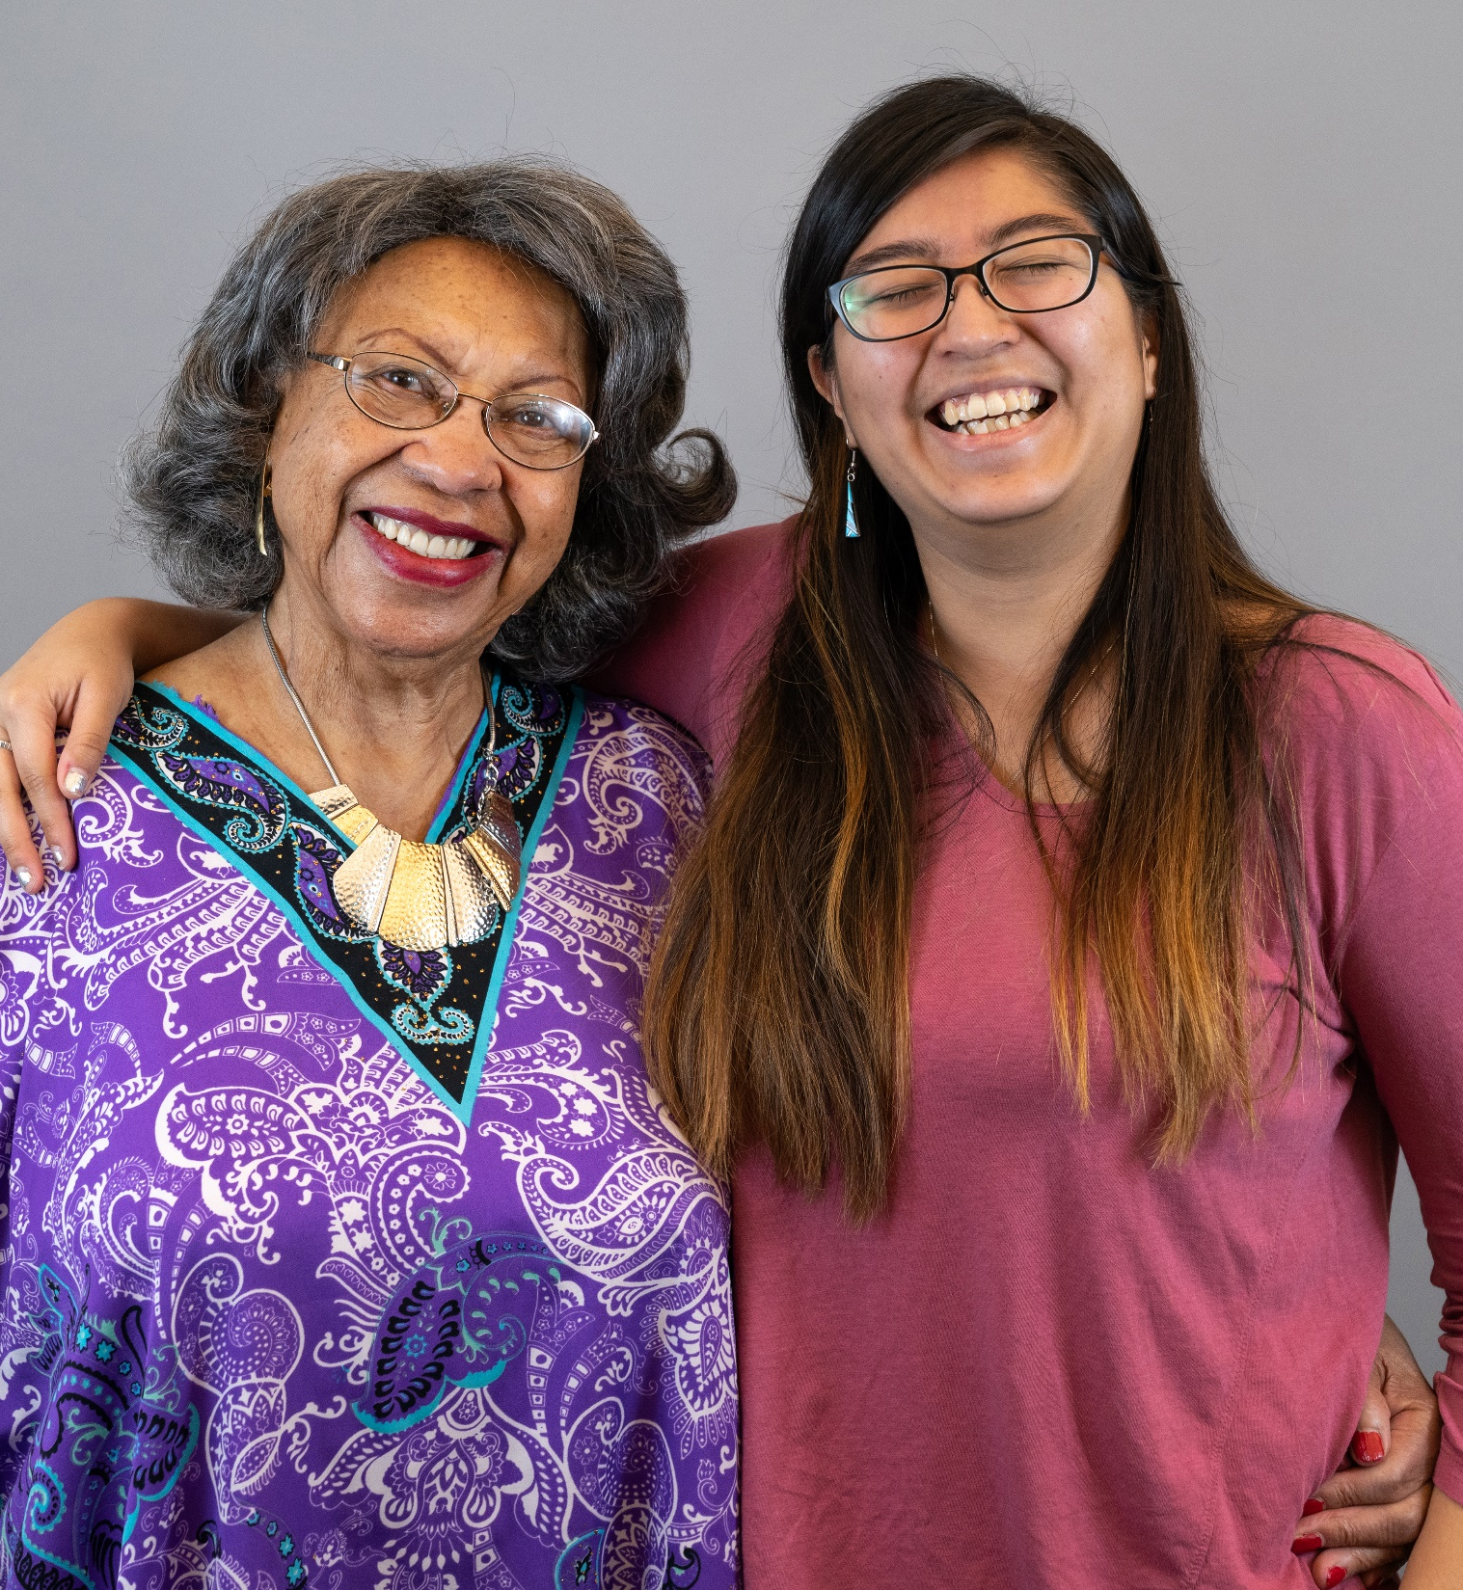
Dementia 101
For Public Library Staff

Slide 2
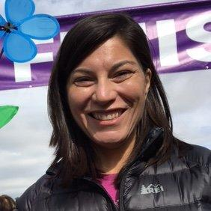
Hello!
I am Amy DelPo
Manager of
Older Adult Services
at Denver Public Library
adelpo@denverlibrary.org

Slide 3

Introductions
Please introduce yourself in the chat:
Where are you geographically?
What job do you do in the library?

Slide 4
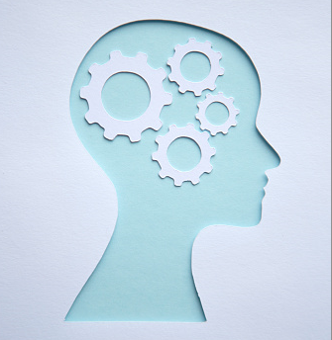
Intentions
For you to gain an understanding of dementia
For that understanding the lead to compassion and skill building
For your compassion and skills to lead to better service and experiences for our customers with dementia
For you to feel more comfortable and empowered

Slide 5
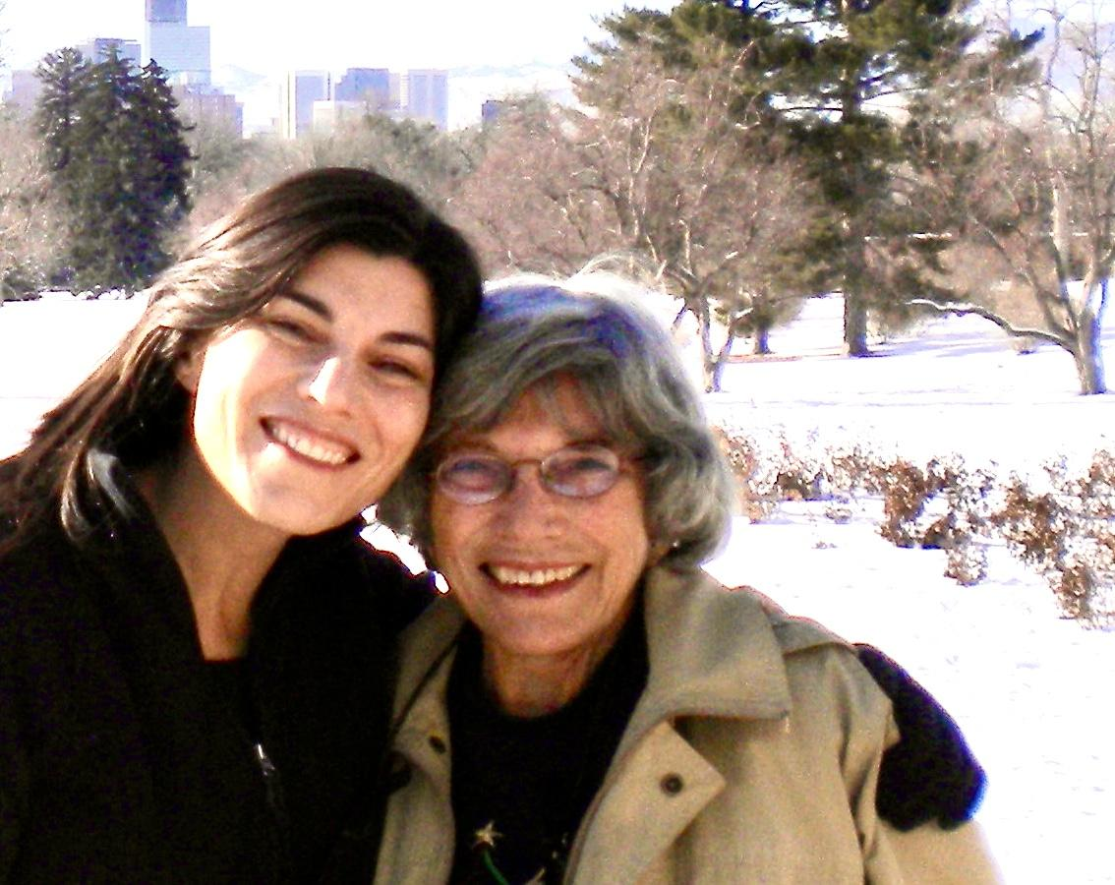
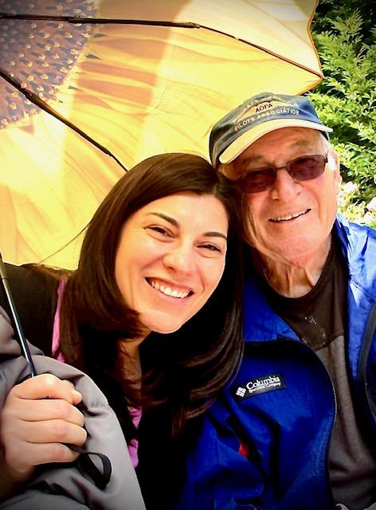
Why this is important to me

Slide 6
Poll 1

Slide 7
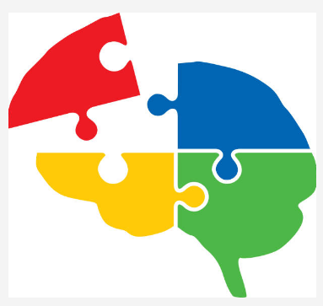
Understanding Dementia
Not a disease or a diagnosis
An umbrella term

Slide 8
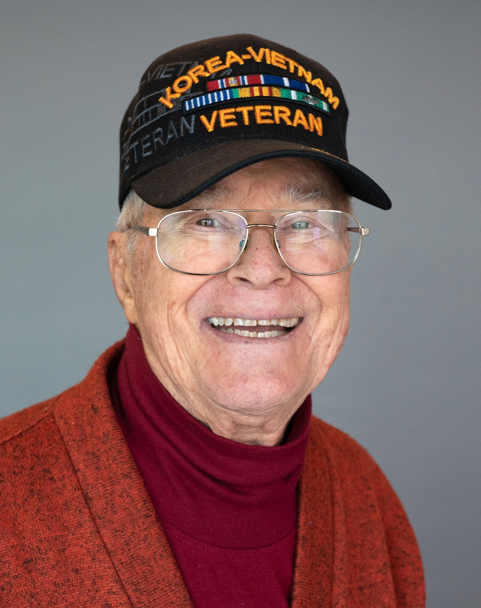
Dementia Definition
Refers to a cluster of symptoms that result from a problem in the brain:
Problem solving
Senses
Communication
Mood
Personality
Language
Memory
Behavior
Judgment
Day-to-day function is impacted
Notes:
We think of it as a memory problem, but it is really a total brain problem.

Slide 9
Causes of Dementia
Reversible
Depression
Infections
Medications/drug interactions
Hydrocephalus
Vitamin/mineral deficiencies
Hypo/hypergylcemia
Irreversible
Alzheimer’s (60 to 80 percent)
Vascular
Frontotemporal
Parkinson’s
Creutzfeldt-Jakob
Lewy Body
Huntington’s
Notes:
There are more than 100 conditions that can lead to dementia
The important thing to remember is that it is not the person’s fault.
The fact that there are some reversible causes mean that people should go to the doctor if they have any signs of dementia.
Poor vision, poor hearing, medication interactions can make someone think they have dementia – or can make them act like they do
For the irreversible causes….
This didn’t happen because they didn’t take care of themselves or eat right or exercise, no more than cancer is a person’s fault. Or Celiac Disease. Or allergies
Although we have ideas about ways to decrease your risk, we don’t not know to prevent it, and we don’t know how to cure it. And some of the cause is genetic.

Slide 10
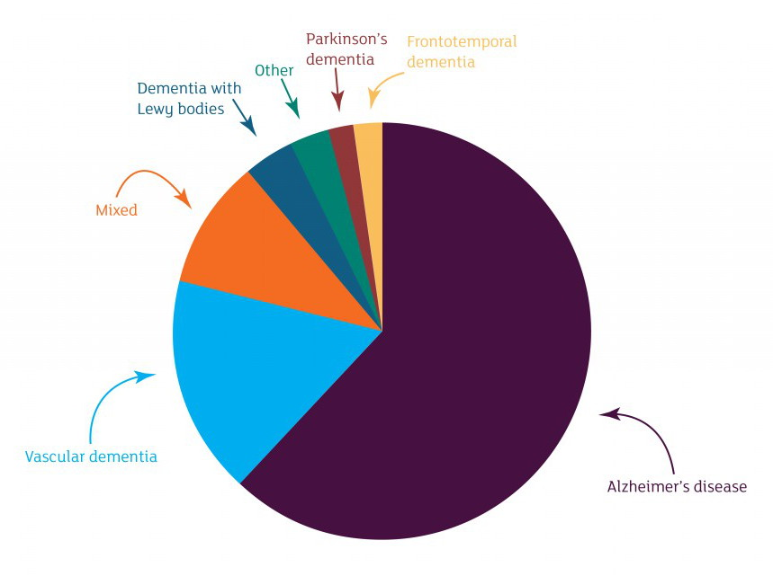
Types of Dementia
Notes:
As you can see, Alzheimer’s Disease is the giant gorilla of dementia. Estimates vary, but some say that Alzheimer’s is the cause of 80 percent of all cases of dementia.

Slide 11
Facts and Figures
Alzheimer’s Disease affects 1 in 9 people age 65 and older
Early onset can impact people in their 30s, 40s, and 50s
Brain changes from Alzheimer’s Disease can start 20 to 30 years before the symptoms become obvious
Individuals with mild symptoms often may continue to work, drive and participate in their favorite activities, with occasional help from family members and friends – and library staff!

Slide 12
Poll 2

Slide 13
The library can make a difference
People with dementia can have joy, meaning, connection, and community – with our help! We can provide them with:
Activities that are meaningful and bring purpose to their life.
Engagement with library staff, who know their name, who are kind and helpful, who treat them with respect.
Opportunities to connect with others living with dementia.
Opportunities to connect with others in the community.
Notes:
Understanding Alz/dementia – having the skills to provide services and programs to people with Alz/Dementia – can make a huge impact on people’s lives. That’s why this training and ones like it are so worthwhile and important for library staff. The need is great, and the impact we make can be profound

Slide 14
What is Alzheimer’s Disease?
Notes:
While you watch this, I want you to think of one take way from it that will help you in your work and in your life when engaging with people with dementia or Alzheimer’s
Think about information that surprises you.
Information that you think is important to underscore
Information that has particular relevance to the library

Slide 15
Let’s Chat!
Please put in the chat something you heard in that video that surprised you.

Slide 16
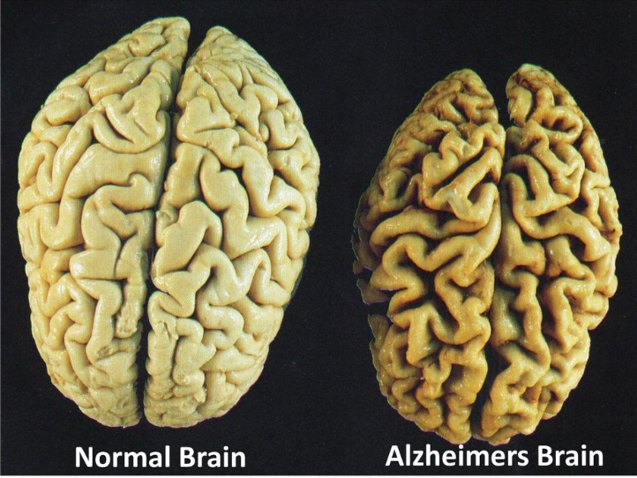
Alzheimer's Brain
Notes:
What do you notice?

Slide 17
Effects of Dementia: In the beginning
Forgetting recent events or information
Repeating comments or questions
Misplacing commonly used items or placing them in unusual spots
Not knowing the date or time
Having difficulty finding the right words
Change in mood, behavior, or interests
Confabulation
Notes:
Raise your hand if you have seen any of these things happen with your patrons

Slide 18
Effects of Dementia: Then it gets worse
Inability to do common tasks like working a TV remote or cooking
Inability to problem solve
Sleeping patterns change
Anxiety, frustration, confusion, agitation, paranoia, sadness, depression
Inability to do activities of daily living – eating, grooming, toileting, bathing
Hallucinations

Slide 19
Effects of Dementia
It is both a chemical change in the brain and a structural change in the brain
So sometimes people with dementia can … and sometimes they can’t

Slide 20
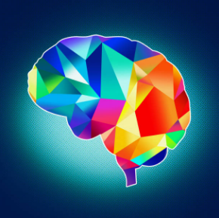
Brain Health Inequity
Intersectionality matters

Slide 21

Brain Health Inequity:
Gender
Two thirds of all people who develop Alzheimer’s are women
Women also make up two thirds of the 17 million unpaid family caregivers for people with dementia
Trans men and women face a particularly complicated landscape

Slide 22
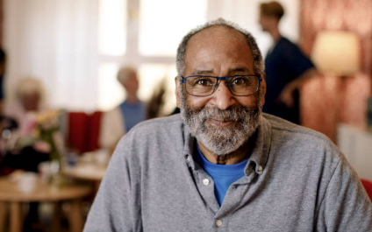
Brain Health Inequity:
Race
Black Americans are TWICE as likely as non-Hispanic whites to develop Alzheimer’s Disease
Half of African Americans say that they have experienced discrimination while seeking care for a person living with Alzheimer's

Slide 23
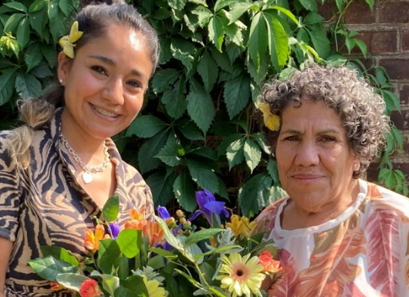
Brain Health Inequity:
Latinos
Latinos are 1.5 times more likely than whites to develop Alzheimer’s.
Symptoms appear almost seven years earlier than in the white population
Latinos are projected to have the steepest increase in Alzheimer’s/dementia in the next 40 years compared to other groups

Slide 24
Brain Health Inequity:
Race and Ethnicity
Structural and systemic factors including unequal access to health care, the health effects of racism, and differences in quality of care, as well as discrepancies in the prevalence of dementia risk factors (such as cardiovascular disease) play important roles in these differences.

Slide 25
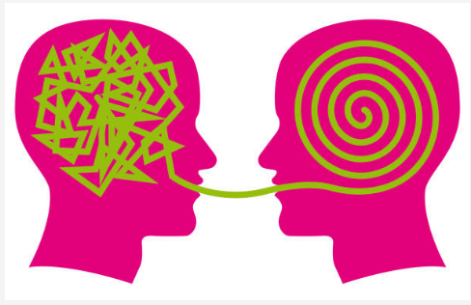
Communication

Slide 26
How does dementia affect communication?
Asking the same question numerous times.
Saying inappropriate things.
Using the same word or phrase without meaning, almost like a vocal tic.
Having difficulty finding the right words.
Getting angry or frustrated.
Describing familiar objects rather than calling them by name.
Easily losing a train of thought.
Having difficulty organizing words logically.
Relying on gestures more than speaking.

Slide 27
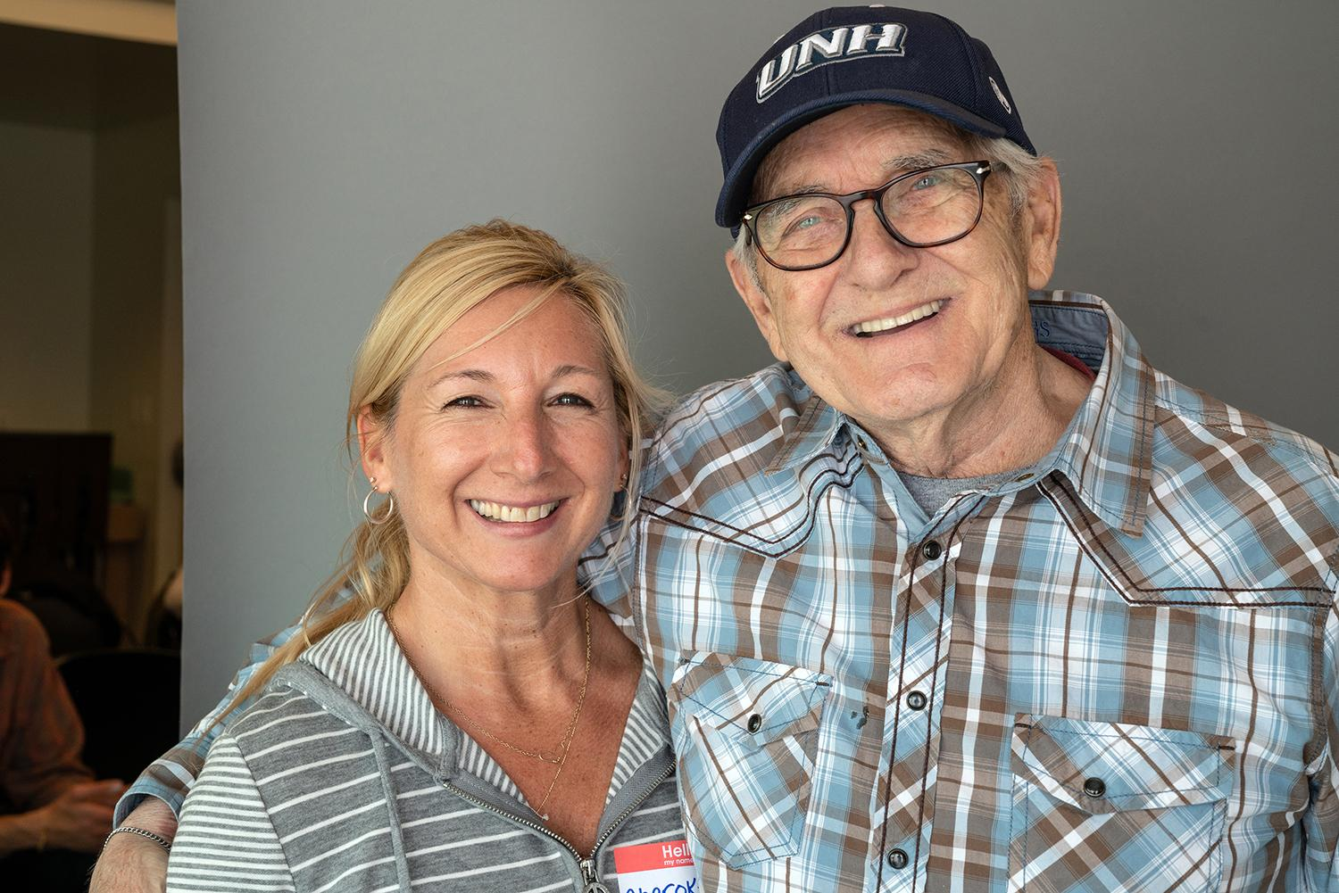
Communication Strategies: One: Attitude matters
Be kind. Be warm. Be patient. Smile!
Be compassionate. They might feel embarrassment or shame.
Don’t talk down or use baby talk.
Don’t ignore the person with memory loss and speak only to the caregiver
Make eye contact.
Speak slowly; don’t cover your mouth.
Don’t take things personally.
You are the one with the healthy brain!
Notes:
They might not understand your words, but they will get a sense of your attitude. Keep your voice calm and your manner kind. Be aware of non verbal cues you are giving.

Slide 28
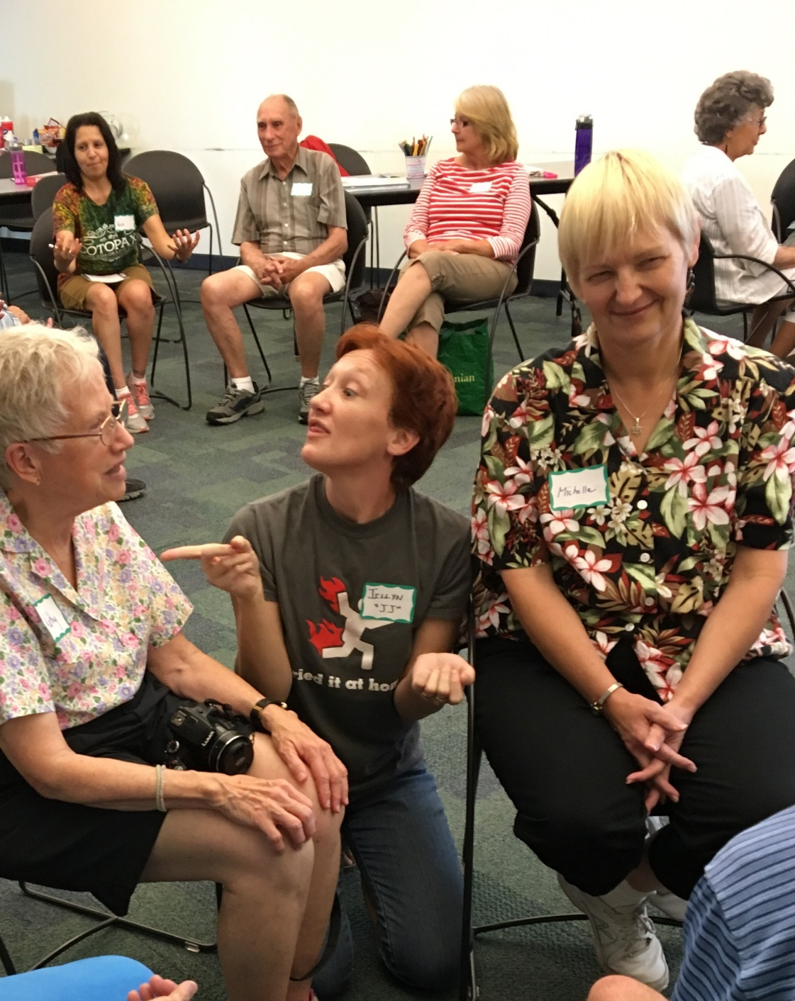
Communication Strategies: Two: Use Improv
Step into their world
Don’t tell them they are wrong
Don’t correct
Don’t say no
Say: Yes, and….
Listen, respond

Slide 29
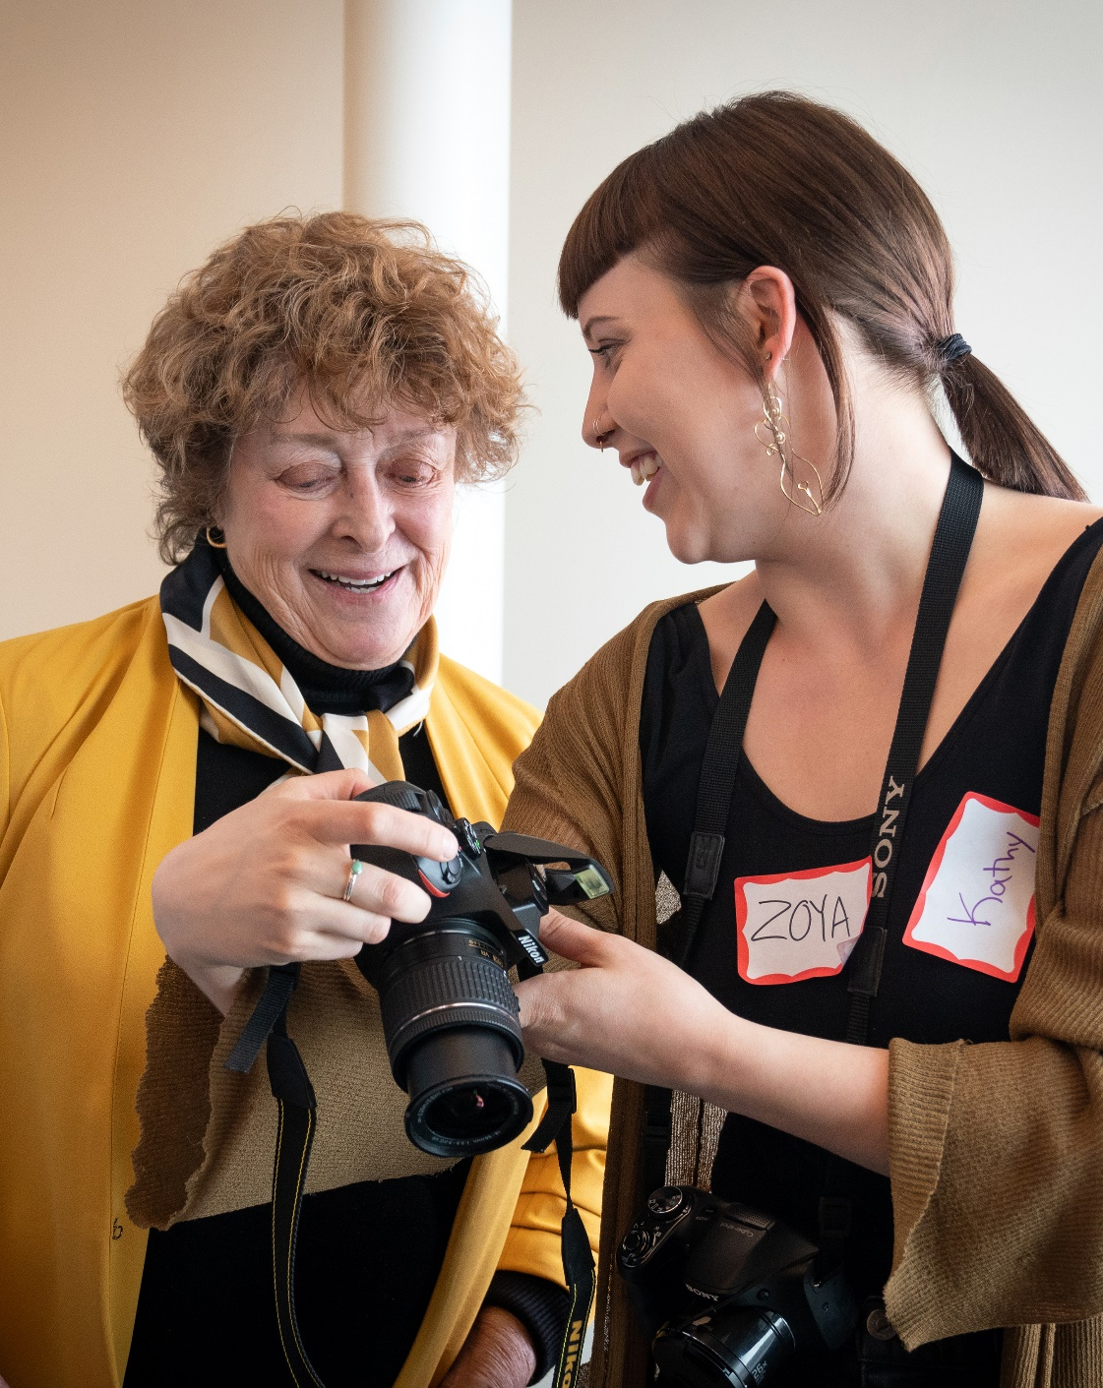
Communication Strategies Three: Understand the impact of the disease
Give the person time to finish a thought or find a word. BE PATIENT.
Don’t guess or help unless asked.
Look for emotions behind the words
Give visual cues
Encourage non-verbal communication
Don’t say “remember?”

Slide 30
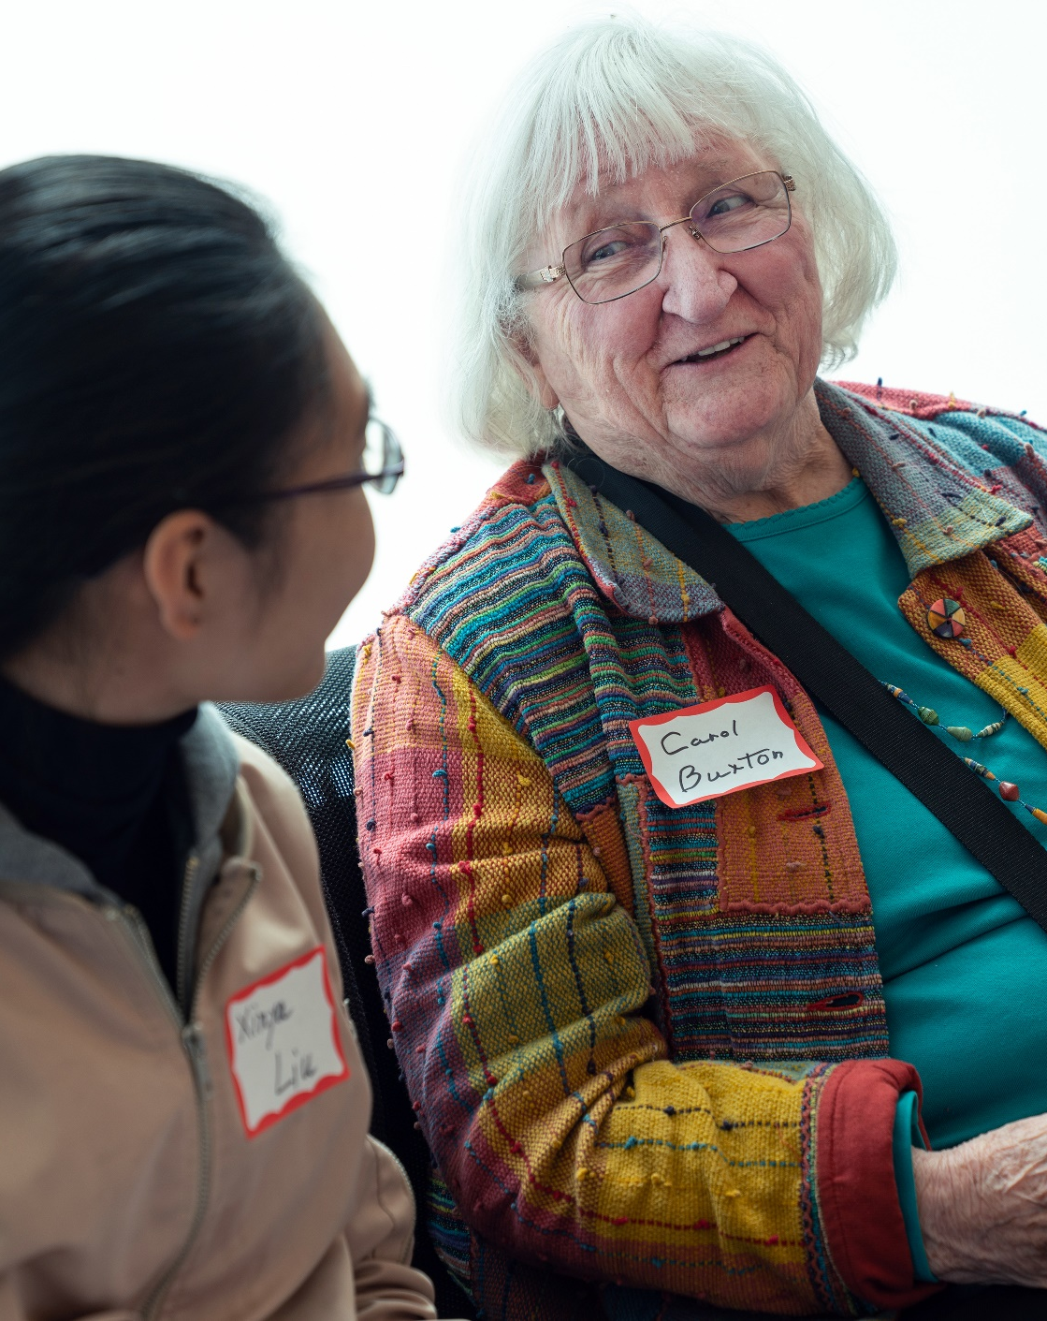
Communication Strategies: Four: Keep it simple
One concept at a time
Limit your words
Use concrete language
Don’t ask lots of questions

Slide 31
Your best friends are:
Warmth and kindness
Patience
Sense of humor

Slide 32
Be compassionate:
They are doing the best they can with the brain that they have!

Slide 33
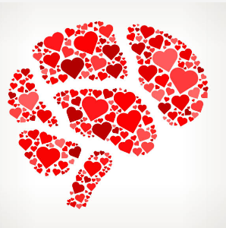
Strengths and Desires
Personhood
Notes:
Let’s talk about ageism and ableism

Slide 34
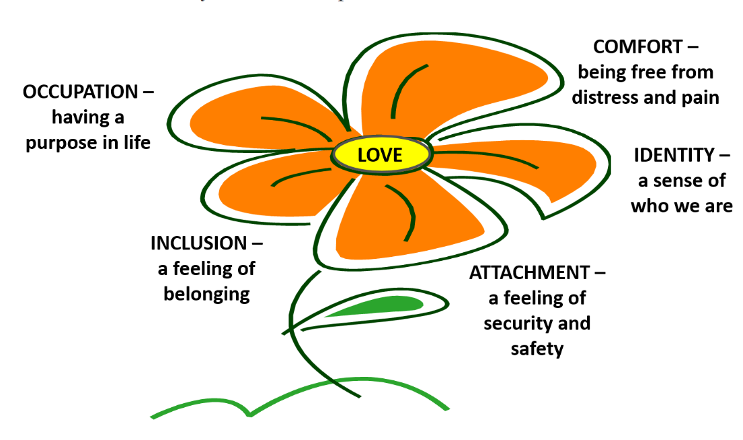
Living With Dementia:
Psychological Needs

Slide 35
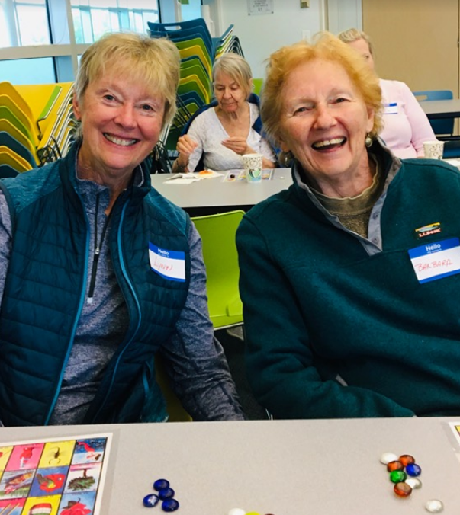
People with Dementia
People with dementia want to:
Feel safe
Feel valued
Feel loved
Have access to local places where people know them (like the library!)
Keep their social connections so they still feel like they belong to the community
Their loved ones want this, too!

Slide 36
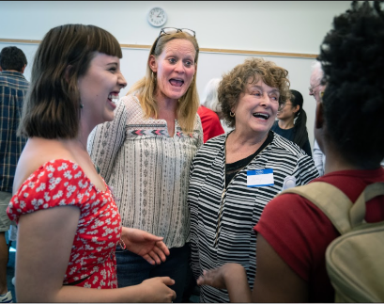
Living With Dementia:
Strengths
Long-term memory
Procedural memory
How to do things
Living in the present moment
Use of non verbal skills to communicate

Slide 37

Programs

Slide 38
Let’s Chat!
If you do programming especially for people with dementia/Alzheimer’s, please put that in the chat.

Slide 39

DPL Programs
Memory Cafe
Memories in the Making
Memory Singers
Photography and Memory

Slide 40

Dementia and Technology

Slide 41
Issues:
Sometimes, trouble with tech is the canary in the coal mine – people will start having trouble with their tech before other signs occur
Sometimes, it isn’t dementia at all
Vision or hearing problems
Internalized ageism

Slide 42
Strategies:
Calm quiet space
Notebook
Checklists:
Large pictograms
Large print
Lots of white space
Caregiver/friend/family support
Creativity
Notes:
Individuals with dementia CAN relearn old skills and learn new skills
Pick your battles: Do they really need to know this?

Slide 43
Teaching Techniques:
No guessing | Immediately offer the correct response or give it as soon as you see hesitancy
Steps | Master the task one step at a time
Modeling | Demonstrate each step before asking the customer to do it
Verbal instruction | Verbally explain each step instead of just showing
Visual instruction | Use visual cues – a checklist with pictograms

Slide 44

Q and A

