Slide 1
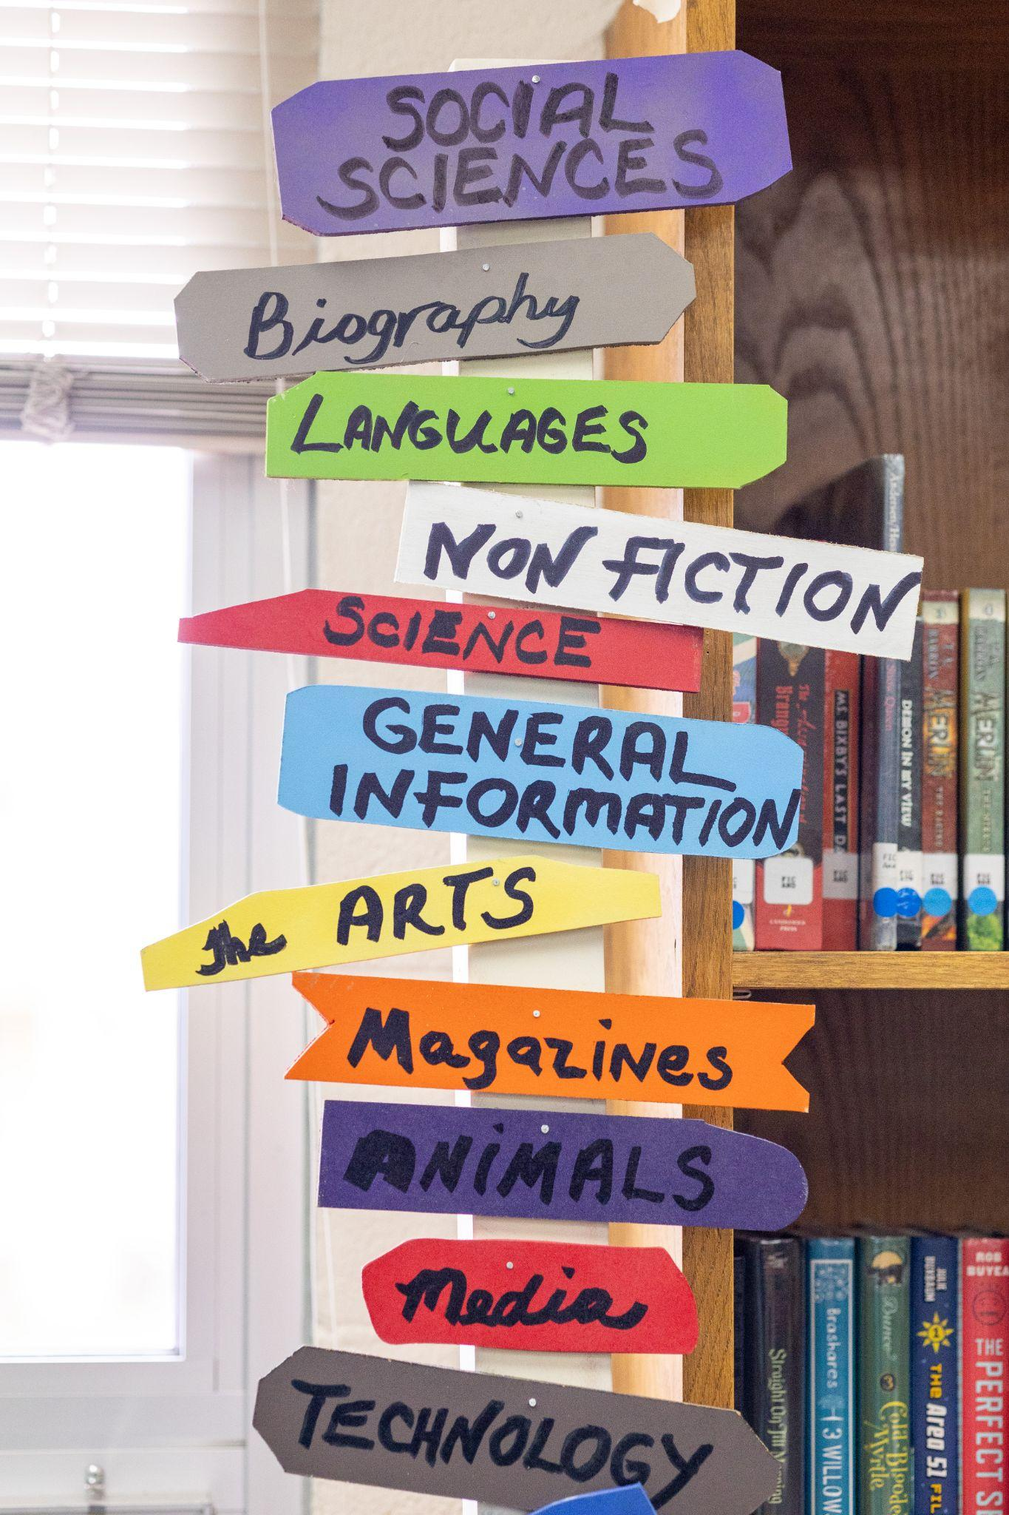
Everyday Library Evaluation
Part 2: Data Collection

Slide 2
Today’s Chat
Group norms/who are you?
Evaluation/Data lifecycle
Data collection methods
Outcomes/Outputs
When things get iffy
Real world examples/workshop!

Slide 3
Data/Evaluation Lifecycle
Step 5
Tell people, repeat and destroy!
Step 1
Defining question/problem/outcome
Library Evaluation Lifecycle
Step 4
Analysis/Synthesis/Data use
Step 2
Collection tool creation
Step 3
Collection & Storage

Slide 4

Data Collection Methods
Found data
Surveys
Interviews
Focus groups
Observation

Slide 5
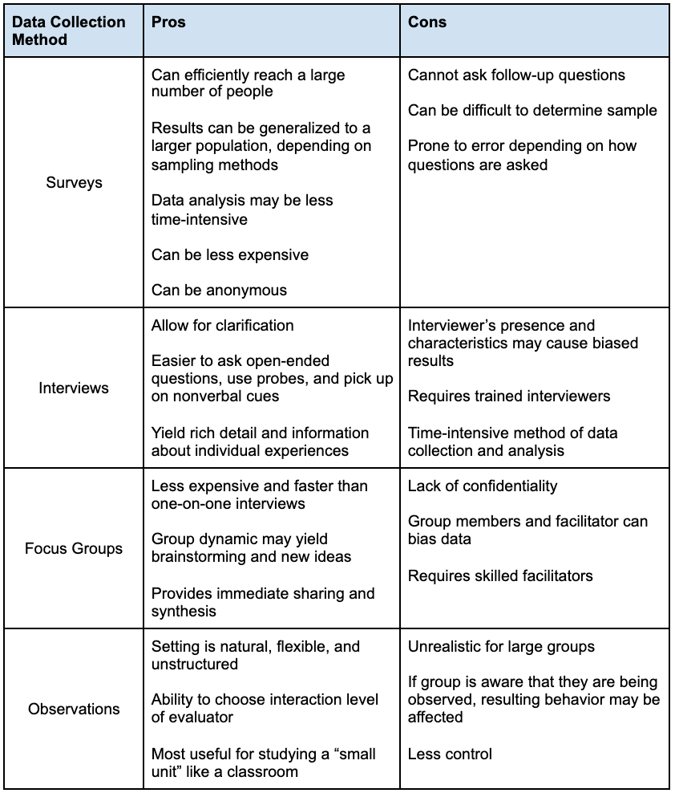
Data Collection Methods Chart
Notes:
https://www.lrs.org/2022/06/15/reading-and-recording-the-room-focus-groups/

Slide 6
Data Collection Considerations
3 Questions to ask when choosing a method
What’s essential? What will you be asking? What are your constraints?
Accessibility
Software
Cost/time
Privacy & Ethics
Accurate representation of a community (nothing about us without us)

Slide 7
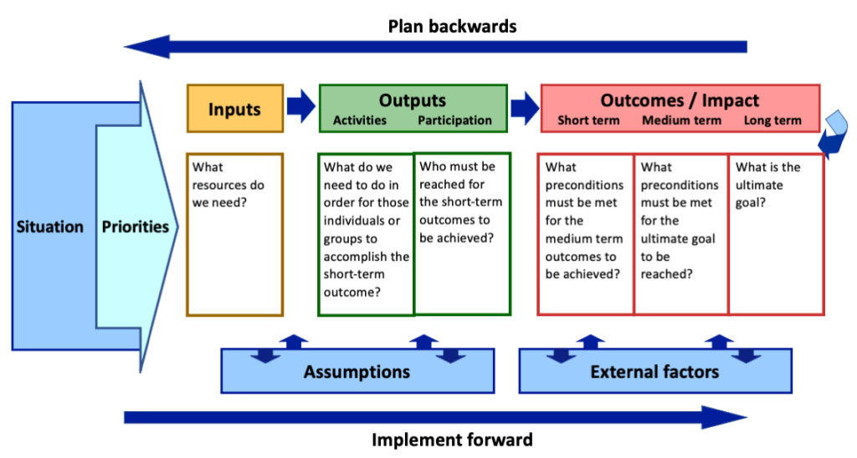
Usefulness of Evaluation
WHY?!
Imagine from University of Wisconsin, “Creating a Logic Model for a NEW PROGRAM“

Slide 8
When things get iffy….
Is the longitudinal data the valuable part or do you need to change your forms to fit your data needs?
Imperfect data: don’t let perfection get in the way of the good
Navigating things that you’re forced to collect

Slide 9
Example: Circulating Resource Kits at CSL
Purpose:
Allowing libraries with limited resources to achieve success in meeting the expectations and needs of their communities through the sharing of materials. Providing access to a broad range of book club sets and circulating resource kits of informational and educational materials. Materials are specifically aimed at helping library staff when working with underserved populations. These populations could include, but are not limited to: LGBTQ+, those experiencing homelessness, elderly patrons and those experiencing memory loss, patrons with disabilities, new parents/caregivers, incarcerated/newly released individuals, and more.
Outcomes:
Libraries with limited budgets will be able to expand programs and materials to better meet the needs of their patrons.
Patrons will have access to more adult and youth programming, including early literacy, STEAM and transitions skills, digitization tools, book club sets, and more.
Library staff will be more knowledgeable when addressing and working with the specific needs of underserved populations in their communities.
Library staff will have an increased awareness of resources and services available to support the activities and needs of Colorado’s rural communities.

Slide 10
Example: Continued
Outcome: Libraries with limited budgets will be able to expand programs and materials to better meet the needs of their patrons.
What are the outputs? (What do we need to do in order for libraries to achieve the outcome? I.e. activities. Who do we need to reach? I.e. participation)
What questions can we ask to know if we’ve achieved this outcome?
What data collection methods can we use to answer those questions?

Slide 11
Example: Circulating Resource Kits at CSL - Forms
Data Collected:
New Feedback Form
Old Feedback Form
Found Data (stats!)

Slide 12
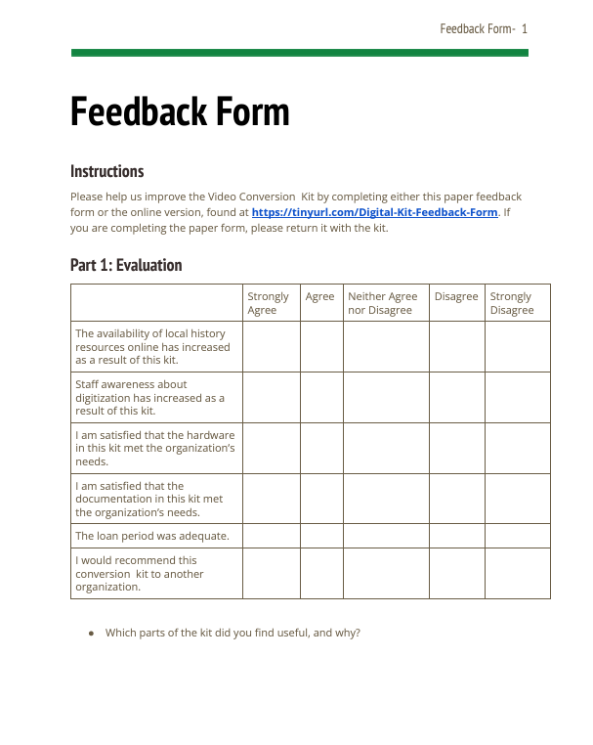
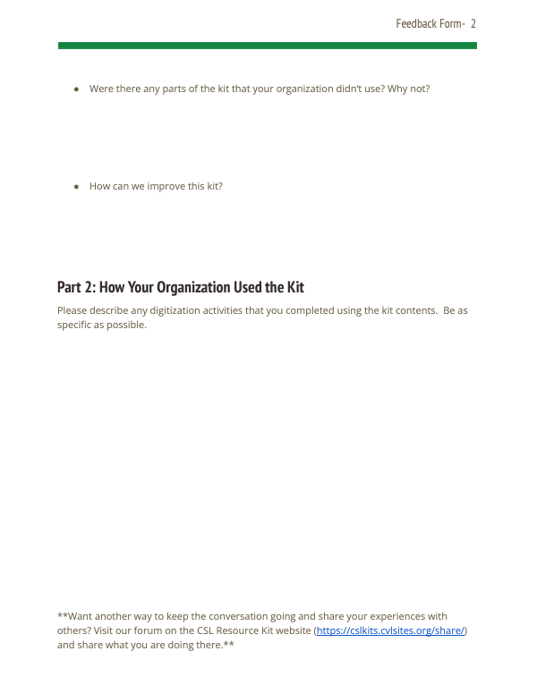
Old Feedback Form

Slide 13
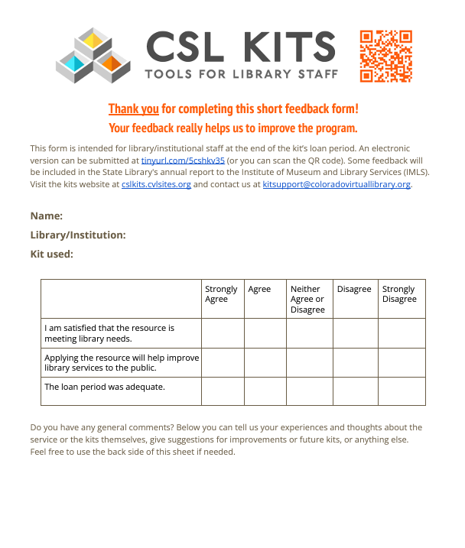
New Feedback Form

Slide 14
Your Turn!
Tell us….
Project description
1 Outcome
Outputs (activities, participation) that will lead to that outcome
Questions to ask that will let you know if you achieved the outcome/outputs
What data will you collect to answer those questions?

Slide 15
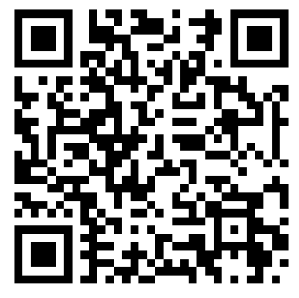
Thank you!
Please take our survey!
Presenters: Amy Bahlenhorst & Mike Peever
Presentation Name: Everyday Library Evaluation: Data Collection
https://costatelibrary.libwizard.com/f/program_evaluation
Contact us:
LRS@lrs.org
Mike: peever_m@cde.state.co.us
Amy: bahlenhorst_a@cde.state.co.us

