Slide 1

Helping Homeschoolers in the Public Library
Notes:
Gail: Welcome. Our goal is for you to come away with ideas you can use in your library.
Poll:
1. Do you currently do homeschool programming? (graph to show percentages?)

Slide 2
What is Homeschooling?
Homeschooling is:
a nonpublic home-based educational program
provided by the child’s parent or an adult relative designated by the parent
not under the supervision and control of a school district
not considered a private or nonprofit school
(Colorado Department of Education)
Notes:
Jessica: We’ve discovered that Homeschooling can be many things. Colorado’s Department of Education sets up specific guidelines on what Homeschooling is, with the biggest point being that it is schooling not under the supervision and control of a school district. However, we’ve found that Homeschooling looks different family to family and sometimes even kid to kid within a family who Homeschools.

Slide 3

Colorado Homeschool Law
Families must file a notice of intent to homeschool from ages 7 to 16.
Children will be tested or evaluated in 3rd, 5th, 7th, 9th, and 11th grades.
Notes:
Jessica: Colorado law defines Homeschooling further, setting up age-ranges and testing parameters.

Slide 4
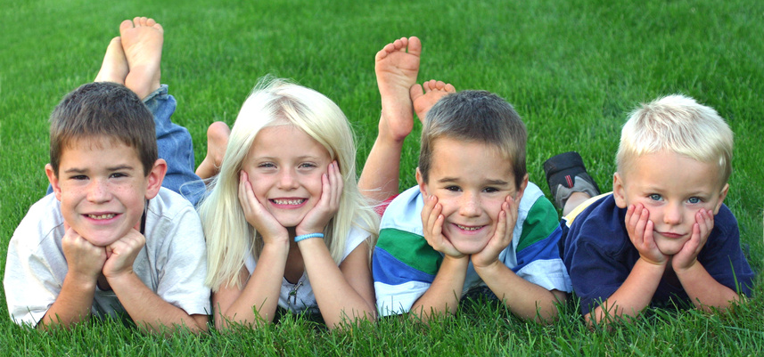
Who Homeschools?
Families who teach their children full-time
Families whose children attend some classes at a public, charter or private school
Families who choose online education
Notes:
Jessica: When we talk to families, we find that in addition to families who teach their children full-time, families who attend homeschool enrichment programs also consider themselves homeschooled, as do some families who choose online education although online education is considered public school.

Slide 5
Why?
Notes:
Jessica: We see supporting homeschool parents in their quest to educate their children as part of our job. But why do we need to single out this one group of patrons?

Slide 6
1.77 million
kids and teens homeschooled in the U. S. (National Center for Education Statistics, 2012)
Notes:
Jessica: 1.77 million homeschoolers in the U.S. in 2012...that’s a 15.4% increase since 2007. That is the most recent statistic for the nation and we believe that that number has only increased in the last couple years.

Slide 7
16,100
kids and teens homeschooled in Colorado (Colorado Department of Education, 2015-2016 school year)
Notes:
Jessica: This is a combined stat: the number of homeschoolers involved in enrichment programs PLUS those not participating in any school district sponsored programs.

Slide 8
2,500
homeschooled kids and teens participated in PPLD’s 2015 Summer Reading Program
Notes:
Jessica: And this number is just the Homeschoolers in El Paso County who participated in our Summer Reading Program.
Question—Does your library keep stats for homeschoolers participating your Summer Reading Program?
If they keep track of the schools kids go to, they can keep track of homeschoolers too

Slide 9
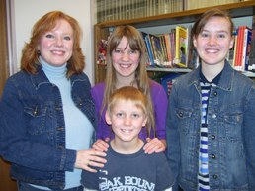
Homeschooling families are often an overlooked part of the community. As a specialized population, homeschoolers may be hard to identify and connect with.
Notes:
Jessica: The biggest reason, however, was simply our families. We have such amazing homeschool families who utilize the library often and we wanted to be able to do more for them. I’m going to hand you over to Gail now and she’s going to talk a bit about how our district has supported these families.

Slide 10
How?
Notes:
Gail: Before we get into the “How”……
Poll (multiple choice)— Tell us about yourself: “I was homeschooled as a child.” “I homeschooled my child(ren).” “I just enjoy working with this community.” “None of the above, but it’s part of my job description.” ☺

Slide 11
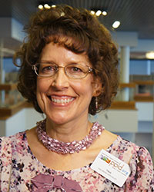
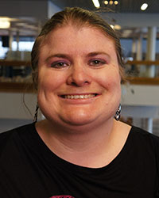
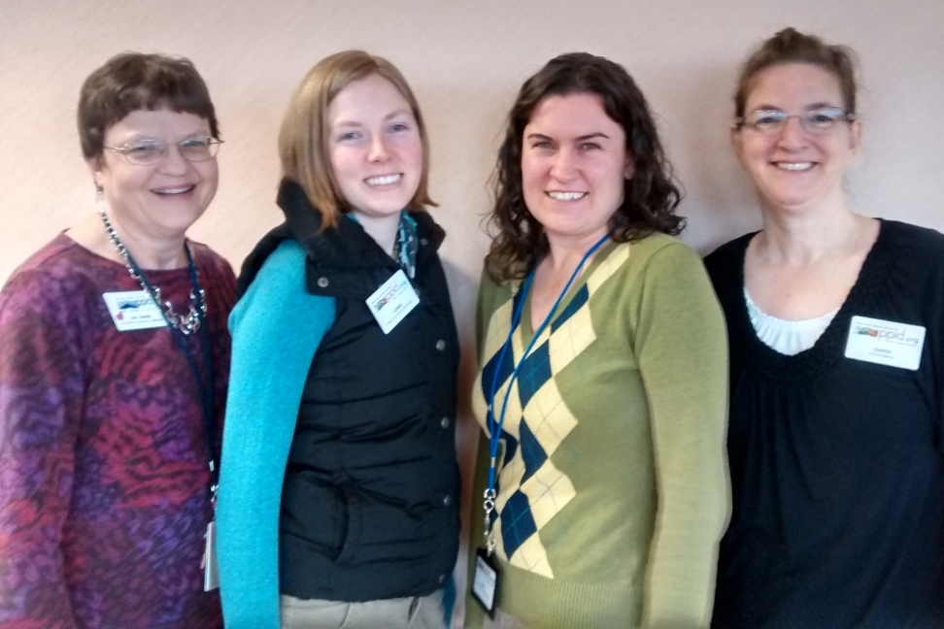
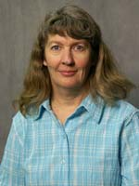
Homeschool Committee
Homeschooled 6 children for 23 years
Was Homeschooled for grades K-12
Homeschooled 1 child for 13 years
Have a passion for working with Homeschoolers
Notes:
Gail: Our Homeschool Committee is made of staff members. Currently we have Tina (describe), Melody (describe), Christa (describe), and then the rest of us (describe). We meet monthly to plan the larger programs, and our publications.
Question: Who else could you invite to be part of a homeschool committee or planning group?

Slide 12
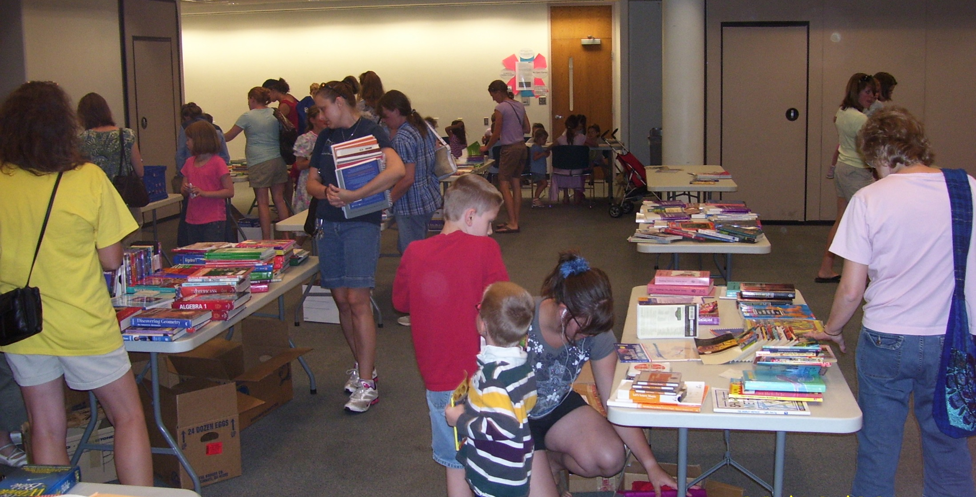
Used Curriculum Swap
FREE!
No money exchanged
All give-away
Schedule late June
(after sales are over)
Notes:
We provide programs that support the homeschooling parents—
Gail: Totally free, our families LOVE the Curriculum Swap. Those who bring items are able to find new homes for almost everything. Those who come to browse often find exactly what they are looking for! That always amazes me. ☺

Slide 13
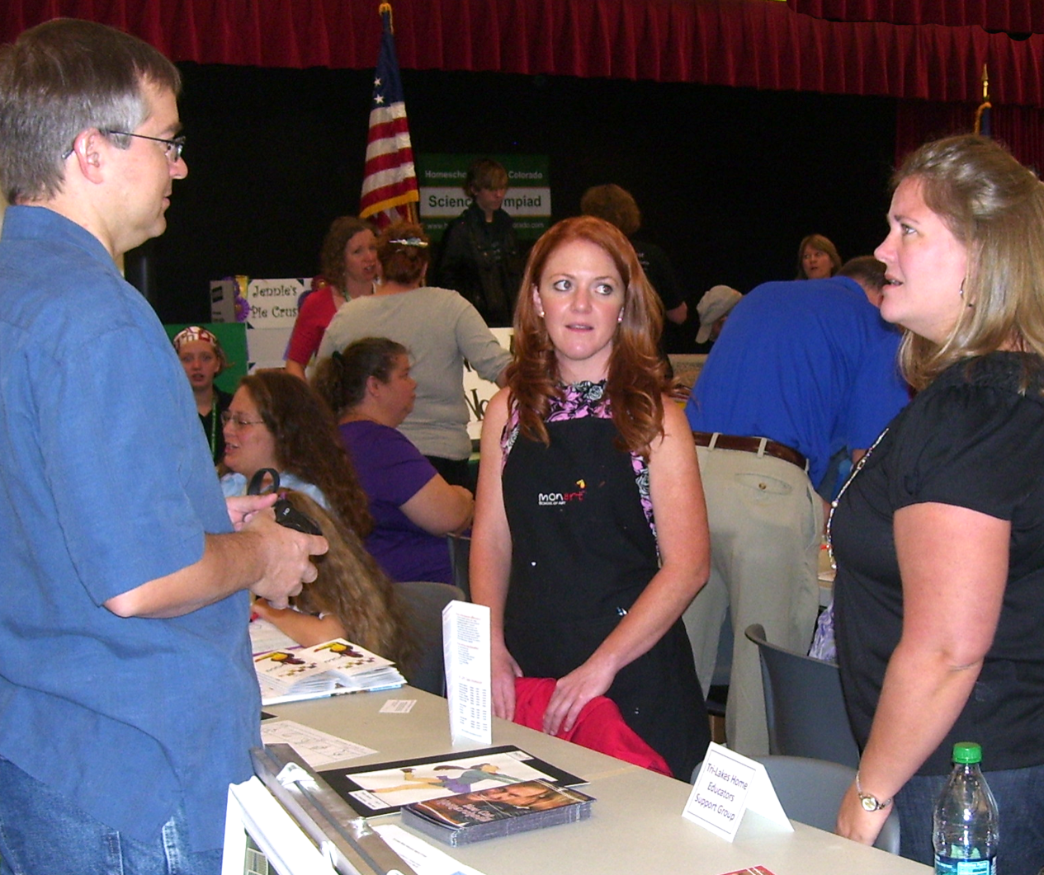
Resource Fair
Enrichment programs
Community resources
Support groups
Notes:
Last year, 45 vendors participated—over 650 attended! We have support groups, enrichment programs, sports, music lessons, organizations with volunteer opportunities. I often get calls & e-mails asking to be included!

Slide 14
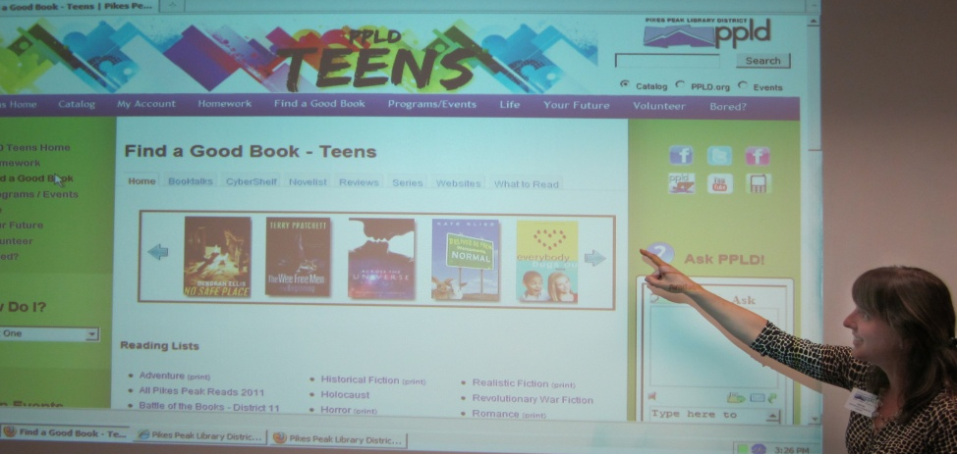
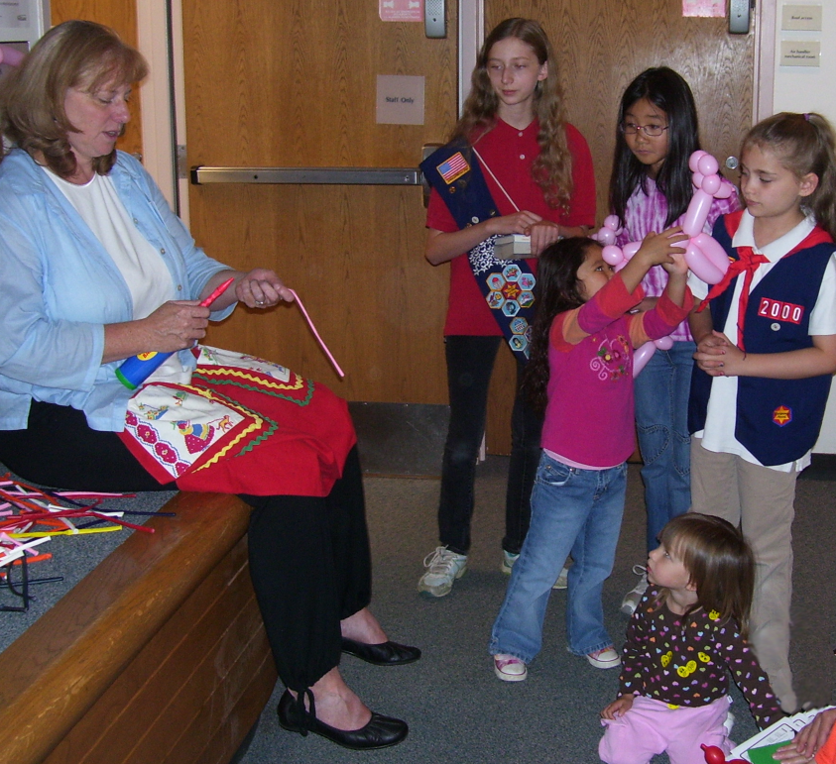
Homeschool Tools
Library resources
Building tours
Children’s activities
Notes:
Gail: The first program we ever offered, more than 10 years ago. It has morphed over the years, but it’s our chance to show off PPLD’s online resources to the homeschooling parents. Since homeschool families usually come to programs as a group, we offer children’s activities too.

Slide 15
Special Presentations
Waldorf
DVD/Video Based
Enki
Enrichment Programs
Unschooling
Classical
Montessori
Eclectic
Online
Charlotte Mason
Thomas Jefferson
School at Home
All-in-One
Unit Studies
Multiple Intelligences
  “Homeschooling Methods: Understanding Your Options”
  “Homeschooling Your Special Needs Child: You Can Do It!”
  “Homeschooling 101”
Notes:
Gail: We’ve had several special presentations that were filmed and later added to the collection. Homeschooling 101, Homeschooling Methods, Homeschooling Your Special Needs Child.

Slide 16
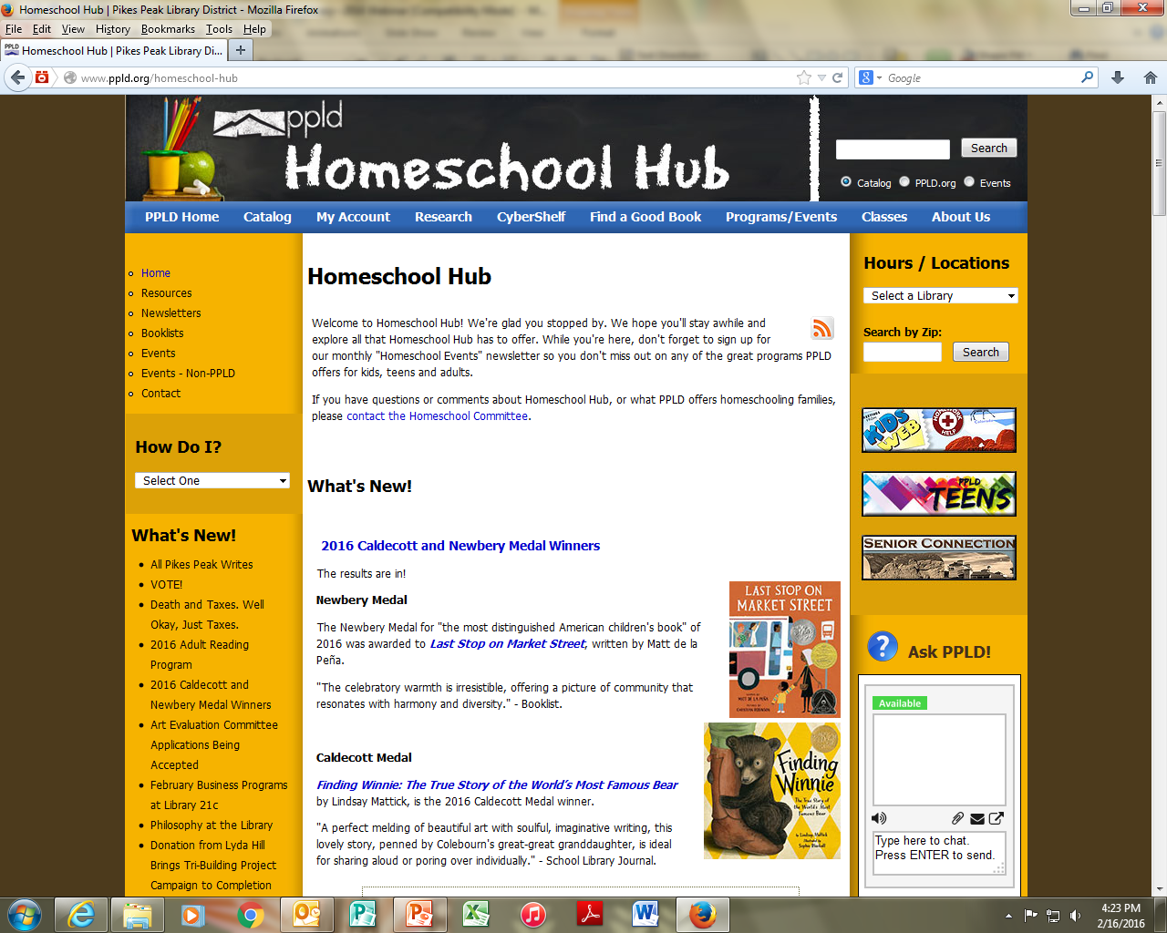
Website
Notes:
Gail: Part of PPLD.org. Blog shows upcoming homeschool programming as well as other library programs & topics of interest to them. Link for asking questions of the Homeschool Committee (well used). Links to local and national resources for homeschoolers, link to events calendar, local non-ppld events of interest, newsletter sign-up.

Slide 17
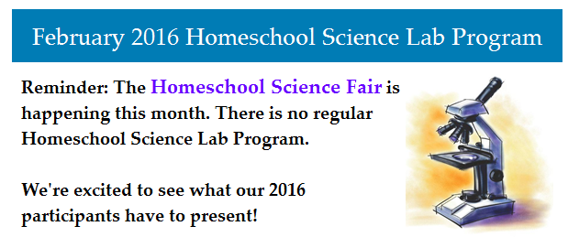
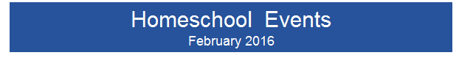
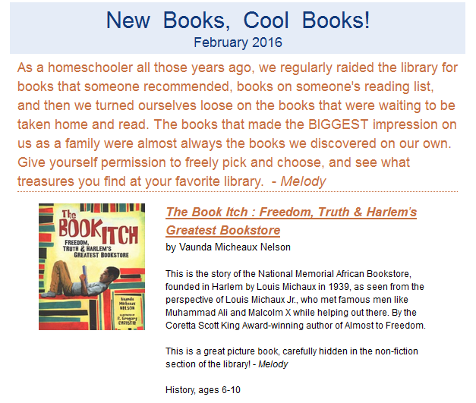
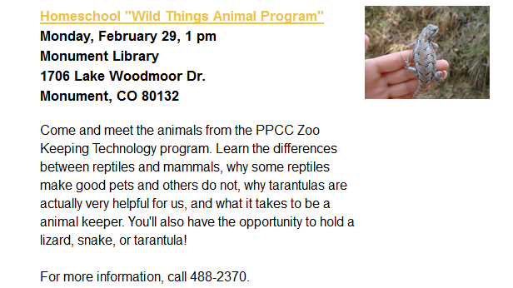
Electronic Newsletters
Notes:
Gail: Three monthly e-mail newsletters using LibraryAware. Events, science program, booklist.

Slide 18
Quarterly Publication
Notes:
Gail: A teaching tool. Our committee submits all the articles for this publication: different topic every quarter, booklists, activities, online resources, ads for upcoming homeschool and other PPLD programming.

Slide 19
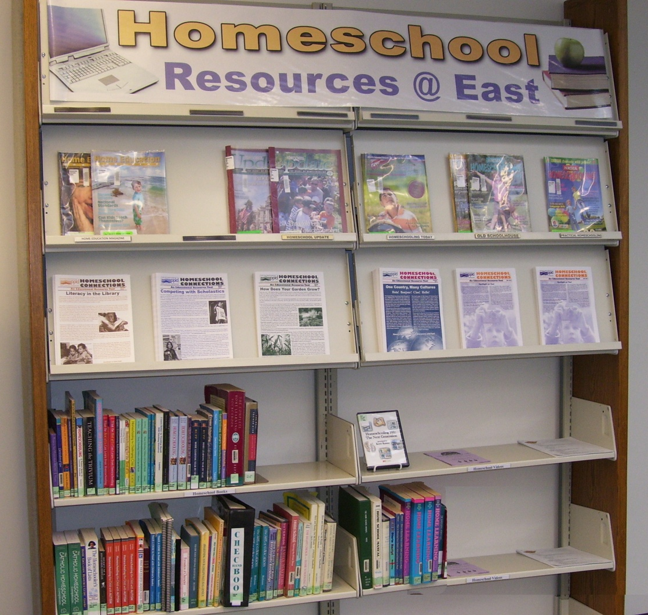
Resources and Materials
Special spine sticker or shelf location to set homeschool books apart
Notes:
Gail: We use green label protector to designate homeschool books (helps our shelvers know where they go)—only two locations actually shelve homeschool materials separately. Even on the regular nonfiction shelves, the yellow helps homeschooling parents find the books more easily.

Slide 20
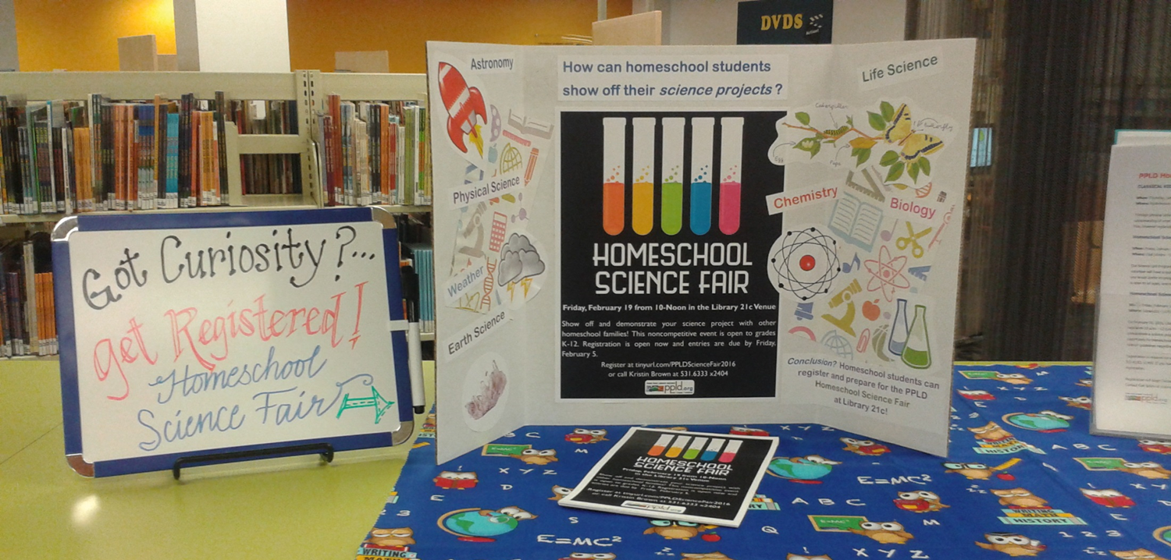
Displays
Notes:
Gail: Tina’s display for the Science Fair we just had.

Slide 21
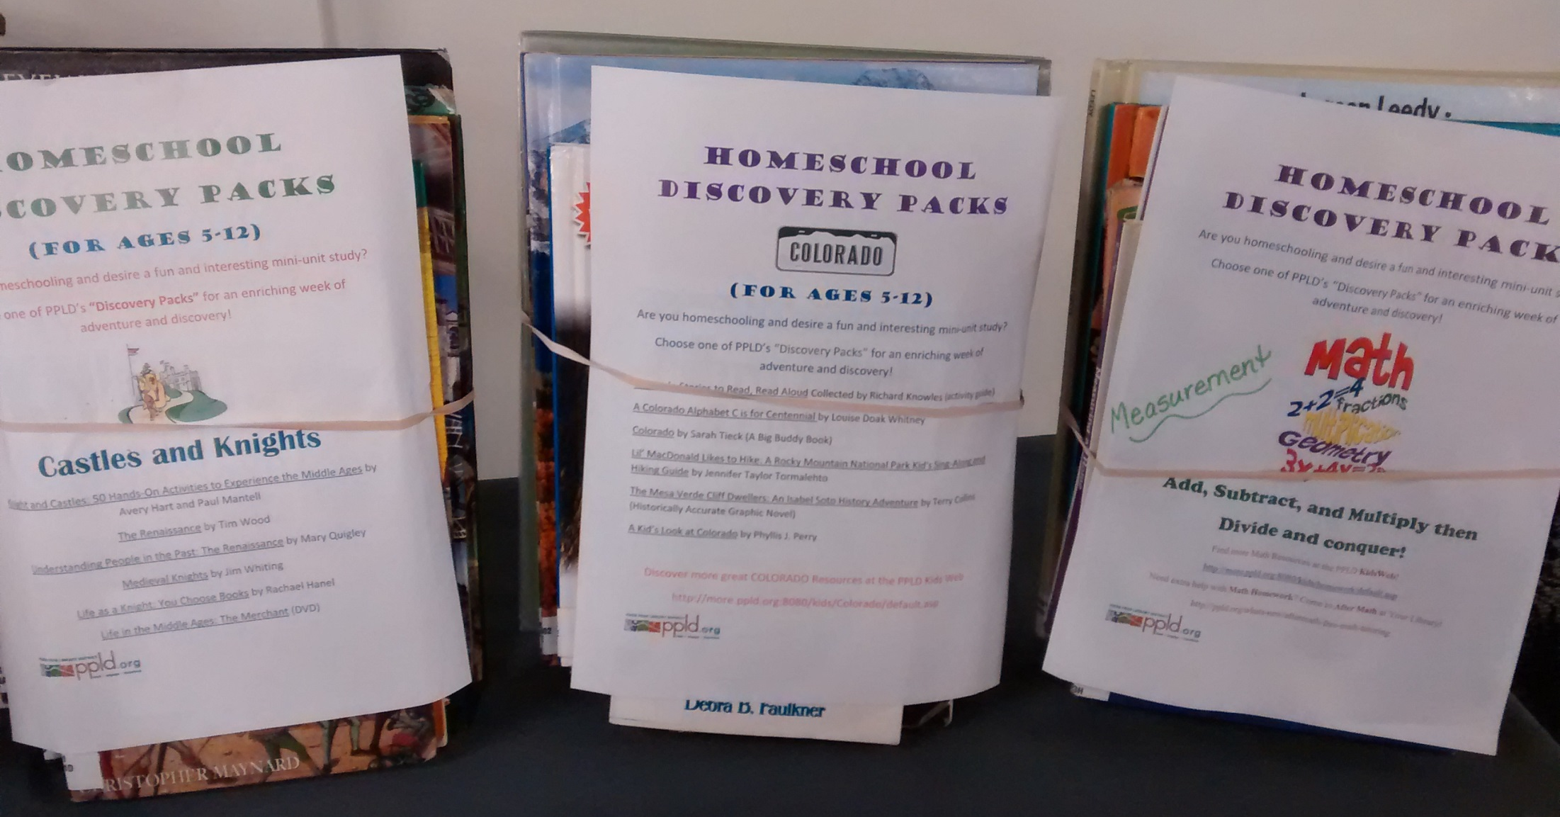
Discovery Packs
Notes:
Gail: Discovery Packs were developed by Tina Lewis (and experienced homeschool mom, and staff member) to be a “mini-unit study” for homeschooling families. Each multi-age Pack usually includes an activity book, multiple Jfiction, several Jnonfiction, picture book, easy reader, DVDs or CD Music items. They often include a book list of other suggested resources.
Question—What resources or tools do you have available for homeschooling families? (chat)
Jessica is now going to tell you about some of the family programming we provide for our homeschoolers.

Slide 22
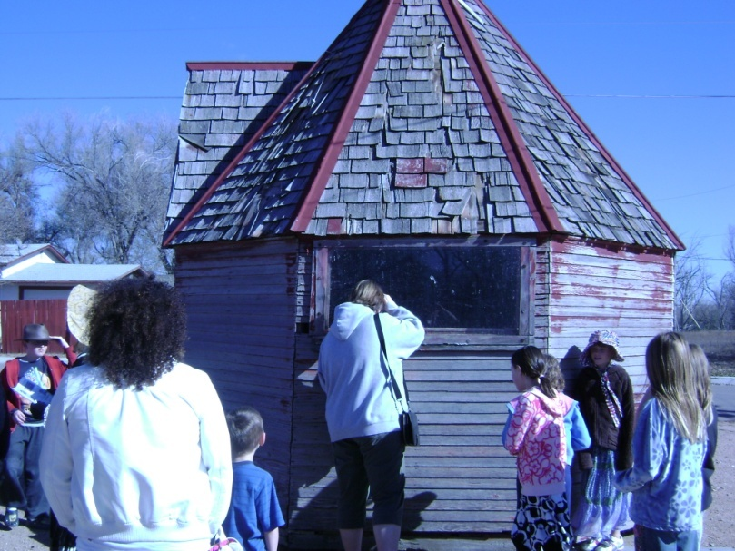
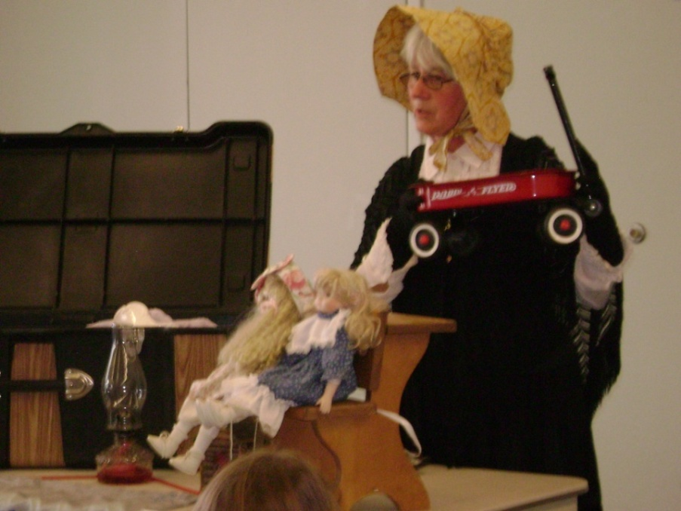
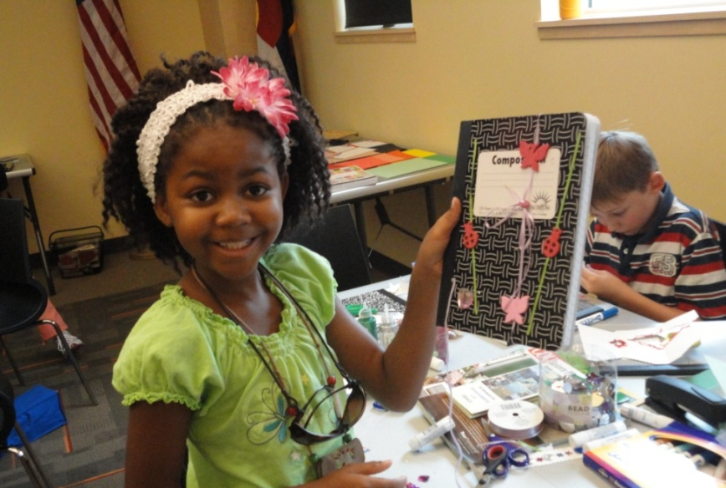
Family Programming
Educational activity or speaker
Families bring sack lunches
Use low cost community partners
Notes:
Jessica: One of my favorite programs that we do for homeschoolers is our Homeschool Lunch Bunch. This is a monthly program, geared to whole families, all ages welcome with a different topic explored each month. After about 45 minutes of the educational activity, we then clean up and let them families stay and eat lunch together and socialize. The best way to do this program is to look for free programs from community partners...any place that will do a school program for free is usually willing to come do one at the library for homeschoolers. Also, ask local business owners or homeschool parents with special talents: we’ve had a local beekeeper, a parent who spoke five languages came and taught sign language...the possibilities are huge!
Question—What community organizations could you contact for free/low cost homeschool programming?

Slide 23
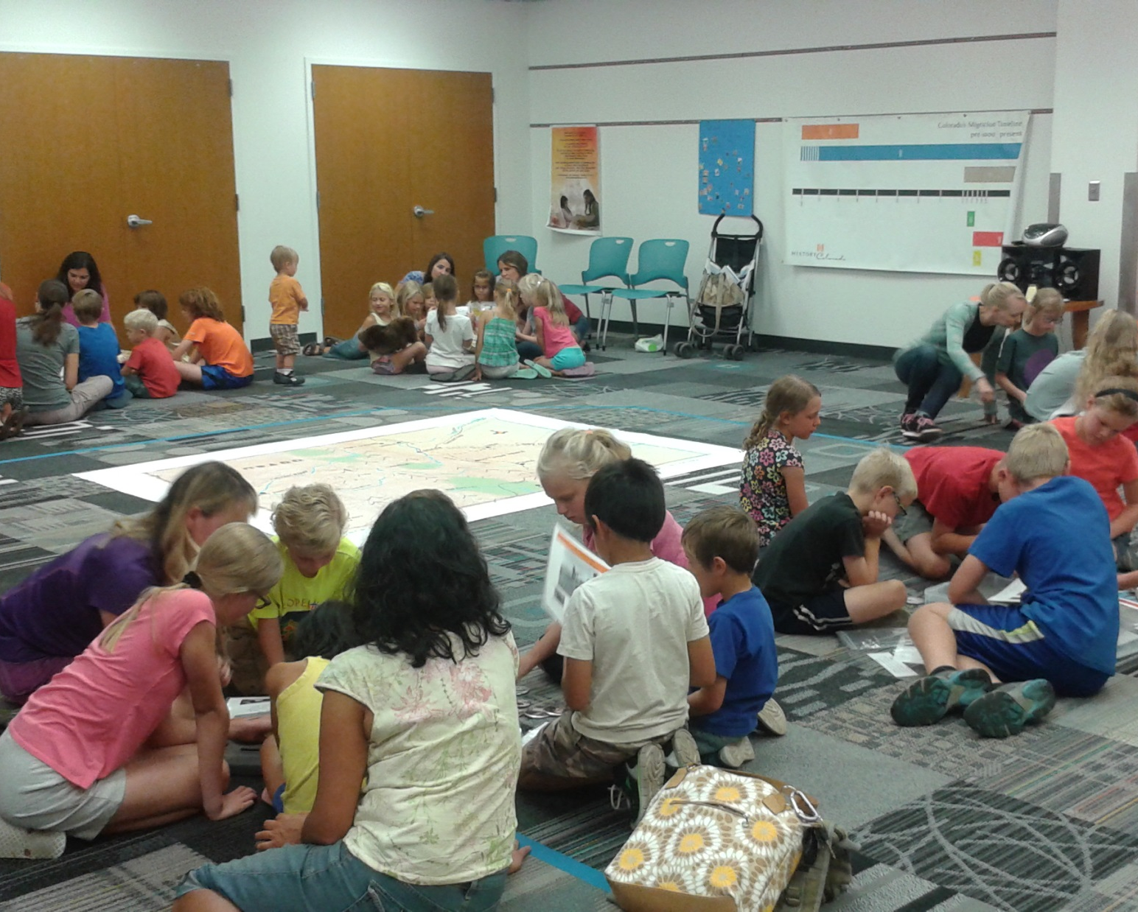

History Colorado: Moving Day
Notes:
Jessica: History Colorado has these amazing school programs, one of which, Moving Day, they have loaned to our district. It involves a huge map, artifacts and tons of fun learning about the different peoples of Colorado’s history.

Slide 24
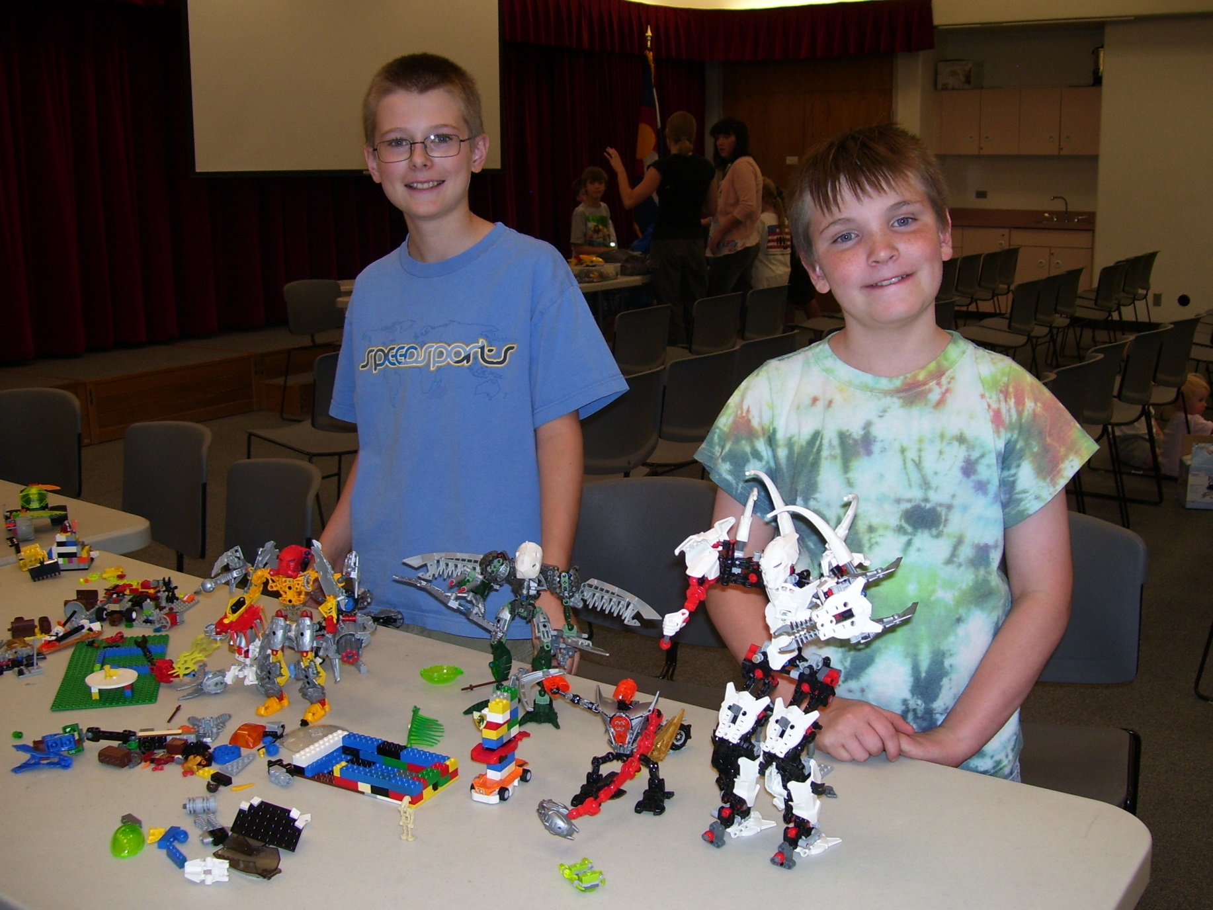
Lego Club
Notes:
Jessica: This is our Homeschool Lego Club. Legos are always popular! I’m going to let Gail talk a bit more about some of our other homeschool programs.

Slide 25
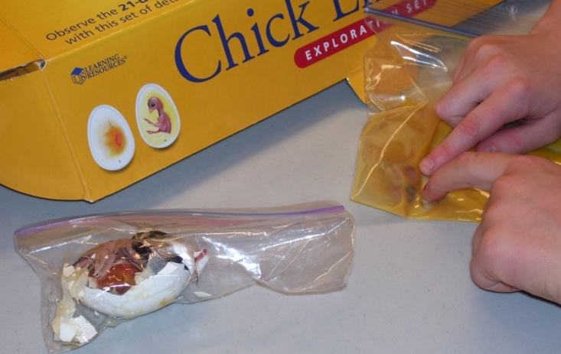
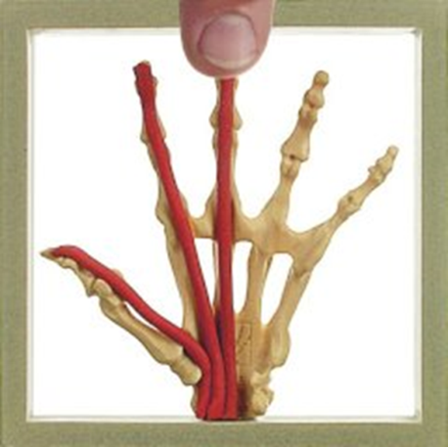

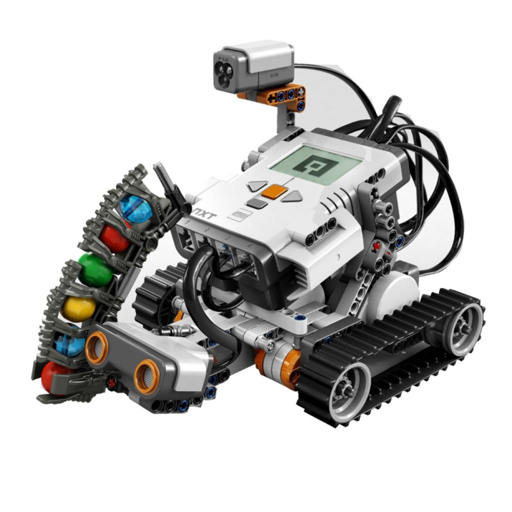

Monthly Science Programs
Volunteer planned and run
Multi-age programs (sometimes divided by age)
Notes:
Gail: We find that science isn’t necessarily the easiest subject for some homeschooling parents to teach so they particularly appreciate our monthly science programs! Our awesome volunteer, a homeschool dad, plans the monthly programs (sometimes teaching something himself, and sometimes bringing in a speaker). Families know in advance what the program will be so can plan accordingly. We’ve had chickens, Lego Mindstorms, our utility company’s water program, Anatomy in Clay, and an egg drop.

Slide 26
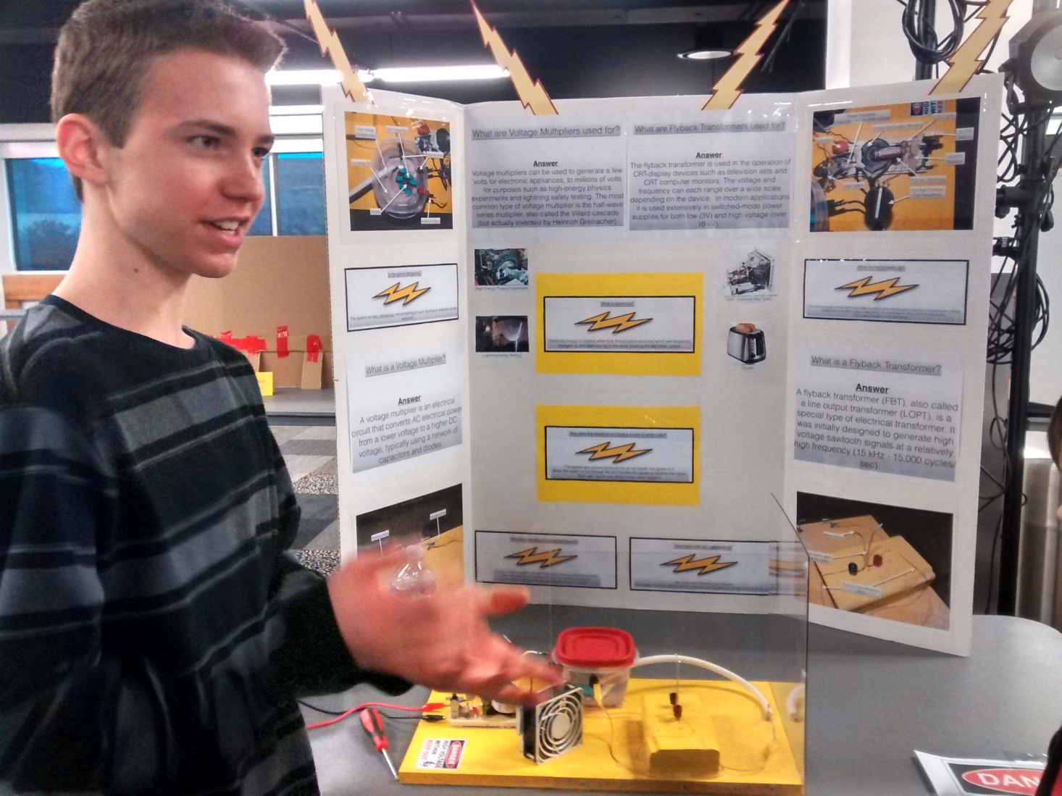
Science Fair
Open to all homeschoolers
Opportunity to talk about their projects
No judging
No prizes
Notes:
Gail: Our Science Fair has become very popular! We had 30 projects in our Fair held last week and were amazed with the knowledge of the participants and the quality of the projects. Each year they get better and better! They are not judged, and there are no prizes, although we do give out certificates of participation each year.

Slide 27
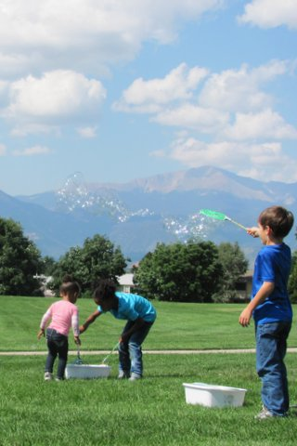
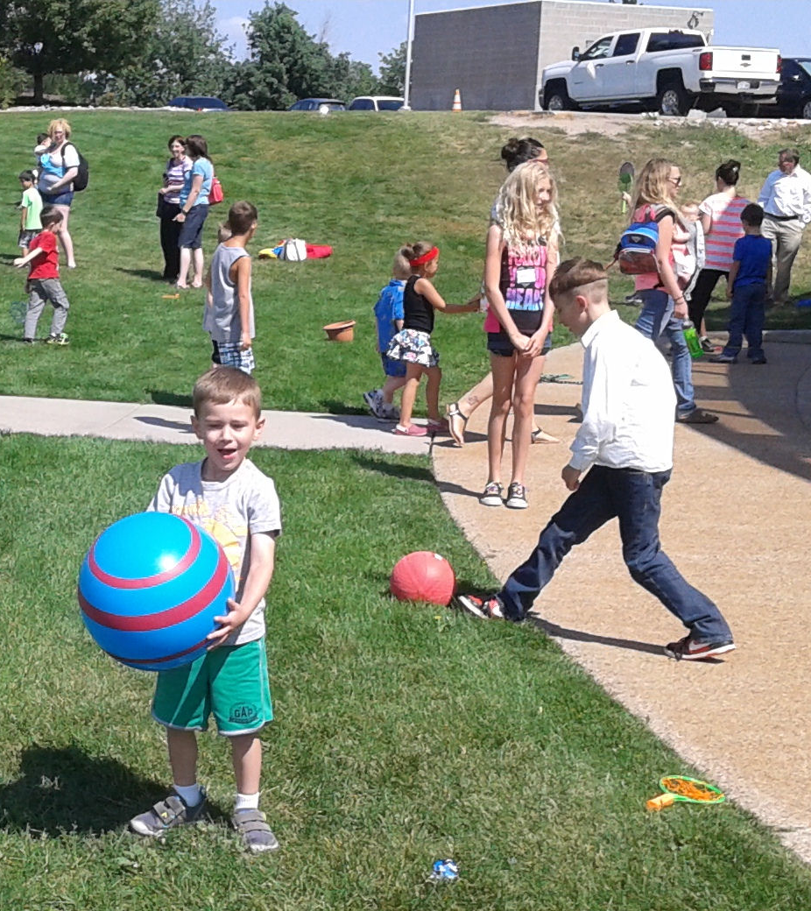
Game Day
Simple games
Picnic
Time to socialize
Notes:
Gail: Our annual Game Day is lots of fun and simple to plan. We usually just put out balls of all types, jump ropes, hula hoops, bean bags, sidewalk chalk, bubbles, Bocce Ball, Ladder ball and anything else we can come up with. Last year one family even brought a kite! The kids play, and often the parents are particpating too. Some families stay after it’s over and picnic in the park, socializing with new-found friends.

Slide 28
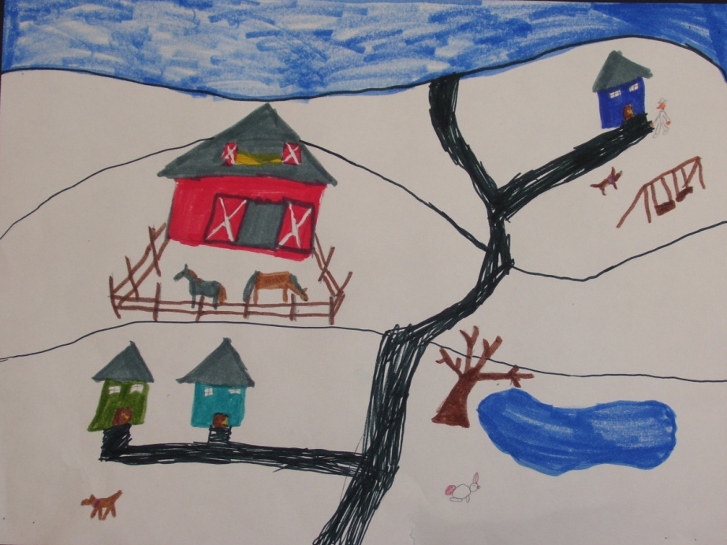
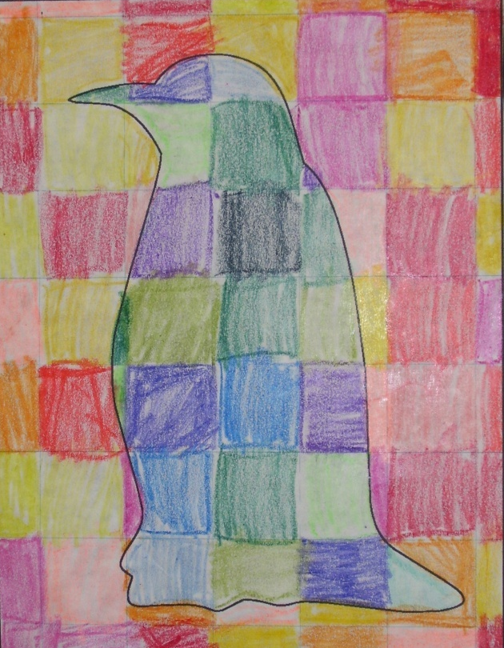
Art Show
Open to all homeschoolers
No prizes
Reception for family & friends
Notes:
Gail: Kids in the schools get to have their artwork displayed in the halls, but homeschooled kids don’t normally get to do that. The Homeschool Art Show is open to all ages of homeschooled students. Like the Science Fair, it is not judged.

Slide 29
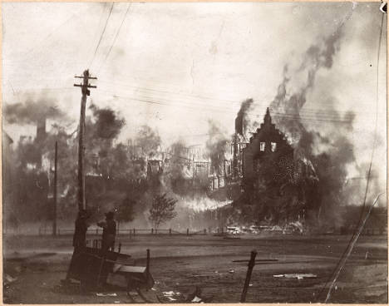
Primary Source Workshop
Notes:
Gail: One of our Homeschool Committee members was a history major and worked for a time in a presidential library. She has held Primary Source Workshops for middle and high school students in our Special Collections area of our library.
Question: What other programming ideas do you have? Please share in the chat box!

Slide 30

Pikes Peak Educational Resource Center
Notes:
Briefly say what the ERC is.
Question—How much would you estimate homeschoolers spend each year educating their children?

Slide 31
$250-$1,000
amount PPLD homeschool families estimate they spend yearly on Homeschooling
Notes:
We polled our families a couple of years ago and this is what they told us they spend on each child in a year. They get no financial help from the school district (even though they pay taxes just like everyone else does!)

Slide 32
Educational Resource Center
Science Equipment & Lab Tables
Software & Databases
Dedicated Staff
Educational Kits & Manipulatives
Study Spaces & Gathering Areas
Computers & Printing
ERC
Educational
Resource
Center
Notes:
Question—Does your library have “non-traditional” items in the collection? (chat—what, do they circulate)

Slide 33



Virtual Dissection
Foreign Languages
Driver’s Education
Notes:
Jessica: We wanted to be sure to include a variety of subjects for a variety of ages. Our software for driver’s education, dissection and also our foreign language database appeal to our older homeschool students in middle and high school.

Slide 34
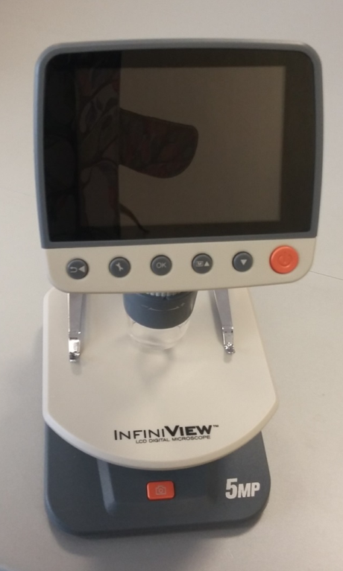
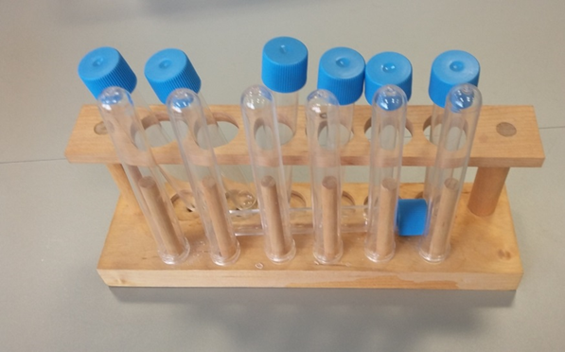
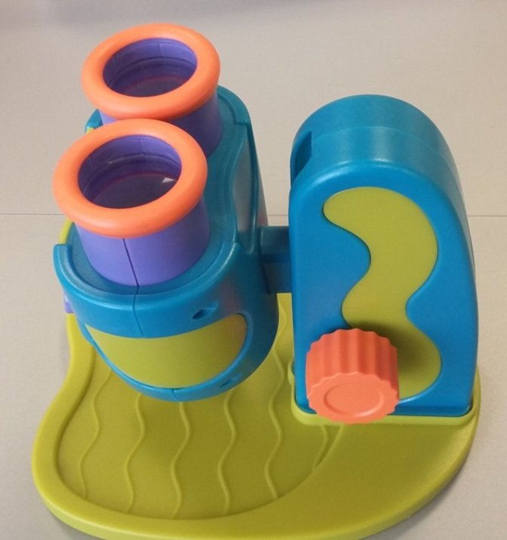
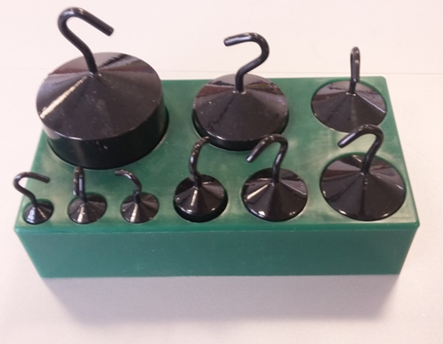
Science Lab
Notes:
Started with donated equipment in a community room, available for use once a month…now we’ve been able to purchase additional equipment and moved to a permanent location in the ERC so it is available whenever the ERC is open

Slide 35
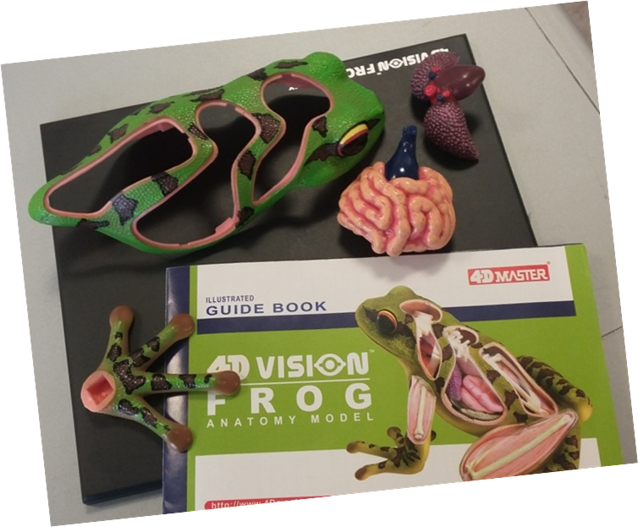
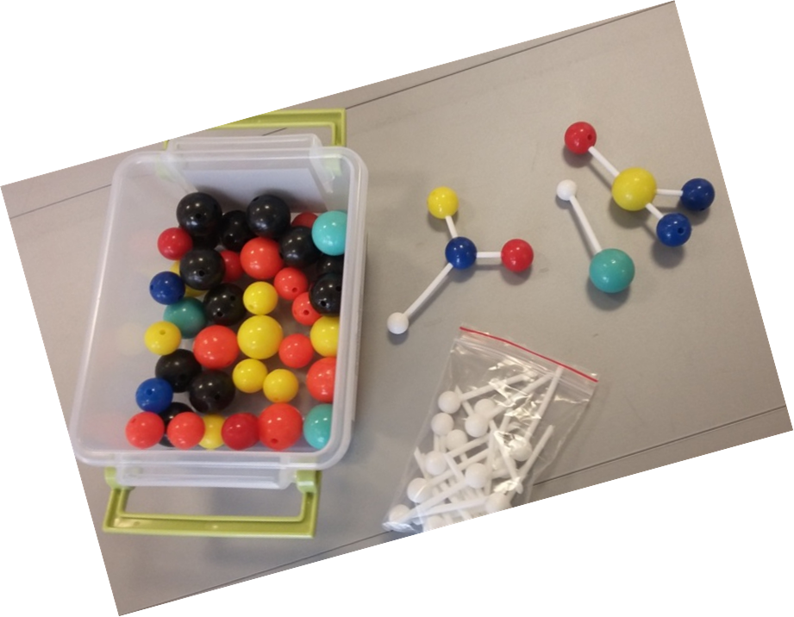
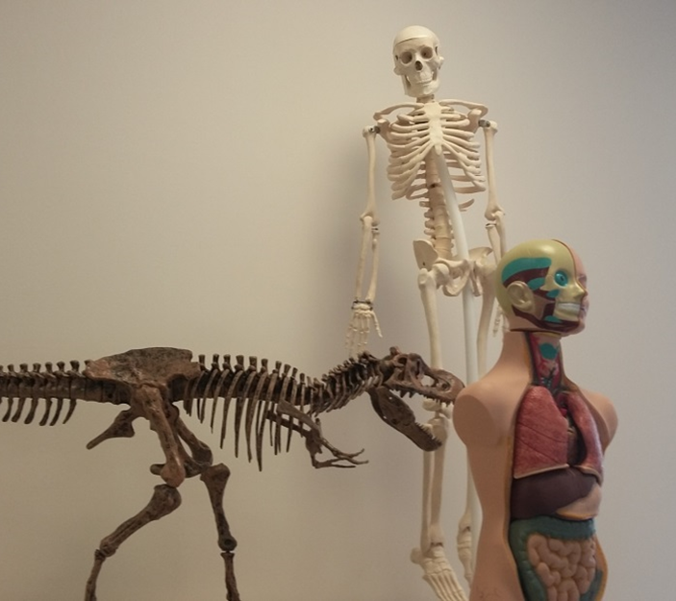
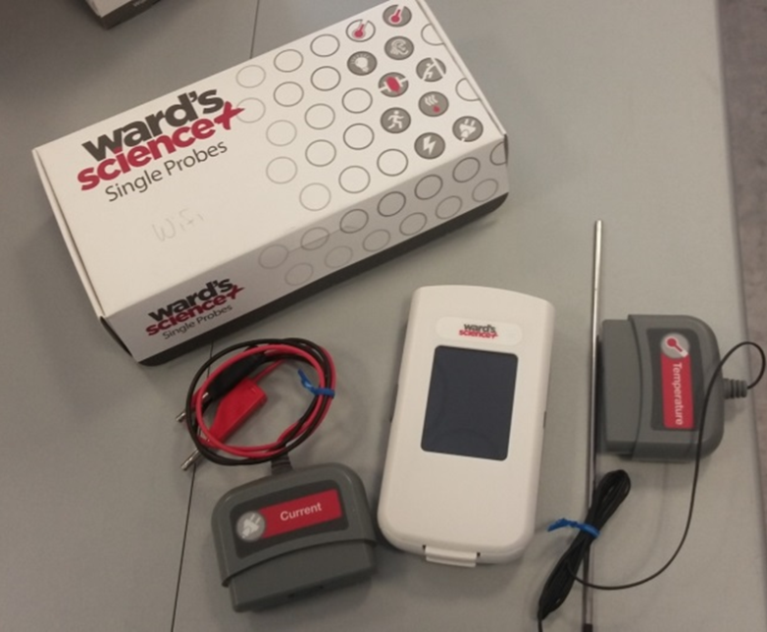
Science
Notes:
Jessica:
We’ve got earth science, life science, biology, chemistry, physics, even a bit of organic chemistry...

Slide 36
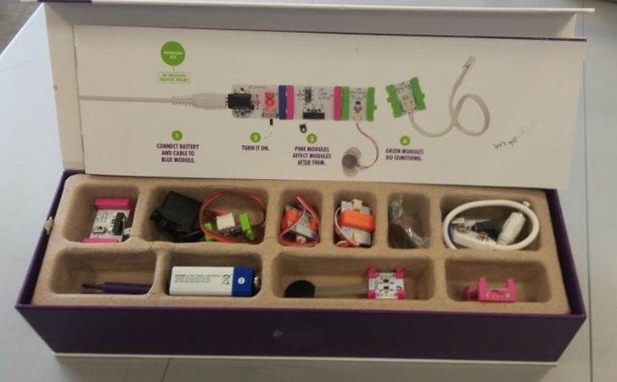
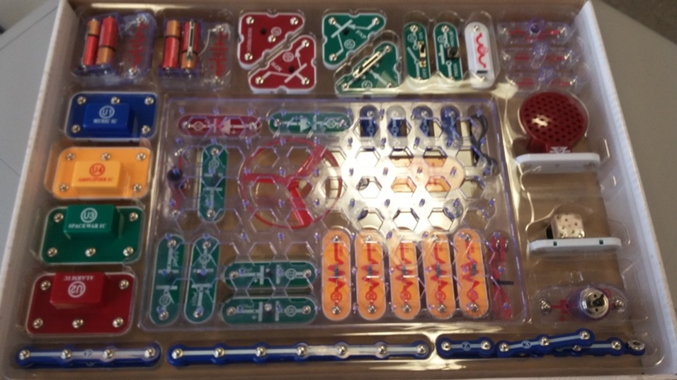
Technology
Notes:
Jessica: We’ve included some fun technology kits like Little Bits and Snap Circuits.

Slide 37
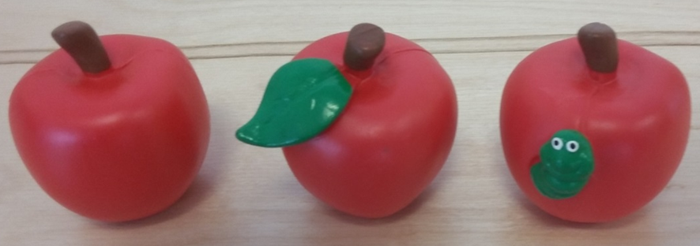
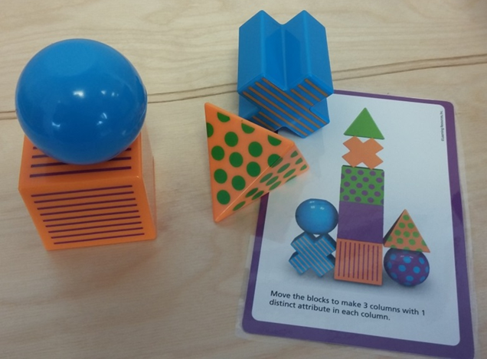
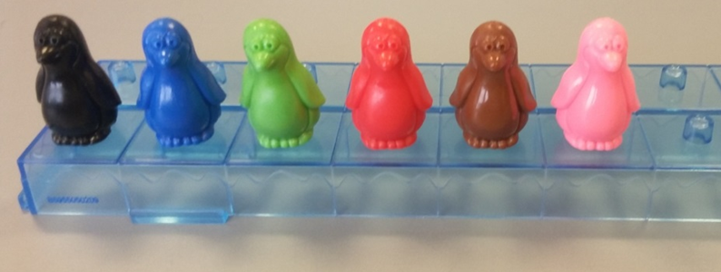
Math
Notes:
Jessica: Math, across a variety of levels from basics on up to geometry and algebra

Slide 38
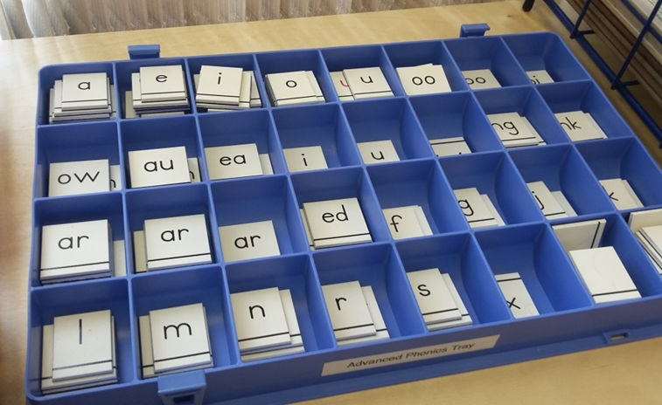
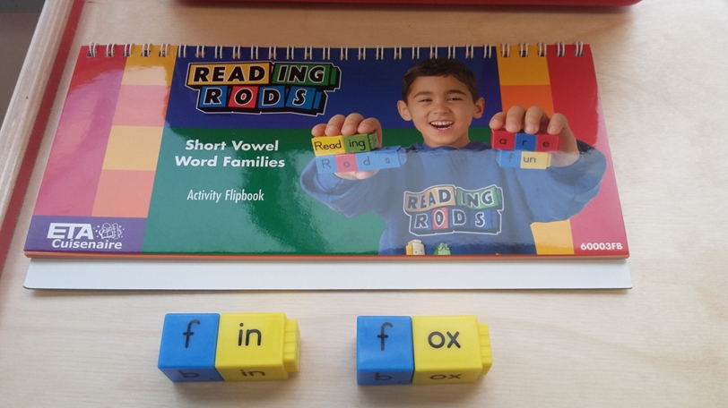
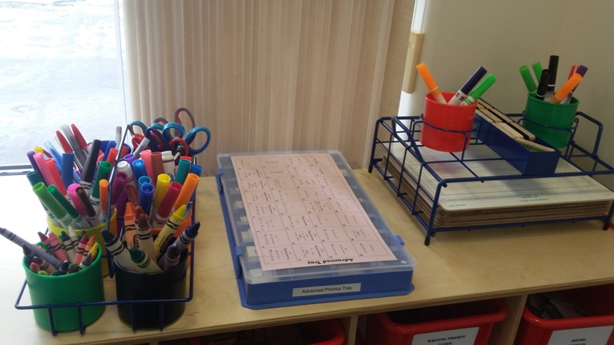
Spanish
ASL/Braille
Language Arts
Notes:
Jessica: In addition to a bunch of different language arts kits, we’ve also included Spanish, American Sign Language and Braille for our Homeschool kids.

Slide 39
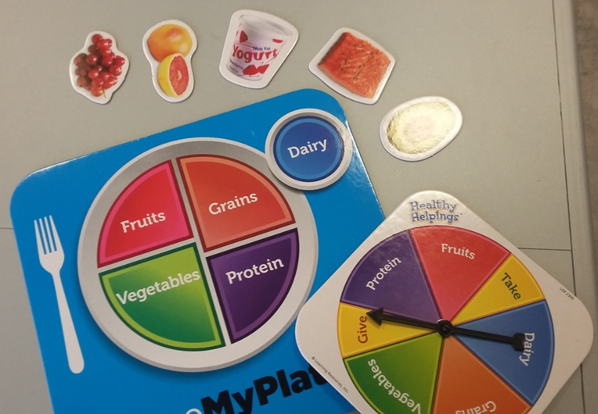
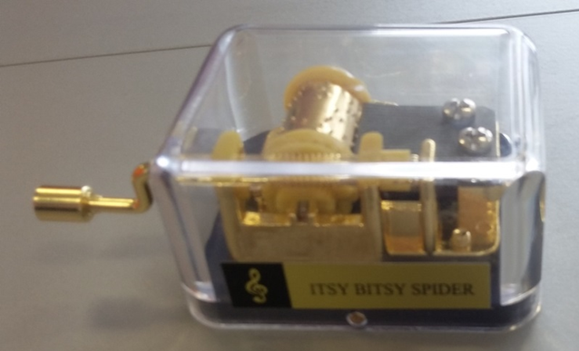

Art
Music
Health
Social Studies
Notes:
Jessica: And to round it out- health, music, art and social studies, including history, cultures, geography and government. And now Gail is going to finish telling you about the center.

Slide 40

Pikes Peak Kits for Checkout

Slide 41

Homeschool Resource Room

Slide 42

Computer Room

Slide 43
“The library system in the city we just moved from did not actively seek out homeschoolers and even seemed a little resistant about providing resources. PPLD’s outreach to homeschoolers has been refreshing and encouraging. We are really enjoying and appreciating the resources available. Thank you!”
“I think the East Library does a FANTASTIC job providing resources for the homeschool community. Keep up the great work!”
“Do it again, please!”

Slide 44
Let’s Collaborate!

Slide 45

Libraries Supporting Homeschoolers Wiki
Notes:
Question: Please share any other online resources you know of in the chat box and they will be posted on the CSL in Session website.

Slide 46
Contact Us
Gail Sohns
Children’s Librarian
Homeschool Committee Lead ● Homeschool Program Coordinator
Educational Resource Center Coordinator
gsohns@ppld.org
Jessica Freeland
Children’s Specialist
Educational Resource Center Team Member
Homeschool Program Coordinator
jfreeland@ppld.org
Tina Lewis
Children’s Specialist
Homeschool Committee Member ● Homeschool Parent
Homeschool Program Coordinator
tlewis@ppld.org
Notes:
Question: One last question before we end…We are hoping that we’ve gotten you thinking about the possibilities for helping homeschoolers at your library…Please share one thing you are excited to try to support your homeschoolers!

