Slide 1


Sorry…you just don’t fit into our culture: Unconscious bias in hiring decisions
Beth Crist Jean Marie Heilig
Youth Services Fiscal Officer

Slide 2

If you have a brain you’re biased”
“
-Dr. Heidi Grant
NeuroLeadership Institute

Slide 3
Main types of bias
Bias
Implicit / Unconscious
Explicit

Slide 4
Where do these biases come from?
Direct Experiences
(with other people, events, situations)
Vicarious Experiences
(those relayed to us through other people, stories, books, movies, media and culture)

Slide 5



Library Workers: Facts and Figures

Slide 6
Addressing the Elephant in the room
https://www.dpeaflcio.org/factsheets/library-professionals-facts-and-figures?rq=LIbrarians

Slide 7
Library worker demographics
https://www.dpeaflcio.org/factsheets/library-professionals-facts-and-figures?rq=LIbrarians

Slide 8
Library professional Mean Annual earnings
https://www.dpeaflcio.org/factsheets/library-professionals-facts-and-figures?rq=LIbrarians

Slide 9

What biases can affect the hiring process?
What biases can affect
the hiring process?

Slide 10
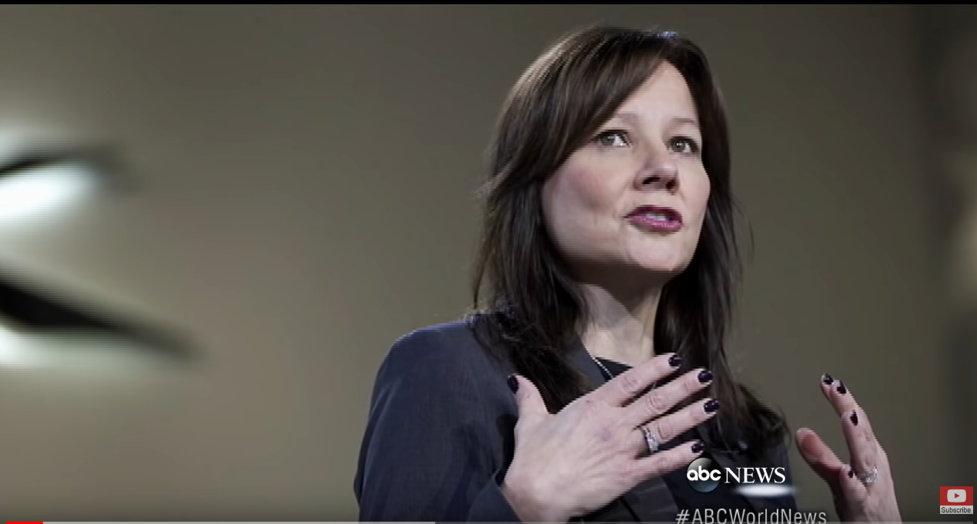
Unconscious Bias Behaviors
Gender Bias
https://www.youtube.com/watch?v=7nJq6des4jg

Slide 11

Unconscious Bias Behaviors
Confirmation Bias

Slide 12
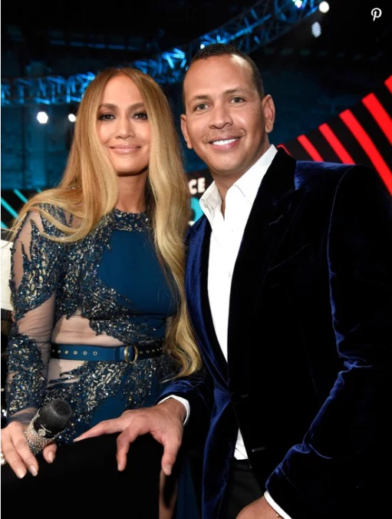
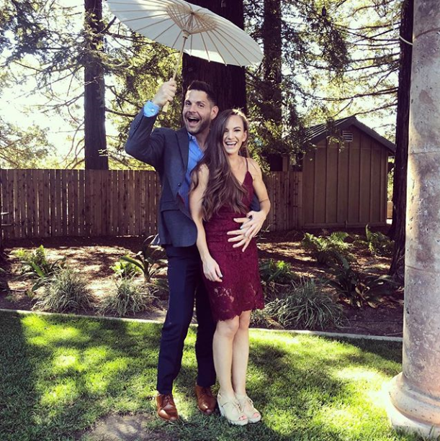

Unconscious Bias Behaviors- beauty bias

Slide 13

Unconscious Bias Behaviors – Halo effect

Slide 14
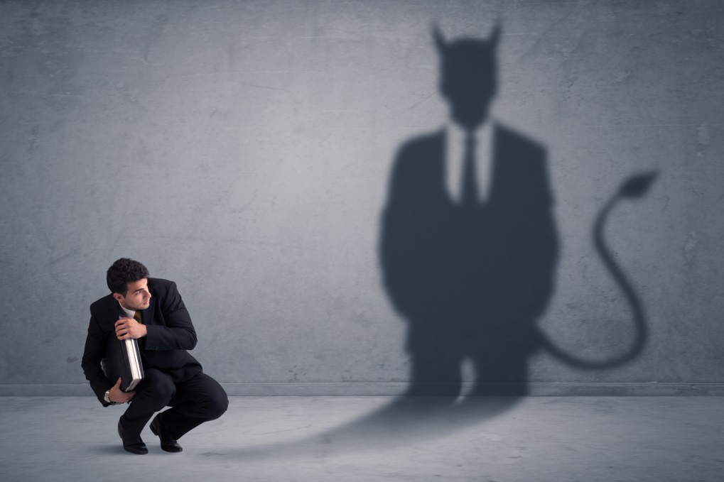
Unconscious Bias Behaviors – Horns effect

Slide 15
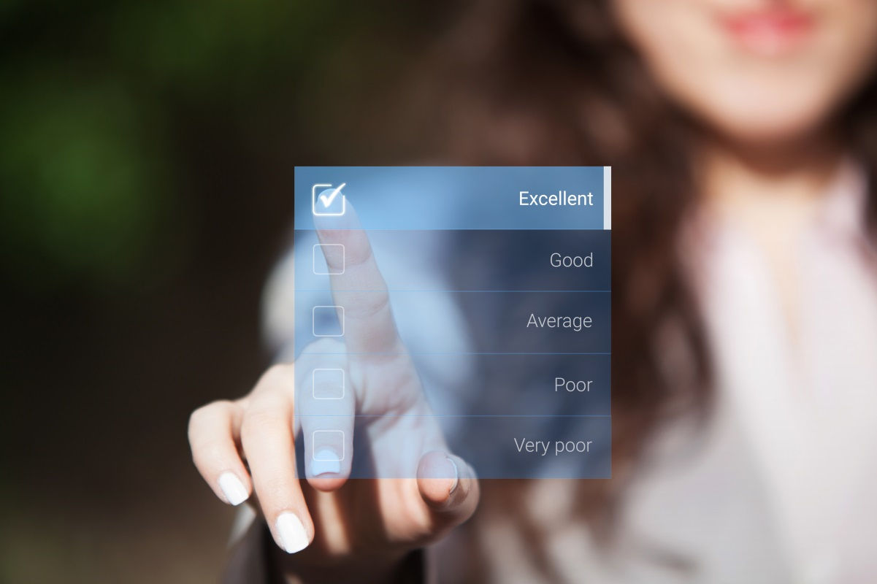
Unconscious Bias Behaviors – leniency bias

Slide 16

Unconscious Bias Behaviors – strictness or stringent bias

Slide 17

Unconscious Bias Behaviors – compare and contrast effect

Slide 18

Unconscious Bias Behaviors – affinity bias

Slide 19

Unconscious Bias Behaviors – conformity bias

Slide 20

Recruitment: Reassess Needs
What are the critical outcomes of the position?
Are “traditional” experience and education requirements necessary?
What skills can be learned on the job?
Notes:
Does the position really require a library degree, or library experience? A bachelors?
Focus on the most critical skills needed

Slide 21

Job Descriptions
Focus on essential skills and
outcomes required over specific
experience and education
Avoid jargon/abbreviations
Use inclusive, neutral
language
Notes:
Research shows that women are unlikely to apply for a position unless they meet 100 percent of the requirements, while men will apply if they meet 60 percent of the requirements.
ZipRecruiter has found that cutting gender-biased terms can increase the number of applicants by 42%.
Masculine-coded words include: Active, Adventurous, Challenge, Confident, Decision, Driven, Independent, Lead, Objective, rockstar, ninja, dominate
Feminine-coded words include:
Agree, Commit, Cooperate, Depend, Honest, Interpersonal, Loyal, Support, Together, understand
Age-coded words include: fresh, energetic, mature, highly experienced
Free services: Gender Decoder for Job Ads: http://gender-decoder.katmatfield.com/
Unbiasify: https://chrome.google.com/webstore/detail/unbiasify/affijhegklbkdinpepgphhlgphnhbenk
if you’d still like to call out certain desired skills, you can soften the message with language like “familiarity with,” “bonus points for,” or “if you have any combination of these skills.”

Slide 22
Job Descriptions
Masculine Terms | Feminine Terms
Confident | Cooperative
Driven | Supportive
Rock Star | Dependable
Ninja | Collaborative
Leader | Interpersonal Skills
Decisive | Honest
Adventurous | Understanding

Slide 23
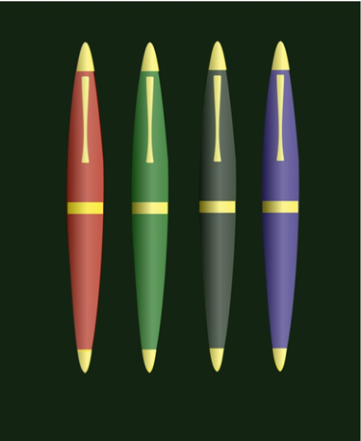
Job Description Activity

Slide 24







Job Postings
Advertise within and beyond traditional library job outlets
Ask community partners to advertise openings
Assign a contact(s) who can provide assistance during the application process
Provide as long an application period as possible
Notes:
Cast a wide net, thinking outside the box.

Slide 25
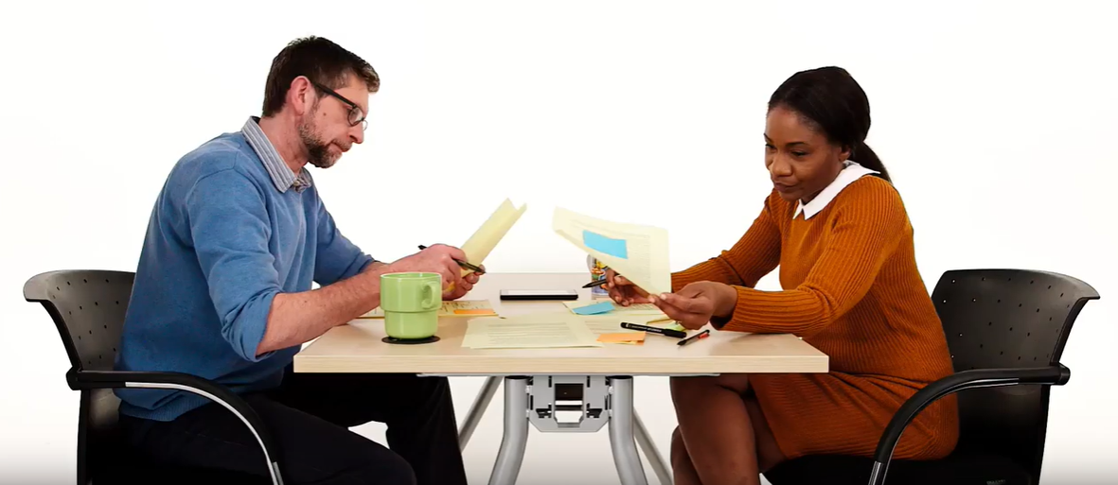
Application/Resume Review
Hiring Bias – Diversity & Inclusion Dramas
https://www.youtube.com/watch?v=MRASZPQDPv0

Slide 26

Application/Resume Review
“Going Blind”

Slide 27
Application/Resume Review – names
Latisha and Jamal
vs
Valentina and Carlos
vs
Emily and Greg

Slide 28
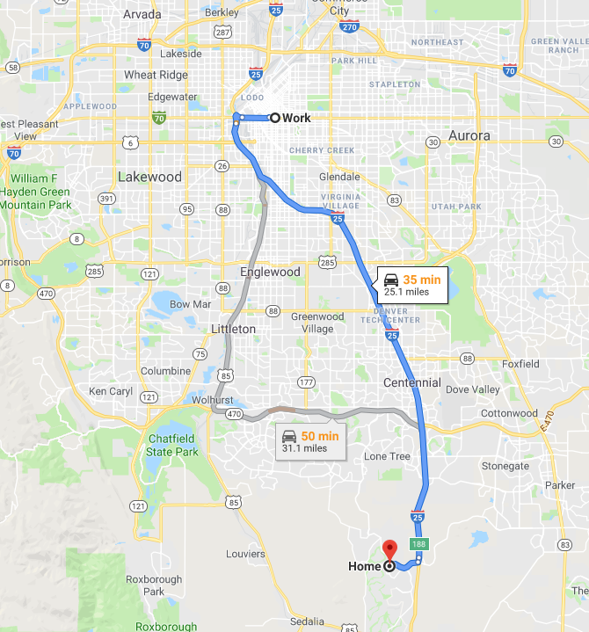
Application/Resume Review - addresses

Slide 29







Application/Resume Review- education
Schools / Graduation Dates

Slide 30
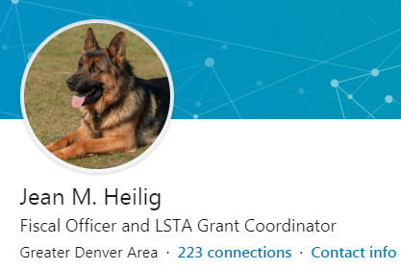
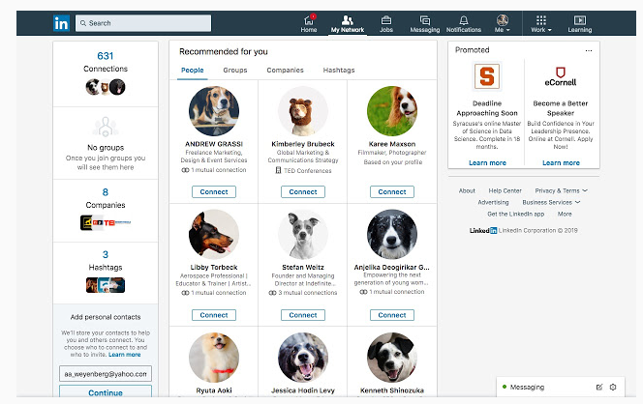
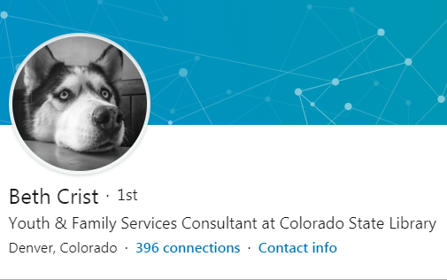
Application/Resume Review – social media

Slide 31

Scheduling Interviews
Offer varied interview times
Offer a remote interview option
Consider phone interviews
Provide one contact
Clearly communicate the hiring process verbally and in writing
Notes:
Offer weekend or evening interviews if possible, and consider the schedule of the actual position.

Slide 32

Interview Panel
3 - 4 interviewers from diverse backgrounds
Awareness of personal biases
Discuss with the panel how to avoid bias during interviews
Avoid discussing candidates between interviews
Notes:
More than 3 or 4 people on a panel can be intimidating
If you don’t have the diversity on your staff, ask a community partner to be on the panel

Slide 33
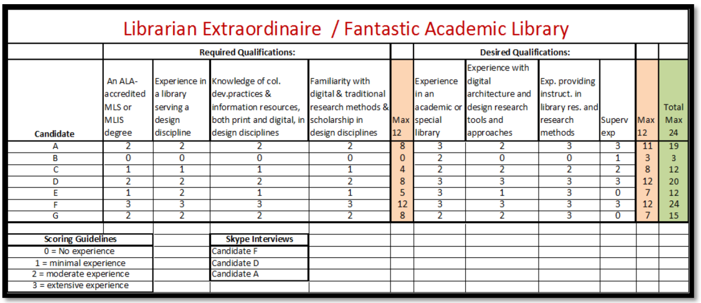
Standardize Interviews
Ask each applicant the same questions
Stick to the script
Create a rubric for scoring each candidate
Include “likeability” on the rubric
Rate candidates separately before discussing as a group

Slide 34

Interview Questions
Ask specific, behavioral questions
Check for bias
Focus on skills and knowledge over specific experience and education
Questions need to be clear and concise while avoiding jargon and abbreviations
Notes:
Ask for examples of a time when…
Biases might be embedded in questions, like expecting a certain approach to conflict, or anticipating one wants to move up a ladder, or expecting a certain characteristic such as assertiveness, or even looking for a word or phrase in an answer, can be biased against certain cultural or linguistic groups, or genders.
Ask questions that can be interpreted within a group context so that candidates who are not aligned with an individualistic orientation to work achievements can respond fully. For example, asking people to talk about strengths or take credit for personal successes may not be perceived as appropriate in some cultures that are more collectively oriented

Slide 35
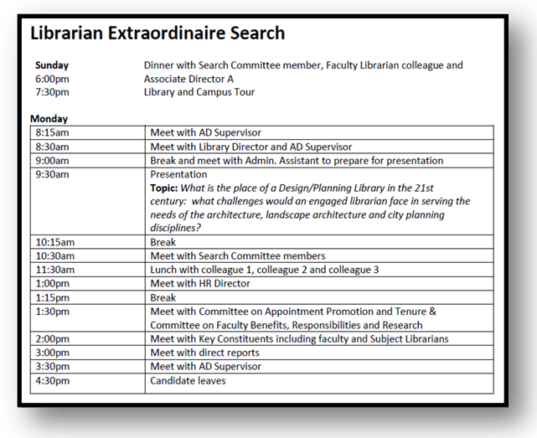
Skills Test
Ask candidate to perform a skill or produce an outcome that will be needed for the job

Slide 36



During Each Interview
Allow candidates to initiate physical greetings
Provide an overview of expectations, agenda, and follow up
Be aware of your body language and tone of voice

Slide 37
After the Interviews
Immediately convene panel; discuss possibility of bias (include your own!)
Gather and review rubrics from panelists; check for bias
Conduct a “flip it to test it”
Focus on knowledge and skills, not “fit”
Use the interview as an independent data point

Slide 38

Questions?

