Slide 1
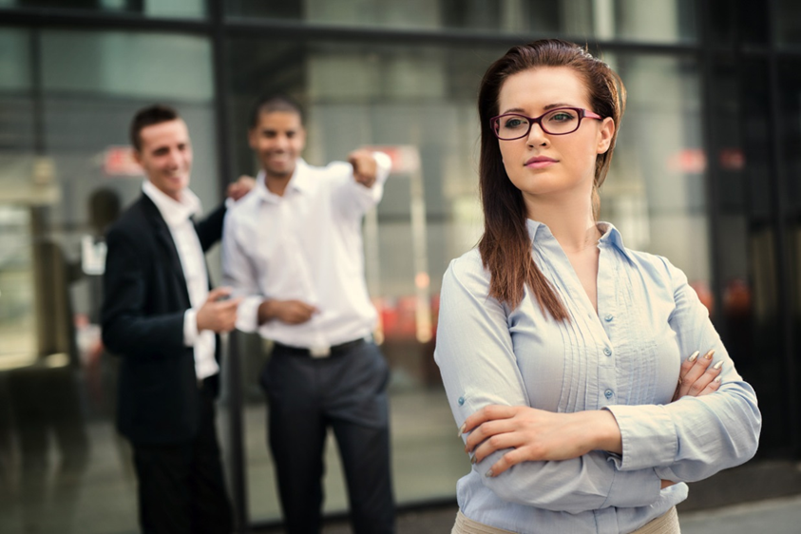

How Rude!
The Price of incivility in the workplace
Jean Marie Heilig Christine Kreger
Fiscal Officer Professional development Consultant
Heilig_j@cde.state.co.us kreger_c@cde.state.co.us
Notes:
Activity – as people arrive for meeting – in workbook
When do you feel disrespected?
When do you feel unheard?
Intro – 1 min
Introductions
CK - As we move through this session, we want you to think about:
Who do you want to be? As an organization? As a colleague? As an employee? As a peer?

Slide 2
Erosion of Civility*
Social Media/Internet
The White House
Politics in General
News Media
*https://www.webershandwick.com/news/civility/
Notes:
Jean – 2 minutes

Slide 3

Civility in America:
An Annual Nationwide Survey*
93% of Americans identify incivility as a problem
68% Classify Incivility as a “major” problem
74% believe civility is worse compared to a few years ago
80% of people have experienced uncivil behavior
10.2 average weekly encounters with uncivil behavior
*https://www.webershandwick.com/news/civility/
Notes:
Jean – 2 minutes

Slide 4
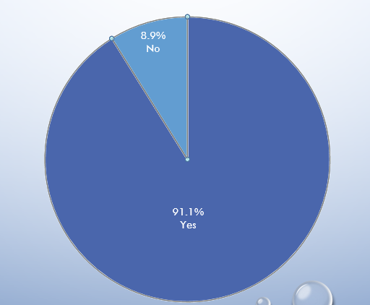
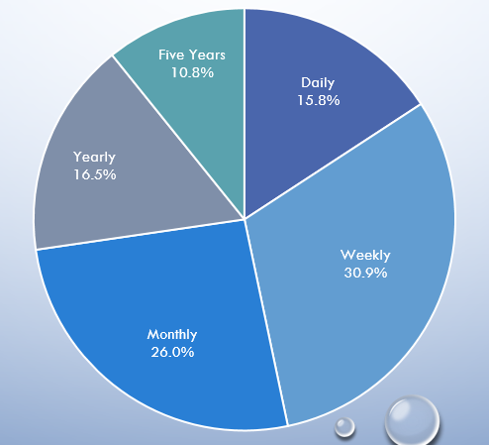
Civility in the library
Experienced
Incivility?
How
Often?
“Incivility and Dysfunction in the Library Workplace.” Henry, Eshleman, Croxton, Moniz
Notes:
Jean add library stats – 2 minutes

Slide 5
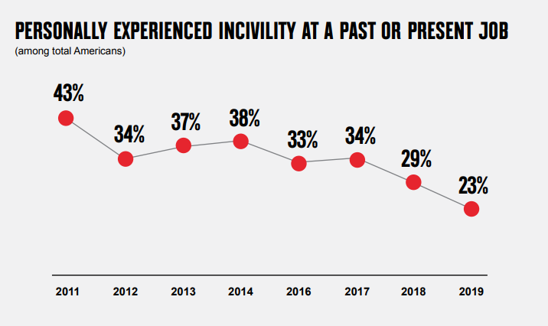
Incivility Experienced at work
“The workplace can serve as a safe haven from the incivility that confronts many Americans in everyday life”
https://www.webershandwick.com/news/civility/
Notes:
Jean – 1 minute

Slide 6
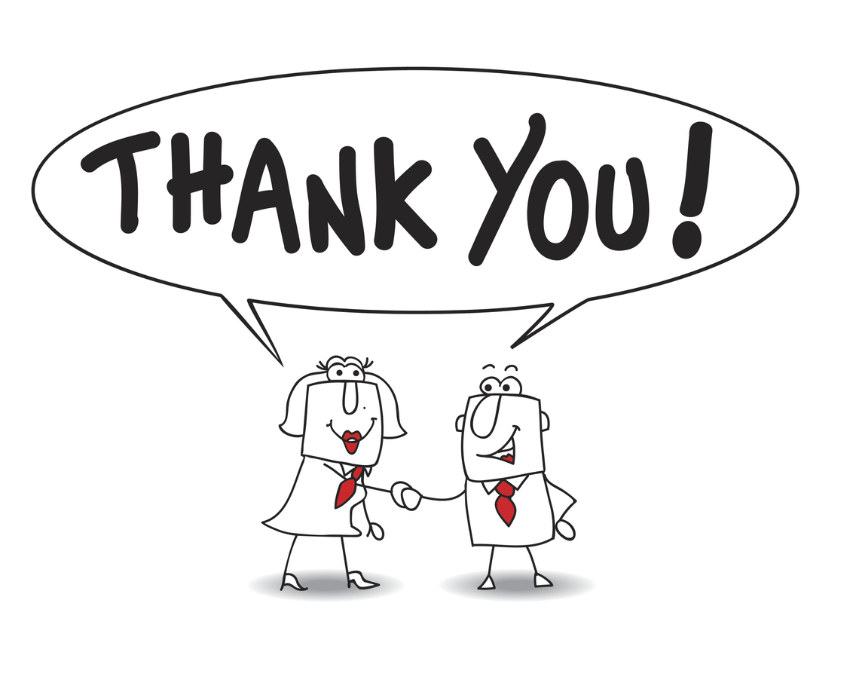
Civility
Positive gestures of respect, dignity, courtesy, or kindness that lift people up
What does Civility in the workplace
look like to you?
Notes:
CK leads brainstorm – Chat - 2 minute
So let's talk a bit more about what civility looks like, feels like, what specific behaviors do you think help define civility in the workplace?

Slide 7
Civil Behaviors
Mutual Respect
Dignity
Courtesy
Kindness
Please
Thank You
Smile
Support
Greetings
Notes:
Jean catches anything missed – 2 minutes

Slide 8
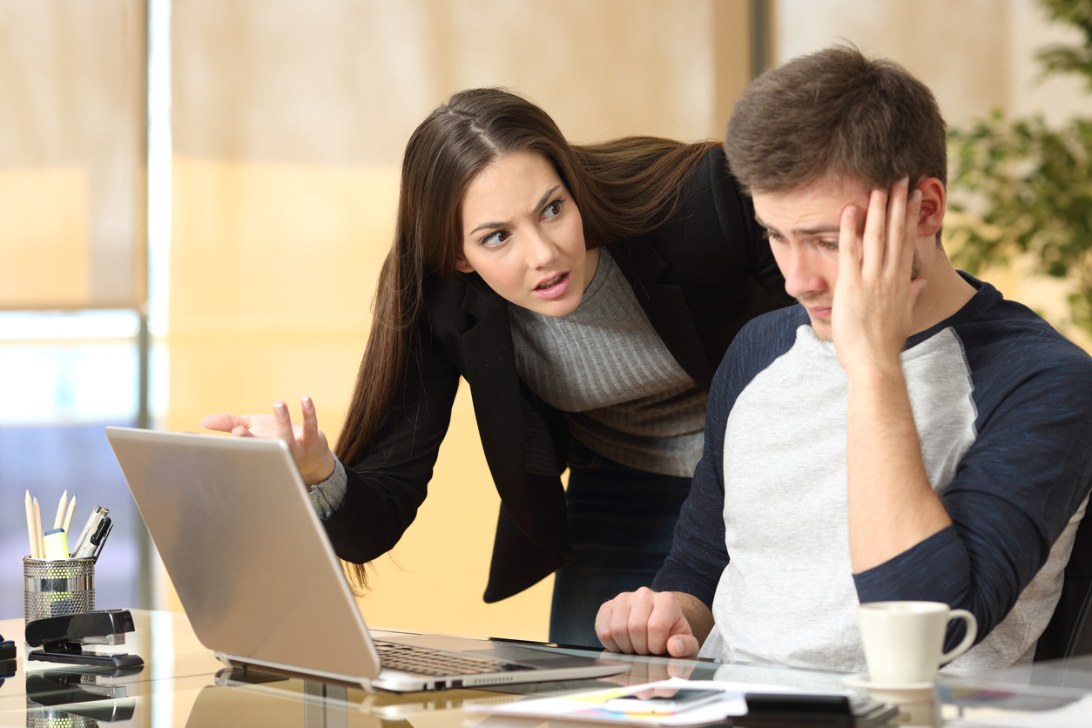
Incivility
Behavior that others perceive as rude or disrespectful
What does incivility in the workplace
look like to you?
Notes:
CK leads brainstorm – Chat 2 minutes
So think to the questions we had you address as you entered – what actions or behaviors in the workplace help define incivility?
And remember this might look different for each of us…

Slide 9
The tell tale signs
Rude Behavior
Disrespectful
Intimidation
Snarky Comments
Demeaning
Ignoring Others
Notes:
Jean catches anything missed – 2 minute

Slide 10
“Incivility is in the eyes of the recipient.
It’s how people feel they are treated”
-Christine porath
Notes:
Jean re-emphasizes 1 minute

Slide 11
why do we care at work?
Decreased
Customer Satisfaction
Work Effort
Lost Work Time
Quality of Work
Creativity
Morale
Notes:
Jean – 3 minutes

Slide 12
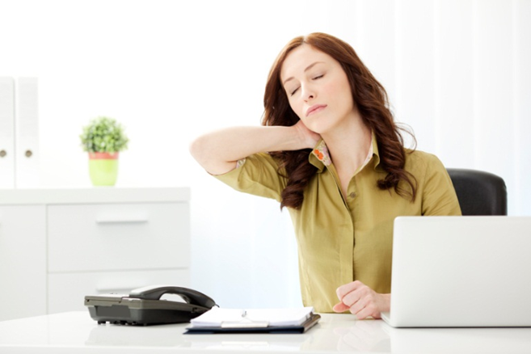
why do we care personal?
Emotional Labor
Stress
Health
Notes:
CK – 3 minutes
So, Jean discussed the cost of incivility to the business, the organization, but there is a huge cost to employees as well.
FAAS Foundation - funds efforts to create healthy, safe work environments and research scientist Zorana Ivcevic Pringle
50% of workers describe feeling stressed, frustrated and overwhelmed at work, and many of the things they shared that cause them to feel unpleasant emotions were related to other people in the workplace.
I just finished reading the book, Permission to Feel - and among other things the author talked about Emotional Labor - effort required to manage emotions.
2018 Gallup Poll surveying over 30k people
34% say they routinely miss 3 - 5 workdays per month owing to job stress
Similarly, in the book Indistractable – depression costs the US economy over 51 billion annually in absenteeism and this is just those who reported having an official diagnosis of depression
Stanford University Study –
more than 120,000 deaths annually may be attributed to workplace stress, and accounts for $190 billion in healthcare costs.
Amy Edmondson, org behavioral scientist at Harvard = Psychological safety – the belief that one will not be punished for speaking up with ideas, questions, concerns, or mistakes.”“Knowing that your voice matters and that you’re not stuck in an uncaring, unchangeable machine has a positive impact on well-being. P. 175

Slide 13

Colorado State Library
State library MISSON
The Colorado State Library (CSL) helps libraries, schools, museums, and other organizations improve services, making it easier for all Coloradans to access and use the materials and information they need for lifelong learning.
State library values
  Access
  Education
  Integrity
  Service
Notes:
CK – 2 minutes
The last piece of this, as Jean alluded to, is incivility can directly affect our relationships with others. Not just within our organization, but our relationships with those we serve.
How many of your organizations have a mission statement? Values?
How many of you know what they are? Don’t worry…we are not going to quiz you…
Mission– Values – On the screen you can see the Colorado State Library’s mission and values. These are key, because we are a support organization…hopefully supporting you!
How do we live these everyday? As employees? As an organization?
According to Russ Harris, author of the Happiness Trap, values are “how we want to be, what we want to stand for, and how we want to relate to the world around us - p. 54
And that ties directly back to civility.
So, as we move into the rest of the session. Keep your org’s mission and values in mind…or make sure to look them up later.

Slide 14

What can supervisors do?
Notes:
Supervisor stuff – 4 min
34 minutes in
How many supervisors do we have in the room? Raise hands

Slide 15

What can supervisors do? Recommendations
Safe Space
Training
Adopt Policies
Take Action
Express Appreciation
Accountability

Slide 16

What can I do?
Self-Care
Notes:
Jean – 3 minutes

Slide 17
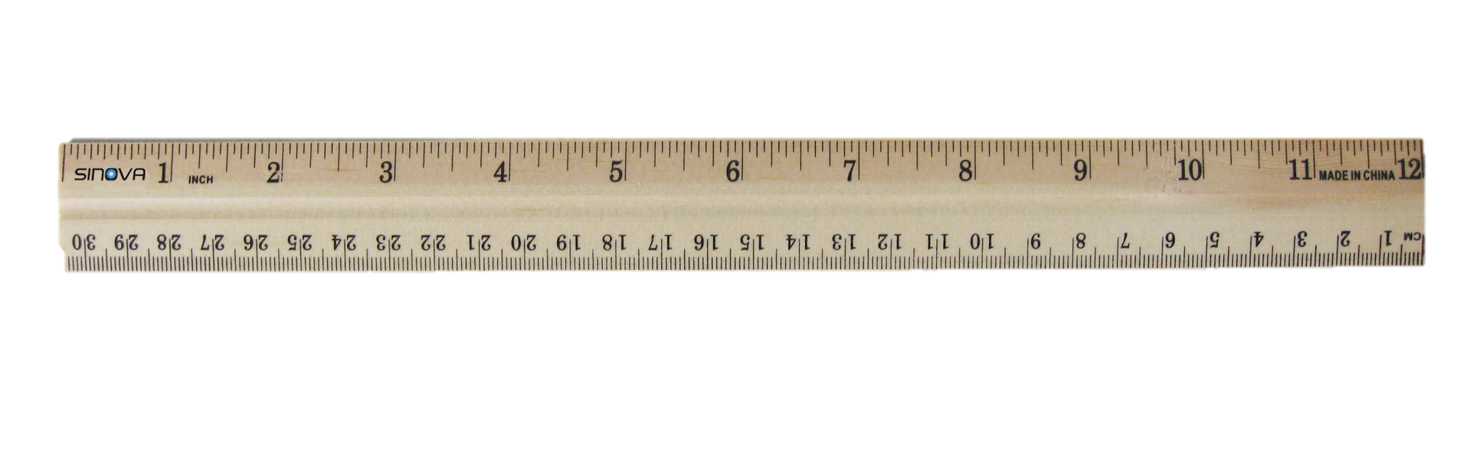
What can I do? Permission to Feel
Recognize
Understand
Label
Express
Regulate
Notes:
CK – 3 minutes
Going back to the book, Permission to feel, the author states, We assume work is powered by skills and experience, by brainpower and accomplishment...but “emotions are the most powerful force inside the workplace - as they are in every human endeavor.” p. 219
In short, Our feelings matter. They are not good or bad, and one person's feelings are not more or less valid than another's
They direct:
Where our attention goes
Decision making - we perceive the world differently depending upon how we feel
Social relations - how we approach others and how they approach us
Health - emotions cause different physical reactions in our body
Performance (creativity/effectiveness) –
We need to be able to use our emotions as tools
Building upon Emotional Intelligence, Marc Brackett outlines a 5-step process to help us positively regulate emotions.
Recognize our own emotions and those of others – physiological level
Understand our feelings and determine their source - what aroused them and how they influence our behaviors
Label emotions – be specific – better able to solve it
Express feelings in accordance with cultural norms and social contexts in a way that tries to inform and invites empathy from the listener –
Don’t suppress emotions – not healthy
can't just yell at people
Civility needs to allow the expression of all emotions in a way that is safe, but helps us move forward
Regulate emotions, rather than let them regulate us - practical strategies

Slide 18
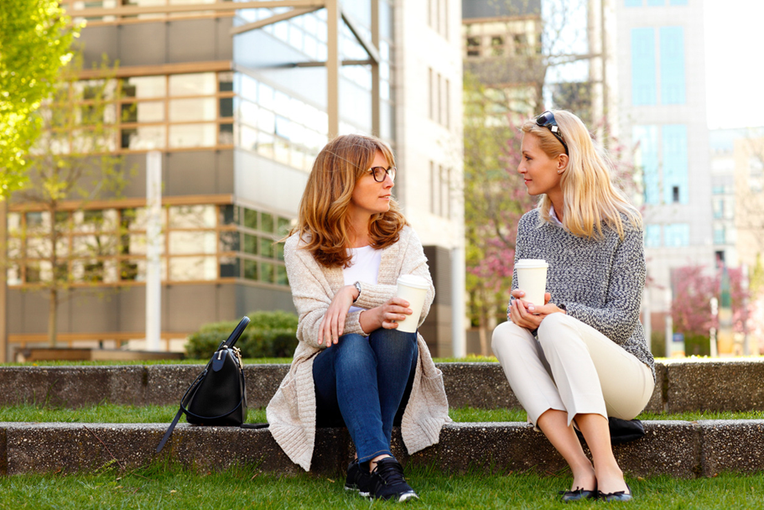
What can I do? Talk about it
Notes:
CK - 3 minute
Here is what I feel and why
Here is what I want to happen next
Here is what I need from you right now
CK could share
I feel unconnected/disengaged when I feel I am not being heard. Makes me incredibly anxious, and then I get frustrated and angry.
Also frustrated when I am trying to figure out hard stuff. How are people to know WHY I am feeling frustrated? Starting to listen to my own tone and say: I can hear the frustration in my voice. It is not directed at you; I am just trying to figure this out
Giving and receiving feedback - Civility is claiming and caring for one's identity, needs, and beliefs without degrading someone else’s in the process.
Difficult conversations provide an opportunity to increase morale, develop collaboration, and foster positive workplace” – Farrell – from Jean’s difficult conversations session.
Feedback does not always have to be a difficult conversation, but the Feedback Model Nicolle shared can help us navigate sticky situations, and be used in coaching moments of all kinds

Slide 19
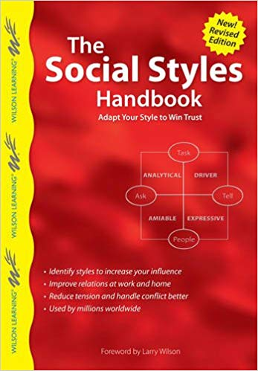
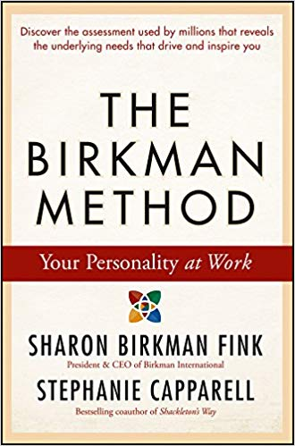
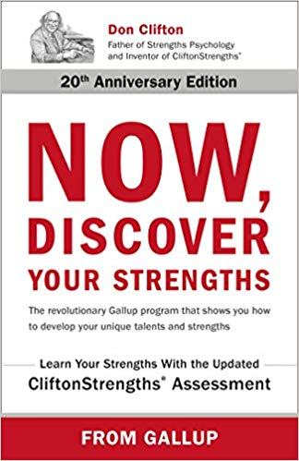
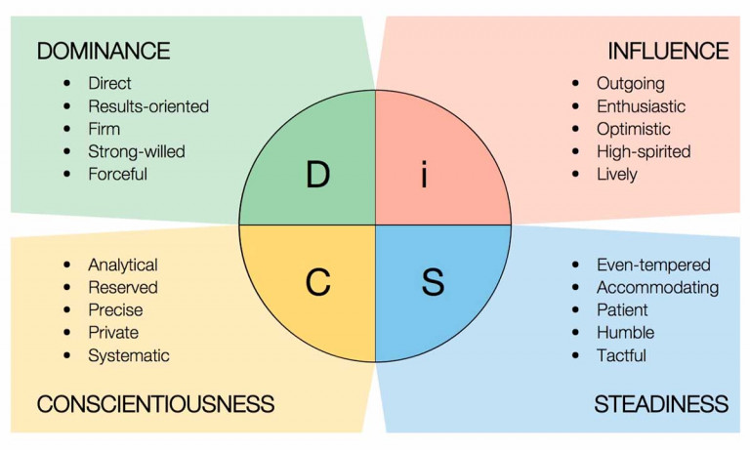

What can I do? Build relationships
Notes:
CK – 2 minute
Build connections/relationships
If incivility is contagious, so is civility - Brene Brown – People are hard to hate close up
The Institute for Civility in organizations notes the importance of
Disagreeing without disrespect
Seeking common ground as a starting point for dialogue
Beware of own biases
Ask for feedback – hone in on your blindspots
Get to know one another - Show people they belong, they matter
Common courtesy – Good morning, please and thank you
Active listening
Chris tine Porath also talks about Being a giver
Share resources
Share recognition
Share gratitude
Share feedback
Share purpose
All the work we do every day takes place within relationships often forged in non-work moments. p. 221 – Permission to Feel

Slide 20
What Can I do? Communication
Body Language
Verbal
Listening
Written
Notes:
Jean – 2 minutes

Slide 21
What Can I do?
Take responsibility for your actions
Model good behavior
Follow up on promises
Understand your triggers and hot buttons
Rely on facts not assumptions
How you respond when under stress
Manage Yourself
Notes:
Jean – 2 minutes

Slide 22
What Can I do? Civility Code
Bryan Cave’s Code of Civility
We greet and acknowledge each other.
We say please and thank you.
We treat each other equally and with respect, no matter the conditions.
We acknowledge the impact of our behavior on others.
We welcome feedback from each other.
We are approachable.
We are direct, sensitive, and honest.
We acknowledge the contributions of others.
We respect each other’s time commitments.
We address incivility.
Notes:
45 minutes in
CK starts activity – 10 minutes
What can we do? 1 minute
We can articulate values and set expectations –
According to Christine Porath – One of the best things you can do as an organization, is to create Group Norms. Define civility in our organization
Click to bring up Civility Code
So that is what we are going to do for the remainder of the session. You are going to start drafting your own Civility Code. We hope this will tie into your organization's mission and values, but you can only control your own behavior.
Instructions: 2 minutes
In workbook or on paper take 2 minutes to look at this civility code, and brainstorm some of your own statements
Start each statement with “I will
Don't just think about aspirations that you or your organization strive for, but action words. Specific things you can do every day.
Think about
Your responses to the questions at the beginning of the session - What specific actions/behaviors would help you feel engaged, motivated, safe, trusted?
Your organization’s Mission and values
How can you hold yourself and others accountable?
How can you share and encourage others to share?
Resources
Recognition
Gratitude
Feedback
Purpose
don’t worry about drafting complete sentences – focus on the action
Bring up chat pod to share statements – 2 minutes
We will create Google doc with all ideas to be shared after the session. You will be able to add statements after the fact

Slide 23
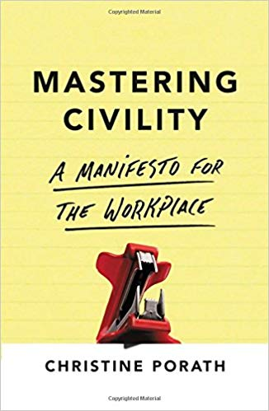

Books
Notes:
Wrap up – 5 minutes
Encourage attendees to use document to select 4-6 statements that can be their personal Civility Code – workbook
Mention directions in handout for group Civility Code activity that they can share with department, library etc.
Mention resources

Slide 24

Questions?
Notes:
Questions
Evaluations

