Slide 1
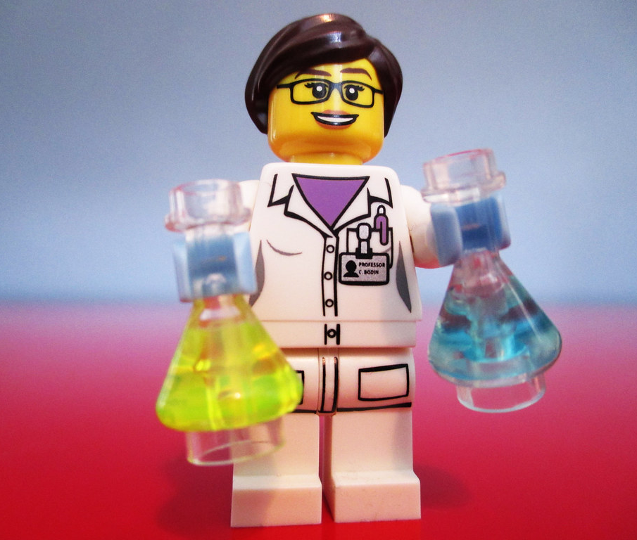
Leading with Emotional Intelligence:
Become an Emotion Scientist
Amy Shipley
Christine Kreger
"scientist-minifig" by pixbymaia is licensed under CC BY-NC-SA 2.0
Notes:
9:10-9:11
1 minute - Christine
Good morning! Today we’re going to talk about becoming emotional scientists and leading with emotional intelligence. We will talk a little bit about the science of emotions, do some activities to help you get in touch with your own feelings, and then we are going to brainstorm practical ways to apply emotional intelligence skills as a leader in our organization,. It’s important to note that in this session we’re talking about leadership from all levels of an organization, not leadership from a management or supervisory role. Working in the State Library, we are all leaders in some fashion. But, before we jump in, I would like to welcome my co-presenter today, Amy Shipley! Amy is the new Executive Director of the Basalt Regional Library.
Amy
Good morning! I am delighted to be joining all of you today! You all should have received a copy of the Playbook for today’s session via email. If not, I will add that to chat.
https://docs.google.com/document/d/13KayWncAEZjesmLTj609NRuRYRL_pOYd/copy
This playbook will give you all the resources we cover today so that you can take notes, explore, journal, draw, or anything else you want to do to capture what we cover today. The activities we’ll be doing in our session today are in the playbook as well.

Slide 2
How are you feeling today?
No, how are you really feeling?
Notes:
9:11-9:12
1 minute - Amy
To start, we want you to take just a moment and think about how you are feeling today, and jot that on the page 2 of your Playbook.
We wanted to acknowledge that this has been a hard year and a half with the pandemic, politics, social justice issues, and now we’re faced with the Delta and now Omicron variant of the virus as it continues.
So, as you think about how you are feeling today, just know as we go through today’s session that what you are feeling is ok, and it’s important to check in and notice how you feel.
Overall, our goals for this session are for you to understand that:
● Emotions are Powerful
● Emotions are Valid
● As a leader, whether you are “an emotional person” or not, it benefits everyone when leaders are emotionally intelligent because people you are leading have emotions.

Slide 3
Science of Emotions
Classic View
Basic Core Emotions
Theory of Constructed Emotions
Notes:
9:12 – 9:15 (slides 3&4)
Amy - Science of Emotions – 3 minutes (slides 3 &4)
As we were doing research for this presentation, it became clear that there is no single definition of emotion, and despite technological advances allowing us to map the brain, exactly HOW and WHERE emotions are created is unclear. There are many theories, however, here are 3 of them:
The Classical view: How many of you remember learning that facial expressions are universally recognized, and that emotions are the same across all cultures? (raise hands)
So, the classic view posits that our emotions are artifacts of evolution and that they are universal. Basically, that there is a fingerprint for emotions, and that people of every age, in every culture, in every part of the world should experience sadness more or less as you do.
No such fingerprints have been found!
Basic/Core Emotions
Another theory is that there are 6 core emotions, fear, anger, joy, sadness, disgust, and surprise, and some theorize that different emotions are linked to specific areas of the brain.
Daniel Goleman’s book Emotional Intelligence is somewhat based on the premise of core emotions and the idea that each emotion has a specific reaction in the body. However, he also stated that … “There are hundreds of emotions, along with their blends, variations, mutations, and nuances. Indeed, there are many more subtleties of emotion than we have words for.”
In his later works, he focuses more on what we can do with our emotional data rather than what causes emotions. We will circle back to Goleman’s work when we talk about how to apply Emotional Intelligence in a leadership context.
Theory of Constructed Emotion
Lisa Feldman Barrett, proposes in her book, How Emotions are Made, that emotions are constructed by our brains in the moment, rather than simply being experienced in the body. Essentially, an emotion is your brain's creation of what bodily sensations mean.
What we do know is that emotions are the product of complex processing systems, including the limbic system and the prefrontal cortex, which essentially convert sensory information into the psychophysiological and behavioral changes that we refer to as emotional responses.

Slide 4
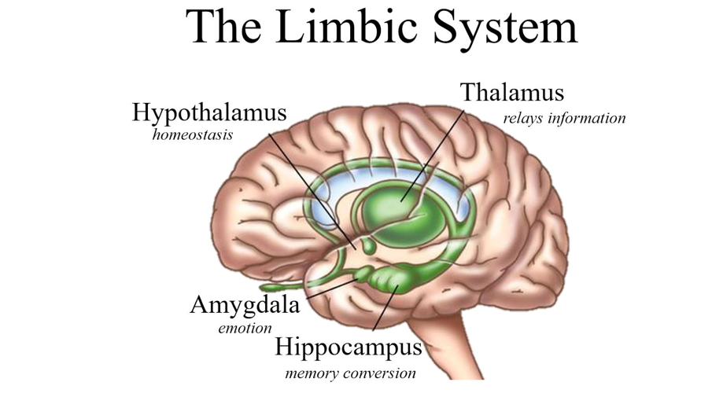
The Limbic System
Prefrontal Cortex
Notes:
Amy
On page 4 of your playbook, you can see a diagram of the brain, with brief explanations of the largely agreed upon roles of different parts of the brain.
We also know that between people, the physiological reaction is not consistent. It’s not the same from person to person. What evokes sadness and anger for me, may not be the same as for Christine, and how I experience sadness or anger may also be very different.

Slide 5
Importance of Emotions
Notes:
9:15 – 9:16
CK - Importance of emotions – 1 minute
Regardless of how or where emotions come from, the important thing to remember is that emotions matter. In fact, according to Marc Brackett, author of the book Permission to Feel, our emotions matter in every aspect of life. They direct:
● Where our attention goes
● Decision making - we perceive the world differently depending upon how we feel
● Social relations - how we approach others and how they approach us
● Health - emotions cause physical reactions in our body
● Performance (creativity/effectiveness)
Emotions are also contagious. The brain's limbic system is an open loop system which depends largely on external factors to manage itself. Unlike a closed loop system, like our circulatory system, which is self-regulating, this means that humans rely on our connections with others for our own emotional stability.
The emotional states of others can affect our hormone levels, cardiovascular function, sleep rhythms, and immune function.
Leaders provide cues for how to respond in any given situation and can directly impact the emotions of the group. So, we need to be able to use our emotions as tools or data. As leaders, we need to become emotion scientists!

Slide 6
Core Elements of Emotional Intelligence
S e l f | Recognition/Awareness |  | O t h e r s
 | Self Awareness Emotional Self Awareness Accurate Self Assessment Self Confidence | Social Awareness Empathy Organizational Awareness Service
 | Self Management Emotional Self Control Transparency Adaptability Achievement Initiative Optimism | Relationship Management Influence Inspirational Leadership Developing Others Change Catalyst Building Bonds Conflict Management Teamwork & Collaboration
 | Regulation/Control
Notes:
9:16 – 9:18
CK 1.5 minutes
Core Elements of Emotional Intelligence
So, let's talk more about Emotional Intelligence. According to Daniel Golman, Emotional Intelligence is a group of skills that allows us all to recognize and understand emotions and to use that awareness to manage behavior and relationships. Golman was not the first to theorize about Emotional Intelligence, but his 1995 book Emotional Intelligence, popularized the concept, and was one of the first to apply Emotional Intelligence to the workplace.
Emotional Intelligence comprises 4 Core Elements and 19 sub-elements.
You can see by the diagram on page 5 of your playbook, that Goleman’s Emotional Intelligence model breaks the 4 core elements into personal competence, or how we manage ourselves, and social competence, which determines how we handle relationships. He also breaks it down into skills for recognition of emotions in ourselves and others and regulation of emotions in ourselves and others.
You should have completed the self assessment on page 2 & 3 of your playbook by rating yourself on the 19 items from 1-10.
This is not a formal assessment, where you add up numbers and get a concrete score, but rather a general gauge of how you rate yourself on the 19 Emotional Intelligence elements. There is no right or wrong, and anything on which you gave yourself a score of 6 or above is good!
Make a quick note of where you scored highest, and we will revisit after we dive deeper into the Core Elements of Emotional Intelligence.

Slide 7

Self Awareness
Notes:
9:18 – 9:25 (through slide 10)
AMY - Let’s start with Self Awareness - (7 minutes)
The Definition of Self Awareness is - knowing one's internal states, preferences, resources, and intuitions. Essentially, knowing what I am feeling and why.
Self-Awareness is the basis of Emotional Intelligence. You can't manage your emotions if you don’t know what they are. Self-awareness also extends to a person’s understanding of his or her values and goals. Someone who is highly self-aware knows where they are headed and why.
The Science of Self Awareness is that it utilizes the prefrontal part of the brain to monitor feelings about our preferences. Self-Awareness also utilizes our Amygdala, which is where our gut feelings originate. Essentially, a stream of feeling runs alongside our stream of thought, but we are not taught to pay as much attention to our emotions as our thoughts. We can often be blindsided by intense emotions because we were not paying attention
Elements:
You can see that self-awareness is comprised of:
■ Emotional awareness - Reading one’s own emotions and recognizing their impact
■ Accurate self-assessment - knowing one's strengths and limits
■ Self-confidence - a sound sense of one's self worth and capabilities

Slide 8
RULER
Recognizing
Understanding
Labeling
Expressing
Regulating
Notes:
AMY
In his book, Permission to Feel, Marc Brackett shares an acronym for skills related to Emotional Intelligence, that fits well for both the personal and social competencies. On page 6 of your playbook, you can see the RULER acronym.
RULER:
● Recognizing emotions in oneself and others
● Understanding the causes and consequences of emotions
● Labeling emotions with a nuanced vocabulary
● Expressing emotions in accordance with cultural norms and social context
● Regulating emotions with helpful strategies
Recognizing, Understanding, and Labeling fit right in with Self-awareness, so let's practice recognizing and labeling our emotions.

Slide 9
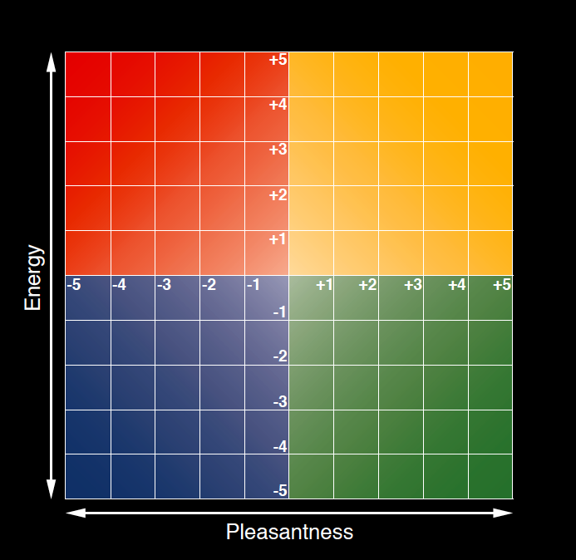
Mood Meter
http://moodmeterapp.com/
https://www.marcbrackett.com/the-colors-of-our-emotions/
Notes:
Amy
Activity – Recognize feelings in body
Look again at what you wrote about how you are feeling today, and think about:
■ Has it changed?
■ How did you know what you were feeling?
■ What cues did your body give you?
■ Is what you wrote really describing what you feel?
Now take a look at the Mood Meter, on page 6, developed by James Russell, a professor at Boston College, and shared in Permission to Feel.
The mood meter is Also an app - http://moodmeterapp.com/
The Mood Meter helps people define emotions on two dimensions: Energy, or how much physical energy is running through our bodies, and Pleasantness, or our subjective, private mental experience.
The red quadrant is for unpleasant, high-energy emotions, feelings like anxiety, rage, frustration, anger, and fear.
The blue quadrant is for unpleasant, low energy feelings like disappointment, sadness, or discouragement.
The green quadrant is for pleasant, low energy feelings like calm, relaxation, and contentment.
The yellow quadrant is for pleasant, high-energy feelings like joy, excitement, and elation.
Can you place your current emotional state into one of these 4 quadrants? How pleasant do you feel from -5 to +5? How much energy from -5 to +5 is running through your body?
What is the color of your quadrant? If you feel comfortable, list that in chat.

Slide 10
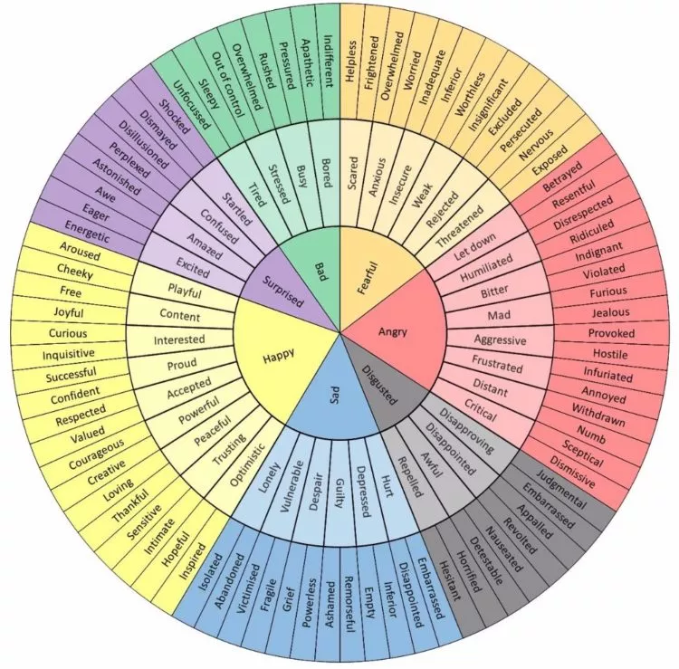
Mood Wheel
https://themighty.com/2020/09/charts-to-help-identify-emotions-mental-health/
Notes:
Amy
Another tool for self awareness is the mood wheel on page 7. This tool can help you cultivate a nuanced vocabulary for the emotions you feel. Can you find a label for your current emotion that better describes what you are feeling? Is there a word that gets at both your levels of pleasantness and energy?
If you feel comfortable, please add that to chat.
If time, what do you like/dislike about the mood meter or mood wheel? 2 minutes

Slide 11

Self Management
Notes:
9:25 – 9:28 Slides 11 & 12)
Christine – 3 minutes
Now let's look at Self-Management or Self-Regulation which is all about managing one's internal states, impulses, and resources. Basically, managing one’s actions, thoughts, and feelings in flexible ways to get desired results and being able to adapt to changing circumstances.
Science – Our prefrontal lobes are designed to help regulate our response to stress, but they can be overridden by the amygdala. We secrete hormones when stressed to prepare for fight/flight, but those hormones stay in our bodies for hours, so even seemingly minor stresses can build on each other directly impacting our working memory, decision making, and overall productivity.
○ Among the sub elements Goleman includes things like:
■ Emotional Self control
■ Adaptability
■ And Initiative
If we return to Marc Bracket’s RULER skills, Self-Management is all about expressing and regulating our emotions. But remember, that emotions are not good or bad, so by regulating, we are not talking about suppressing emotions, but finding healthy ways to express them.
Expressing emotions is all about how you are showing this feeling to the world. What about your face, body, voice, and actions align with how you are feeling? Is the way you’re expressing your feeling helpful for the situation you are in?
Regulating, then, is about the strategies you can use to feel more, less, or the same of what you are feeling? Is your current feeling helpful? If so, what will you do to continue feeling that way or to intensify that feeling? If not, what could you do to feel less of the feeling or to shift to feeling something different?

Slide 12
Meta Moment
Here is what I feel and why
Here is what I want to happen next
Here is what I need from you right now
Notes:
Christine
On page 8, Marc Brackett recommends taking time to pause, or to take a Meta Moment before we express our emotions. To literally think about our emotions.
● Here is what I feel and why
● Here is what I want to happen next
● Here is what I need from you right now
CK story – Some of you heard this story before, but I can feel unconnected/disengaged when I feel I am not being heard. Makes me incredibly anxious, and then I get frustrated and angry. I also can feel frustrated when I am trying to figure out hard stuff. I have learned that when I feel frustrated, I get a particular edge to my voice.
So, how are people supposed to know WHY I am feeling frustrated? I am starting to listen to my own tone and when I recognize that edge, I can say: I can hear the frustration in my voice. It is not directed at you; I am just trying to figure this out. Can I ask a few questions? OR, I can hear the frustration in my voice, I seem to be having trouble making myself clear. Can we talk this through a bit more? This takes practice, and self management is dependent upon self awareness.
● Here is what I feel and why
● Here is what I want to happen next
● Here is what I need from you right now

Slide 13

Social Awareness
Notes:
9:28 – 9:30 (Slides 13 & 14)
AMY - Social Awareness (2 minutes)
Now let's move onto Social Competencies, or the Emotional Intelligence skills that determine how we handle relationships, starting with Social Awareness.
Social Awareness is the ability to accurately notice the emotions of others and “read” situations appropriately.
When we talk about the Science of Social Awareness, we talk about Empathy – Empathy is our social radar which relies on biological mimicry. When we see others’ facial expressions, and interpret them as happy or sad, we can literally feel that emotion. This ability to empathize with others stems from neurons in our extended circuitry to and in the amygdala that read another person’s face and voice and attunes to how someone feels as we speak to them.
Empathy is dependent upon our own self-awareness, and leaders cannot influence others without empathy. Empathy allows leaders to listen and see other’s perspectives.
In addition to empathy, other sub-elements include organizational awareness, or being able to read the currents, decision networks, and politics at the organizational level, and service - Recognizing and meeting follower, client, or customer needs

Slide 14
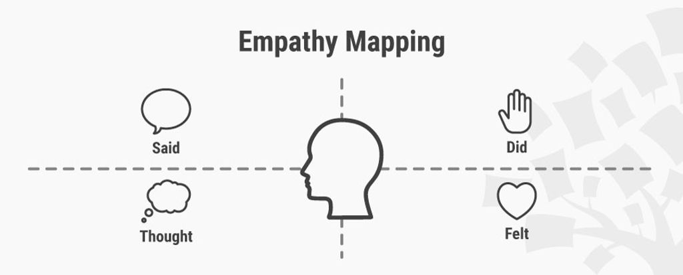
Empathy Map
https://www.interaction-design.org/literature/article/empathy-map-why-and-how-to-use-it
Notes:
Amy
Example – Empathy Map
Who here has heard of or used an Empathy Map? Borrowed from the world of design thinking, you can see on page 9 of your playbook that an Empathy Map consists of four quadrants reflecting what another Said, Did, Thought, and Felt. An empathy map can be a great tool to use if you are having trouble communicating with someone. It can put you in the other person’s shoes, by helping you to reflect on what they MAY be thinking and feeling based upon what they said and did.
The key here is to do the exercise to help you tap into empathy for the other person, and to follow up later with that person to see if your thoughts are on the right track. Remember, not everyone experiences emotions in the same way or at the same time.
When you check in with that person later, you can say something like “I have thought more about our interaction the other day, and the story I am telling myself is….” and then go into what you learned when you mapped out the interaction to check to see if you were on the right track.

Slide 15

Relationship Management
Notes:
9:30 – 9:35 (slides 15 & 16)
Christine - Relationship Management (5 minutes)
And, lastly, we have Relationship Management or the ability to take into consideration our own emotions, the emotions of others, and the context of the situation to manage social interactions successfully. These social skills are built on all the previous Emotional Intelligence skills, self-awareness, self-management, and social awareness, and is our most valuable leadership tool when it comes to persuasion, and influence.
Science – We now know that we directly influence each other’s moods, and this emotional exchange is part of every human interaction. Relationship skills allow leaders to put emotional intelligence to work.
So, according to Goleman, important sub elements include:
■ Inspirational leadership - Guiding and motivating with a compelling vision
■ Having influence over those you interact with
■ The desire to Develop others - via feedback and guidance
■ Change catalyst - Initiating, managing, and leading in a new direction
■ Conflict management skills
■ Teamwork and collaboration
■ Building Bonds – Cultivating and maintaining a web of relationships

Slide 16
Listening and
Asserting Skills
Listening Skills | Asserting Skills
Releasing Attending Amplifying Reflecting | Clarifying Intentions Remaining Centered Expressing Supporting Persisting
Uroda, Kathy, et al. Leadership Through Influence. Lore International Institute, 2008.
Notes:
Christine
Activity – Listening and Asserting
A core component of building relationships, is using emotional intelligence to communicate effectively. And good communication requires listening and asserting skills.
Turn to page 10 in your playbook to look through listening and asserting skills you can practice when you communicate.
2 Minutes to add to chat - Take a moment to review the skills listed, what resonates with you? What does not? Anything you would add?

Slide 17

Scenario
You are facilitating a meeting with library staff from across Colorado, and one member is bullying other members.
You do not know any of the attendees well.
How would you use your strongest Core Element to address this behavior, either during the meeting, or after the meeting with the bully, or with the person being bullied, or both?
Notes:
9:35 – 9:37
1.5 minutes
CK- So, now we are going to spend some time really digging into Emotional Intelligence from a leadership perspective.
Flip back to your self-assessment and note the Emotional Intelligence Core component where you had the highest ratings overall.
Amy is going to give us a scenario, and we are going to have you break into 4 groups by core elements: Self Awareness, Self-Management, Social Awareness, and Relationship Management. You will pick the breakout room where you feel you scored the highest.
CLICK
Amy - The scenario is also included on page 11 of your playbook, followed by a list of emotional intelligence competencies you may find helpful as you discuss the scenario.
So, today, you’re facilitating a meeting with library staff from across Colorado, and one member is bullying other members. You do not know any of the attendees well. How would you use your strongest Core Element to address this behavior, either during the meeting, or after the meeting with the bully, or with the person being bullied, or both.
Christine – Explains breakout
TEST IN ZOOM
Ok, so we are going to have you go into breakout rooms. When you see the prompt on the screen, you will select the breakout room labeled with the Core Element you scored the highest on.
While you are in your breakout rooms, you will have access to audio, video, and chat that no one else can see. Please pick a person to take notes and report out when we come back together.
There will be a 60 second warning when the rooms before the rooms will close, and you will automatically be returned to the main room.
We’ll give you about 8-10 minutes to talk, and then we’ll ask each group to report out.

Slide 18
Using Emotional Intelligence
Notes:
9:37 – 9:45 – in groups
9:45-9:55 8-10 minutes - Groups report out

Slide 19
EQ Action Plan
Select a Core Element you want to work on in the next month.
Pick a strategy or 2 you can commit to practicing over the next month.
Think of someone you work with that excels in the skill you are wanting to work on and set a date to meet.
Notes:
9:55 – 10:00
1 minute talking
Amy - Thanks for participating in our Emotional Intelligence Leadership discussions. Hopefully, you either learned a few new strategies to try, or learned that you know more about Emotional Intelligence than you previously thought!
CK - Action Plan
As we wrap up today’s session, we want you to leave with an action plan for practicing Emotional Intelligence. So, once again, take a look at your self-assessment, and select a Core Element you want to work on in the next month.
Turn to page 14 in your playbook
List that element and a sub-element if relevant
Think about everything we have talked about today and pick a strategy or 2 you can commit to practicing over the next month. List those in your playbook. You may also want to check out some of the resources on page 15 for more inspiration.
Think of someone you work with that excels in the skill you are wanting to work on. Note that person in your playbook and set a date to contact them this month to chat.
Amy - And don't forget all the resources we have included at the end of your playbook.

Slide 20
Questions?
"scientist-minifig" by pixbymaia is licensed under CC BY-NC-SA 2.0
Notes:
Survey - https://www.surveygizmo.com/s3/4404594/kreger-c

