Slide 1

North of 50
Making libraries fun, welcoming, and enriching places
for older adults

Slide 2
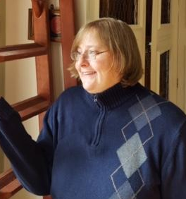
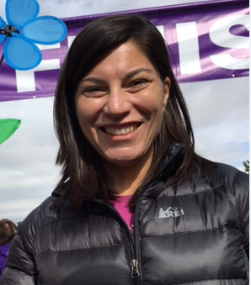
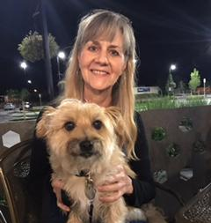
Introductions
Tara Bannon Williamson
Senior Librarian
Amy DelPo
Reference Librarian
Stephanie Two Eagles
Shelver

Slide 3
Inspirations

Slide 4
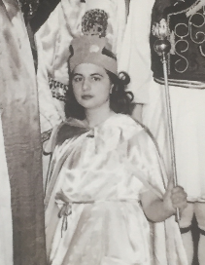
Stephanie
“I’m inspired by my mother, Mary.”

Slide 5
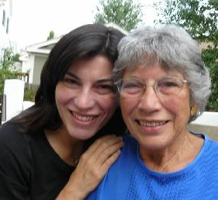
Amy
“I’m inspired by my mother, Eleanor.”

Slide 6
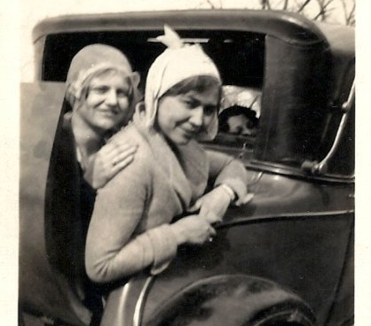
Tara
“I’m inspired by my grandmother, Willa”

Slide 7
Who inspires you?

Slide 8
Successes!

Slide 9
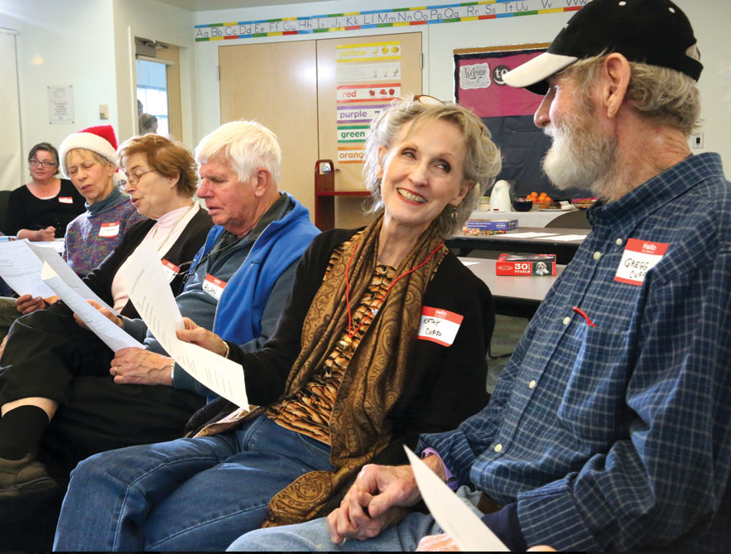
Memory Cafe
A social group for people experiencing memory loss, along with their friends, family members, and caregivers

Slide 10
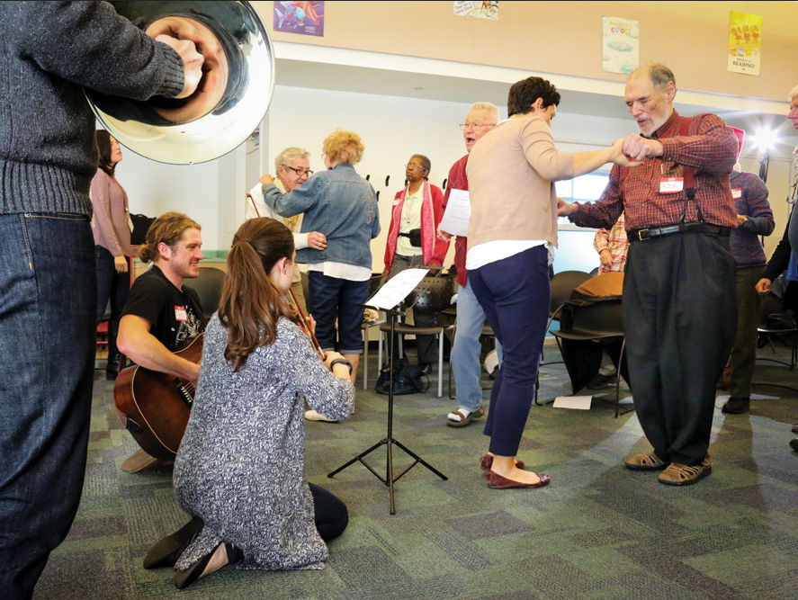
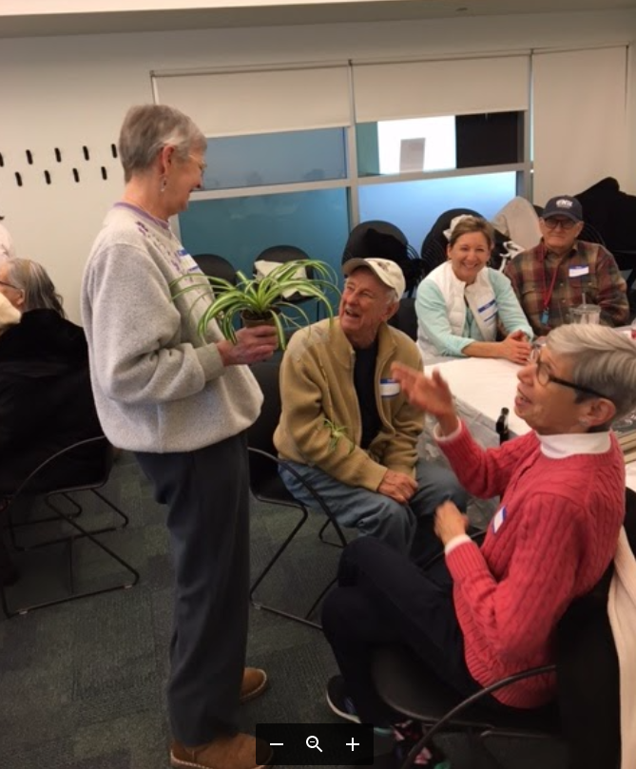
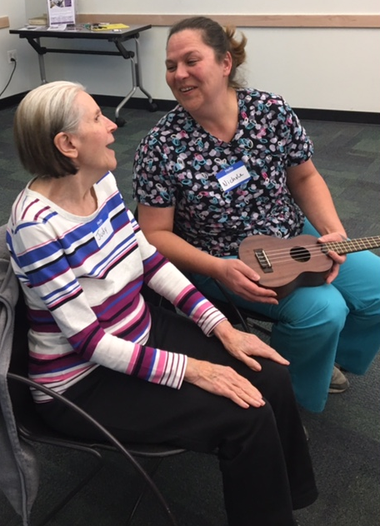
Memory Cafe Programs

Slide 11
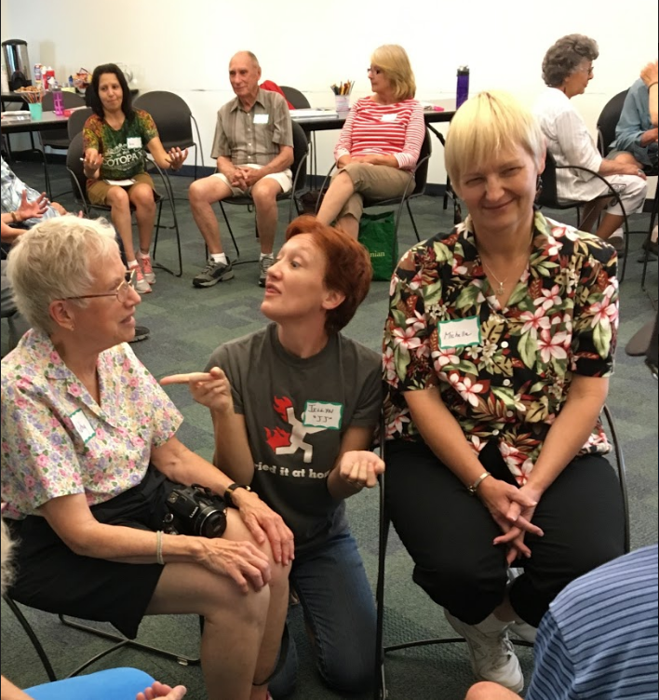
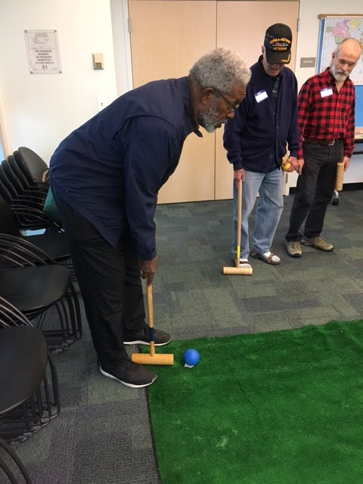
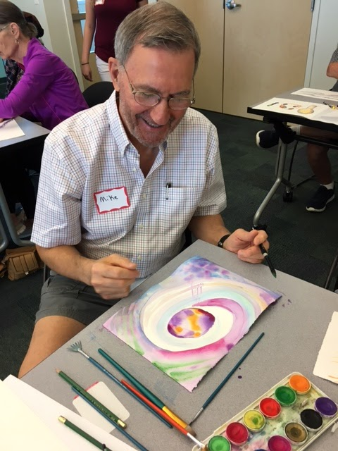
More Memory Cafe Programs

Slide 12
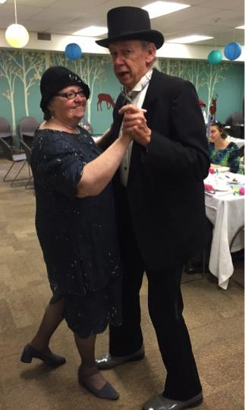

What programs are you doing for this population? If you are already doing programs, what do you call them? Did you name the series?

Slide 13
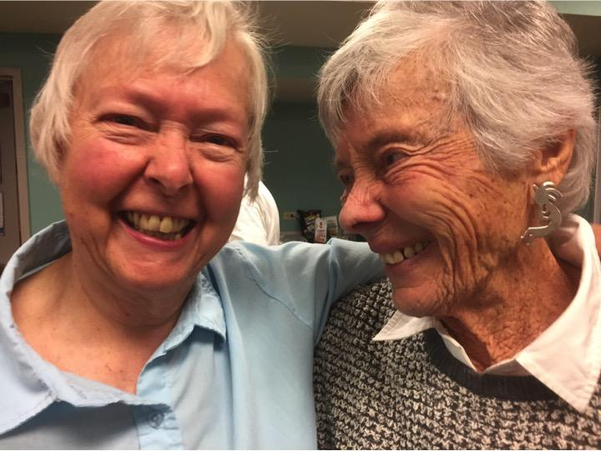
Getting Started & What’s in a Name?
2015
•Origami for Seniors (May and November)
•No Strings Attached Book Chat
•Voice of the Wood Chamber Players
2016 (Jan-June)
•Parkinson’s Disease
•Navigating Assisted Living Options
•Bell Policy Center
•Nutrition and Brain Health
•Simple Techniques for Pain Management
•$ecure Colorado
Notes:
Stephanie

Slide 14
Picking up Steam
2016 (July-December)
•This is Your Brain on Dance
•Plant Based Diet with Dr. Freeman
•The Basics: Memory Loss, Dementia and Alzheimer’s
•AARP: Plan Well to Live Well
•Two Raging Grannies film and discussion
•No Dumb Questions: You and Your Phone
•Celebration and Brainstorming
Notes:
Stephanie

Slide 15
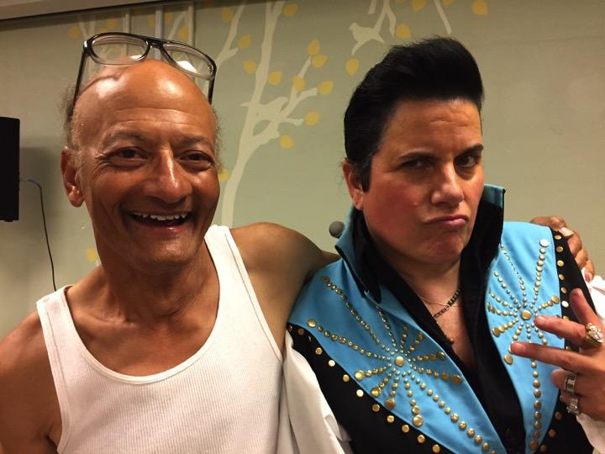
Our Year So Far
Grief and Loss with Denver Hospice Autumn Romance with C. Ruthy Denker Colorado Talking Book Library Caregiving in the 21st Century with AARP Life Reimagined with AARP Bridge Time: The Consequences of Change Cross-Country Cycling over 60 Financial Resilience with AARP Advanced Directives Compassion Fatigue with AARP Reaching Older Adult Drivers – Transpo Fair
Origami for Seniors
Choir for the Tone Deaf
Laughter Yoga* Holiday Blues*
Notes:
Stephanie

Slide 16



Organizations for Seniors

Slide 17
Using Data
Data Points
Cookbooks High Circulation Rate
Demographics
Requests from Customers
Results
Cooking for #1

Slide 18
Customer Quotes
“I have Chronic Fatigue Syndrome and have scaled back on all of my activities, even quitting choir. The only thing I still attend is this book club anymore.” “I recently took time off of work as a nurse for a hip replacement. The drugs make it too hard to read but I have been coming to 2-3 programs all over the system each week. As a traveling nurse, I travel all over the country, and am always going to libraries and love this one so much that I would like to retire in Denver.”

Slide 19
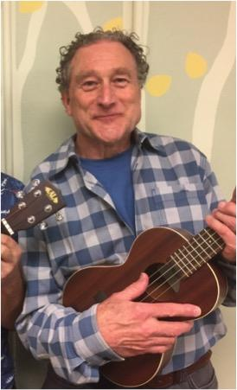

Rocky Mountain Ukulele Orchestra
A grandpa who regularly attended my baby storytime stopped me in the hall to let me know that he was so inspired by seeing me play the ukulele in baby storytime that he decided to attend the ukulele classes offered at Park Hill. He found that he loved the ukulele so much that he has now joined the Rocky Mountain Ukulele Orchestra, and says he owes it all to us.

Slide 20
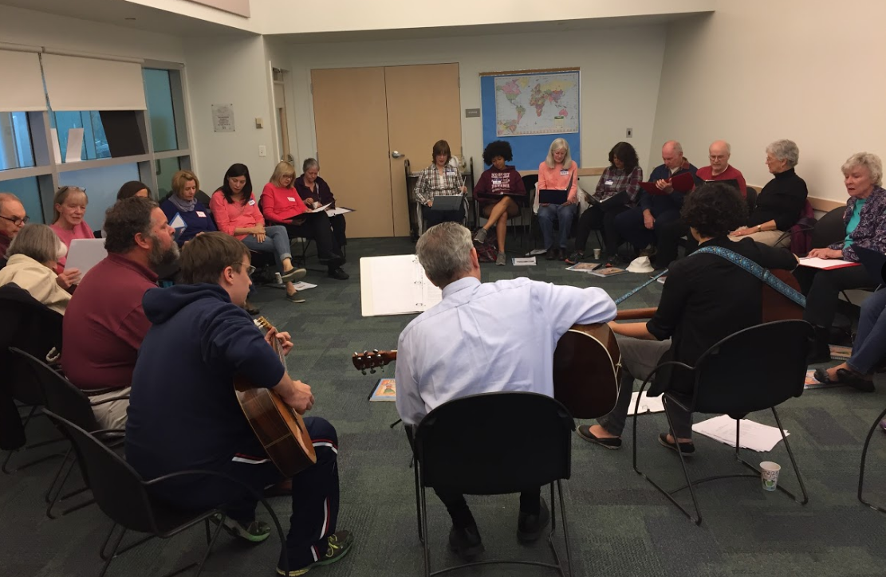
Community Singers
A singing group for anyone who loves to sing -- on key or off!

Slide 21
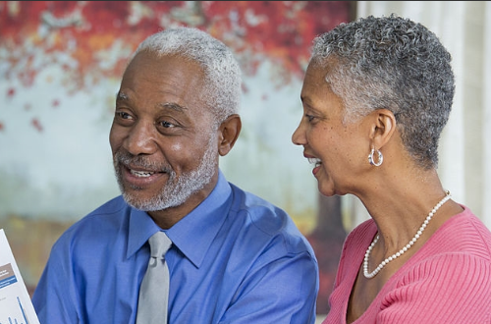
Conscious Aging
An eight-week series about embracing aging and living a passionate and fulfilling mature life

Slide 22
Lessons Learned

Slide 23
Lessons learned #1
Intergenerational means fun for everyone!
People crave information
Think about the physical space
The more relationships you build, the more successful you will be
Great ideas are everywhere, if you keep your eyes and ears and mind open
Don’t be afraid to experiment… and sometimes even fail

Slide 24
Lessons learned #2
Train your staff in age friendly and dementia friendly practices
Find partners in your community
Seniors are busy! Use consistent timing
Everyone loves snacks!
Details are appreciated
Reject stereotypes
Have FUN!

Slide 25
Do now (or kind of soon-ish)!

Slide 26
Actions you can take right now
Make a commitment to serve this population
Make a list of ideas of programs you can offer and services you can provide
Pay attention to who your customers are
Dig into demographics

Slide 27
Questions? Comments? Please share!

