Slide 1
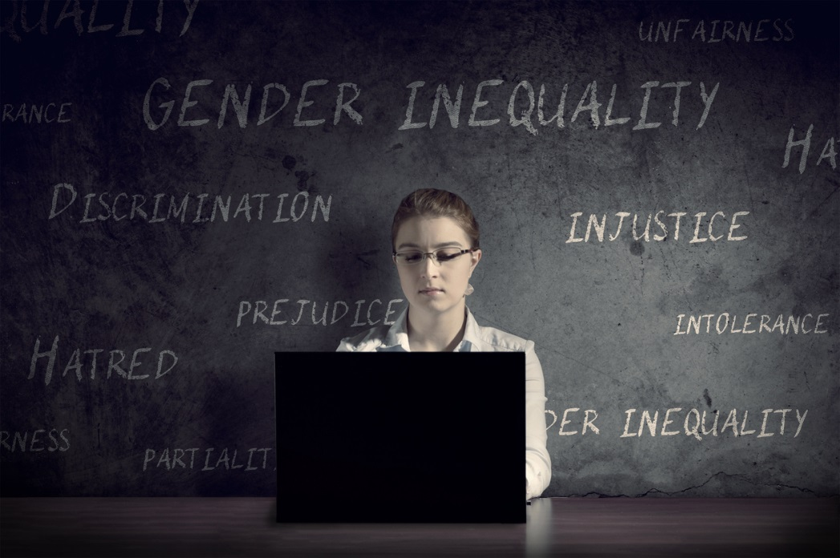

The Hidden Biases of Good People
Beth Crist Jean Marie Heilig
Youth Services Fiscal Officer

Slide 2
Outcomes
Identify your personal biases
Understand the impact of unconscious bias
Identify the types of bias behavior
Learn how to think and behave differently

Slide 3
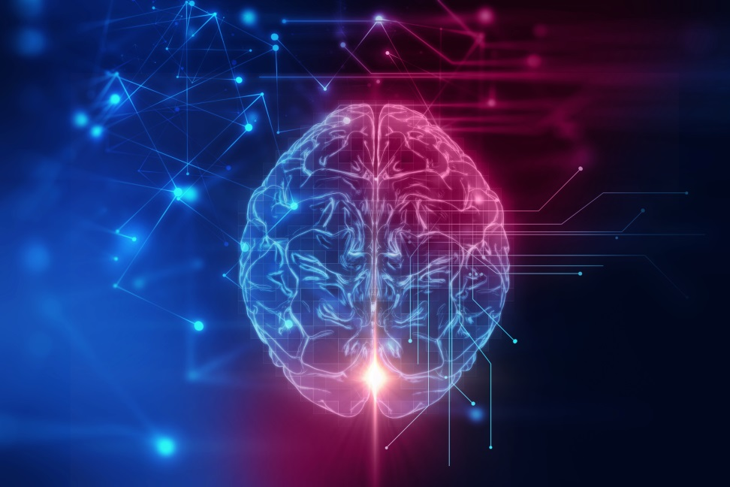
“If you have a brain you’re biased”
-Dr. Heidi Grant
NeuroLeadership Institute

Slide 4
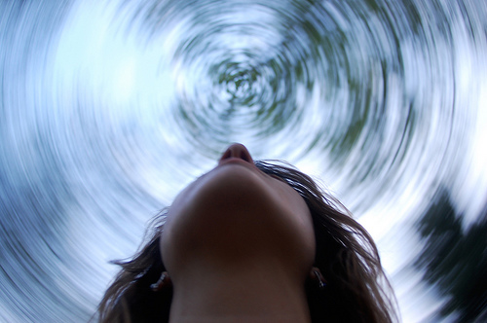

I’m so confused!
Explicit
Microaggressions
Micro-assault
Micro-insult
Micro-invalidation
Bias
Implicit / Unconscious
Prejudice
Discrimination
Environmental

Slide 5
What do you think?
What kind of Asian are you?
https://www.youtube.com/watch?v=DWynJkN5HbQ

Slide 6

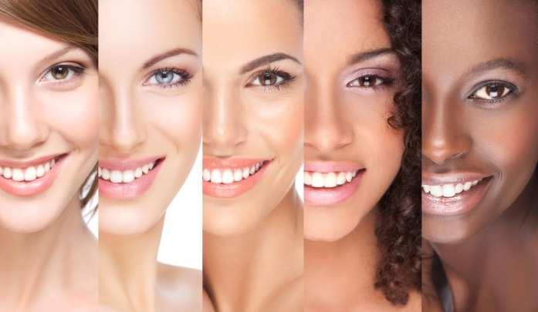

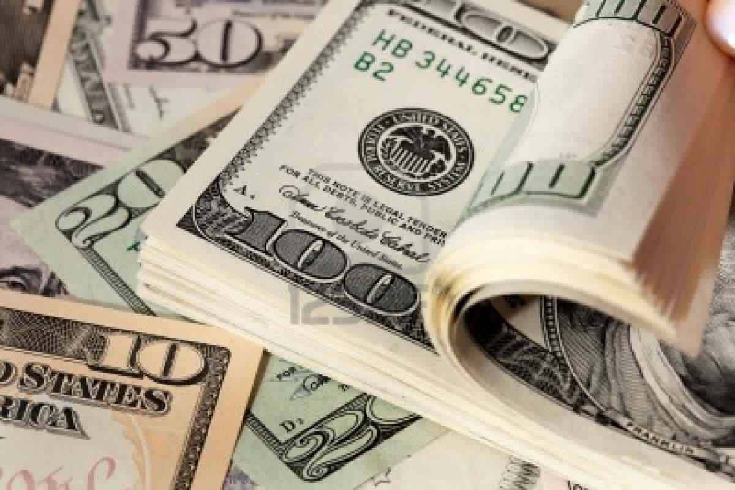
Things people can be biased about

Slide 7
Where do these biases come from?
Direct Experiences
(with other people, events, situations)
Vicarious Experiences
(those relayed to us through other people, stories, books, movies, media and culture)

Slide 8
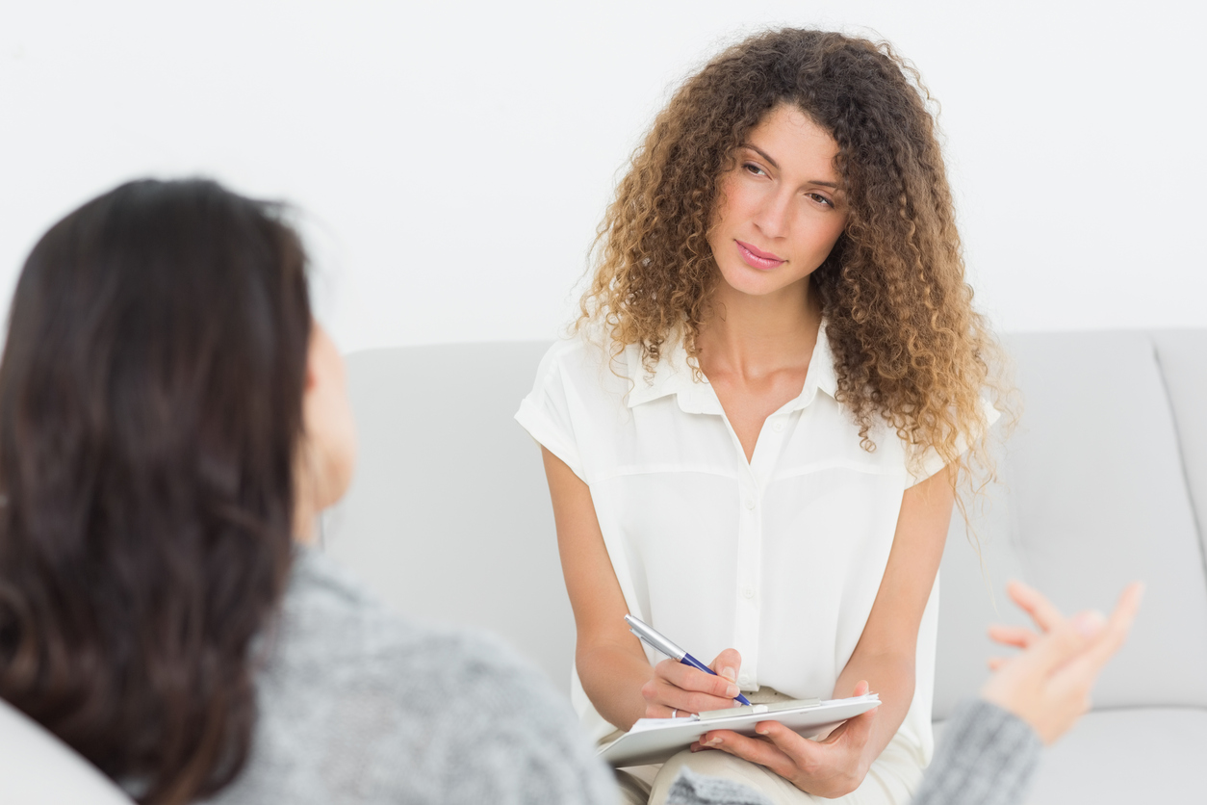
How can we identify our biases

Slide 9
How can we identify our biases?
Implicit Association Test (IAT)
Race
Gender
Sexual Orientation
Religion
Weight
Self-esteem
Anxiety
Alcohol
Disability
Age
https://implicit.harvard.edu/implicit/

Slide 10

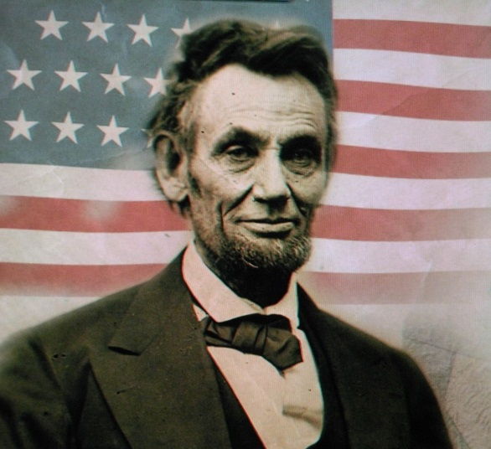
the IAT
Good: Excitement, Magnificent, Laughing, Beautiful, Terrific, Pleasure, Spectacular, Celebrate
Bad: Tragic, Pain, Evil, Poison, Gross, Horrific, Disaster, Rotten

Slide 11
After the IAT
What did you expect?
What was your reaction?
What can/will you do with this information?

Slide 12
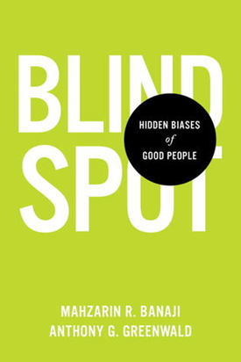
Book recommendation

Slide 13
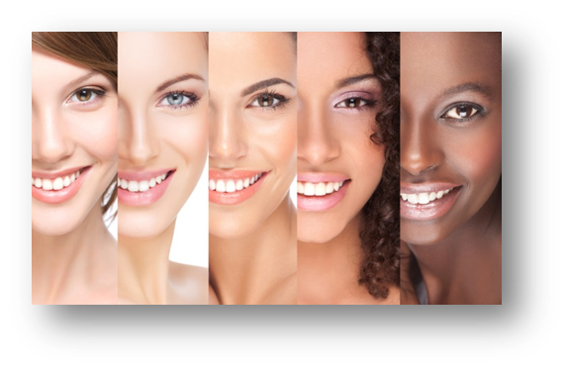
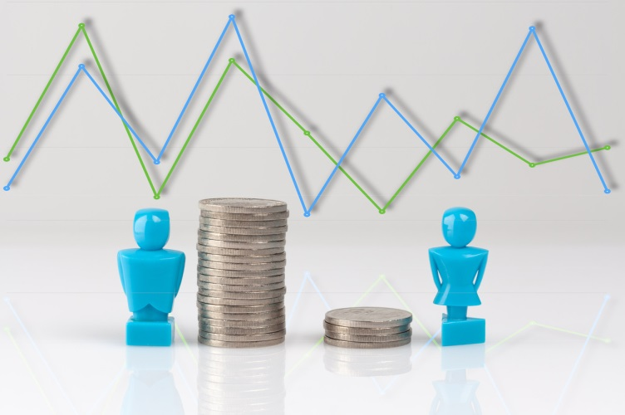
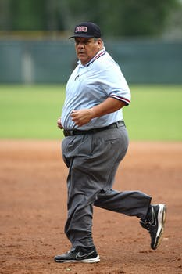
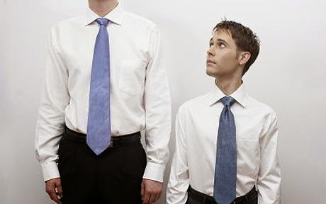
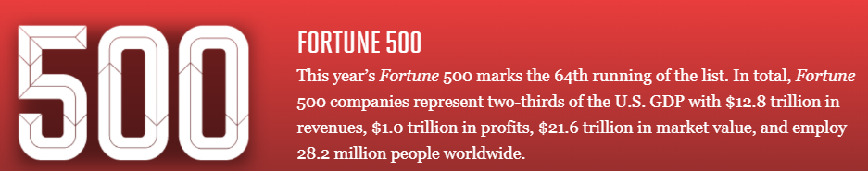
Impact of unconscious bias
Economic

Slide 14

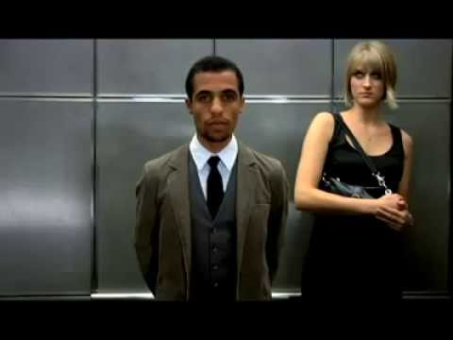
Impact of unconscious bias - Physiological
Notes:
discrimination accelerates aging at the cellular level
Doctors and psychologists tell us that discrimination contributes to poor health, both directly and indirectly. The presence of high levels of stress hormones in the bloodstream for long periods of time can lead to wear-and-tear on the body. In addition, stress caused by racism has been linked to heart disease in African-American populations.
A white woman clutching her purse when walking past a black man (signaling black men are dangerous criminals)
Asking someone who isn't white "Where are you really from?" (signaling they are not American)
"Complimenting" a gay person by saying "but you're not gay gay" (signaling stereotypically gay traits are bad)
Mistaking a female physician for a nurse (signaling women aren't as capable as men)
experience of rac
Native Americans diagnosed with type 2 diabetes experienced racial microaggressions from their health care providers. Among those sampled in the study, a correlation was found between microaggressions and self-reported histories of heart attack, depressive symptoms, and prior-year hospitalization.ism can result in traumatic stress. This stress is linked to negative mental health outcomes, such as depression, anger, physical reactions, avoidance, intrusion, hypervigilance, and low self-esteem.

Slide 15

Impact of unconscious bias – Customer Service
  Speed in responding
  Politeness in responding
  Equitable service
  Body language and tone of voice
  Loaded words
Notes:
Ask how implicit bias can affect customer service
My example: when I walk into an auto shop

Slide 16


Impact of unconscious bias - Collections
Collection development/ reader’s advisory
Notes:
collection development. biases from 4 sources to consider:
CD library staff, community, organization, and CD tools and resources
conservative vs liberal topics
race, ethnicity, stereotypes, gender, LGBTQ, age
'we don't need that book because there's no one in the community of that _'
readers advisory:
biases can come out when you suggest a princess book to a young girl and a book about snakes to her brother, or a picture book featuring all white characters to a white chld; when you express disapproval through body language or facial expressions when a patron asks for a book or subject that you have a bias against; create a book display with no diversity

Slide 17
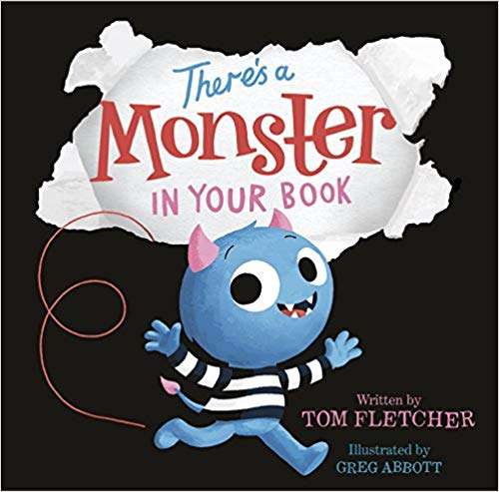

Bias in children’s literature
Notes:
http://lettoysbetoys.org.uk/constructing-bias-the-wonky-world-of-picture-books/
http://www.teachingforchange.org/selecting-anti-bias-books
http://www.abc.net.au/news/2018-08-22/kids-book-top-100-analysis/10042904
male villains were eight times more likely to appear compared to female villains
Let Books be Books—movement to end books for girls and books for boys (Let Toys be Toys too)
Recent study of bestselling picture books in 2017:
The lead characters were 50% more likely to be male than female, and male villains were eight times more likely to appear compared to female villains.
Mothers were also present almost twice as often as fathers. By contrast, fathers barely featured at all unless accompanied by a co-parent, appearing alone in just four books.
Speaking characters were 50% more likely to be male.
Gender bias was even more of an issue amongst the non-human characters, who were 73% more likely to be male.
Male animals were more likely to be large, powerful, or predatory creatures such as bears or tigers, while female animals tended to be "smaller and more vulnerable creatures such as birds, cats, and insects."

Slide 18
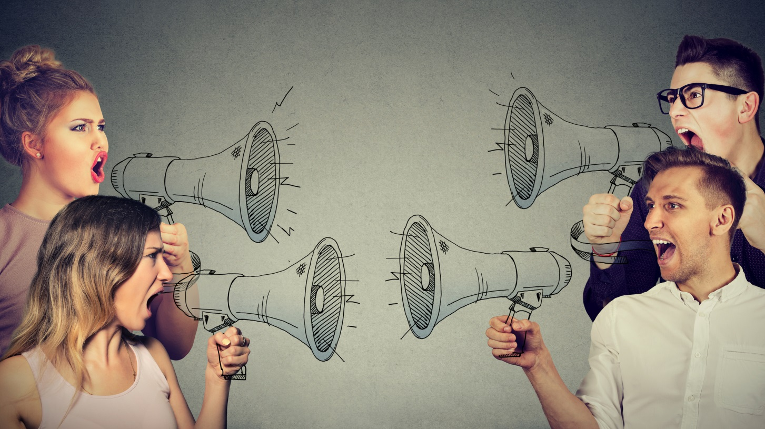
Unconscious Bias Behaviors
Confirmation Bias

Slide 19

Unconscious Bias Behaviors - Conformity
Conformity Bias

Slide 20
Unconscious Bias Behaviors – perception Video
Perception Bias
Carlsberg stunts with bikers in cinema
https://www.youtube.com/watch?v=RS3iB47nQ6E

Slide 21
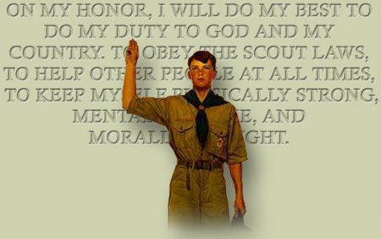
Unconscious Bias Behaviors - perception

Slide 22
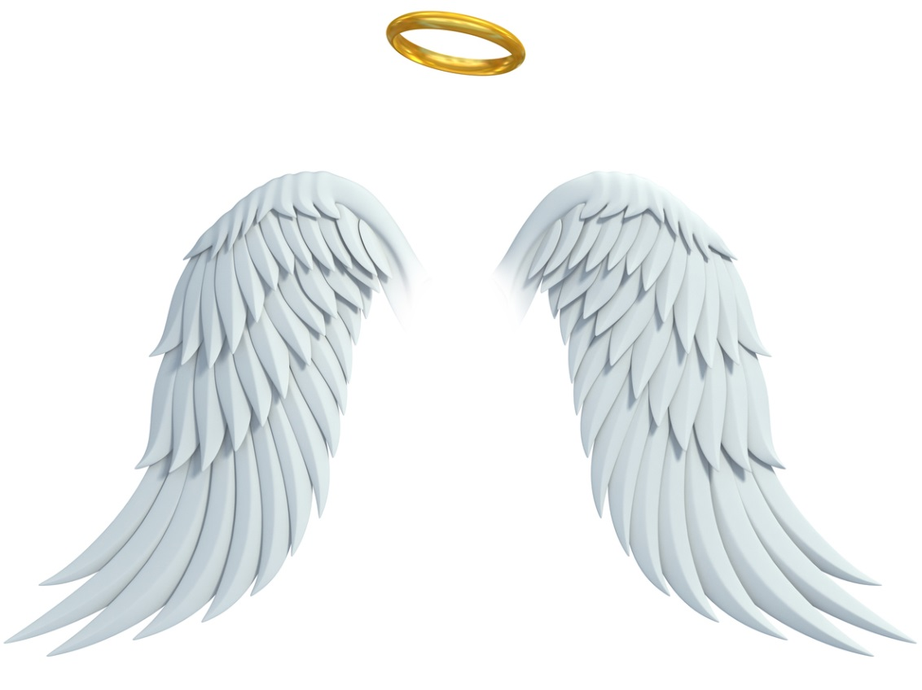
Unconscious Bias Behaviors – halo effect

Slide 23
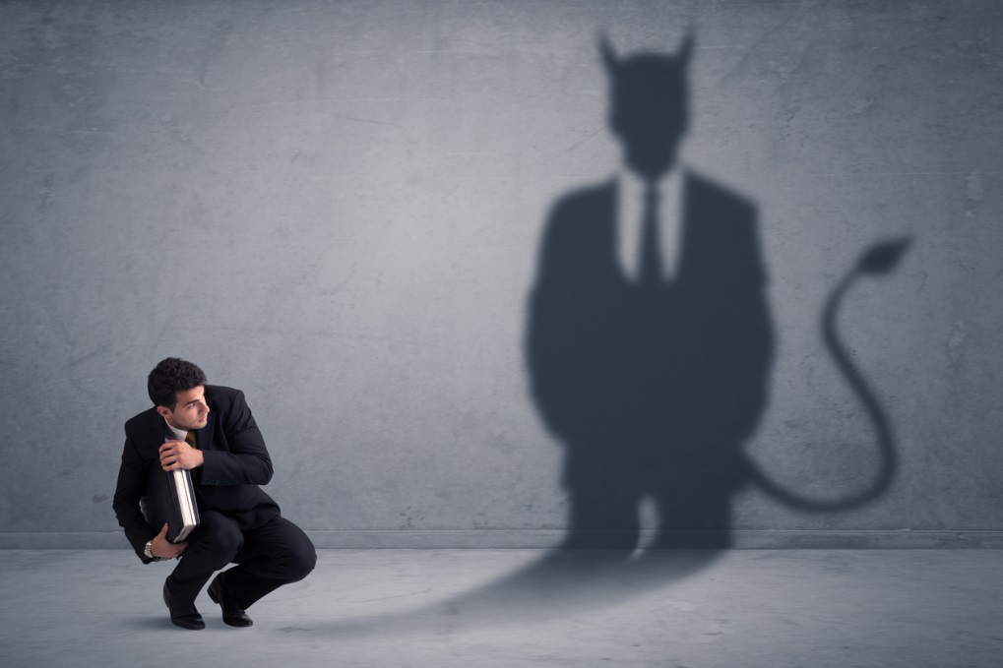
Unconscious Bias Behaviors – horns effect

Slide 24
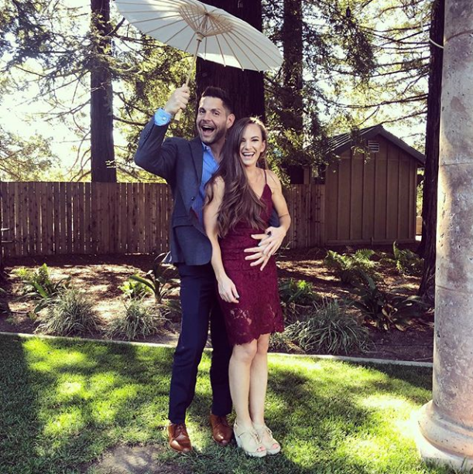
Unconscious Bias Behaviors - Beauty

Slide 25
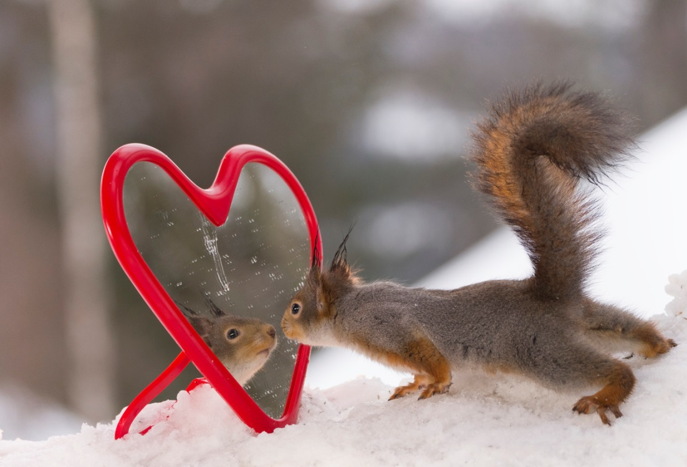
Unconscious Bias Behaviors - similarity

Slide 26
Unconscious Bias Behaviors - trust
Write down 10 people you really
trust that are not family
1.
2.
3.
4.
5.
6.
7.
8.
9.
10.

Slide 27
Unconscious Bias Behaviors - examples
Gender
Race/Ethnicity
Age

Slide 28
Unconscious Bias Behaviors – more examples
Sexual Orientation
Education
Disability Yes/No
Marital Status

Slide 29
Unconscious Bias Behaviors – circle of trust
“Hi Ya!”
“COMFY”
“Trust”
3
Relationship
2
Trust
1
Notes:
https://dramatictrainingsolutions.com/unconscious-bias-3-great-exercises-to-use-in-your-training/

Slide 30
Learn to think and behave differently
Take the IAT test
Identify Situations
Make an effort!
Awareness
Hanging Out
Expose Yourself to Media

Slide 31
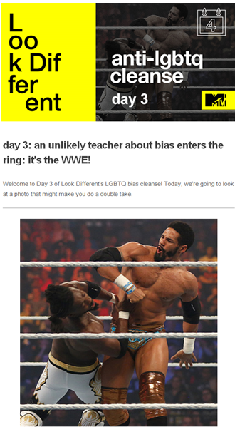
Bias Cleanse
Bias Cleanse-
Lookdifferent.com

Slide 32
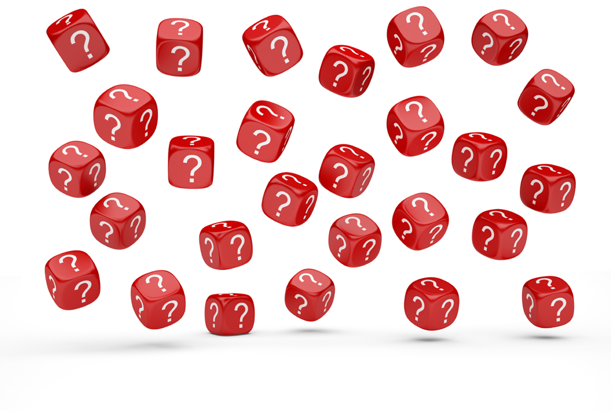
questions
Notes:
Jean and Christine

