Slide 1
The Importance of Monsters Presentation
THE IMPORTANCE
OF
MONSTERS
How Engaging the Horror Genre Sparks Adolescent Bravery
KIT ELSTAD

Slide 2

AGENDA
THE IMPORTANCE OF MONSTERS
Introduction
Learning Outcomes
Why Horror?
Collection Development
Questions?

Slide 3
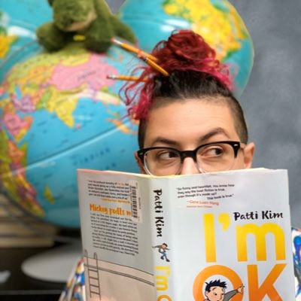
ABOUT ME
THE IMPORTANCE OF MONSTERS
Library Media Specialist at Bennett Elementary School in the Poudre School District since 2023
Library Media Specialist, Adventures Education Coordinator, Middle School Library Lead at the Expeditionary Learning Middle School (ELMS) in the Syracuse City School District in New York from 2012-2023.
My goal in the library is to create a welcoming environment where kids feel inspired to explore and share their interests with the community.
Kit Elstad (Tads)
They/Them

Slide 4
LEARNING OUTCOMES
THE IMPORTANCE OF MONSTERS
Attendees will be able to explore and understand the importance of adding exciting and engaging middle grade horror titles to their collection.
Attendees will be able to recognize barriers that may arise during the collection development process and prepare to meet those needs.
Attendees will be able to explore the needs of their student population and evaluate current collections to identify what moves should be made with their collection development specifically as it relates to the horror genre.

Slide 5
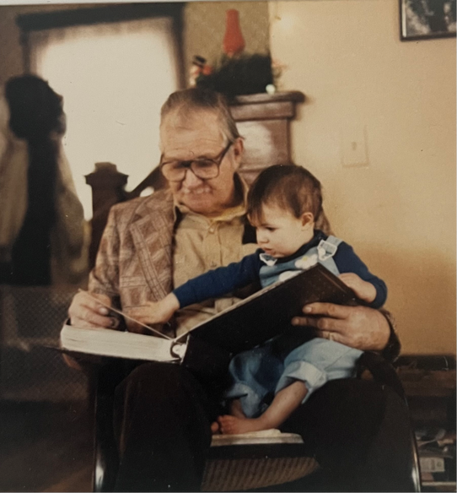
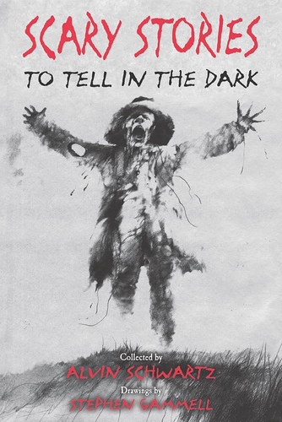
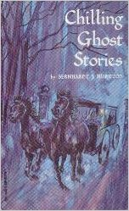
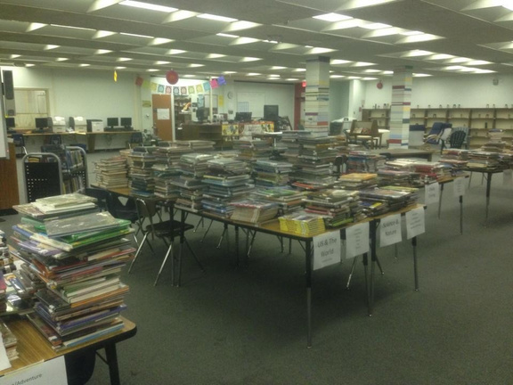

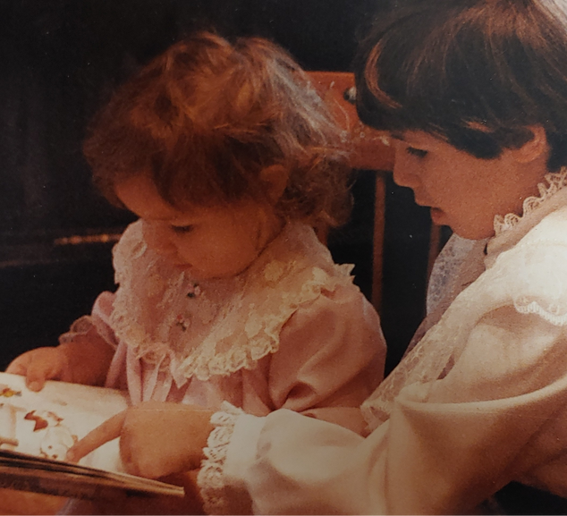
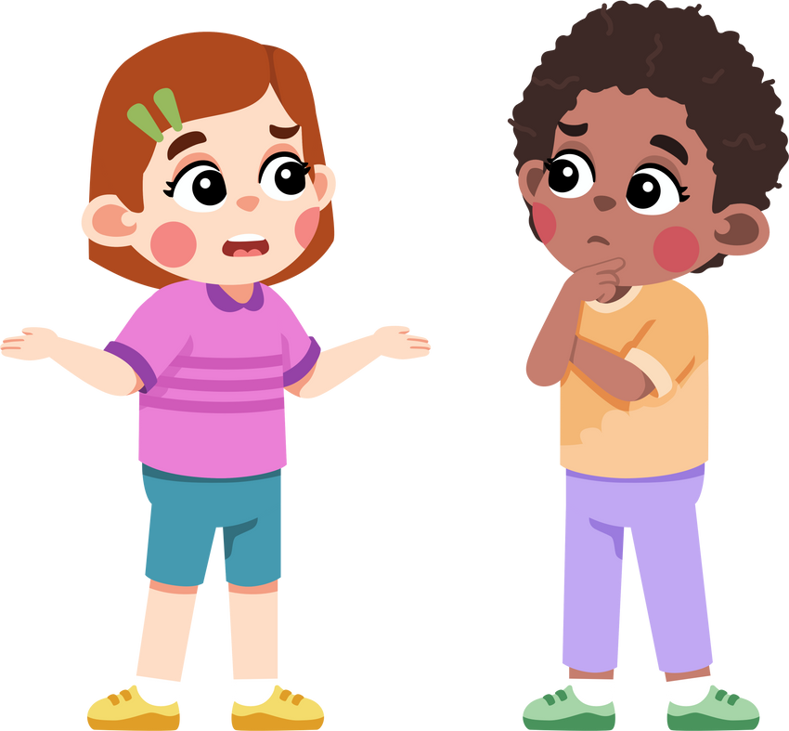
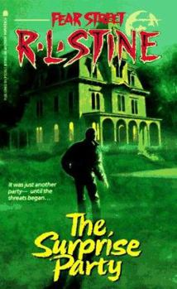
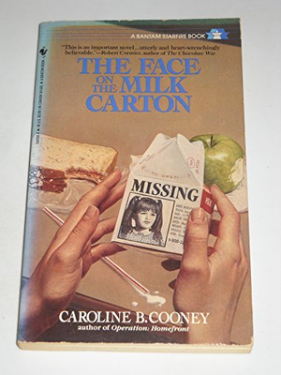
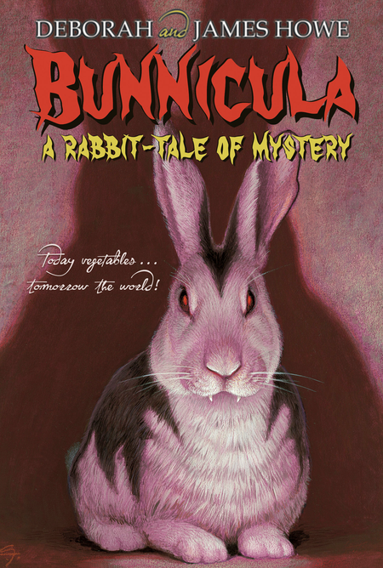
WHY HORROR?
THE IMPORTANCE OF MONSTERS
WHERE ARE ALL
THE SCARY BOOKS?

Slide 6
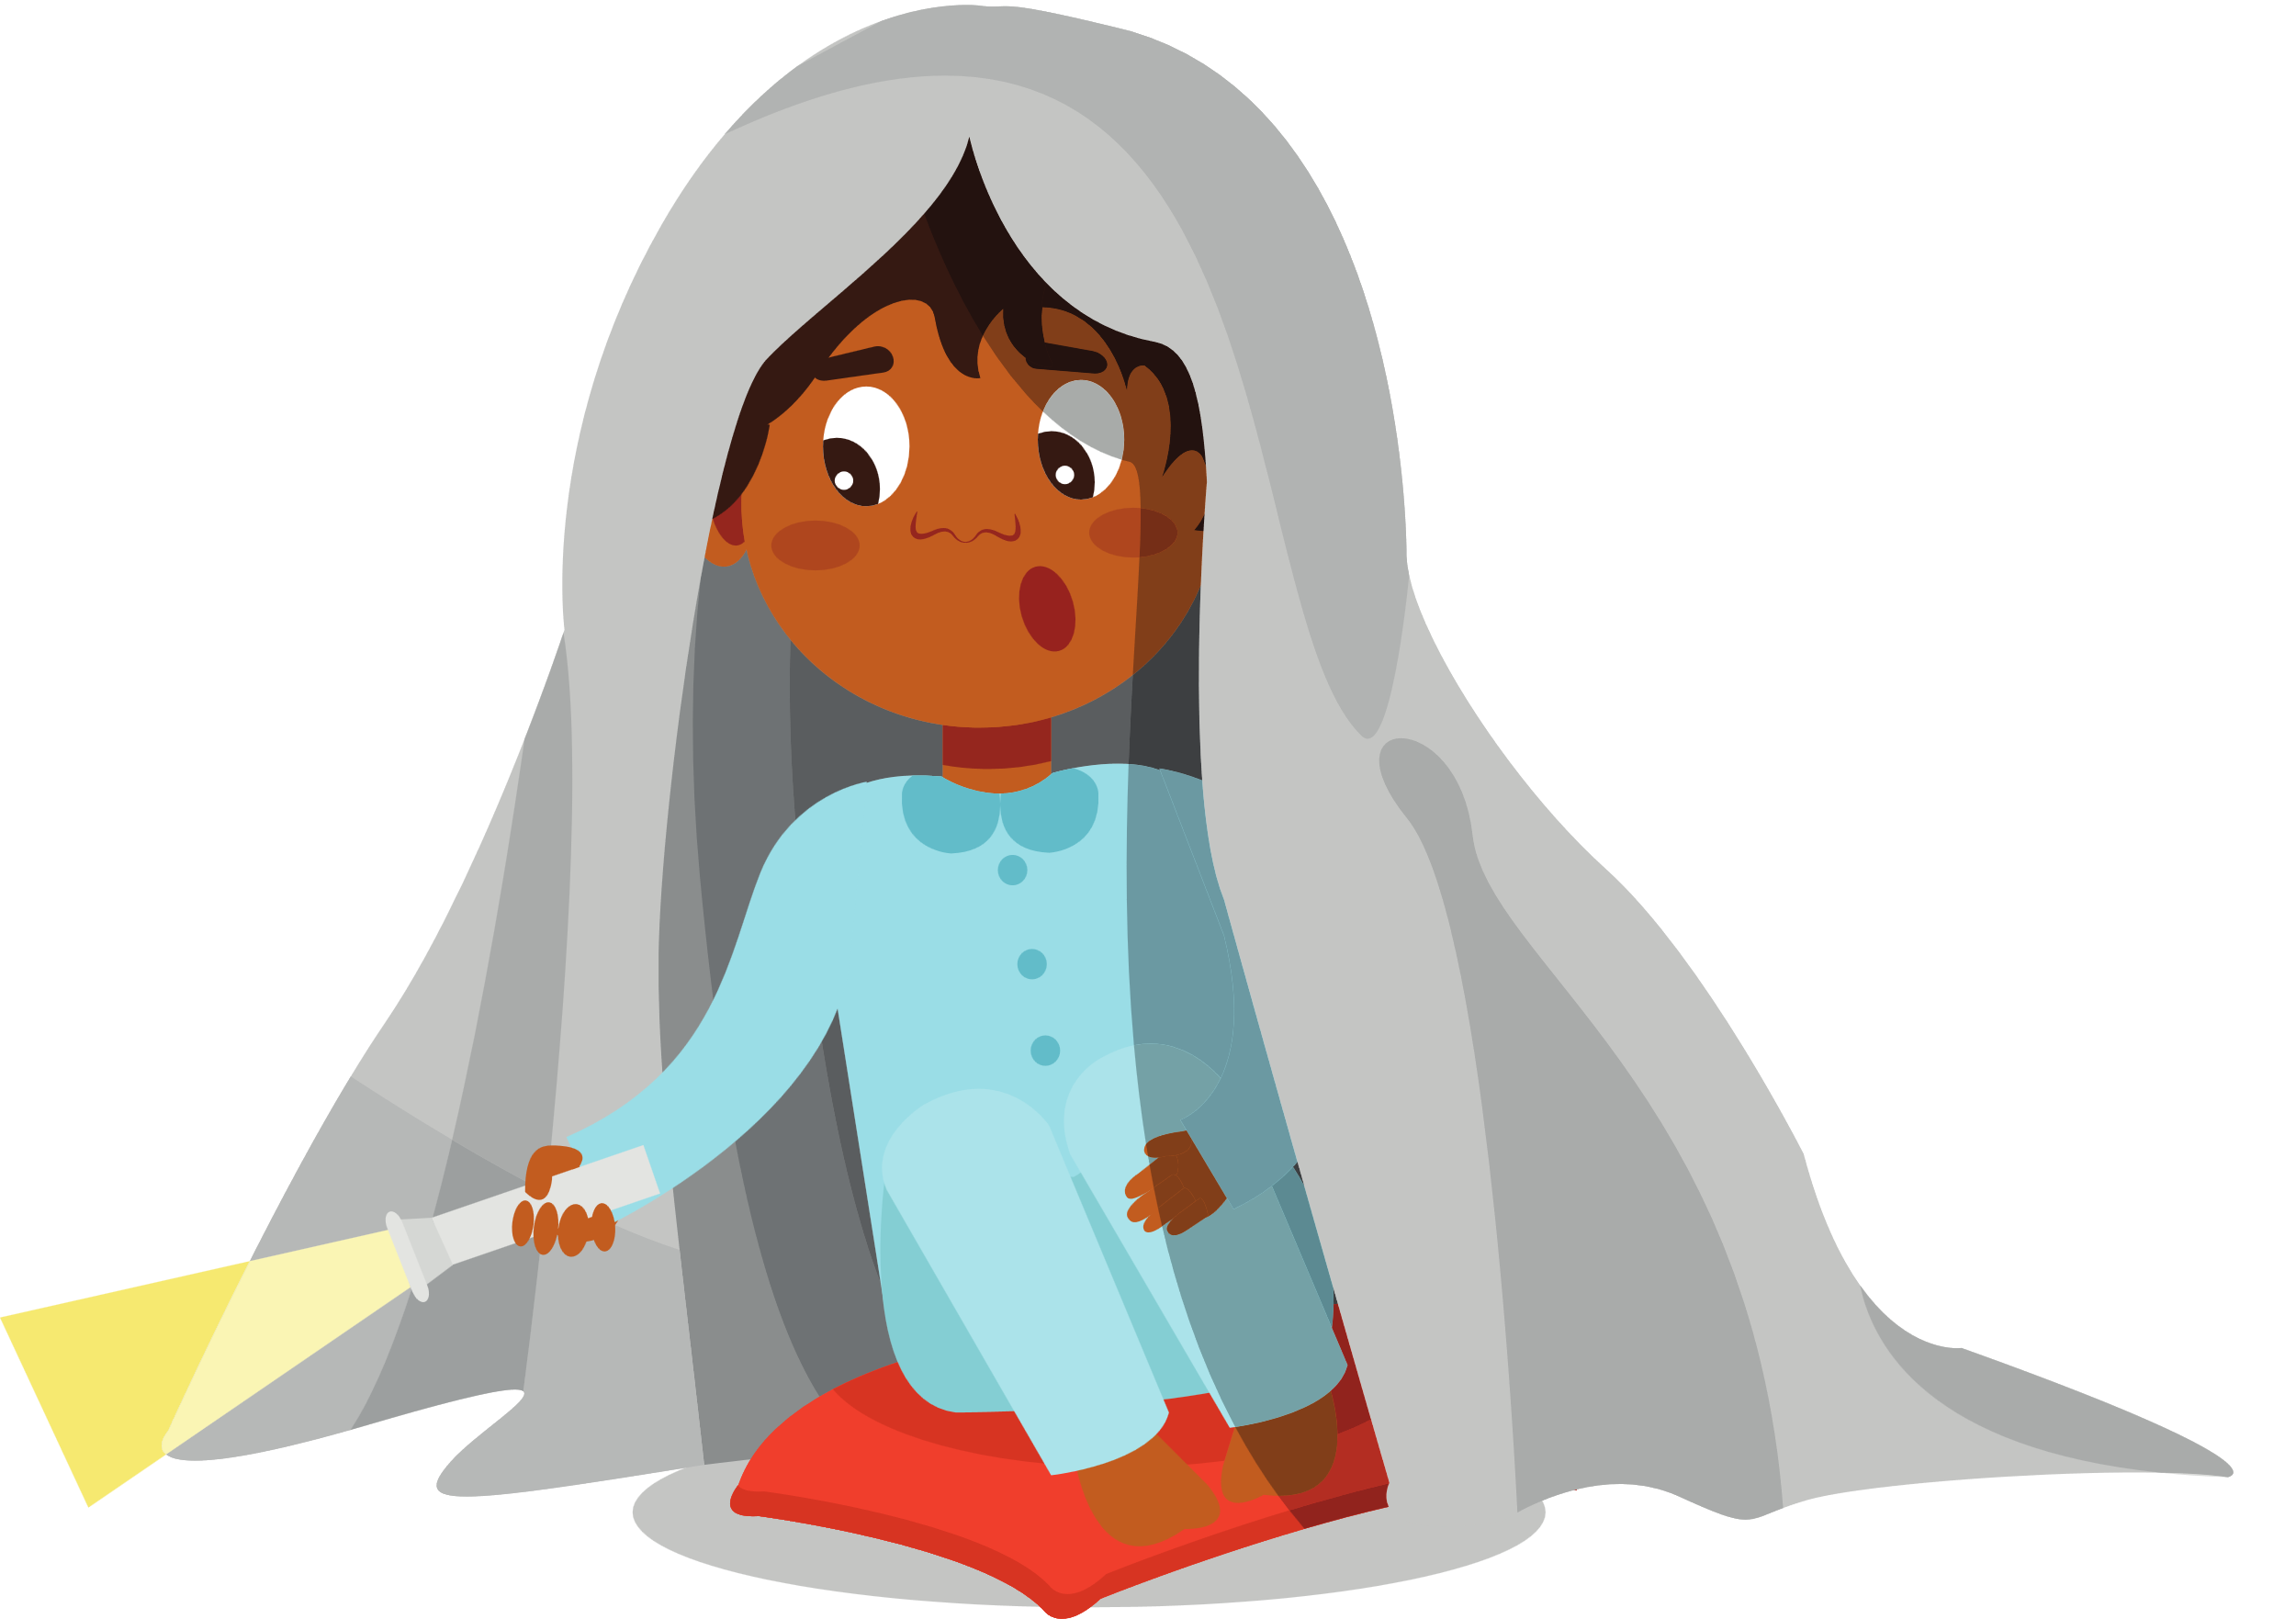

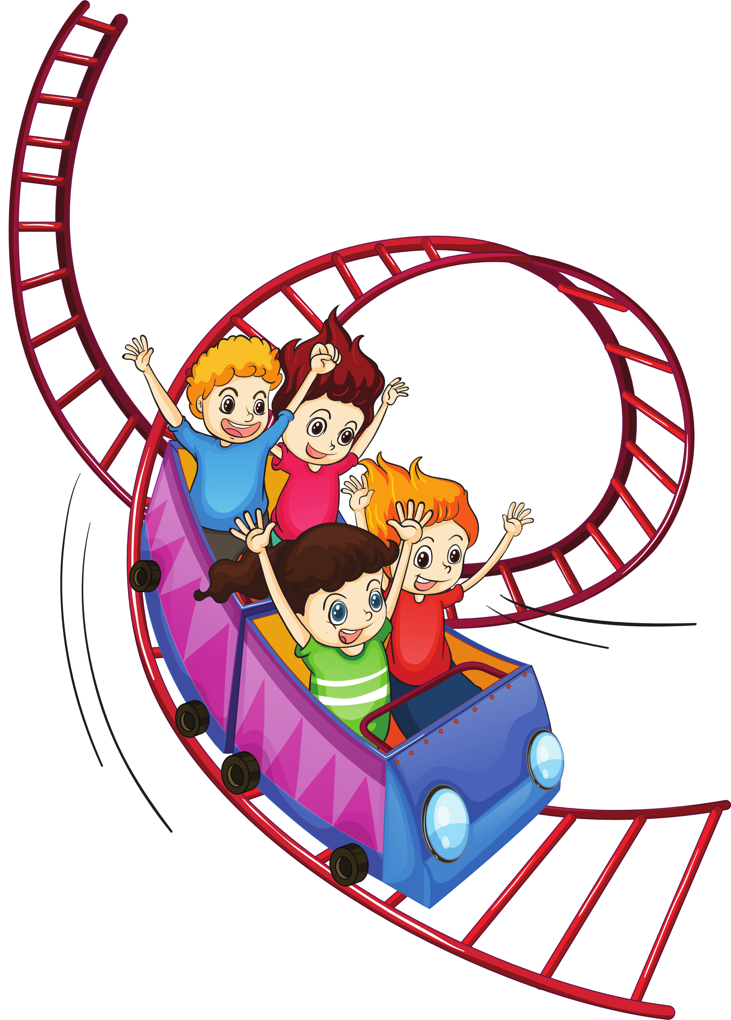
Why Horror continued
THE IMPORTANCE OF MONSTERS
THE IMPORTANCE OF MONSTERS
WHY ARE
KIDS ASKING
FOR SCARY
BOOKS?
WHY SHOULD
YOU HAVE
THEM ON
THE SHELF?
Some kids just like to be scared... but it goes a little deeper then that...
Scary stories aid in child development.
The opposite of feeling scared is feeling brave.
When you are reading a scary story you can imagine yourself in similar situations and it activates your bravery and problem solving muscles. You think about how you might respond in a similar situation. (Capstone)
Experience fear with a safety net
“A scary story is the literary version of a rollercoaster. You strap yourself in and are sent on a thrilling ride that quickens your pulse. Your stomach lurches and your fingers tingle. Then when it’s over, nine-times-out-of-ten, you laugh. You’ve just pushed yourself to the edge of your comfort zone, all without being in actual danger.”
The world is a scary place, especially when you are little.
Scary stories let kids learn how to deal with those fears
in a safe environment. (Scott)

Slide 7
Into the Darkness (Ally Malinenko)
THE IMPORTANCE OF MONSTERS
The other thing horror does is tells kids the truth. Adults often forget that kids have the same emotions as they do but often lack the skills to express them. They are acutely aware when things are not okay. But we are rarely honest with kids about the bad parts of life. We lie when their pets die. We tell them everything is fine when Mom and Dad aren’t speaking at the dinner table. We throw the truth in a dark corner and hope they never see it. Horror, on the other hand, doesn’t deal in platitudes. It doesn’t pretend away reality. It puts you front and center against a monster and then it places in your hand the sword you need to vanquish it. Horror believes in kids and trusts them to go along for this ride. It knows they’ll last the night.
Fear is a natural part of life and adults have learned coping skills for their fear. They have had years of experiences to pull from when the bottom drops out. But kids don’t. Horror books offer very important lessons about fear. The biggest being that you either conquer it for succumb to it. Fear offers no middle ground. It is through story telling that we learn how to navigate our emotions. Stories build empathy. They are a way for humans to say to each other “I felt this. Did you feel this too?” They are ways for us to make connections in a world that often seems devoid of them. Horror by nature builds empathy simply because when the main character is threatened, you root for them. You want them to win. You want them to survive the night. A connection is built. A lesson is learned. A fear is conquered. A hero emerges, dusty and shaken but still standing.

Slide 8
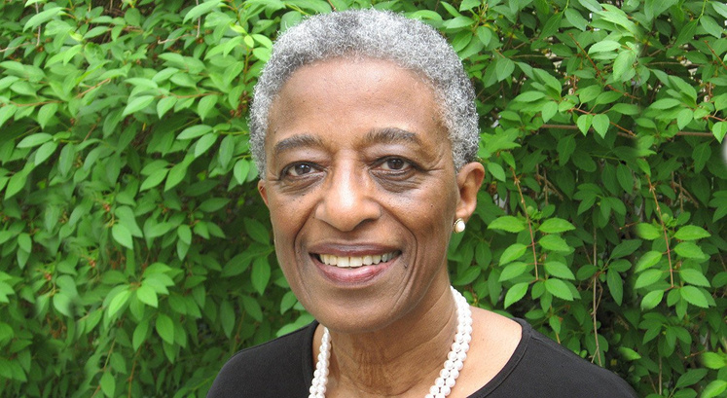
WINDOWS, MIRRORS & SLIDING GLASS DOORS
THE IMPORTANCE OF MONSTERS
“Books are sometimes windows, offering views of worlds that may be real or imagined, familiar or strange. These windows are also sliding glass doors, and readers have only to walk through in imagination to become part of whatever world has been created or recreated by the author. When lighting conditions are just right, however, a window can also be a mirror. Literature transforms human experience and reflects it back to us, and in that reflection we can see our own lives and experiences as part of a larger human experience. Reading, then, becomes a means of self-affirmation, and readers often seek their mirrors in books.” (Bishop, 1990)
For kids who have grown up in a safe and secure household reading scary books allows them to experiment with both fear and bravery. It allows them to test out what they think they might do in a similar situation as they follow along with the story, from being afraid to feeling proud when the story comes to it’s triumphant conclusion. (Roos)
For kids who have or are currently experiencing insecurity or trauma reading scary books feels familiar and reminds them they are not alone. It can help them find ways to confront overwhelming and frightening situations where they have felt powerless. It allows readers to see that there is a way through it, even when it’s scary. (Roos)

Slide 9
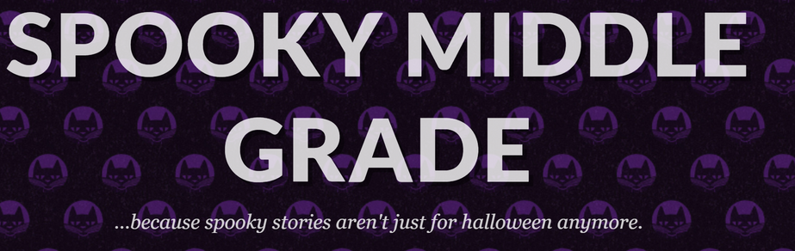





FINDING THE RIGHT BOOKS
THE IMPORTANCE OF MONSTERS
Advance Read Copies
Websites
Edelweiss
NetGalley
Aimed at grades 3-8 provides reading lists, upcoming releases and the opportunity to connect with authors for classroom visits.
Social Media
I follow a TON of authors on Twitter and Instagram, and they are constantly hyping up and recommending new and upcoming authors. It’s one of the most consistently reliable ways I’ve found great books to add to the library collection.
School Library Journal
Scary Podcasts for Kids
Mackin
Browse Genre Lists

Slide 10

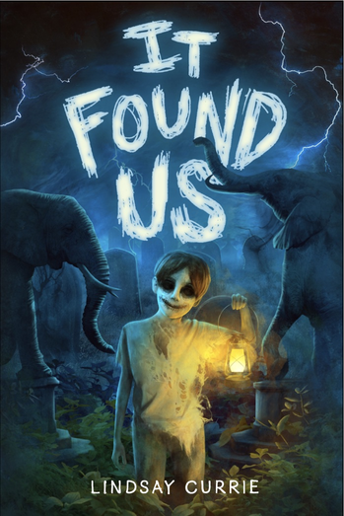
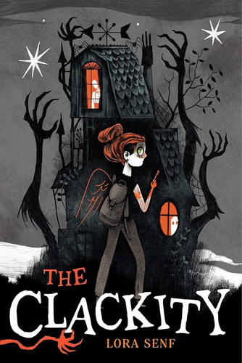
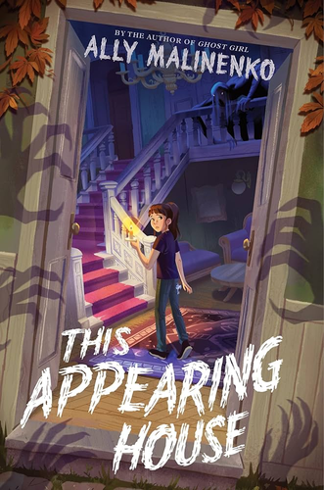
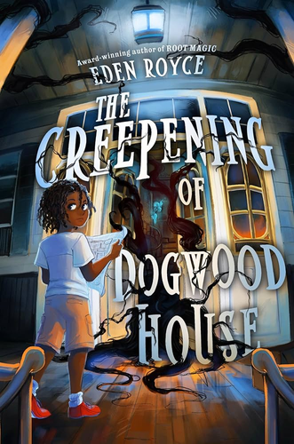
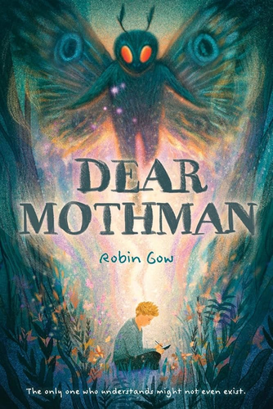
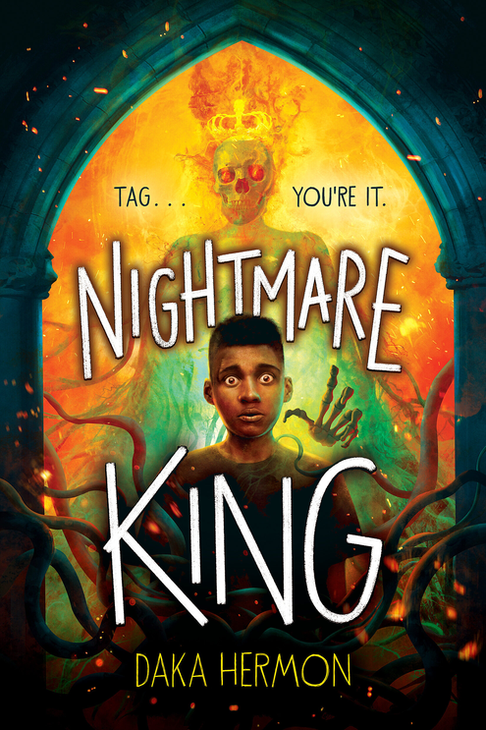
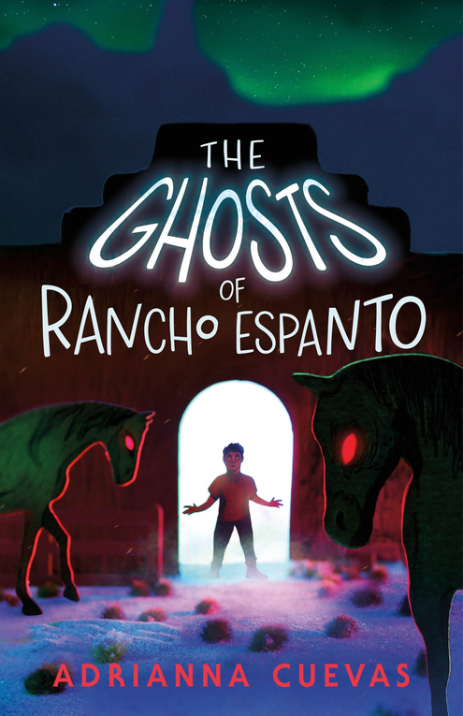
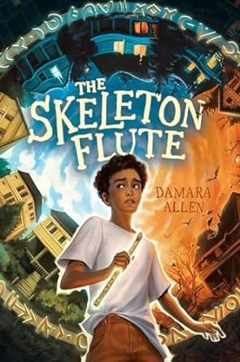
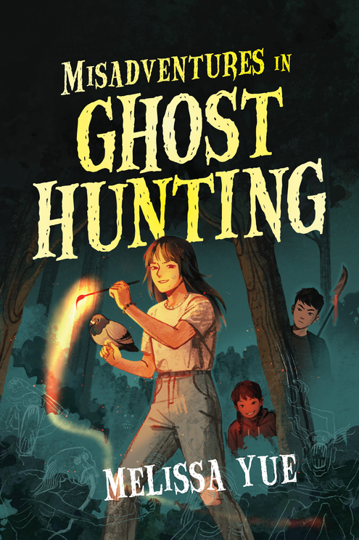
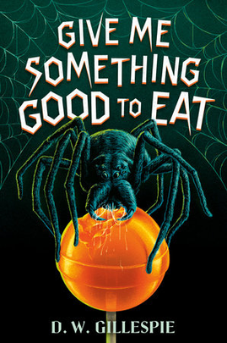
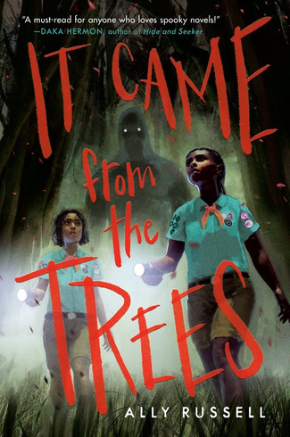
HORROR IN HIGH DEMAND
THE IMPORTANCE OF MONSTERS
Grade
MIDDLE

Slide 11
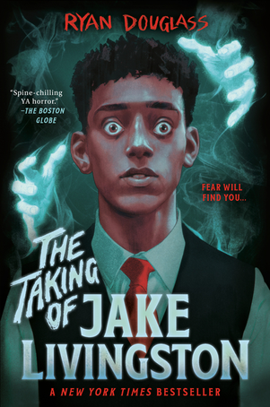
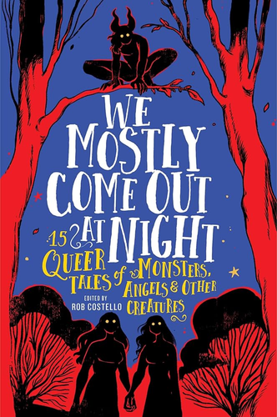
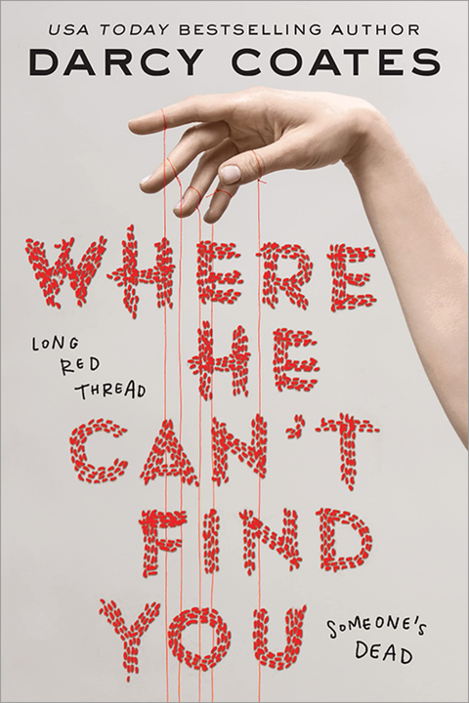
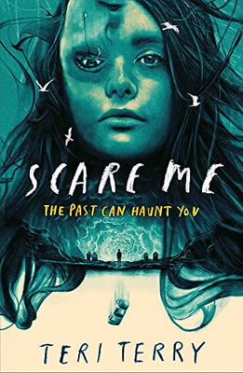
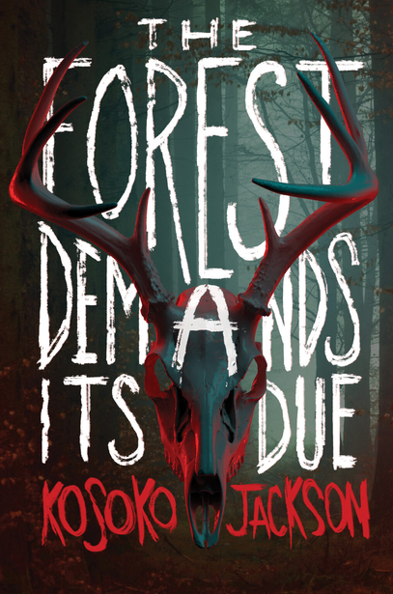
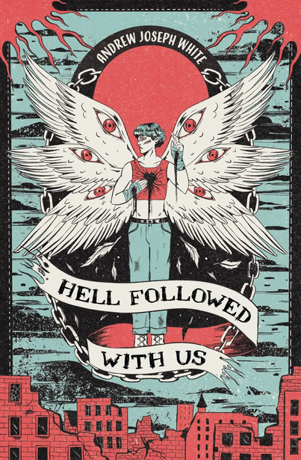
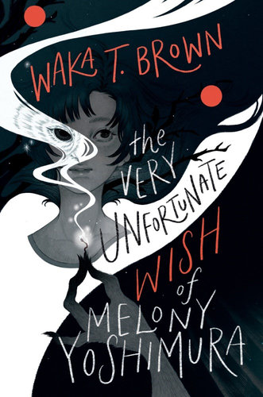
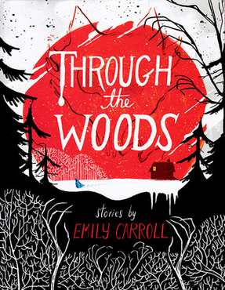
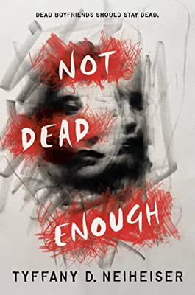
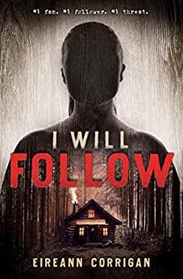
Horror in High Demand YA
THE IMPORTANCE OF MONSTERS
HORROR IN HIGH DEMAND
YOUNG
Forest Demands its Due book cover
Adult

Slide 12
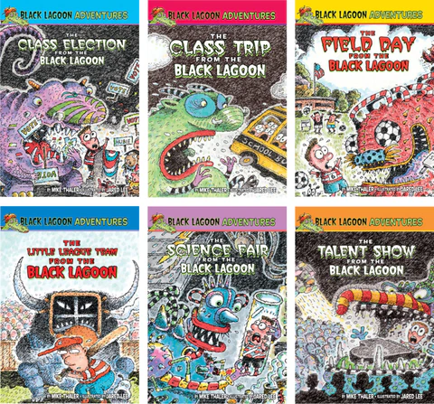
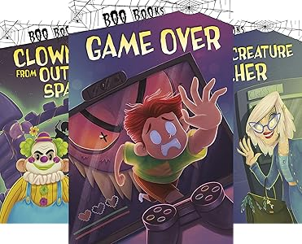
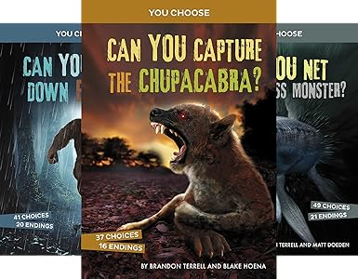
HORROR IN HIGH DEMAND
THE IMPORTANCE OF MONSTERS
Elementary

Slide 13
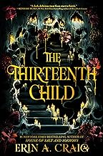
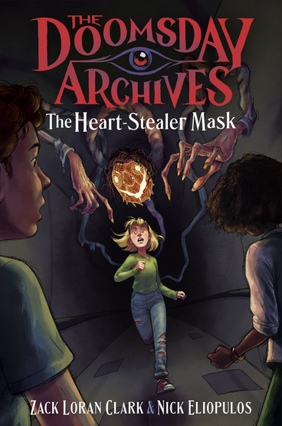
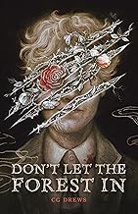
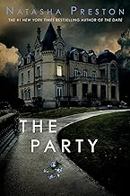
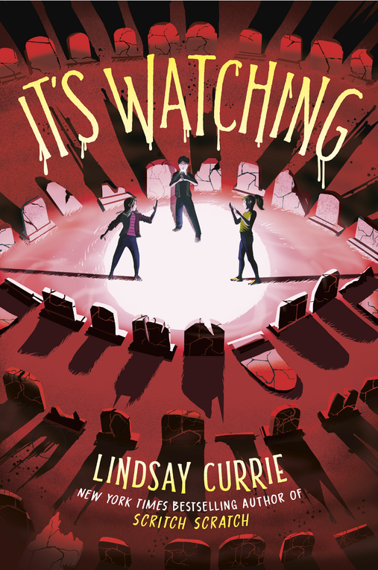
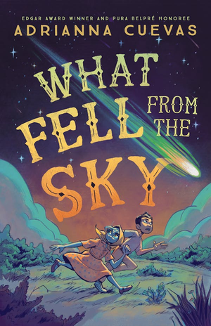
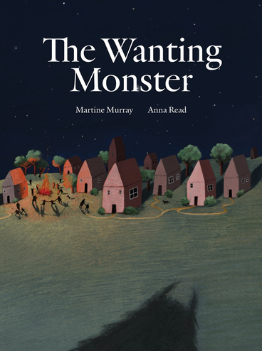
Just Released and Coming Soon
THE IMPORTANCE OF MONSTERS
JUST RELEASED &
COMING SOON!
September 24th
September 24th
October 29th
December 3rd
February 24th
February 14th
February 18th

Slide 14


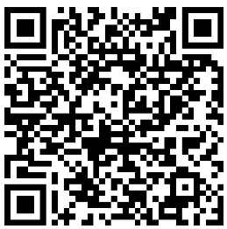
THANK YOU!
THE IMPORTANCE OF MONSTERS
Questions after you leave?
Feel free to reach out to
kit.elstad@gmail.com
Have a favorite book or resource I didn’t mention?
Please share in the chat and
I’ll add it to the shared google drive.
Google Drive with resources
and presentation.

Slide 15
Sources
THE IMPORTANCE OF MONSTERS
SOURCES
Malinenko, Ally Into the Dark: Why Kids Should Read Horror (8/18/2021) School Library Journal
Roos, Chelsey Why Kids Love Horror (10/8/2021) ALSC Blog
Scott, Cavan Fear with a Safety Net: Why children should read scary books. (2/27/2019) BookTrust
Sims Bishop, Dr. Rudine Mirrors, Windows and Sliding Glass Doors (Summer 1990) Perspectives: Choosing and Using Books for the Classroom. Vo. 6, No. 3.
Why Kids Love Scary Books (9/28/2021) Capstone

Slide 16
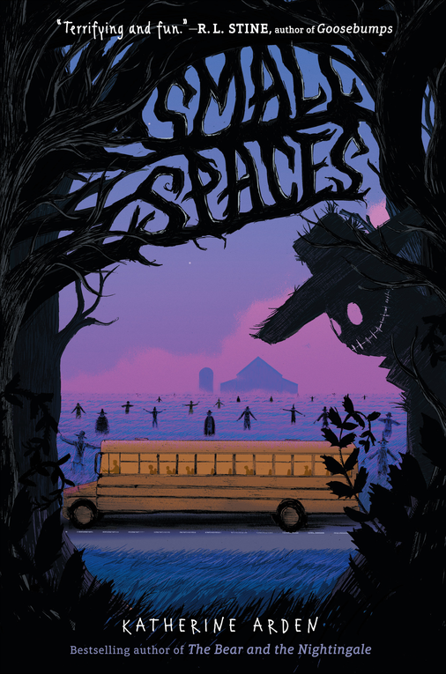
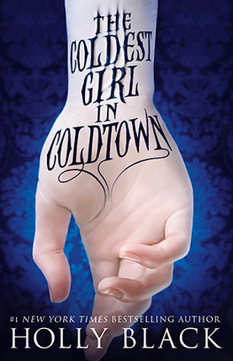
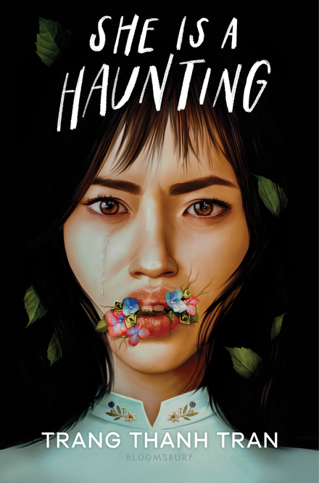
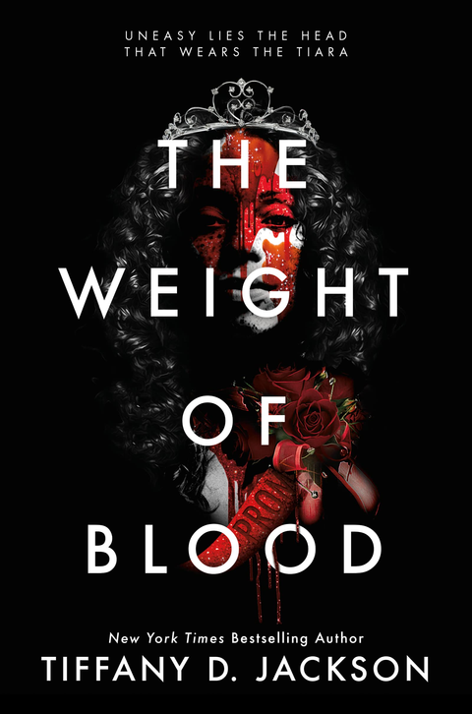



AUDIENCE RECOMMENDATIONS
THE IMPORTANCE OF MONSTERS

