Slide 1
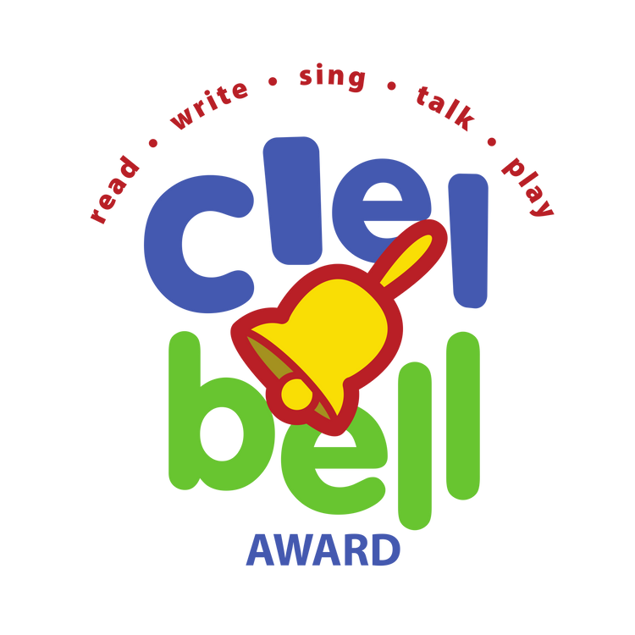


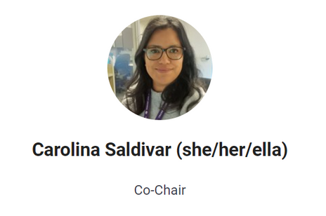
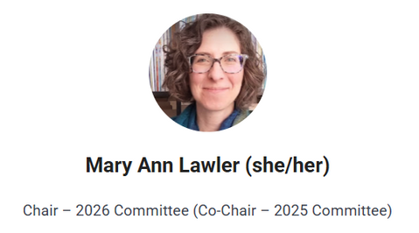
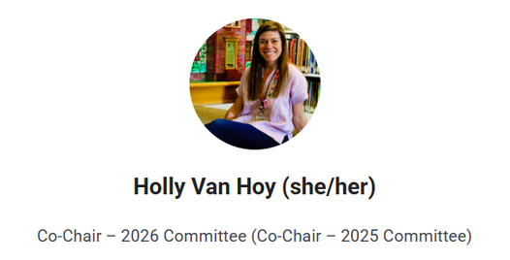
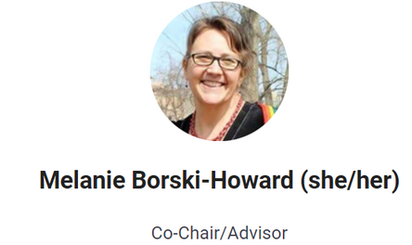
What is a CLEL Bell?
English
Spanish
An award
for high-quality picture books that highlight the five early literacy practices: READ, WRITE, TALK, PLAY, and SING.
Our Mission
In support of the Colorado Libraries for Early Literacy (CLEL) mission to strengthen children’s literacy through library services and community advocacy, the Bell Awards will:
Provide recognition to authors, illustrators, and publishers
Recognize children’s books that provide excellent support of early literacy development in young children ages 0-5
Serve as a collection development, program planning, and early literacy information resource for librarians, educators, and caregivers
Notes:
Link to clel.org in title
Remember to put clel.org in the chat
Introduce ourselves
Melanie
Carolina
Holly
Holly - overall arch of Bells (what it is and history)
In 2013, Melissa Depper & Carol Edwards were two brilliant and motivated children's librarians who wanted to find a way to support and promote the newly published Every Child Ready to Read (ECRR) five early literacy practices (Read, Write, Talk, Play, Sing) through picture books. So, they wrote criteria, built a committee and put out their first list of Silver Bells, a list of 25 books from the previous 25 years. Then in 2014 came the first shortlist of 25 books published that year, with 5 nominated titles in each practice. Then, five winners are chosen, one from each practice, and fun activity pages are created for each!
Now, over ten years later, we have a growing committee, are approached by publishers with title suggestions and are creating more content and resources to share with librarians, educators, parents and caregivers.
Carolina - how Spanish came to be. Participant, co-chair Melanie, Campanitas de Plata, where are we now.
Our Mission
In support of the Colorado Libraries for Early Literacy (CLEL) mission to strengthen children’s literacy through library services and community advocacy, the Bell Awards will:
Provide recognition to authors, illustrators, and publishers
Recognize children’s books that provide excellent support of early literacy development in young children ages 0-5
Serve as a collection development, program planning, and early literacy information resource for librarians, educators, and caregivers
Our Mission
In support of the Colorado Libraries for Early Literacy (CLEL) mission to strengthen children’s literacy through library services and community advocacy, the Bell Awards will:
Provide recognition to authors, illustrators, and publishers
Recognize children’s books that provide excellent support of early literacy development in young children ages 0-5
Serve as a collection development, program planning, and early literacy information resource for librarians, educators, and caregivers
Our Mission
In support of the Colorado Libraries for Early Literacy (CLEL) mission to strengthen children’s literacy through library services and community advocacy, the Bell Awards will:
Provide recognition to authors, illustrators, and publishers
Recognize children’s books that provide excellent support of early literacy development in young children ages 0-5
Serve as a collection development, program planning, and early literacy information resource for librarians, educators, and caregivers
Our Mission
In support of the Colorado Libraries for Early Literacy (CLEL) mission to strengthen children’s literacy through library services and community advocacy, the Bell Awards will:
Provide recognition to authors, illustrators, and publishers
Recognize children’s books that provide excellent support of early literacy development in young children ages 0-5
Serve as a collection development, program planning, and early literacy information resource for librarians, educators, and caregivers

Slide 2
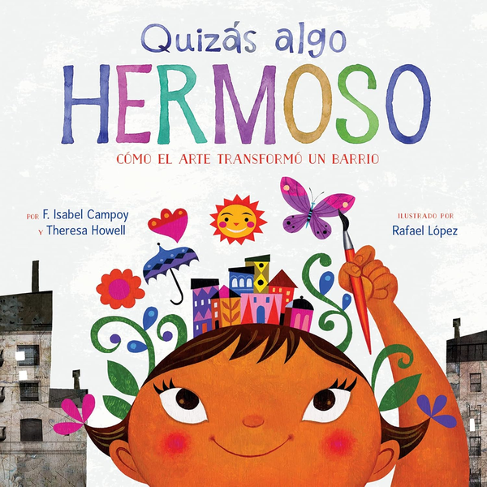
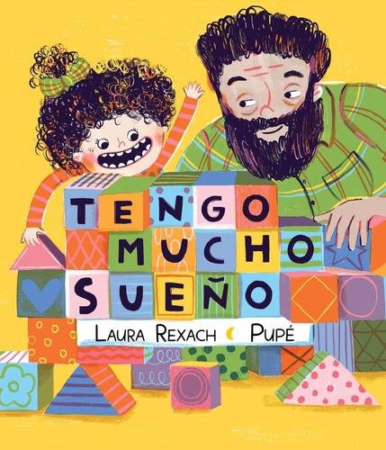
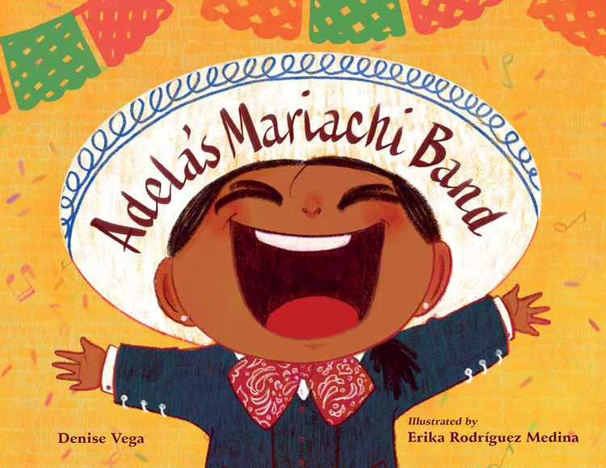
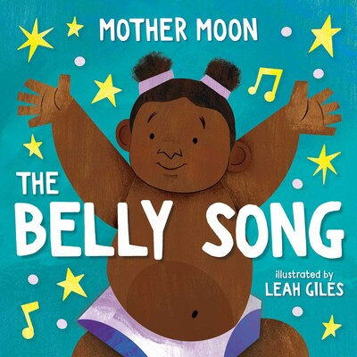
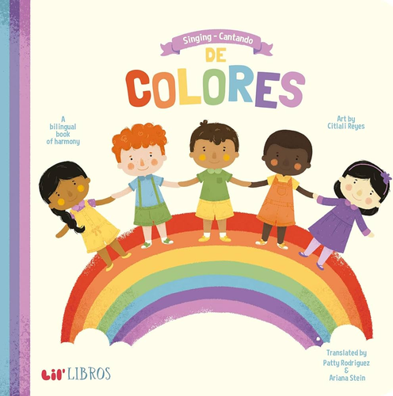
Is this for me?
The titles are a great resource for sharing early literacy tips in storytime and with families in your library.
Plus, you can use the activity sheets for each winning title to help you plan programs!
Notes:
We will each say how we use them
Melanie-Programmer storytimes and programs
Carolina-Supervisor resource for who she works with
Holly- outreach preschools and activities

Slide 3
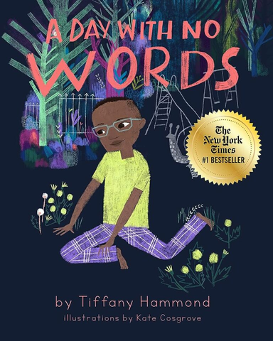
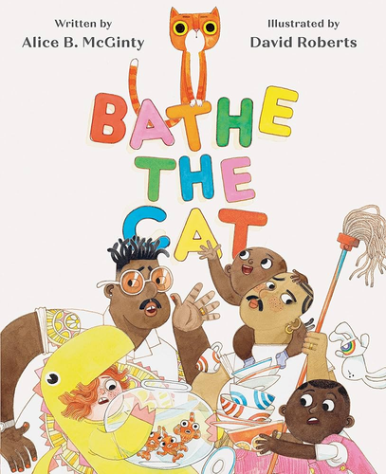
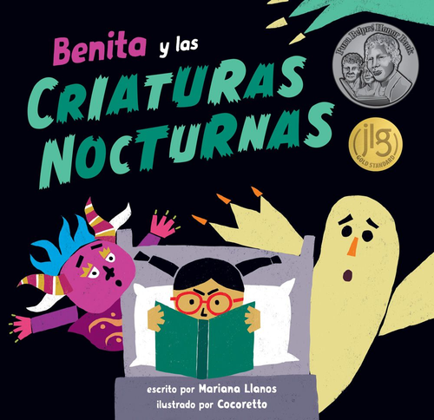
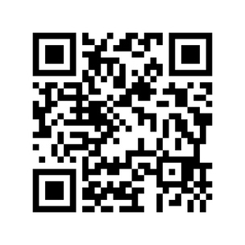
How to use a
CLEL Bell Book
TALK
Honors neurodiversity and communication in its many forms
READ
Watch cat rearrange the family to-do list. Words have meaning!
Take a trip to the park. Talk about the things you like best. Make picture cards of the things you want to do first, then and last.
READ
Creatures from Peruvian folklore try to scare a child who's so absorbed in her bedtime reading.
Trace the magnet letters
to build hand muscles.
WRITE
Learn more at clel.org/bells
Notes:
Melanie
Carolina
Holly -

Slide 4
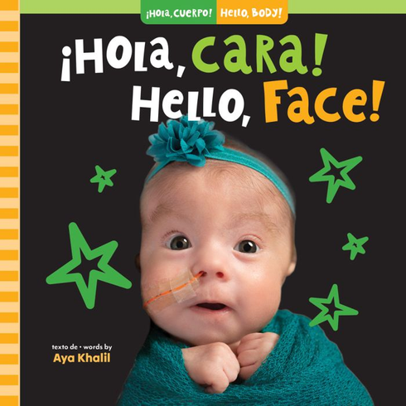
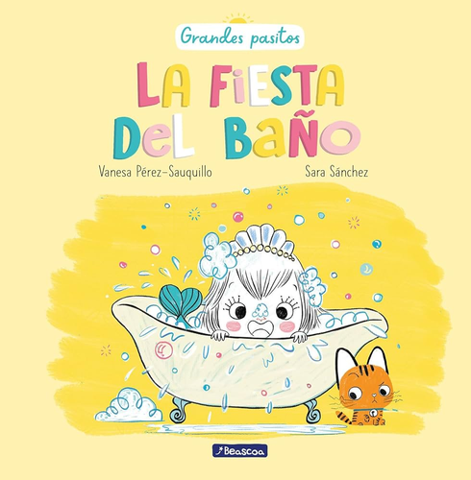
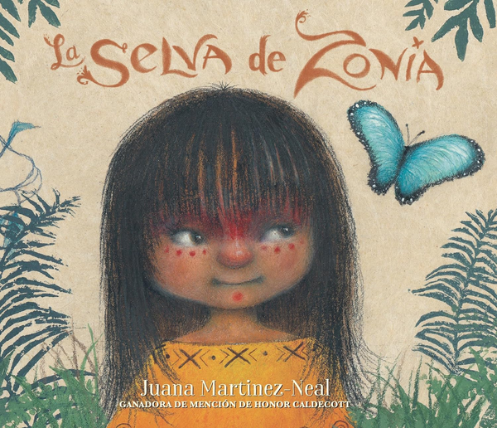
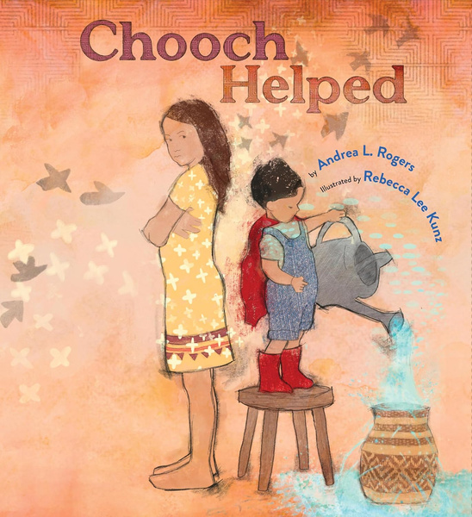
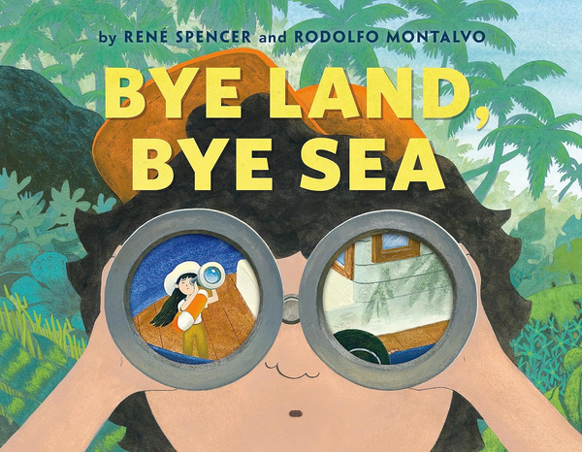
Can I join the awards committee?
Yes! New members
are invited to apply annually in February (English) and biannually January (Spanish).
Visit clel.org
to learn more.
Notes:
Melanie
-Professional development o
-great experience
-So much fun

Slide 5
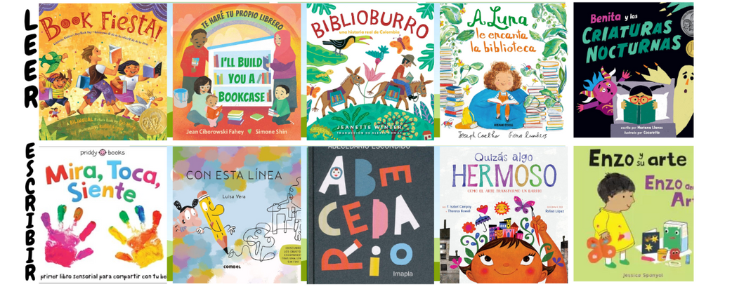
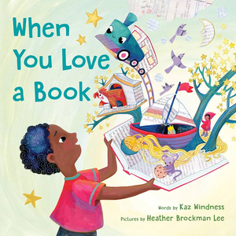
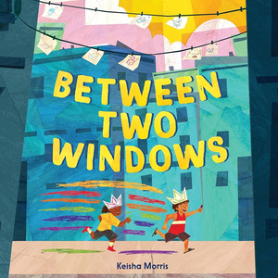
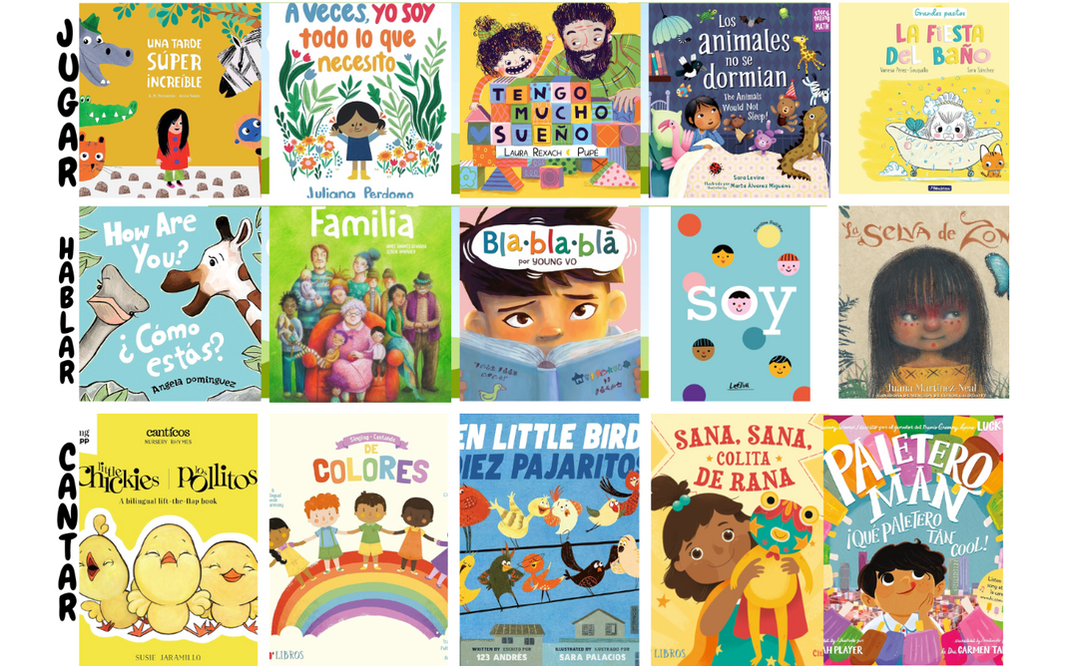
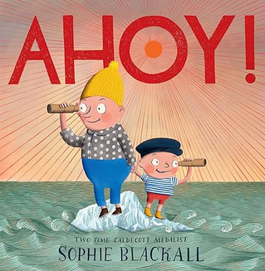
2025 Winners
CAMPANITAS DE PLATA
READ
WRITE
TALK
SING
PLAY
ENGLISH
2025 El Los Premios de CLEL Bell will be announced at CLELCON 2025!

Slide 6




How can I participate now?
Suggest a title!
ENGLISH title suggestions
Spanish TITLE SUGGESTIONS
Contact us!
Clel.org
clelbellawards@gmail.com
spanishbellawards@gmail.com
Notes:
Title Suggestions and Questions
FAQS
Time commitment
Supervisor approval

